Slide 1
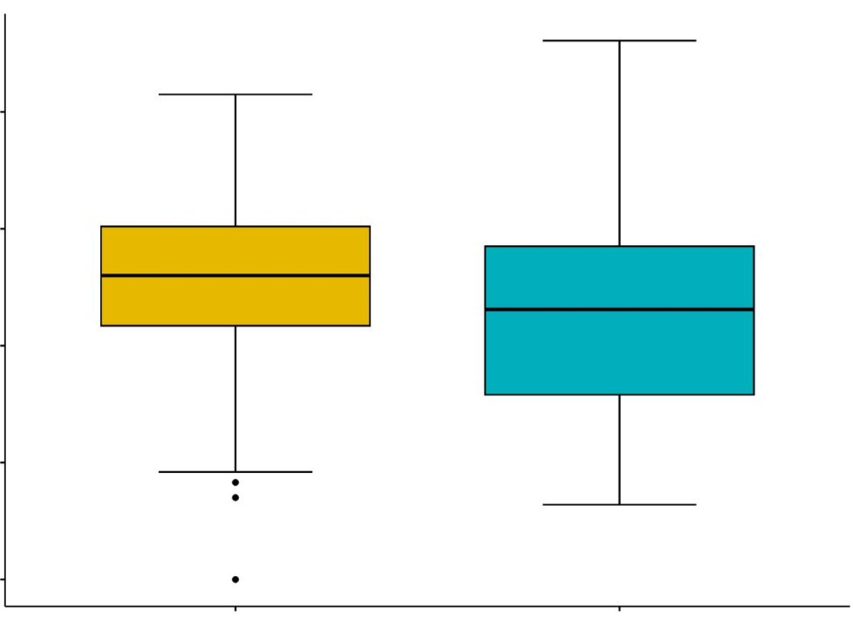
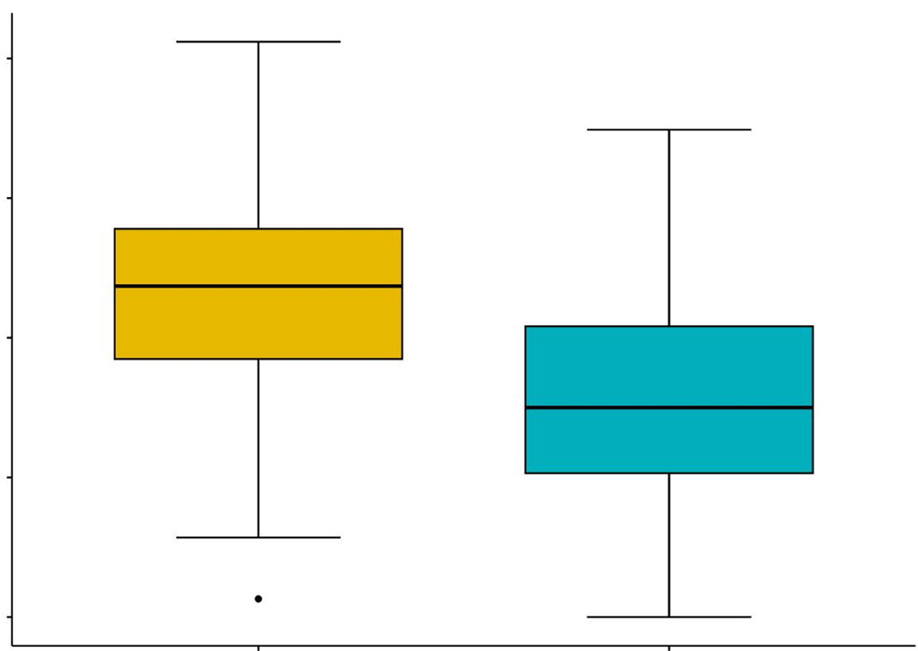
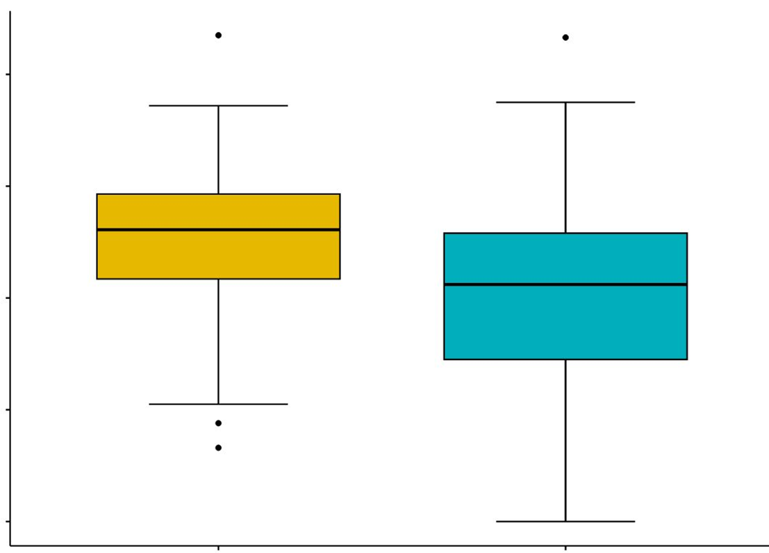
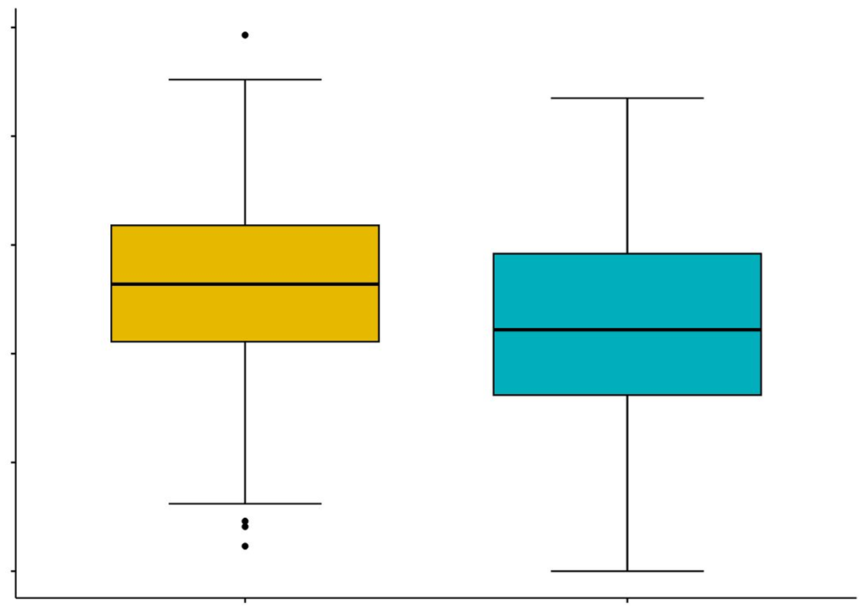
Supplementary Figure1
CESC
HNSC
P＜0.001
P＜0.0001
0.4
0.4
0.3
0.3
0.2
0.2
0.1
0.1
0.0
0.0
High expression
Low expression
High expression
Low expression
OV
STAD
Macrophages
P＜0.0001
0.5
P＜0.0001
0.4
0.4
0.3
0.3
0.2
0.2
0.1
0.1
0.0
0.0
High expression
Low expression
High expression
Low expression
NNMT
Supplementary Figure1.Macrophgaes infilitration in NNMT high and low expression group in CESC, HNSC, OV and STAD.

