Slide 1
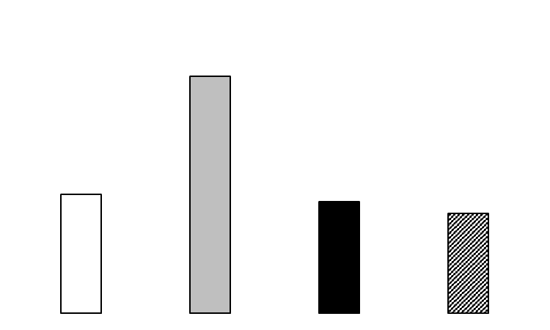
Supplementary Figure S1
2
RQ of UBASH3A mRNA
1
0
Th1 Th2 Th17 Treg

