Slide 1
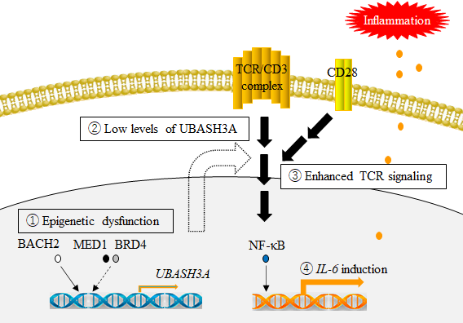
Supplementary Figure S2

