Slide 1
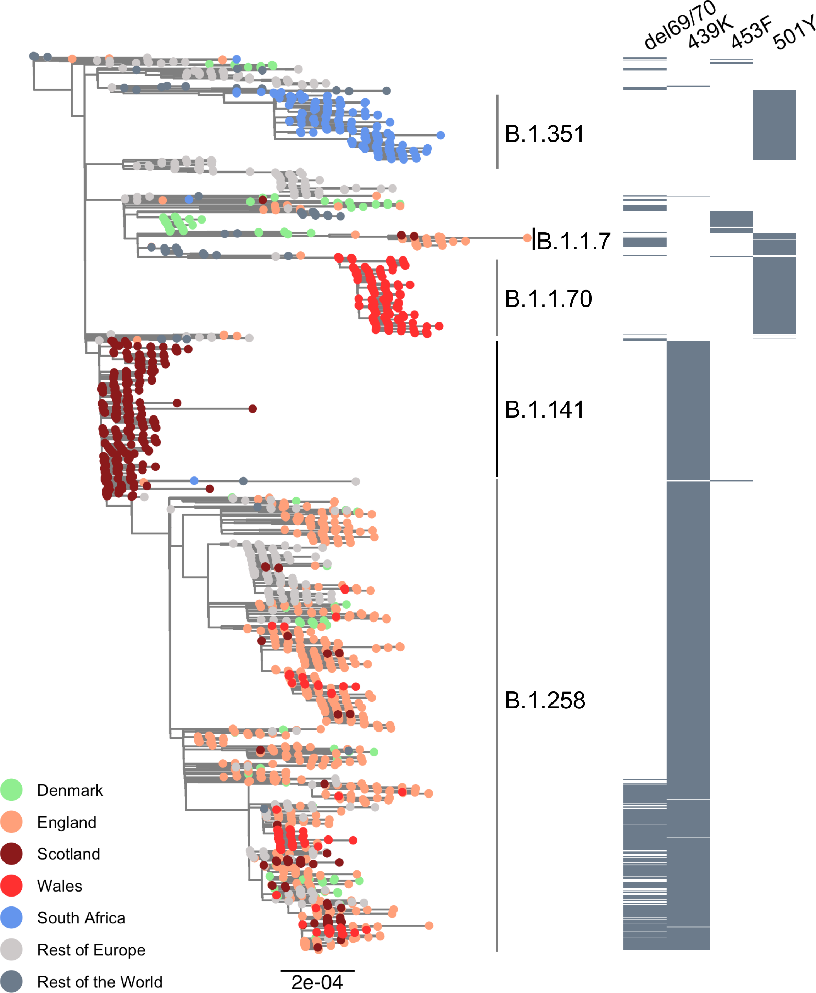
Supplementary Figure 1. Sub-sampled global phylogeny of SARS-CoV-2 whole genome sequences highlighting those with specific mutations in Spike: 𝚫69/70, N439K, Y453F and N501Y. Tree tips are coloured by country (see key). Grey bars showing presence or absence of deletion and amino acid variants N439K, Y453F, and N501Y. Lineages from Rambaut et al. 2020 are shown.

Slide 2
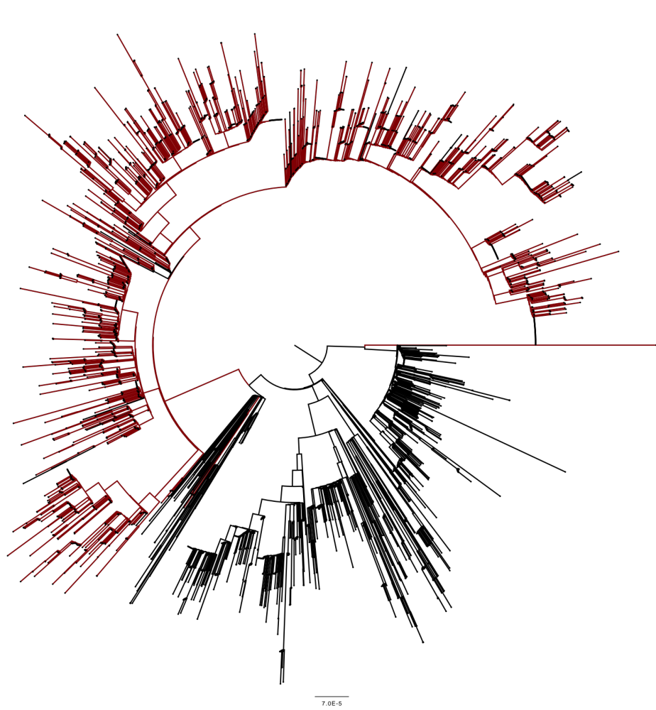
Supplementary Figure 2. Circularised maximum likelihood phylogeny of global sequences carrying Spike mutant 439K. All sequences in the GISAID database containing S:439K (3820 sequences, 26th November 2020) were realigned to Wuhan-Hu-1 using MAFFT. Viruses carrying the Spike double deletion 𝚫H69/V70 (red) emerged and expanded from viruses with S:439K (black).
𝚫H69/V70

Slide 3
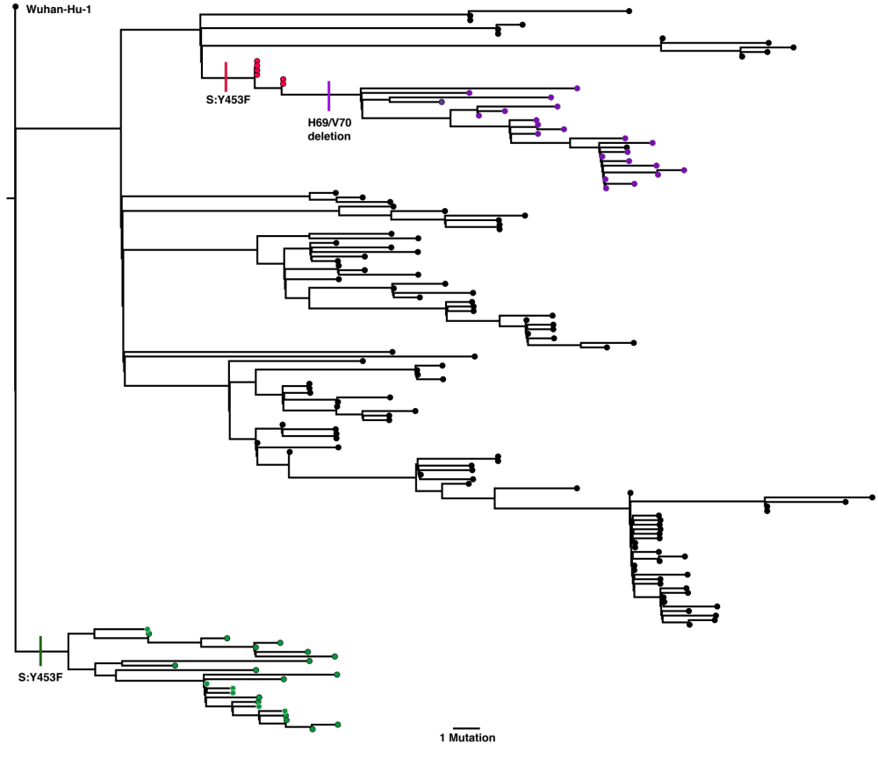
Supplementary Figure 3. Maximum likelihood phylogeny phylogeny of mink-origin SARS-CoV-2 sequences. All 753 sequences in the GISAID database (accessed 14th December 2020) were downloaded and realigned to Wuhan-Hu-1 using MAFFT. Two distinct lineages carrying the mink-associated Spike Y453F mutations can be seen in Danish (red) sequences, with a separate lineage isolated only in Netherlands (green). After acquiring the Y453F mutation, Danish mink also appeared to acquire the Spike deletion 𝚫H69/V70 (purple).

Slide 4
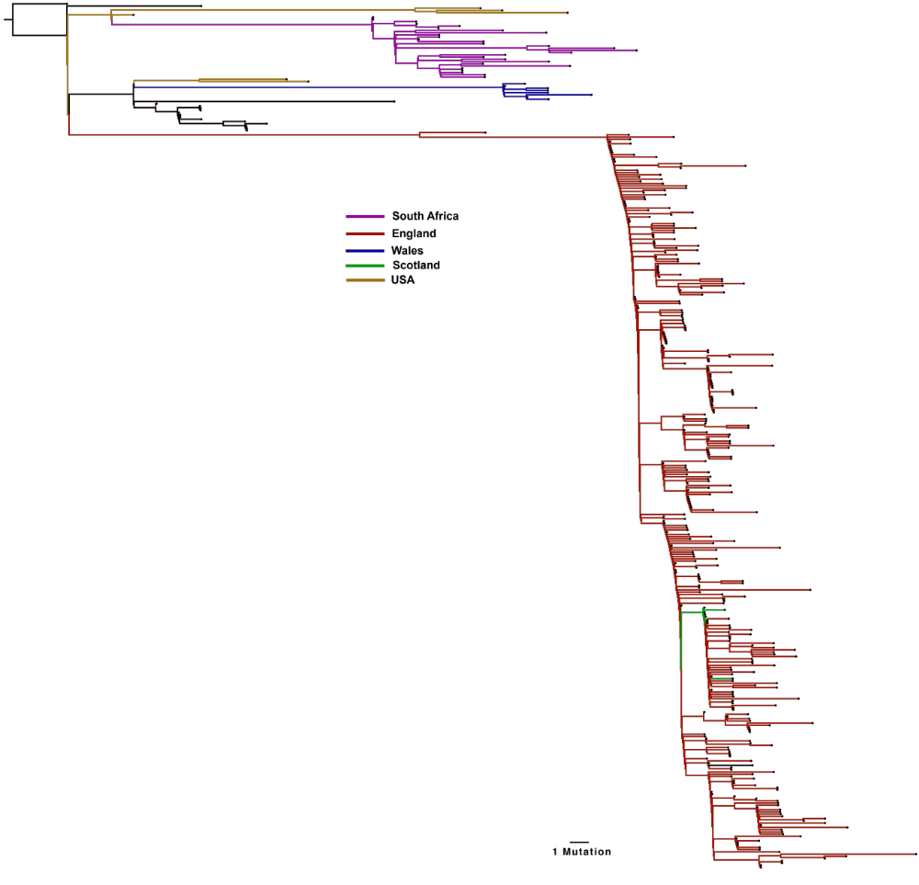
Supplementary Figure 4. A. Divergence of global lineages bearing Spike 501Y mutation: A global maximum likelihood phylogeny of all SARS-CoV-2 sequences bearing the 501Y mutations were downloaded from the GISAID database (2000 sequences, accessed 16th December 2020). All duplicate sequences were removed to create a representative sub-sample of sequences. Distinct sub-lineages of the Spike 501Y variants are currently circulating in the UK (predominantly England, red), with significant expansion also occurring in South Africa (pink). UK variant VOC 202012/01 is shown in red.

