Slide 1
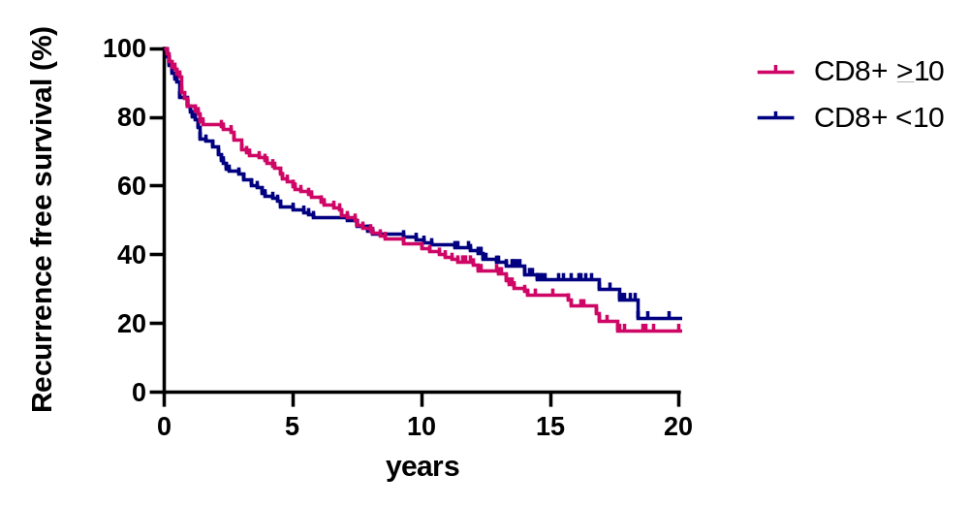
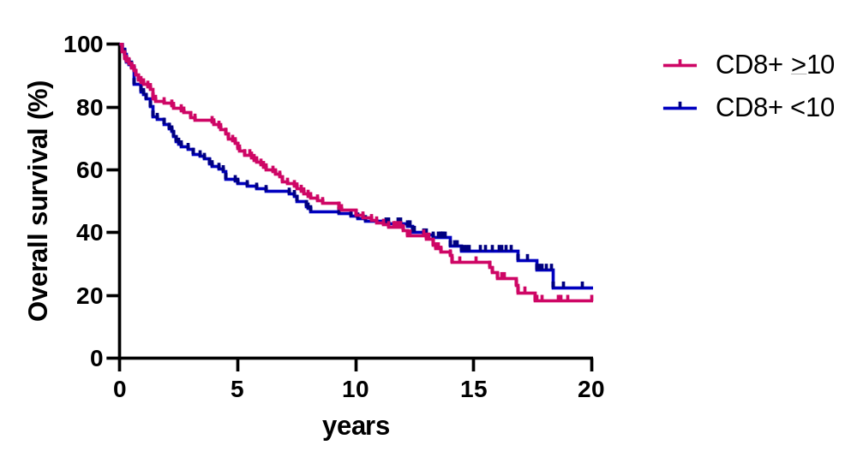
Supplementary Figure 4
a
b
Median RFS:
7.5 (CD8+ ≥10, n = 133) vs. 7.3 years (CD8+ <10, n = 126)
HR: 1.08 (95% CI: 00.80–1.44) (P = 0.62)
Median OS:
4.8 (CD8+ ≥10, n = 133) vs. 10.0 years (CD8+ <10, n = 126)
HR: 1.04 (95% CI: 0.77–1.40) (P = 0.80)

