Slide 1
Supple figure 1
 | % |  |  | p-value
 | HV | IMN-W | IMN-R | HV vs IMN-W | HV vs IMN-R | IMN-W vs IMN-R
YRNA | 2.9 | 5.1 | 2.1 | ns | ns | ns
tRNA | 16.6 | 15.9 | 22.5 | ns | ns | ns
snRNA | 7.7 | 9.5 | 14.2 | ns | <0.0001 | 0.0025
snoRNA | 11.1 | 12.7 | 21.2 | ns | 0.0002 | 0.0077
piRNA | 1.9 | 1.9 | 2.2 | ns | ns | ns
miRNA | 59.8 | 55.0 | 37.6 | ns | <0.0001 | 0.0033
**
†††
**
†††
**
†††
* IMN-W vs IMN-R
† HV vs IMN-R

Slide 2
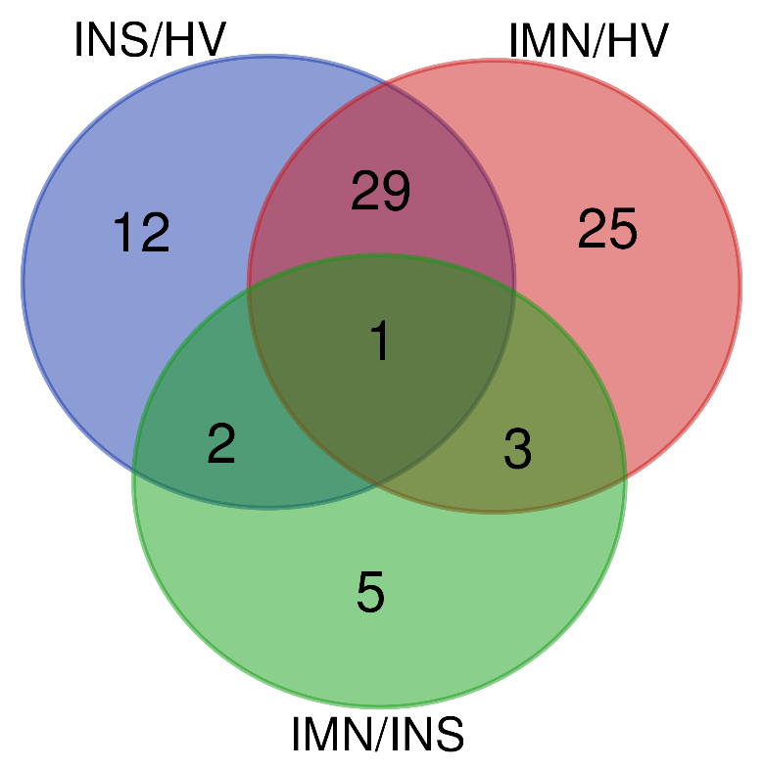
Supple figure 2
A
B
 | INS/HV |  | IMN/HV |  | IMN/INS
Mature_ID | FC | p-value | FC | p-value | FC | p-value
hsa-miR-192-5p | 2.29 | 0.012 | -1.29 | 0.157 | -3.19 | 0.001
hsa-miR-194-5p | 3.24 | 0.003 | 1.23 | 0.625 | -2.73 | 0.011

Slide 3
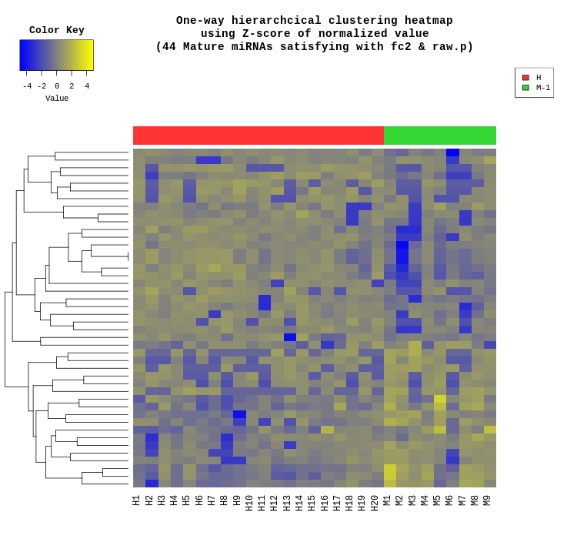
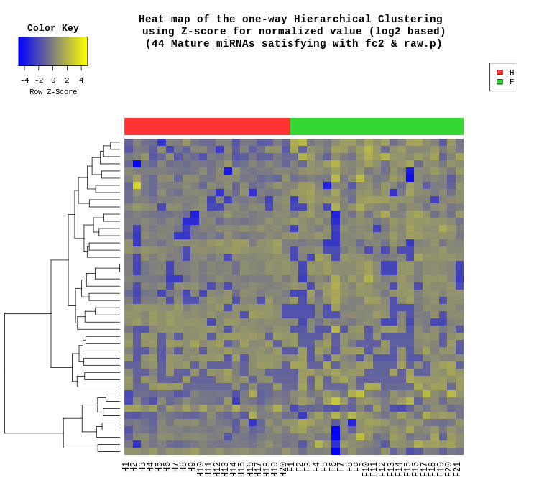
Supple figure 3
A
B
HV
IMN-W
Mature miRNA | IMN-W/HV fold change | IMN-W/HV p-value
hsa-miR-4732-5p | 4.65 | 0.000
hsa-miR-3605-5p | 3.68 | 0.002
hsa-miR-1290 | 3.02 | 0.001
hsa-miR-629-5p | 2.80 | 0.009
hsa-miR-320d | 2.79 | 0.001
hsa-miR-2110 | 2.73 | 0.012
hsa-miR-6735-5p | 2.72 | 0.008
hsa-miR-150-3p | 2.59 | 0.002
hsa-miR-144-3p | 2.52 | 0.001
hsa-miR-107 | 2.48 | 0.000
hsa-miR-4449 | -5.98 | 0.000
hsa-miR-199a-5p | -4.37 | 0.000
hsa-miR-340-3p | -3.72 | 0.000
hsa-miR-301a-3p | -3.20 | 0.005
hsa-miR-28-5p | -3.03 | 0.000
hsa-miR-1229-3p | -2.89 | 0.004
hsa-miR-199a-3p | -2.85 | 0.000
hsa-miR-199b-3p | -2.85 | 0.000
hsa-miR-556-3p | -2.83 | 0.010
hsa-miR-223-3p | -2.81 | 0.000

Slide 4
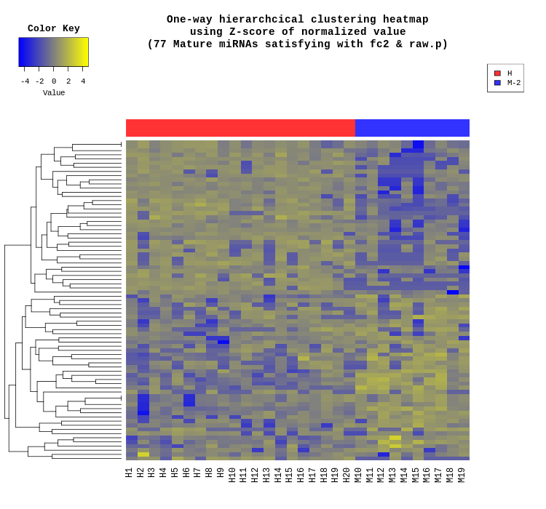
Supple figure 4
A
B
HV
IMN-R
Mature miRNA | IMN-R/HV fold change | IMN-R/HV p-value
hsa-miR-145-3p | 7.27 | 0.000
hsa-miR-483-5p | 4.67 | 0.000
hsa-miR-1285-3p | 4.64 | 0.000
hsa-miR-1273c | 4.63 | 0.000
hsa-miR-6516-3p | 4.42 | 0.000
hsa-miR-3605-5p | 4.19 | 0.003
hsa-miR-5684 | 4.17 | 0.000
hsa-miR-6126 | 3.73 | 0.000
hsa-miR-6735-5p | 3.31 | 0.006
hsa-miR-8485 | 3.21 | 0.000
hsa-miR-224-5p | -15.56 | 0.000
hsa-miR-875-5p | -9.88 | 0.007
hsa-miR-340-3p | -8.89 | 0.000
hsa-miR-199a-5p | -8.62 | 0.000
hsa-miR-148b-3p | -7.70 | 0.001
hsa-miR-181a-5p | -6.09 | 0.000
hsa-miR-30b-5p | -5.44 | 0.000
hsa-miR-4644 | -5.09 | 0.015
hsa-miR-335-3p | -4.73 | 0.006
hsa-miR-625-3p | -4.25 | 0.000

