Slide 1
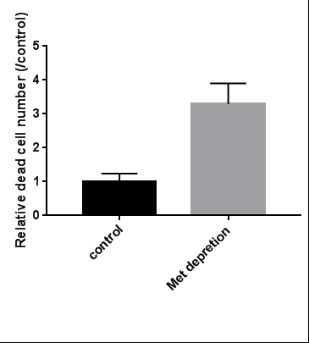
A
B
Control Met depletion
*
* p<0.01
Control
Met depletion
C
Notes:
Supplementary Figure S1

Slide 2
Notes:
Supplementary Figure S2

Slide 3
Notes:
Supplementary Figure S3

Slide 4
Notes:
Supplementary Figure S4

Slide 5
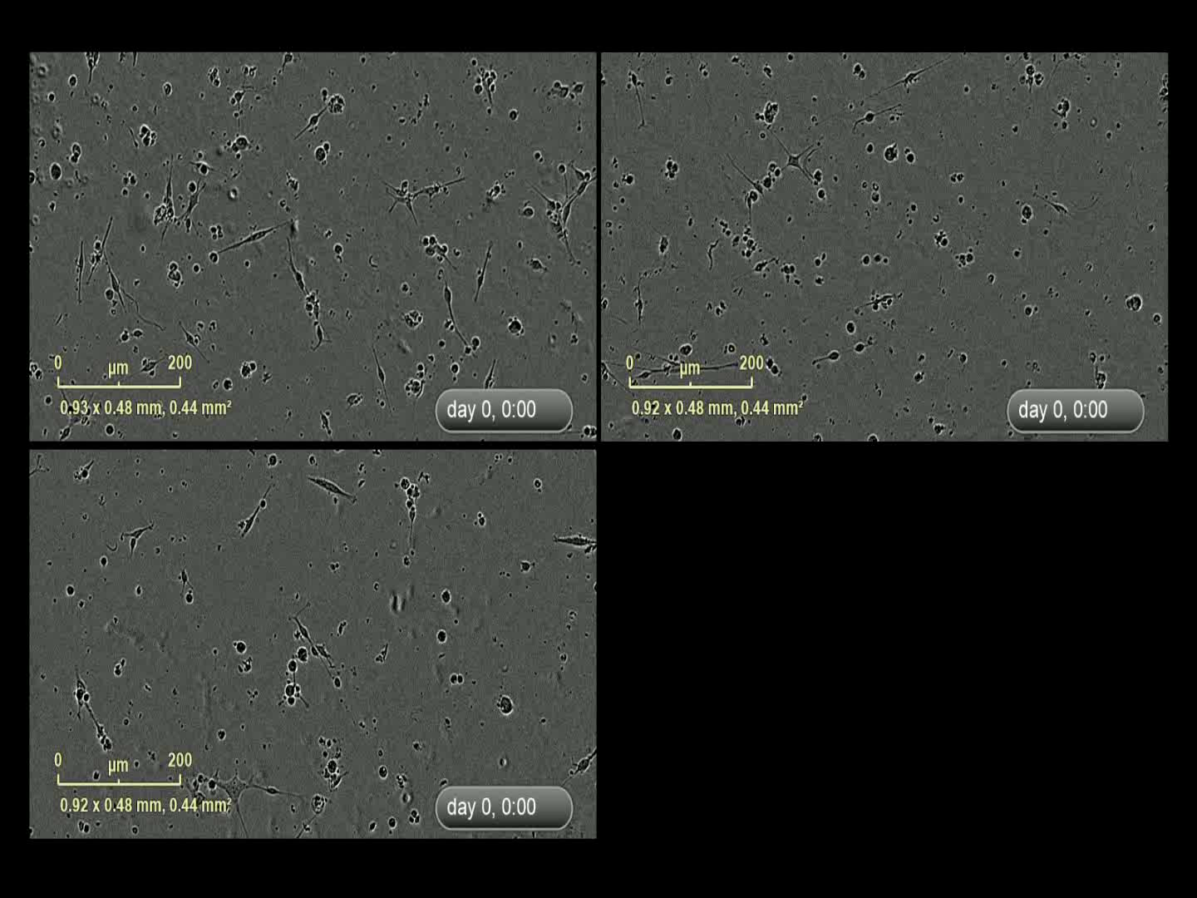
control
Simvastatin 30uM
Methionine depletion
Notes:
Supplementary Figure S5 (movie) please use hyperlinked video

Slide 6
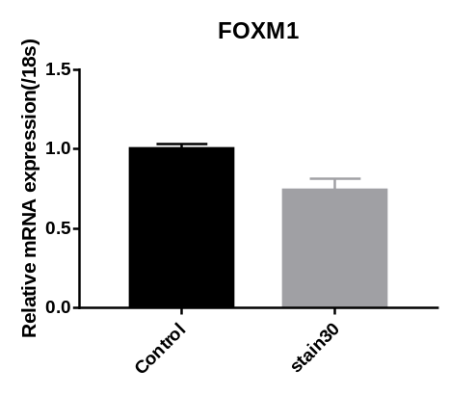
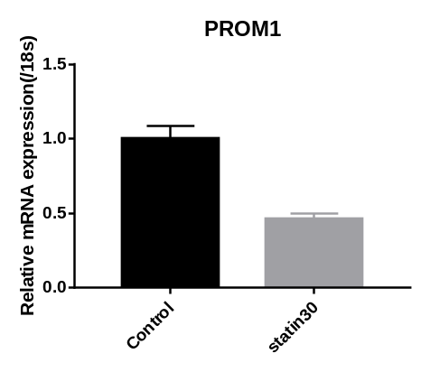
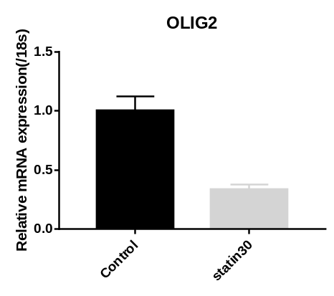
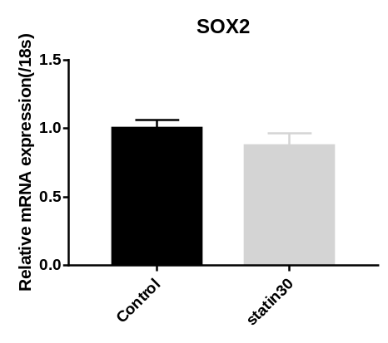
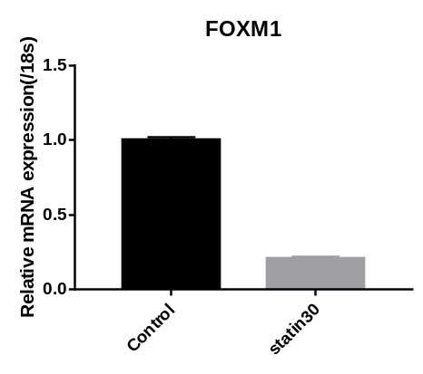
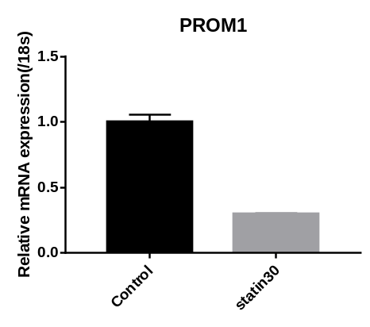
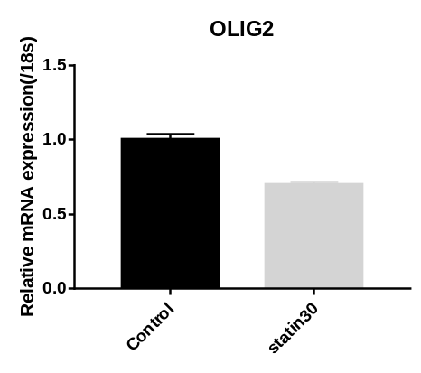
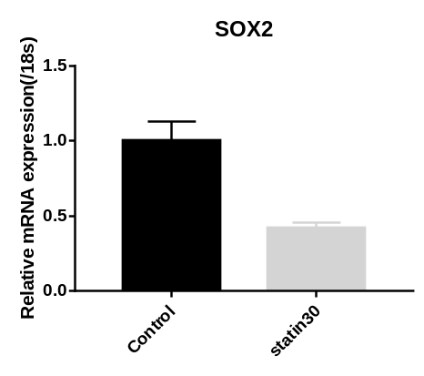
* p<0.005
*
*
*
MZGC4
*
*
*
*
MZGC5
Notes:
Supplementary Figure S6

Slide 7
Notes:
Supplementary Figure S7

Slide 8
Appotosis ⤴
Methionine
Depletion
Epitranscriptomic modification
METTL16/20
TNFA signaling pathway ⤴
MAT2A ⤴
SAM⤵
Cholesterol
efflux ⤴
Epigenetic Modification
3’UTR modification
SREBF2⤵
ACA43⤵
HMGCS1 ⤵
FDPS ⤵
IDI1 ⤵
SC5D ⤵
HSD17B7 ⤵
TM7SF2 ⤵
Pseudouridylation of U4938
28SrRNA
CpGi in the promoter and genebody
FOXM1⤵
Protein
Synthesis⤵
GIC Pluripotency ⤵
PROM1 ⤵
SOX4 ⤵
SOX2 ⤵
OLIG2 ⤵
Cholesterol
Biosynthesis⤵
Cell Growth ⤵
Notes:
Supplementary Figure S8

