Slide 1
Artemisinin blocks neutrophil migration
Videos on the following page show calcium-imaging of migrating neutrophils. Chemoattractant gradients are from bottom to top (vertical arrows). Intracellular calcium concentration is shown from low (blue) to high (red) – see scale at lower right. Videos taken over 1 min at 500 ms frame rate.
Press arrow below each image to activate video. Panels show (from left):
Neutrophil migrating in gradient of H₂O₂ from 0 (below bottom) to 10μM (above top). Note high calcium signal at leading edge. Velocity 54.4 μm/min, peak calcium 484 nM.
Abolition of leading-edge calcium signal and migration in presence of 10μM artemisinin. Velocity 0.46 μm/min, peak calcium 154 nM.
Neutrophil migrating in gradient of ADP-ribose from 0 (below bottom) to 10μM (above top). Velocity 62.2 μm/min, peak calcium 492 nM.
Abolition of leading-edge calcium signal and migration in presence of 10μM artemisinin. Velocity 0.28 μm/min, peak calcium 151 nM.

Slide 2

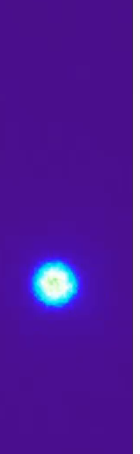

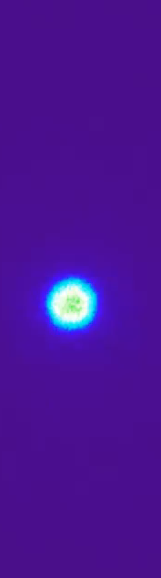

H₂O₂
H₂O₂ + Art
ADPR
ADPR + Art
500
[Ca²⁺] nM
0
DMEM
DMEM + Art
DMEM
DMEM + Art

