Slide 1
Artemisinin inhibits immune cell chemotaxis, cytokine production and NET release:
Supplementary information

Slide 2
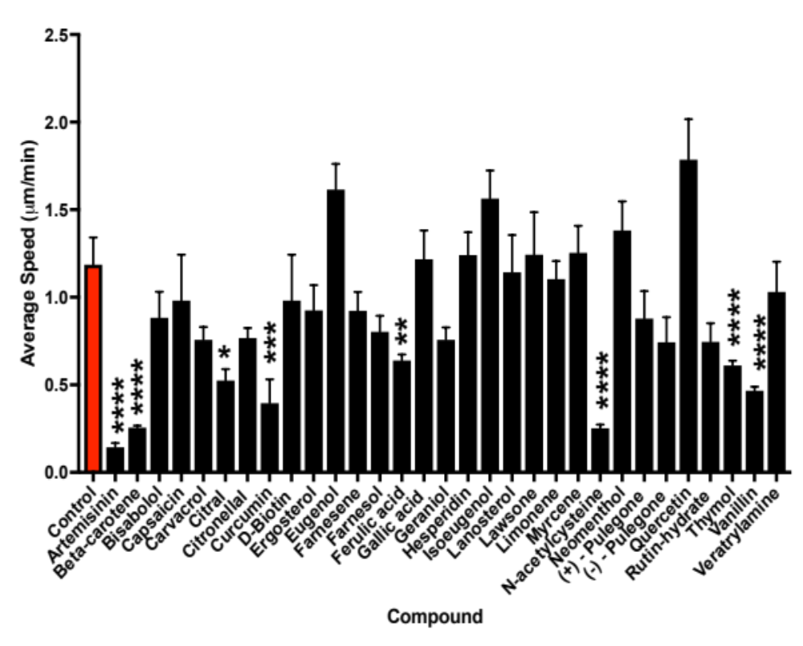
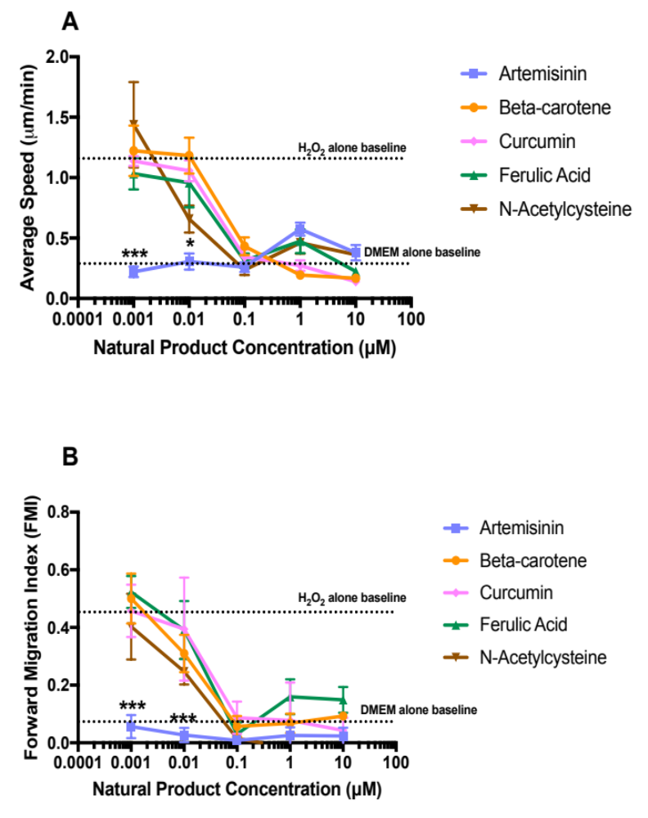
Supplementary Fig. 1.
A
Ferulic acid
N-acetylecysteine
Artemisinin
Curcumin
Beta-carotene
B
B
Supplementary Fig. 1. Artemisinin directly inhibits neutrophil chemotaxis
A. Five natural compounds significantly inhibit speed of migration of neutrophils. These same five compounds also inhibited forward migration index (Fig. 1A).
B. Dose-response relations for the five compounds identified in A. The IC50 values for Beta-carotene, Curcumin, Ferulic acid and N-acetylcysteine were all similar, while artemisinin was significantly more potent. Each bar/point shows mean ± SEM from n = 3 mice. Statistical analysis: **, p < 0.01, ***, p < 0.001, ****, p < 0.0001 (One-way ANOVA and Tukey–Kramer post-hoc test).

Slide 3
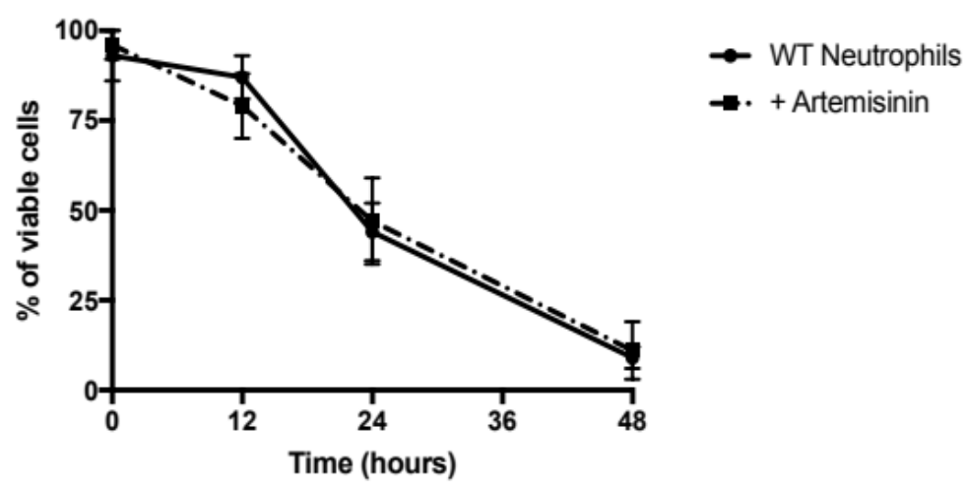
Supplementary Fig. 2.
Supplementary Fig. 2. Artemisinin is not toxic to neutrophils
Percentage of viable cells as a function of time in culture, in presence and absence of artemisinin (10μM). Points show mean ± SEM, n = 3. No significant difference at any time point.

Slide 4
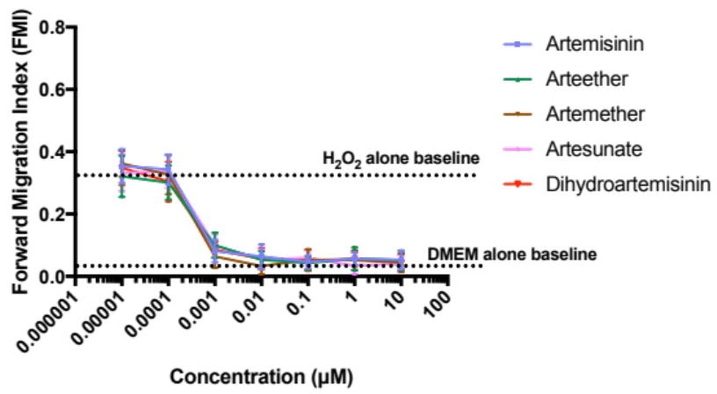
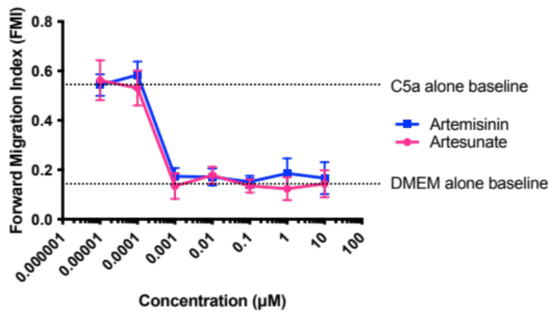
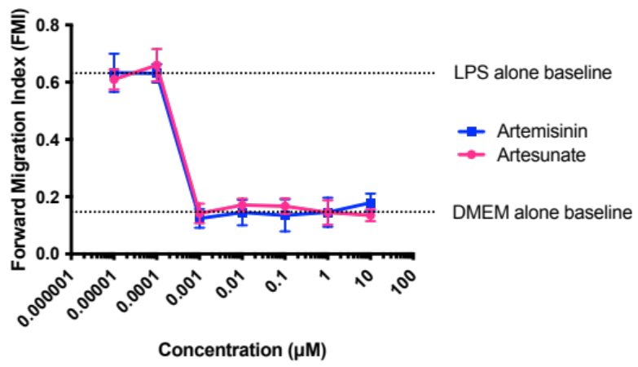
Supplementary Fig. 3.
A
H₂O₂
B
C5a
C
LPS
Supplementary Fig. 3. Artemisinin and analogues inhibit neutrophil migration towards H₂O₂, cytokines and LPS.
A: Inhibition of neutrophil migration in gradient of H₂O₂ (10nM). IC₅₀ values: artemsinin, 0.36nM; arteether, 0.31nM; artemether, 0.37nM; artesunate, 0.39nM; dihydroartemisinin, 0.35nM.
B: Inhibition of migration in gradient of C5a (10nM). IC₅₀ values: artesunate, 0.36nM; artemisinin, 0.32nM.
C: Inhibition of migration in gradient of LPS (50 ng/ml). IC₅₀ values: artesunate, 0.35nM; artemisinin, 0.33nM.
In all cases, each point shows mean ± SEM from n = 3 mice.

Slide 5
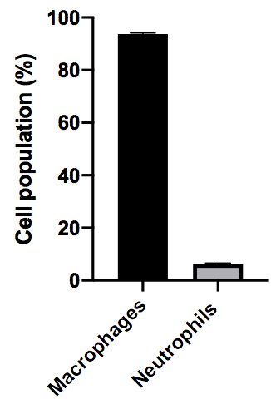
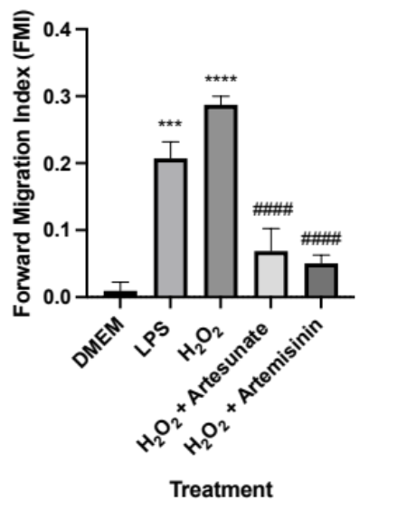
Supplementary Fig. 4.
A
B
C
Supplementary Fig. 4. Artemisinin and artesunate inhibit macrophage chemotaxis
A. Example image showing difference between mononuclear macrophages and polymorphonuclear neutrophils. Macrophages isolated by i.p. injection of thioglycolate (3% thioglycolate solution, 10 μl/g, 4d) followed by peritoneal lavage (see Methods). Identity of cells in lavage was confirmed by using a cytocentrifuge (400 rpm x 5 minutes) to adhere the cells to slides that were then fixed and stained with the Ral diff-quick staining kit (a modified version of the May-Grünwald-Giemsa staining).
B. Percentages of macrophages and neutrophils isolated as in A.
C. Forward migration index (FMI) for migration of macrophages up gradients of lipopolysaccharide (LPS, 50ng/ml) and H₂O₂ (10μM). Migration inhibited by artesunate (10μM) and artemisinin (10μM). Macrophages imaged every two minutes for one hour. Each bar shows mean ± SEM from n = 4 mice. Statistical analysis: For comparison with DMEM: ***, p < 0.001, ****, p < 0.0001, for comparison with H₂O₂: ####, p<0.0001 (One-way ANOVA and Tukey–Kramer post-hoc test). * = comparison between DMEM and LPS; # = comparison between H₂O₂ and H₂O₂ +artesunate/artemisinin.

Slide 6
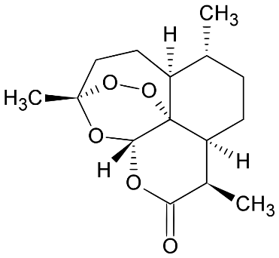
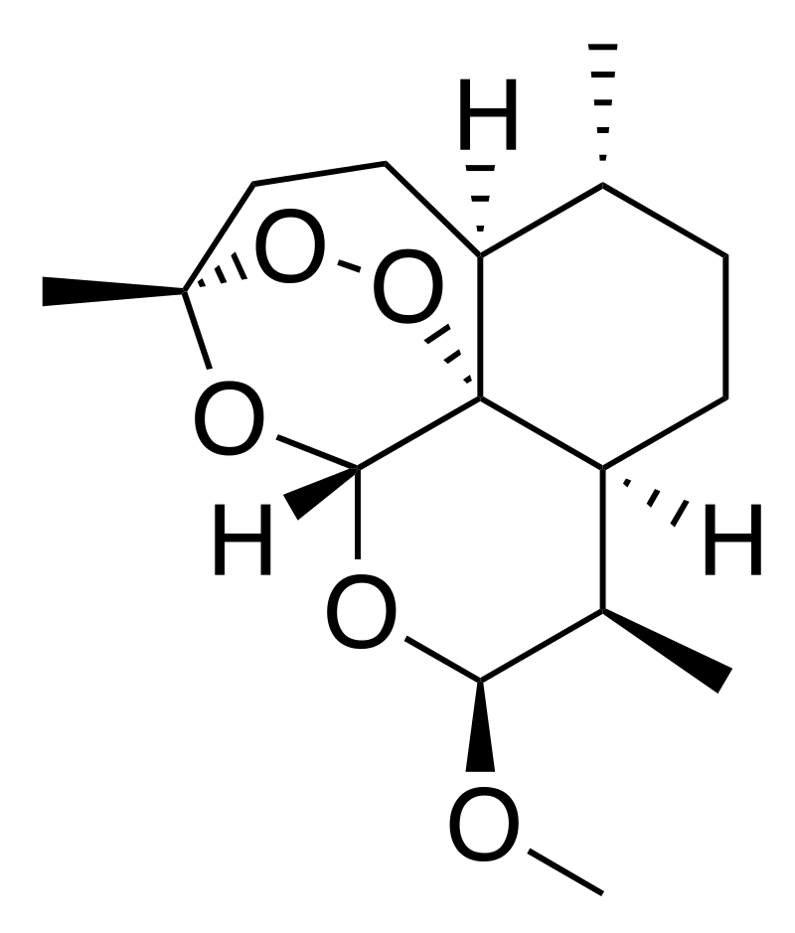
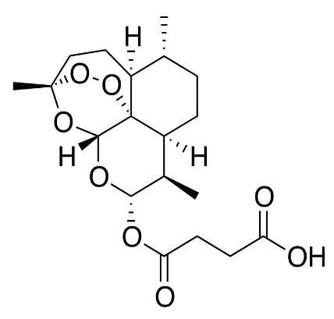
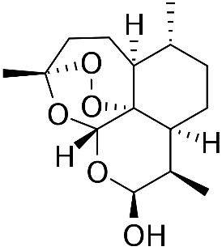
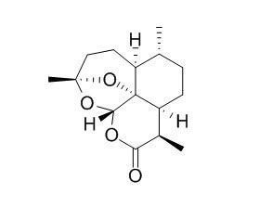
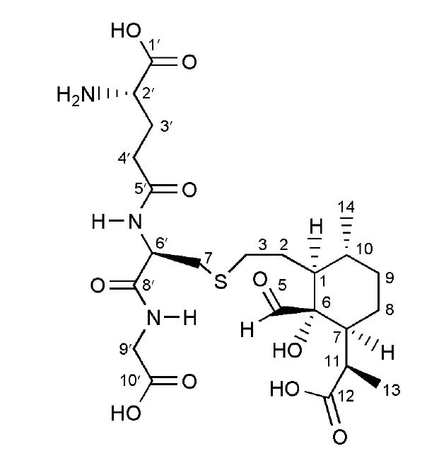
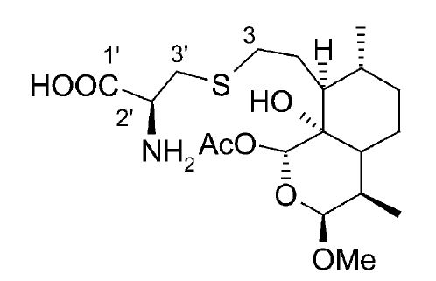
Supplementary Fig. 5.
A
Artemisinin Arteether Artemether Artesunate (AS)
Dihydroartemisinin (DHA) Deoxyartemisinin
B
C
Supplementary Fig. 5
Chemical structures of artemisinin and some of its analogues used in the present study.
Reaction product of cysteine with artemether (Wu, Chen, Zhai, Xiao & Wu, 2003)
Reaction product of the tripeptide glutathione with artemisinin (Wang & Wu, 2000)

Slide 7
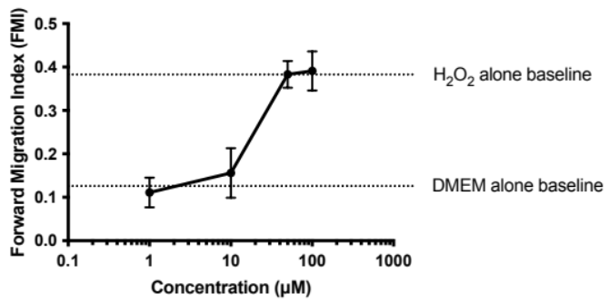
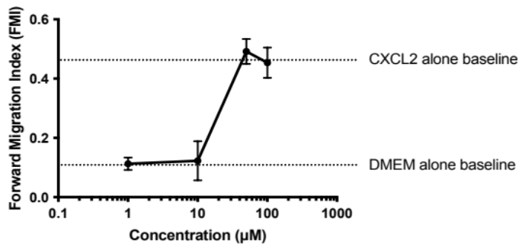
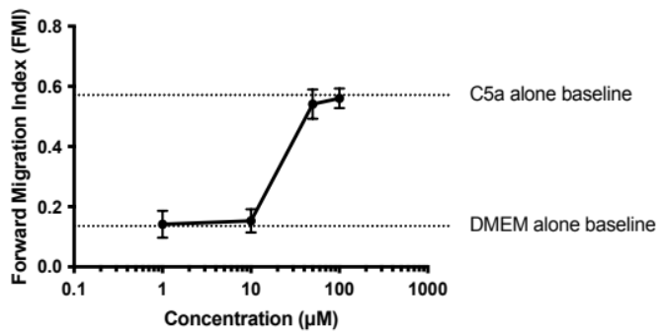
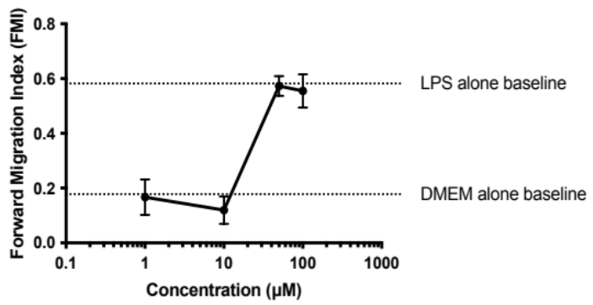
Supplementary Fig. 6. Concentration-dependence of effect of the iron chelator desferrioxamine on inhibition of neutrophil migration by artemisinin
A
B
H₂O₂
CXCL2
C
D
C5a
LPS
Supplementary Fig. 6 Concentration-dependence of effect of the iron chelator desferrioxamine on inhibition of neutrophil migration by artemisinin (10μM). Concentration gradients of the following chemoattractants over 1mm: A: H₂O₂, 10nM: B: CXCL2, 1 nM; C: C5a, 10 nM; D: LPS, 50 ng/ml. Each point shows mean ± SEM from n = 3 mice.

Slide 8
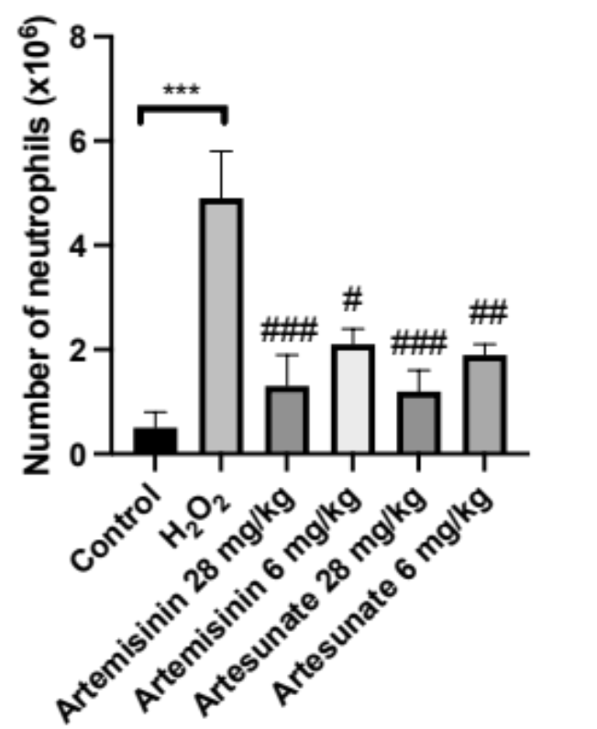
Supplementary Fig. 7. Suppression of peritoneal neutrophil invasion by artemisinin and analogues
Supplementary Fig. 7. Suppression of peritoneal neutrophil invasion by artemisinin and artesunate. Ordinate: total number of peritoneal neutrophils 90 min after i.p. injection of 10μM H₂O₂ or vehicle. Artemisinin or artesunate injected s.c. 30min before injection of H₂O₂ largely suppressed neutrophil invasion. Neutrophils identified by Cytospin histology (see Methods). Each bar shows mean ± SEM from n = 3 mice. Statistical analysis: For comparison of H₂O₂ with control: ***, p <0.001; for comparison of artemisinin/artesunate with H₂O₂: #, p < 0.05, ##, p < 0.01, ###, p < 0.001 (One-way ANOVA and Tukey–Kramer post-hoc test).

Slide 9
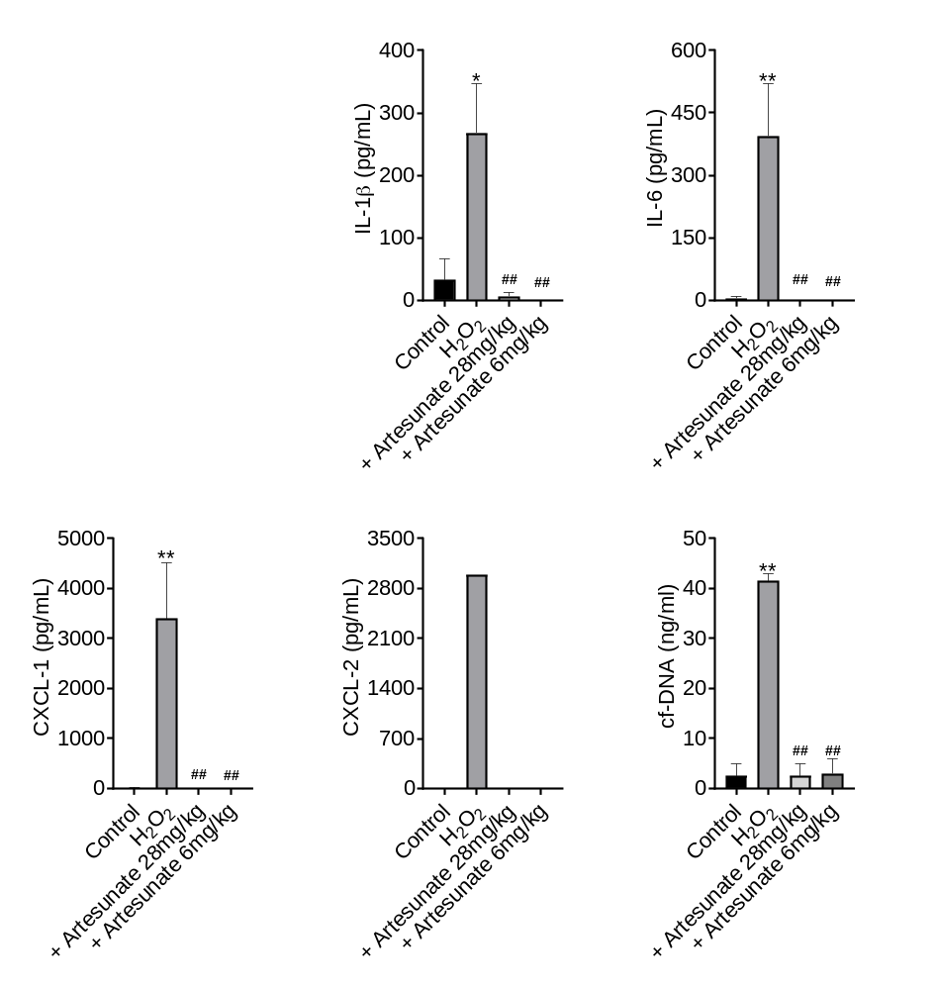
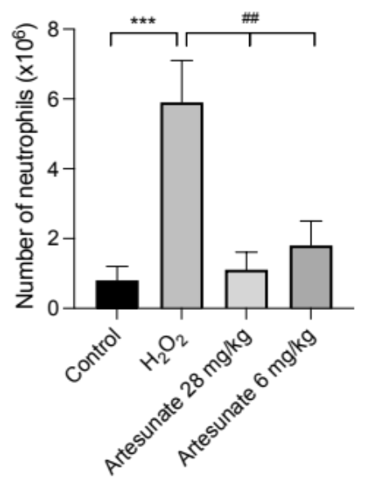
Supplementary Fig. 8. Artesunate suppresses neutrophil invasion and release of cytokines and NETs in response to infusion of H₂O₂ into lung.
A
B
C
D
E
F
Supplementary Fig. 8. Artesunate suppresses neutrophil invasion and release of cytokines and NETs in response to infusion of H₂O₂ into lung.
A. Number of neutrophils (see Methods for cell identification) recovered in bronchio-arteriolar lavage fluid (BALF) at t = 60 min following infusion of H₂O₂ (10μM) into lung. Bars show control (no H₂O₂); H₂O₂ alone; two doses of artesunate (28 or 6mg/kg) administered s.c. 30min before infusion of H₂O₂.
B., C., D., E.: Concentration of IL-1β, IL6, CXCL1 and CXCL2 in peritoneal lavage measured by ELISA, using samples obtained in A.
F.: Concentration of cell-free DNA, an index of NET release.
Each bar shows mean ± SEM from n = 4 mice except E, n = 1. Statistical analysis: *, p<0.05; **, P<0.01; ***, p<0.001, compared with negative control (no H₂O₂); ##, p<0.01 artesunate groups compared with no-artesunate group at same time point. ANOVA with Bonferroni post-hoc correction.

Slide 10
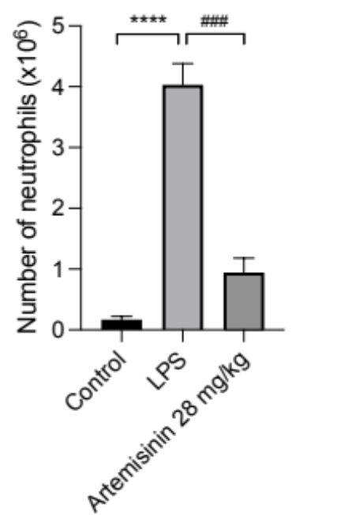
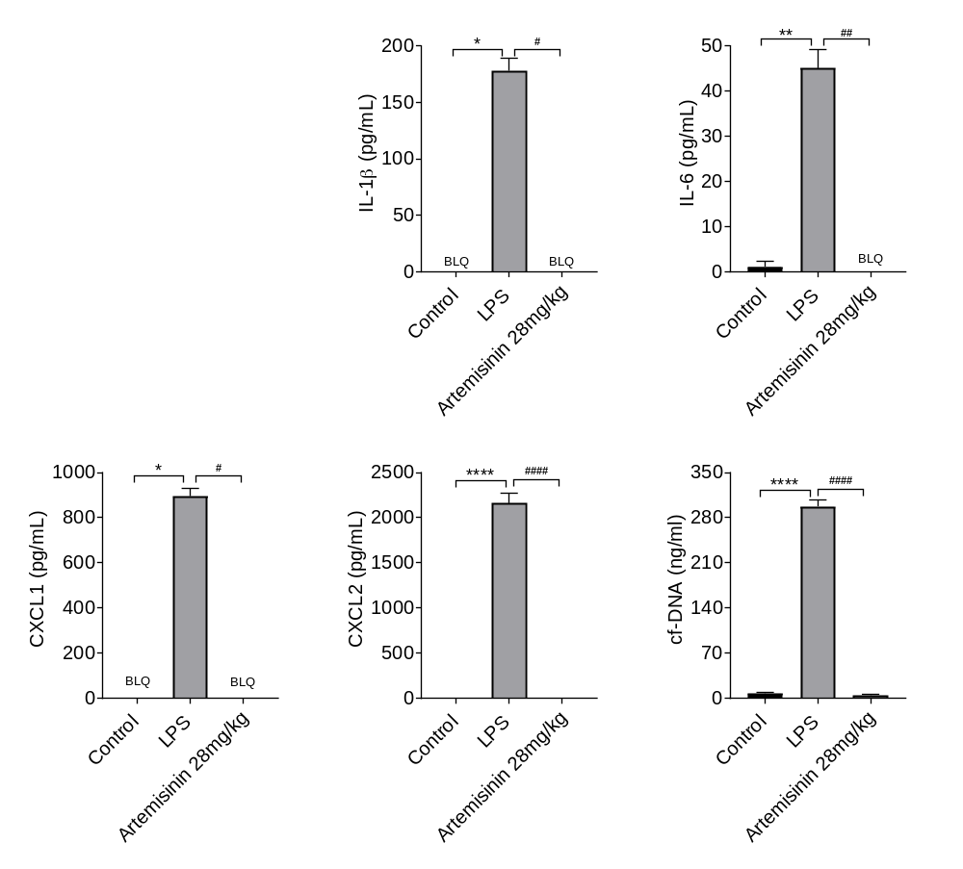
Supplementary Fig. 9. Artemisinin suppresses neutrophil invasion and release of cytokines and NETs in response to LPS infusion into peritoneum.
A
B
C
D
E
F
Supplementary Fig. 9. Artemisinin suppresses neutrophil invasion and release of cytokines and NETs in response to LPS infusion into peritoneum.
Number of neutrophils recovered from intraperitoneal lavage at t = 5h following i.p. injection of LPS (30ng). Each bar shows mean ± SEM from n = 3 mice. Neutrophil influx suppressed by artemisinin (28mg/kg) administered s.c. at 30min before injection of LPS, and 90min and 210min after.
B., C., D., E. Concentration of IL-1β, IL6, CXCL1 and CXCL2 in peritoneal lavage measured by ELISA, using samples obtained in A.
F. Concentration of cell-free DNA, an index of NET release.
Statistical analysis: *p < 0.05; **p < 0.01; ****p < 0.0001 comparing LPS with control group. #p < 0.05, ##p<0.01; ###p<0.001comparing LPS+Artemisinin with LPS group (One-way ANOVA and Bonferroni post-hoc test). Each bar shows mean ± SEM from n = 3 mice.

Slide 11
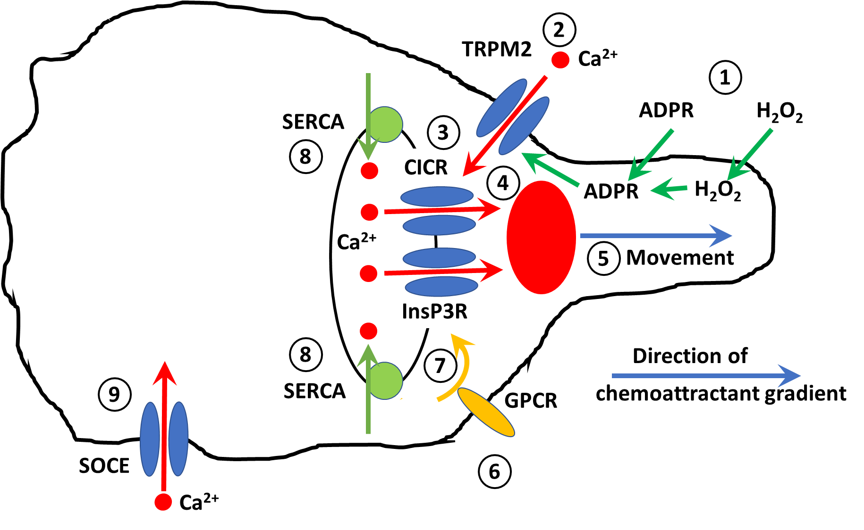
Supplementary Fig. 10.
Notes:
Description of steps in chemotaxis
(i) Immune cell guidance by H₂O₂. The concentration, and thus influx, of H₂O₂ is greater in the direction of the concentration gradient (step 1).The intracellular mediator ADP ribose (ADPR) is synthesized inside the cell in response to H₂O₂, and is the likely mediator acting directly on TRPM2 ion channels (13-17). ADPR applied externally can also act as a chemoattractant and therefore must be bale to penetrate the cell membrane, by unknown mechanisms (1, 15, 18). Higher levels of intracellular ADPR in the direction of an extracellular H₂O₂ or ADPR gradient preferentially activates TRPM2 ion channels towards the leading edge of the neutrophil. A calcium influx through open TRPM2 ion channels (step 2) triggers calcium release from intracellular stores via calcium-induced calcium release (CICR, step 3), forming an intracellular calcium “pulse” at the cell leading edge, as observed in calcium imaging experiments (step 4). The leading-edge calcium pulse activates the cellular motile machinery, leading to forward movement (step 5).
(ii) Immune cell guidance by conventional chemoattractants. Guidance by conventional chemoattractants such as cyto/chemokines employs a different mechanism, as it is not inhibited by pharmacological block or genetic deletion of TRPM2 and is therefore independent of TRPM2 (lower part of Figure). Chemoattractants such as CXCL2 are known to activate agonist-specific G-protein coupled receptors, and there is evidence for activation of calcium release via activation of G_{q} (19) (step 6) resulting in release of IP3 and efflux of calcium from intracellular stores through receptors for IP3 (InsP3R, step 7).
(iii) Refilling of calcium stores. Following release of calcium from intracellular stores, refilling of stores occurs via the sarcoplasmic and endoplasmic reticulum Ca ATPase, SERCA (step 8). This is a likely but unproven mechanism in immune cells, for which we will look for evidence in the proposed work. Finally, intracellular calcium lost to the external medium during the cycling process described above is replenished in other cells by a process of store-operated calcium entry (SOCE), which will also be explored in the proposed work.
Inhibition of chemotaxis by artemisinin
Evidence presented here shows that artemisinin inhibits SERCA (step 8), thus emptying intracellular calcium stores and preventing the generation of calcium pulses (step 4) on which chemotaxis depends.

Slide 12
Supplementary Fig. 10. Schematic diagram of critical steps in chemotaxis of immune cells.
(i) Immune cell guidance by H₂O₂. The concentration, and thus influx, of H₂O₂ is greater in the direction of the concentration gradient (step 1).The intracellular mediator ADP ribose (ADPR) is synthesized inside the cell in response to H₂O₂, and is the likely mediator acting directly on TRPM2 ion channels (13-17). ADPR applied externally can also act as a chemoattractant and therefore must be bale to penetrate the cell membrane, by unknown mechanisms (1, 15, 18). Higher levels of intracellular ADPR in the direction of an extracellular H₂O₂ or ADPR gradient preferentially activates TRPM2 ion channels towards the leading edge of the neutrophil. A calcium influx through open TRPM2 ion channels (step 2) triggers calcium release from intracellular stores via calcium-induced calcium release (CICR, step 3), forming an intracellular calcium “pulse” at the cell leading edge, as observed in calcium imaging experiments (step 4). The leading-edge calcium pulse activates the cellular motile machinery, leading to forward movement (step 5).
(ii) Immune cell guidance by conventional chemoattractants. Guidance by conventional chemoattractants such as cyto/chemokines employs a different mechanism, as it is not inhibited by pharmacological block or genetic deletion of TRPM2 and is therefore independent of TRPM2 (lower part of Figure). Chemoattractants such as CXCL2 are known to activate agonist-specific G-protein coupled receptors, and there is evidence for activation of calcium release via activation of G_{q} (19) (step 6) resulting in release of IP3 and efflux of calcium from intracellular stores through receptors for IP3 (InsP3R, step 7).
(iii) Refilling of calcium stores. Following release of calcium from intracellular stores, refilling of stores occurs via the sarcoplasmic and endoplasmic reticulum Ca ATPase, SERCA (step 8). This is a likely but unproven mechanism in immune cells, for which we will look for evidence in the proposed work. Finally, intracellular calcium lost to the external medium during the cycling process described above is replenished in other cells by a process of store-operated calcium entry (SOCE).

