Slide 1
Zhang et al. Supplemental Fig.1
A
shNC
shCYLD#1
shCYLD#2
A2780
Control
A2780
DDP (5μM)
PI
FITC

Slide 2
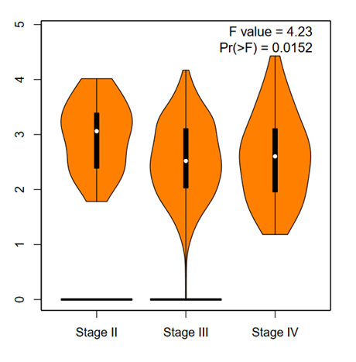
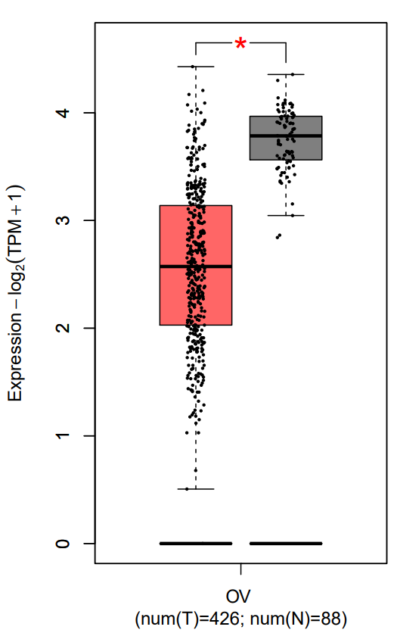
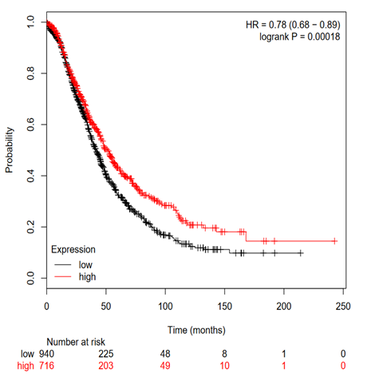
Zhang et al. Supplemental Fig.2
B
A
C

Slide 3












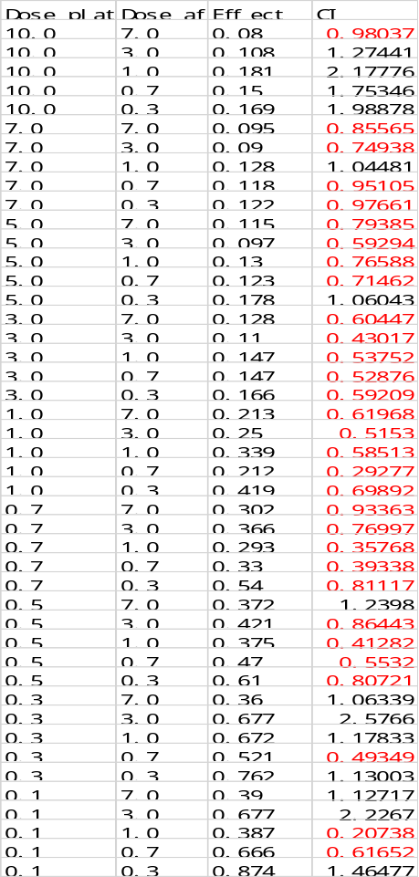
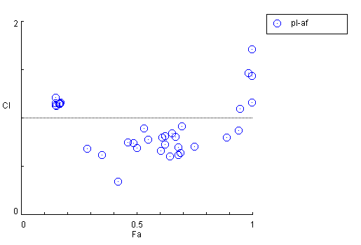
Zhang et al. Supplemental Fig. 3
A
B
OVCAR3
A2780
D
Vector
HER3
Vector
HER3
HER3
p-p38
OVCAR3-DDP
DDP 10μM+
TX1 5μM
p-Erk
none
TX1 5μM
p-c-Jun
CYLD
GAPDH
DDP 10μM
TX1 10μM
DDP 10μM+
TX1 10μM
C
E
A2780-DDP
TX1
A2780-DDP
none
TX1 3μM
DDP 7μM+
TX1 3μM
DDP 7μM
TX1 7μM
DDP 7μM+
TX1 7μM
F
OVCAR3-DDP
G
OVCAR3-DDP
Autagonism
Additive
effect
synergy

Slide 4
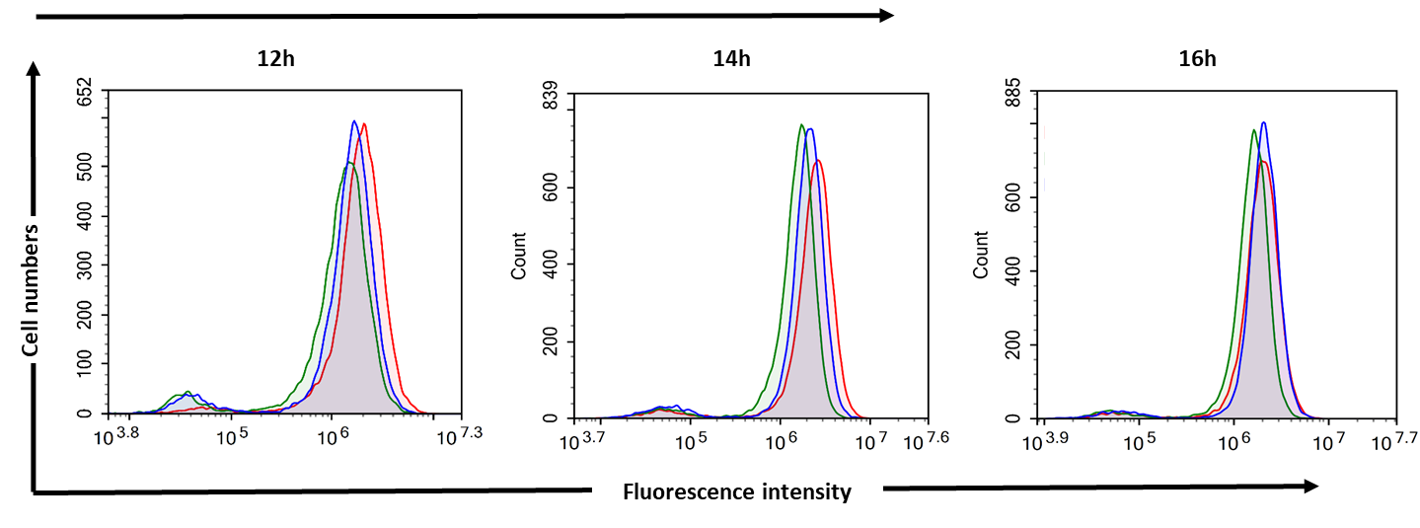
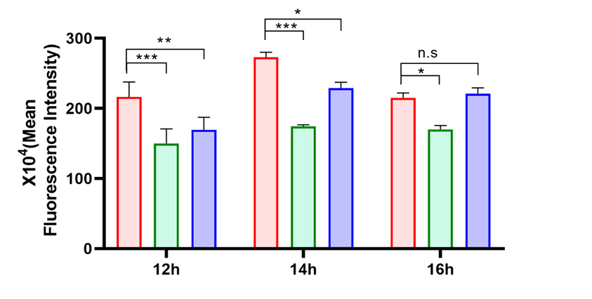
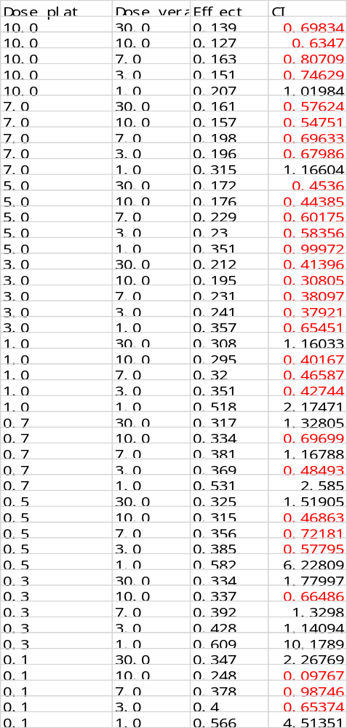
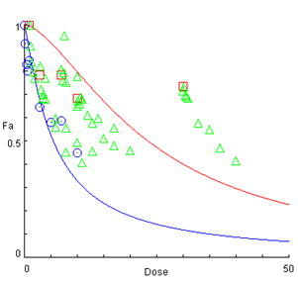
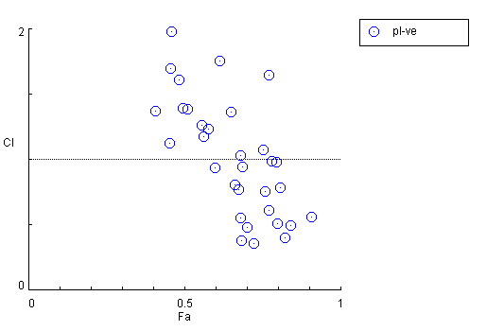

Zhang et al. Supplemental Fig. 4
A
B
DDP 3 μM +
Verapamil 3μM
D
DDP 3μM
Verapamil 3μM
E
OVCAR3
shCYLD#1
C
E
A2780
shCYLD#1
F
A2780 shCYLD#1
G
H
Autagonism
Additive
effect
synergy

