Slide 1
Genome-wide identification of potential biomarkers in multiple myeloma using meta-analysis of mRNA and miRNA expression data
Amit katiyar^{1,2}, Gurvinder Kaur³, Lata Rani³, Harpreet Singh¹, Punit Kaur^{2#}, Ritu Gupta^{3*}
¹ICMR-AIIMS Computational Genomics Centre, Division of Biomedical Informatics, Indian Council of Medical Research, Ansari Nagar, New Delhi-110029, India
²Department of Biophysics, All India Institute of Medical Sciences, Ansari Nagar, New Delhi-110029, India
³Laboratory Oncology Unit, Dr B. R. A. Institute Rotary Cancer Hospital, All India Institute of Medical Sciences, New Delhi-110029, India
#Co-Corresponding author
*Corresponding author
Prof Ritu Gupta
Laboratory Oncology Unit, Dr B.R.A.IRCH,
AIIMS, New Delhi
Email: drritugupta@gmail.com

Slide 2
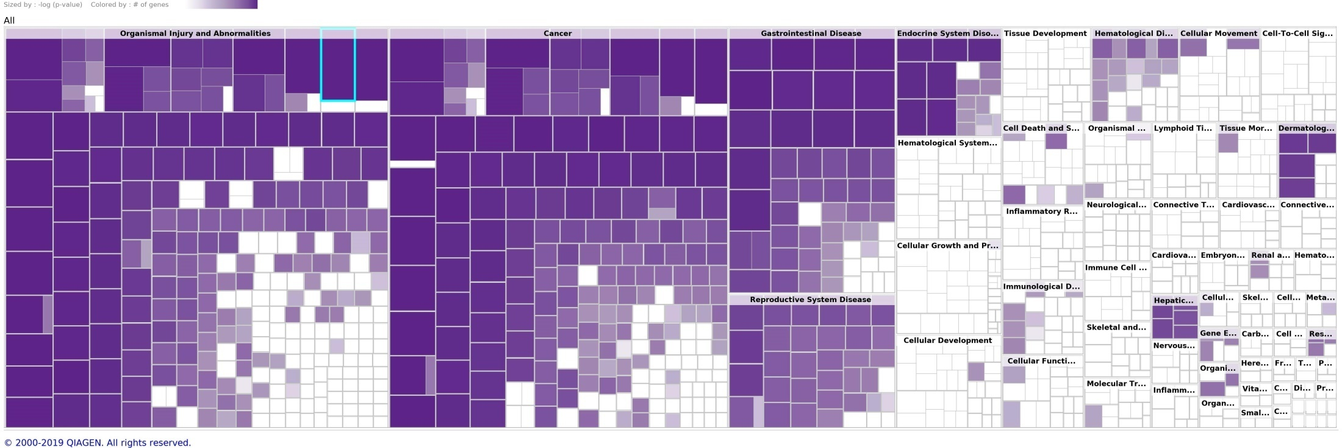
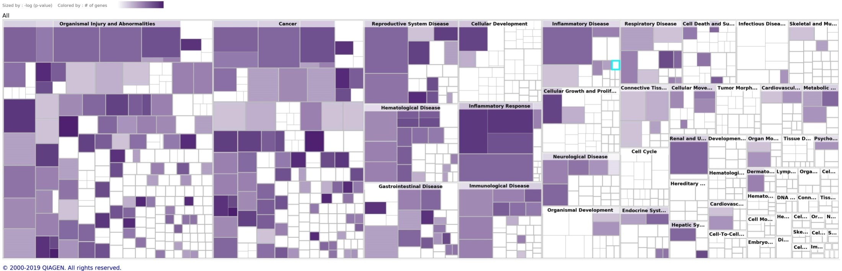
Figure S1a
Figure S1b

Slide 3
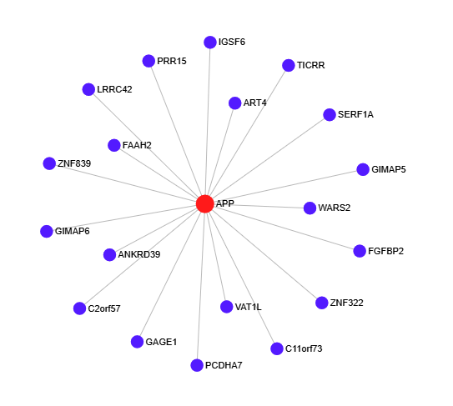
Figure S2

Slide 4
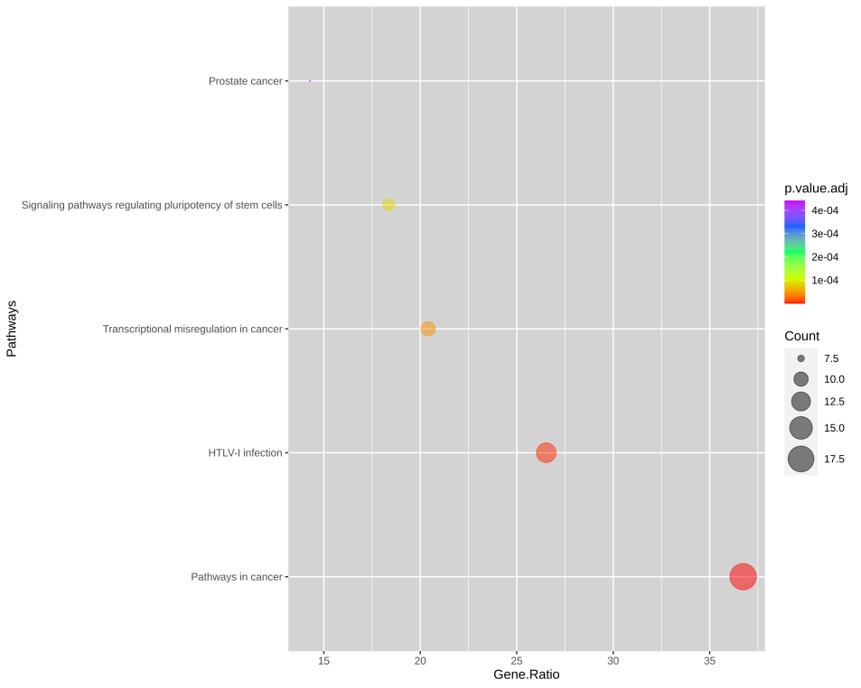
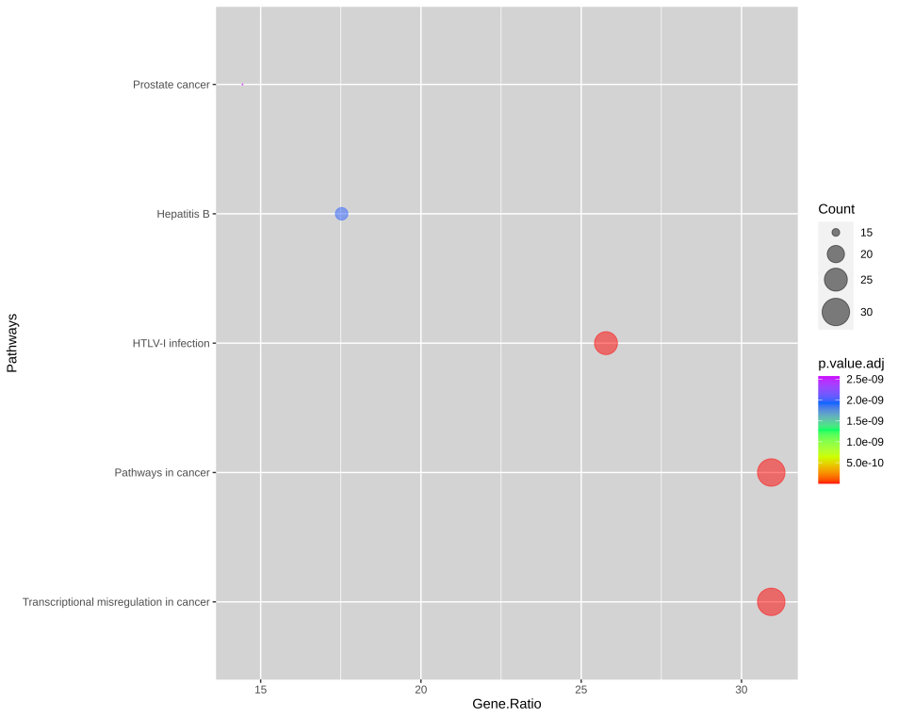
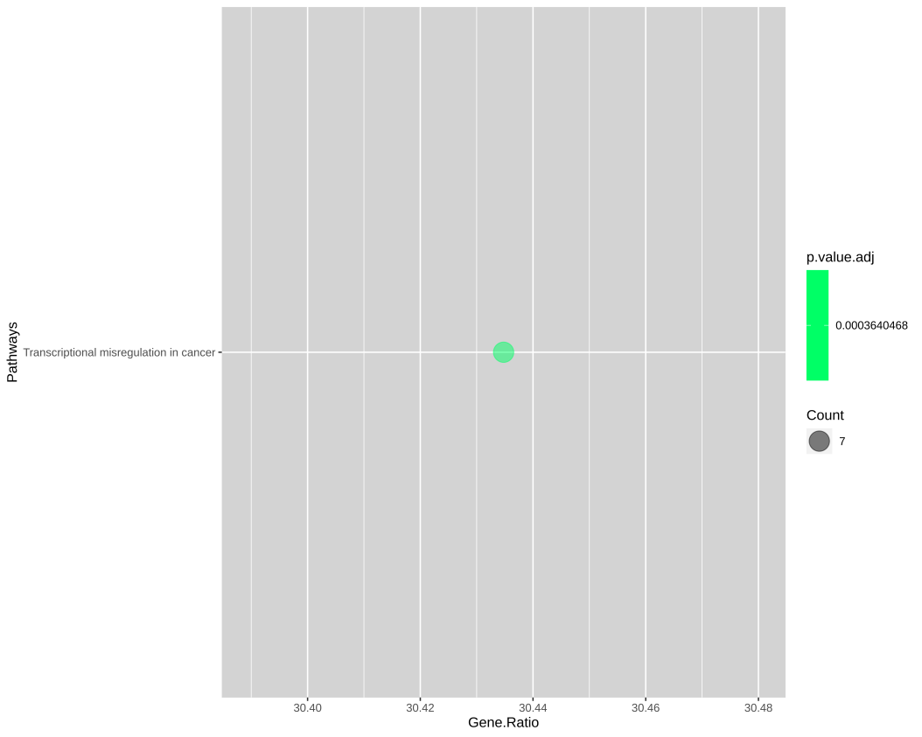
a)
b)
c)
Figure S3

