Slide 1
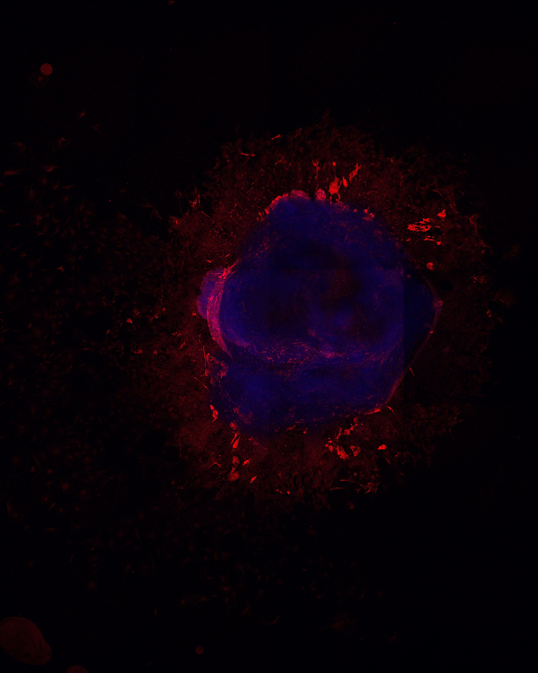
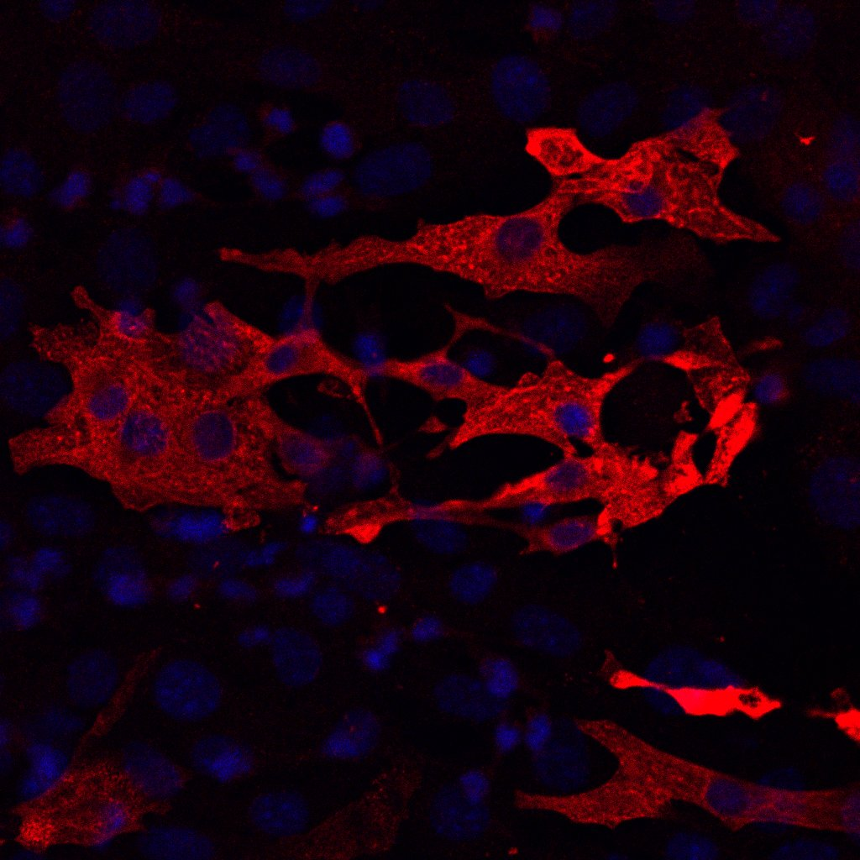
Additional figure 1 A. Whole embryoid body staining. The embryoid body was stained on day 20 with DAPI (blue) and MHC (red). The embryoid body of WT cells is shown. Scale bar 200μm. The inset of the magnified section is shown in a yellow rectangle. Scale bar 50μm

Slide 2
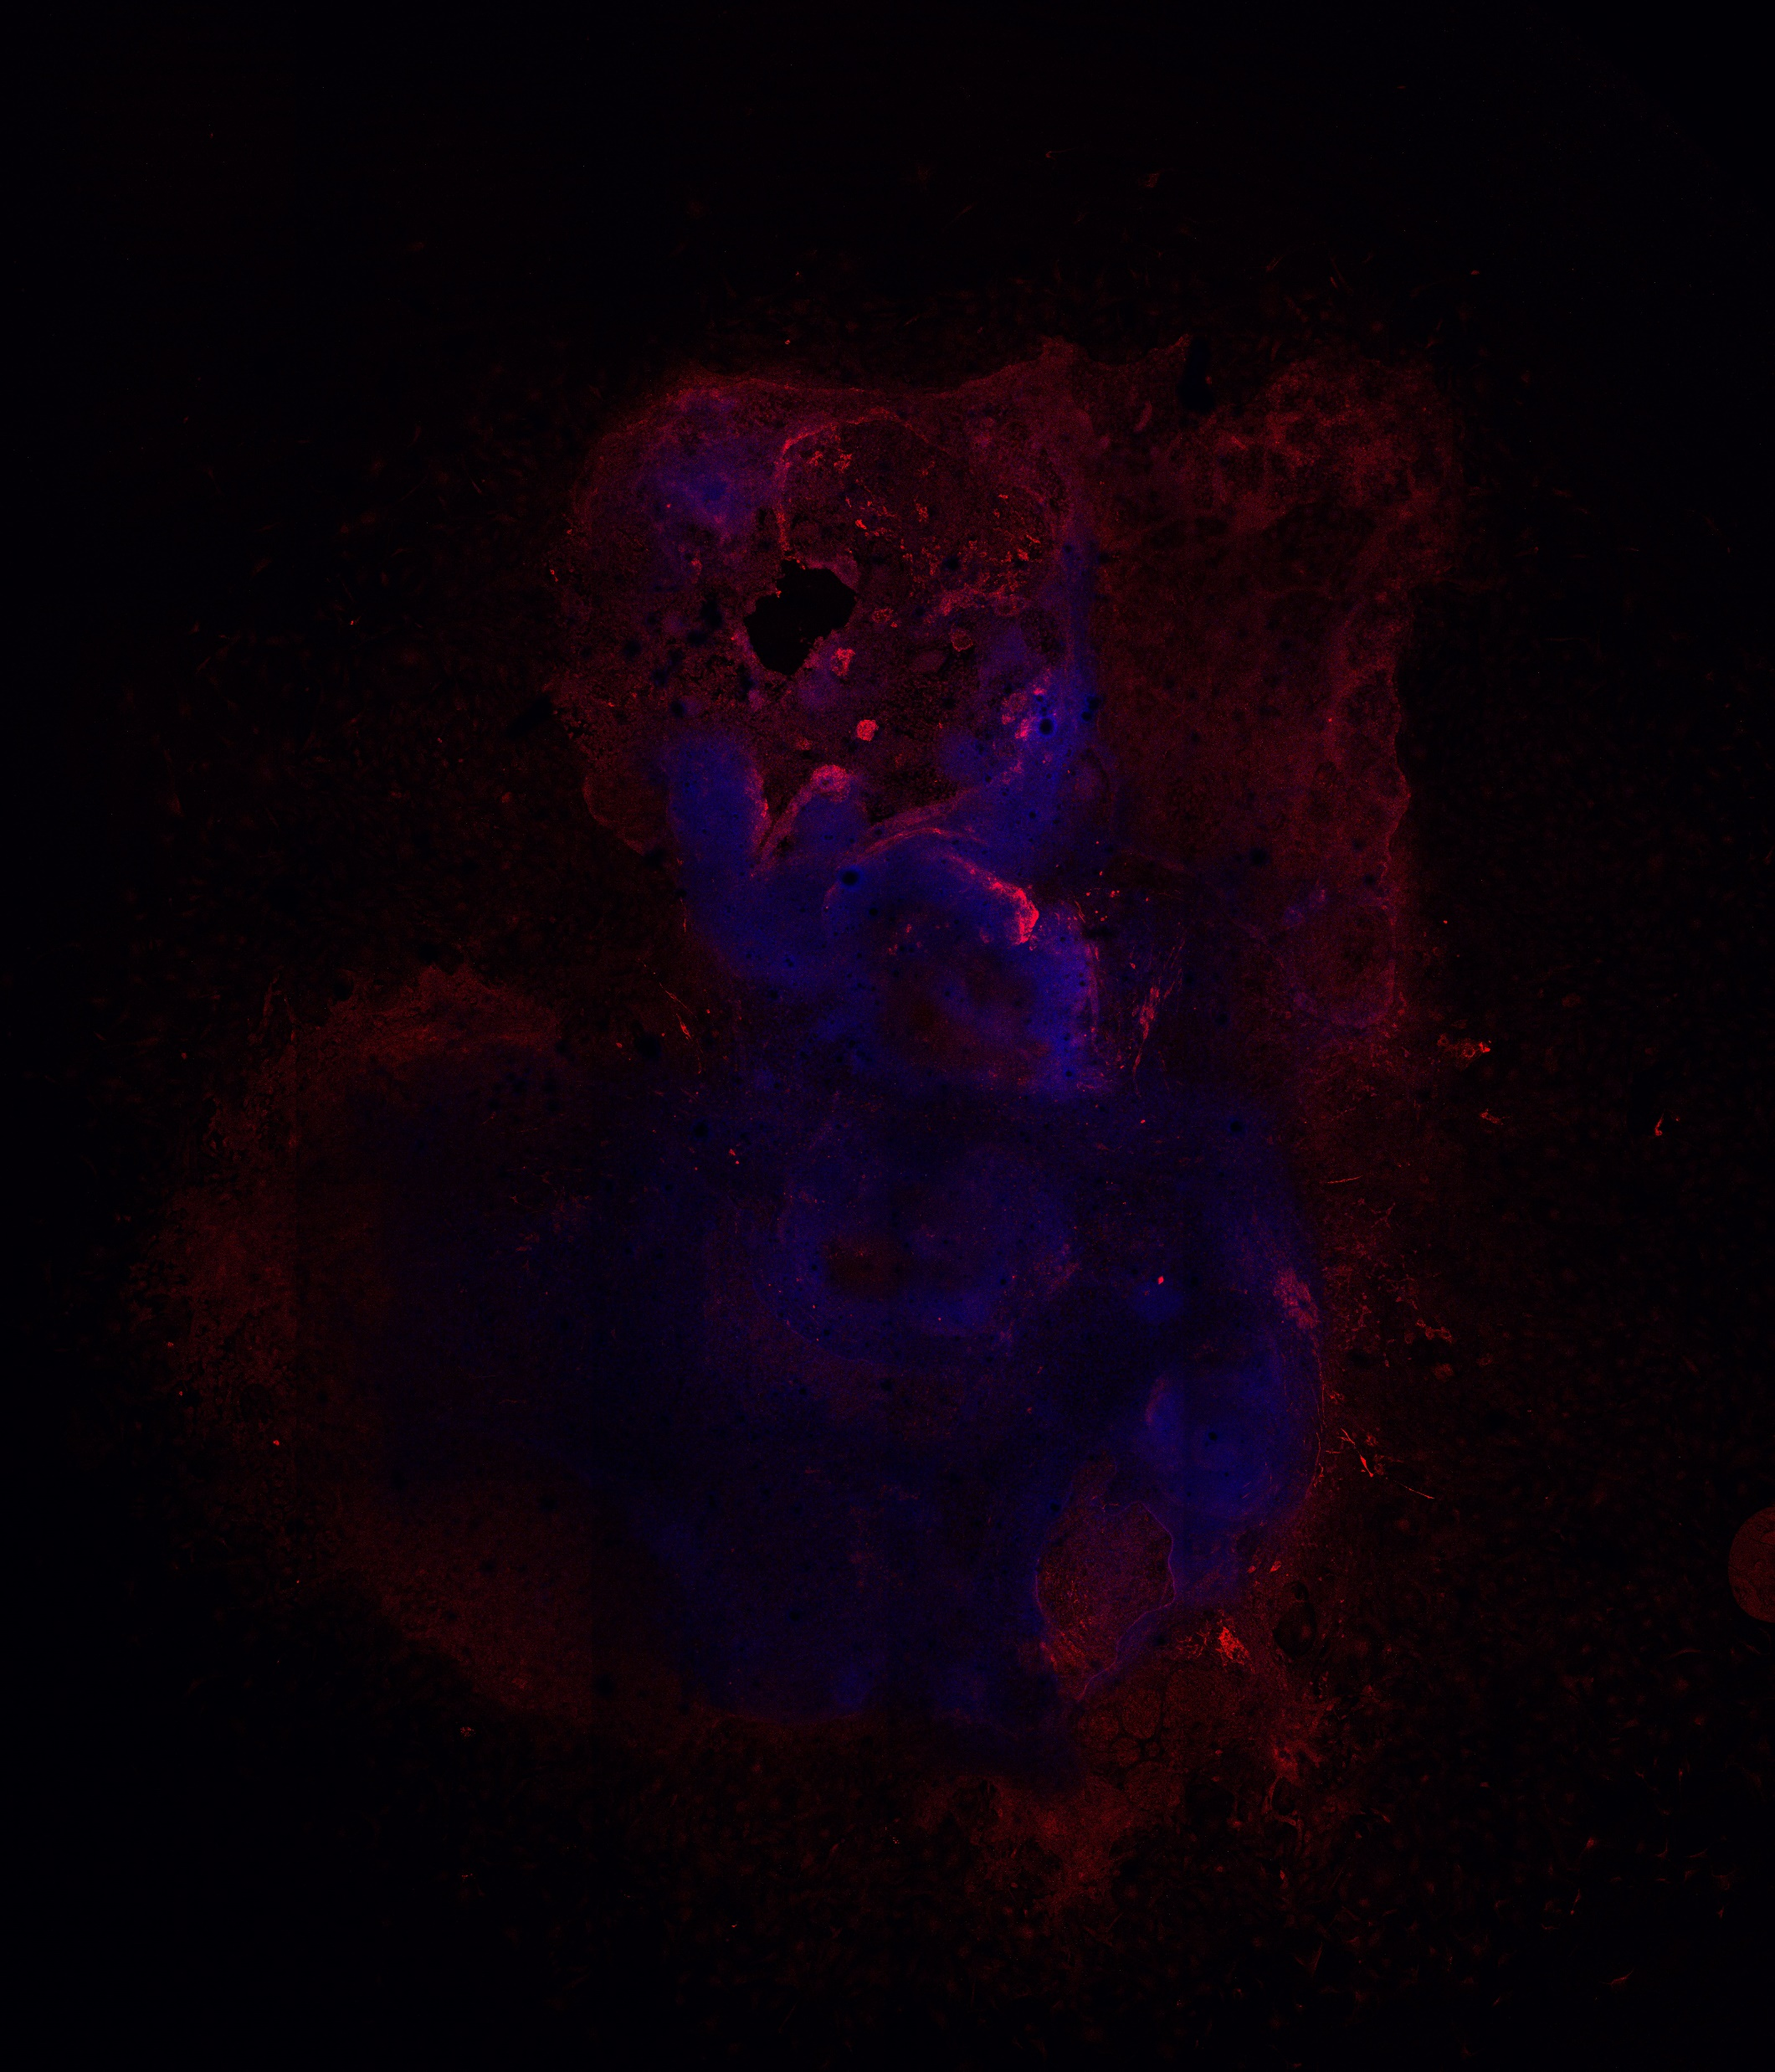
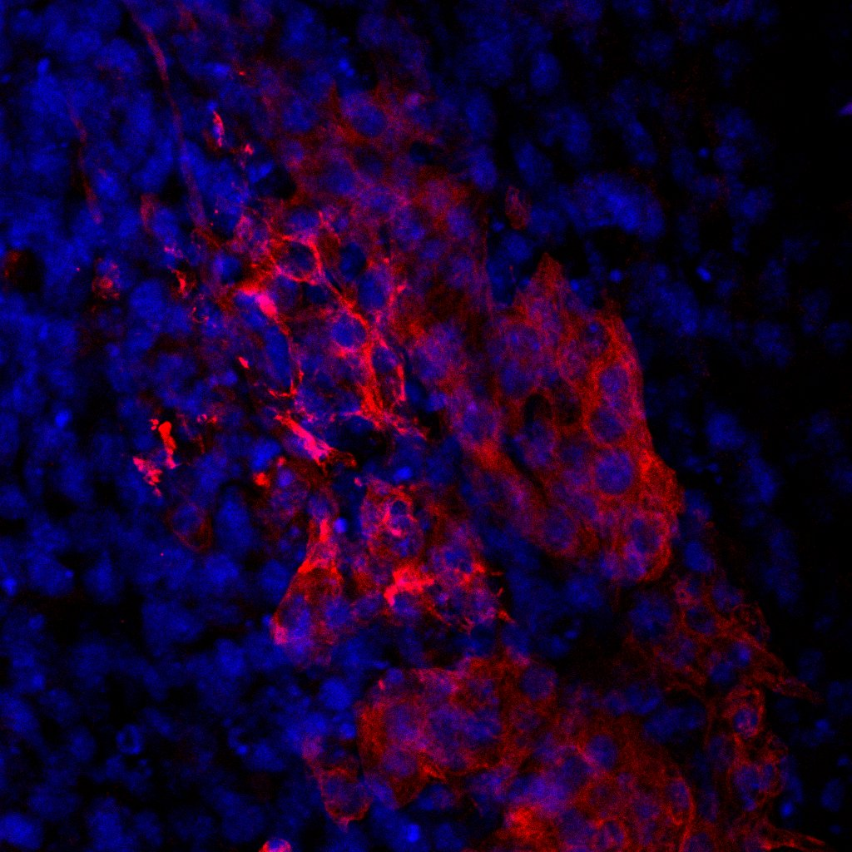
Additional figure 1 B. Whole embryoid body staining. The embryoid body was stained on day 20 with DAPI (blue) and MHC (red). The embryoid body of DUSP7 KOa cells is shown. Scale bar 200μm. The inset of the magnified section is shown in a yellow rectangle. Scale bar 50μm

Slide 3
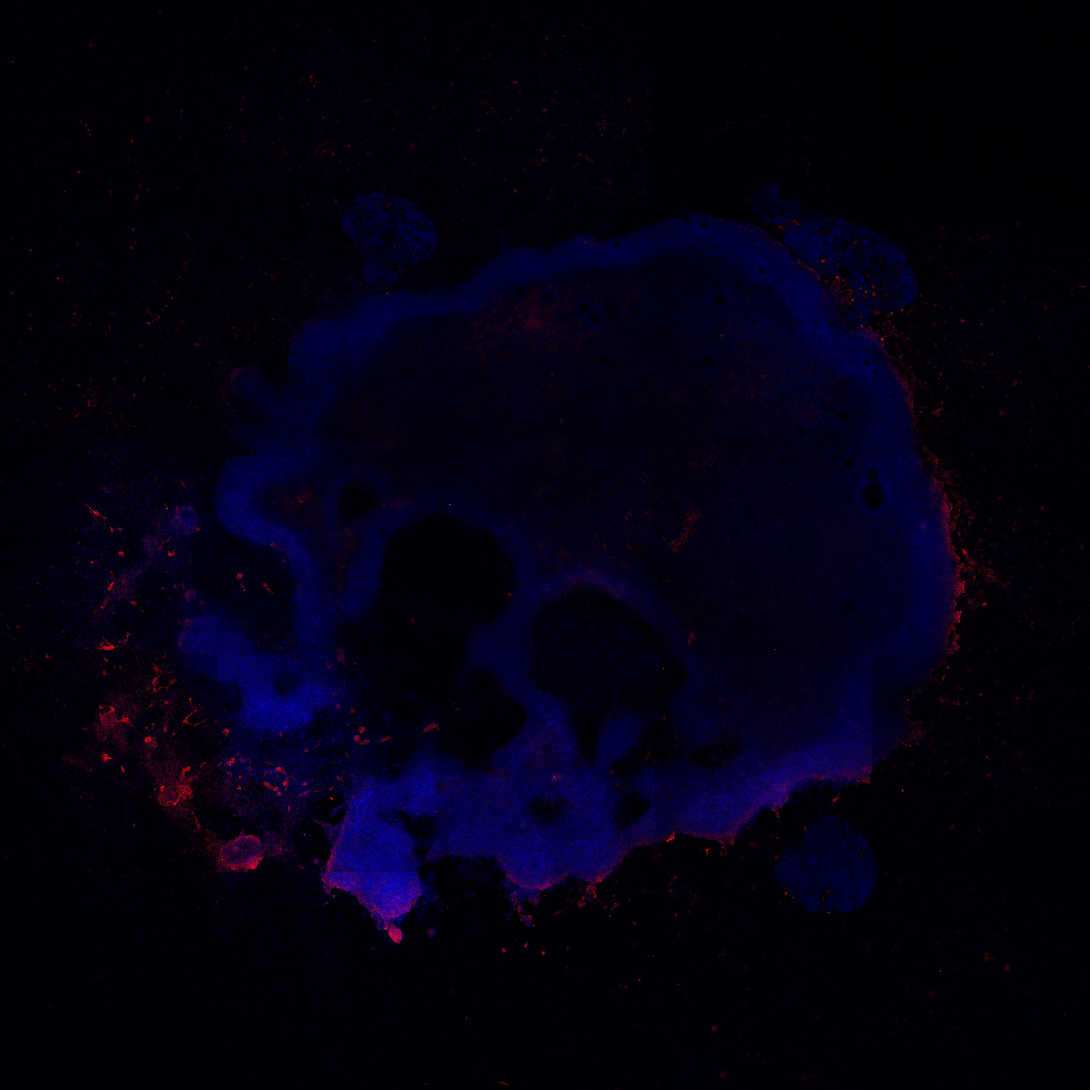
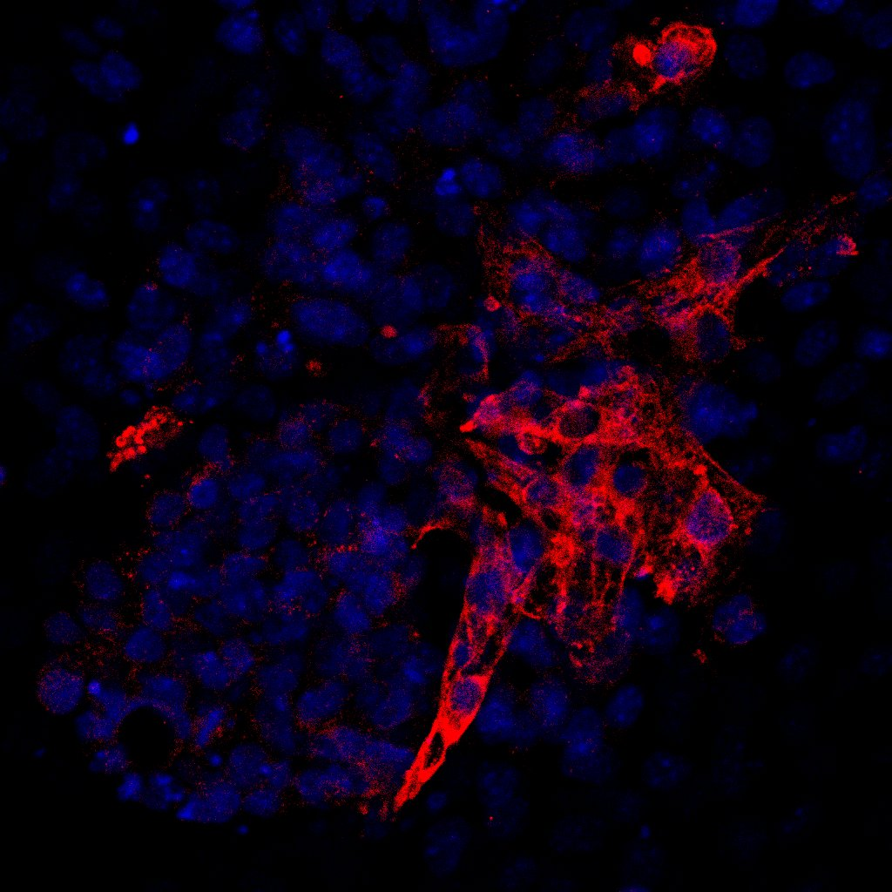
Additional figure 1 C. Whole embryoid body staining. The embryoid body was stained on day 20 with DAPI (blue) and MHC (red). The embryoid body of DUSP7 KOb cells is shown. Scale bar 200μm. The inset of magnified section is shown in a yellow rectangle. Scale bar 50μm

Slide 4
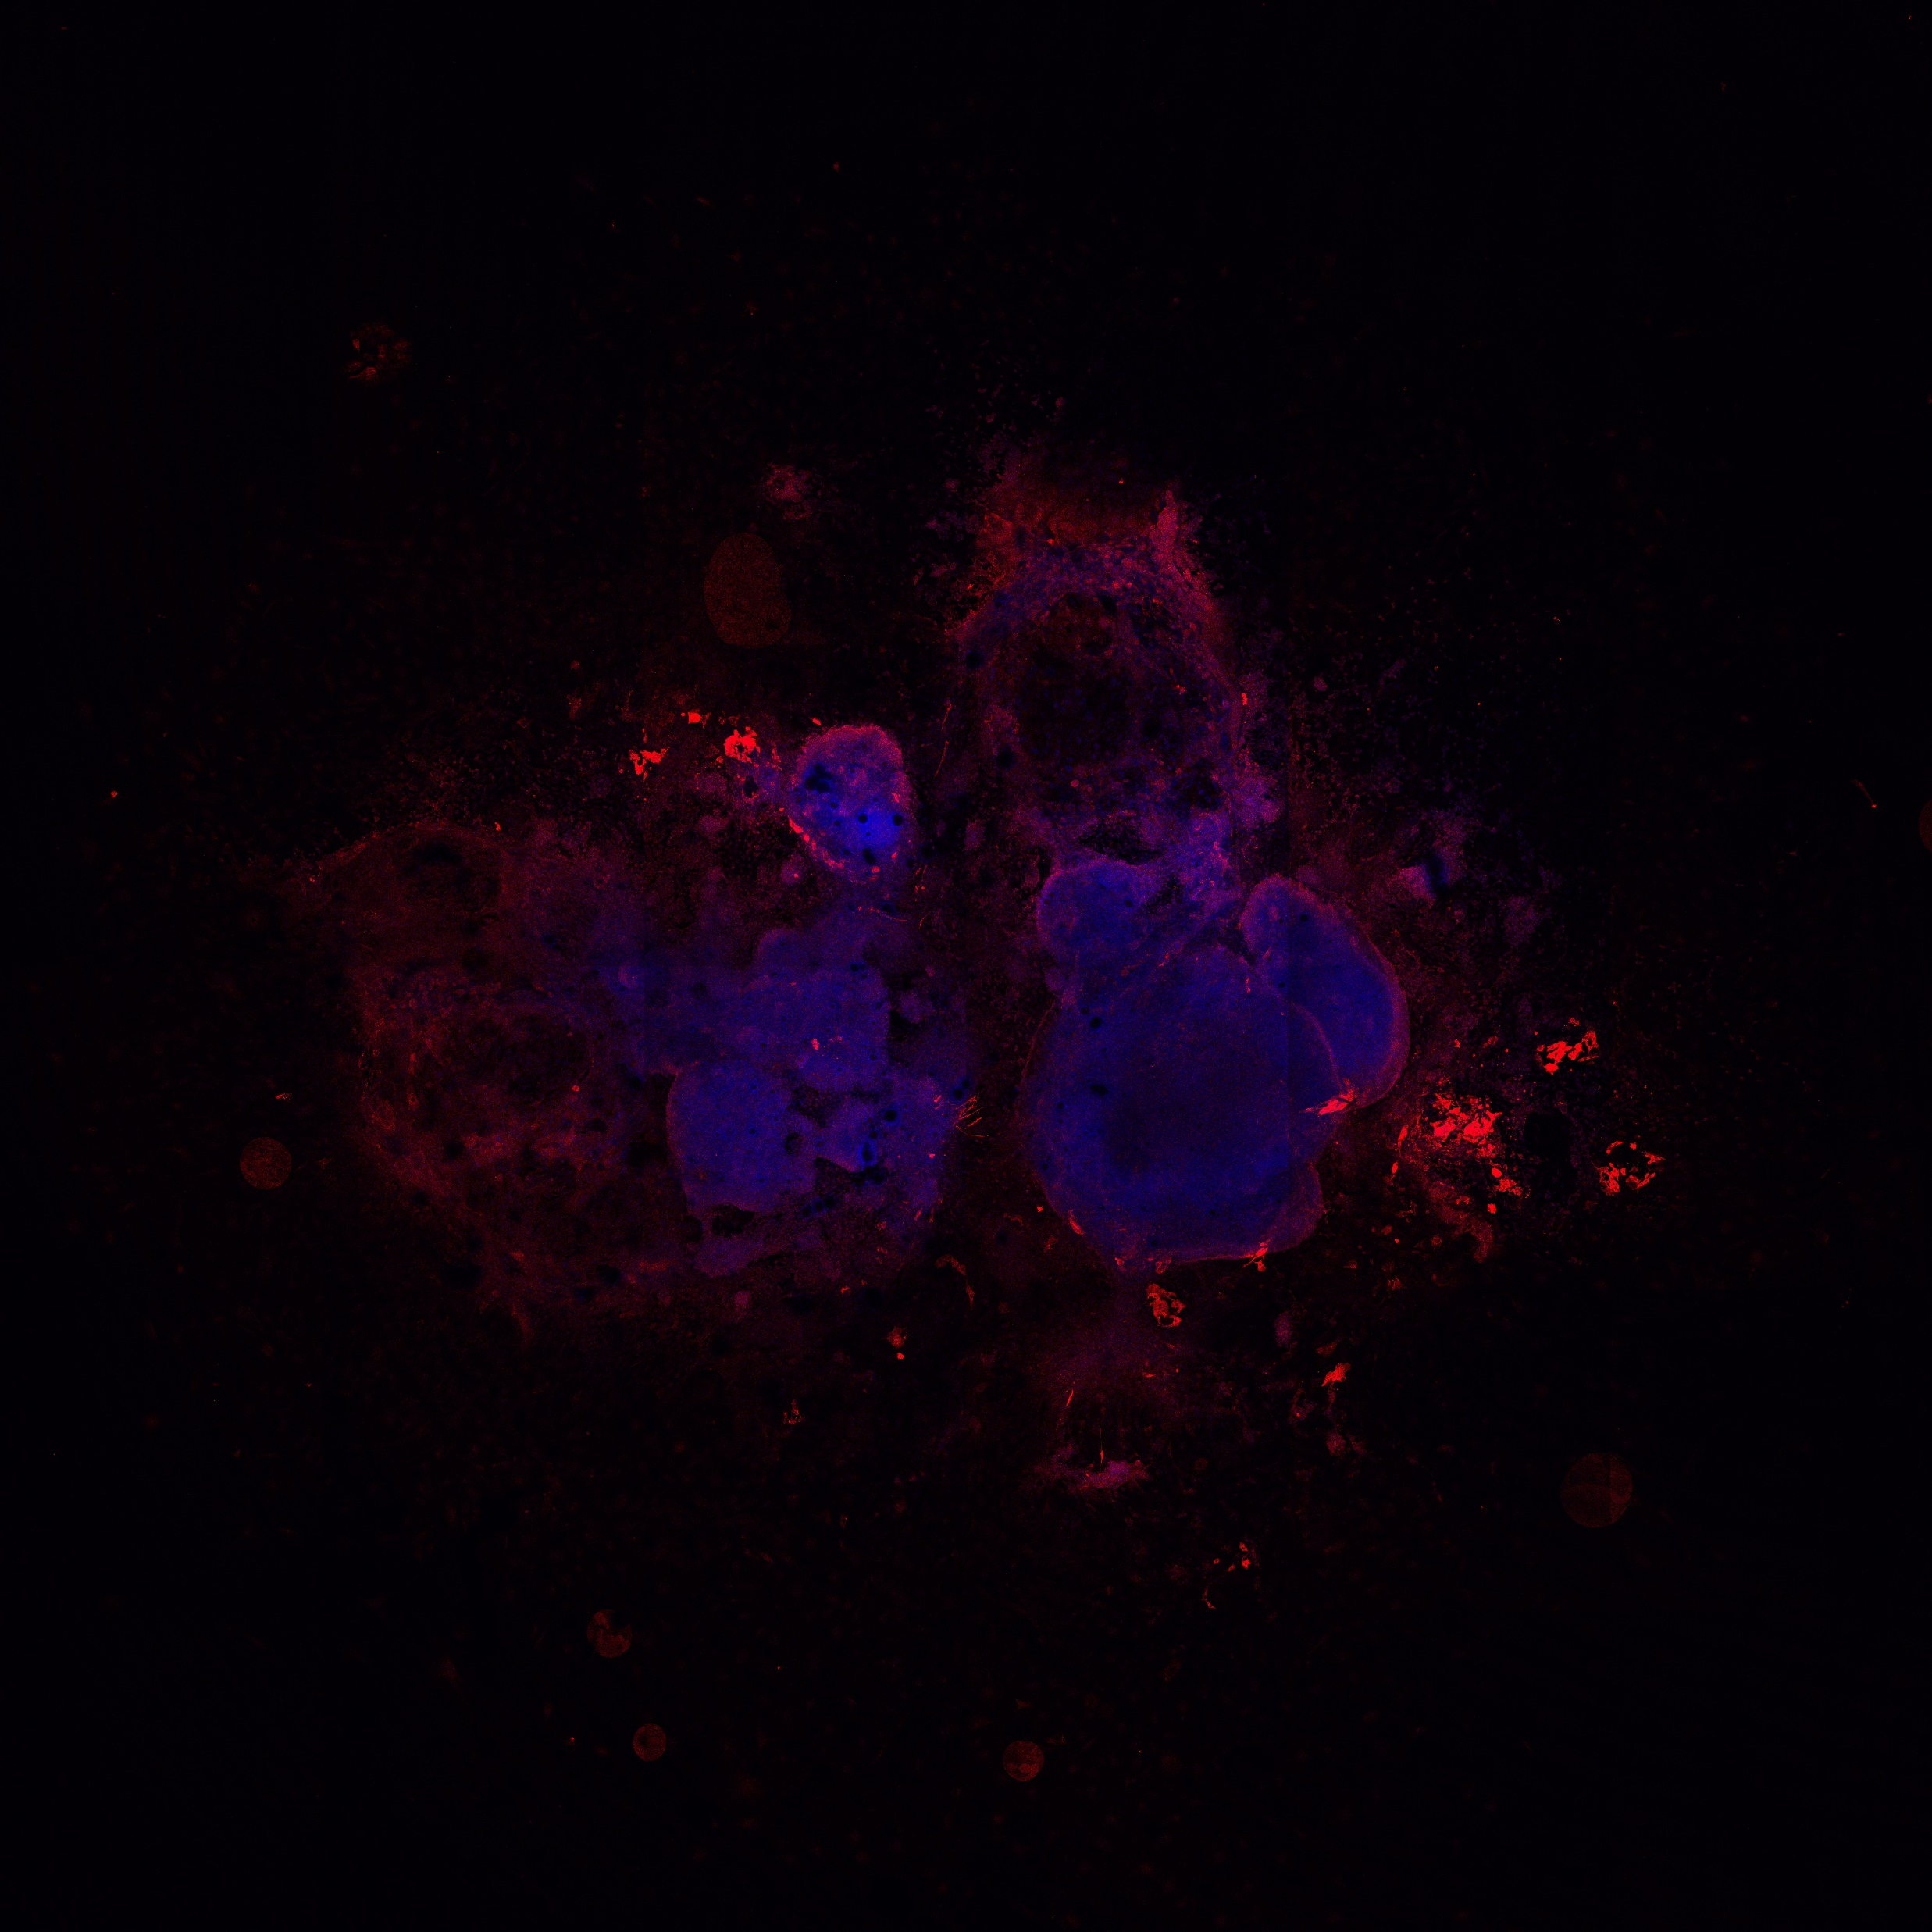
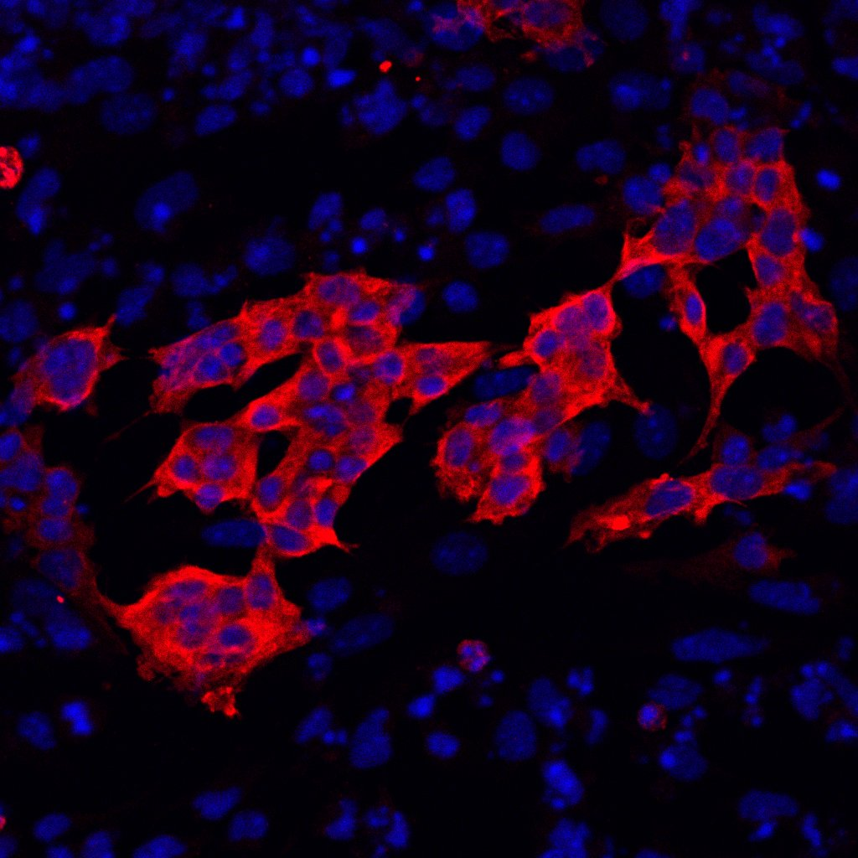
Additional figure 1 D. Whole embryoid body staining. The embryoid body was stained on day 20 with DAPI (blue) and MHC (red). The embryoid body of DUSP7 KOc cells is shown. Scale bar 200μm. The inset of magnified section is shown in a yellow rectangle. Scale bar 50μm

Slide 5
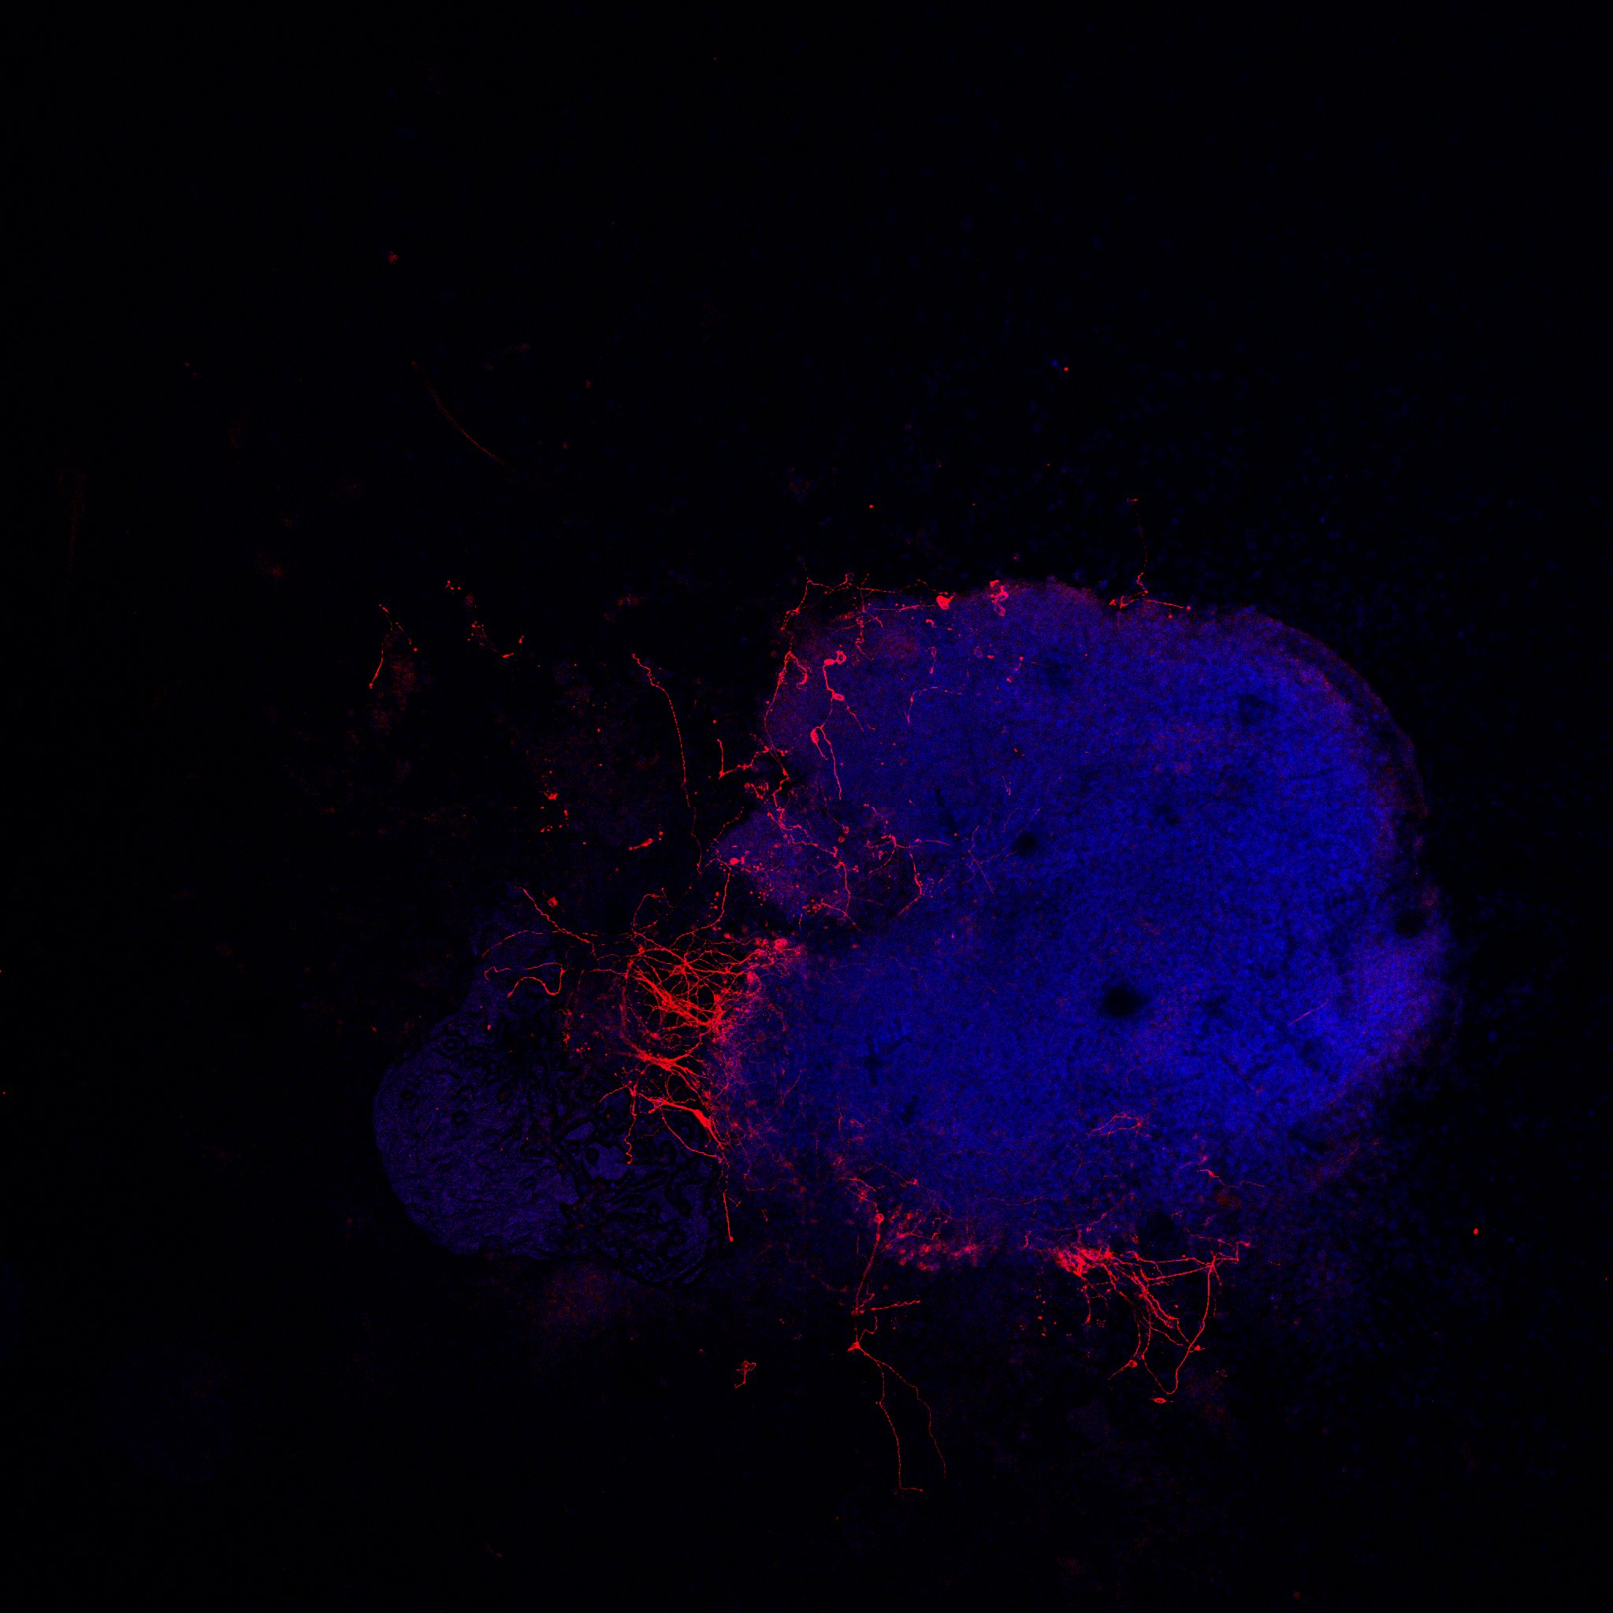
Additional figure 2 A. Whole embryoid body staining. The embryoid body was stained on day 20 with DAPI (blue) and βIIItubulin (red). The embryoid body of WT cells is shown. Scale bar 200μm

Slide 6
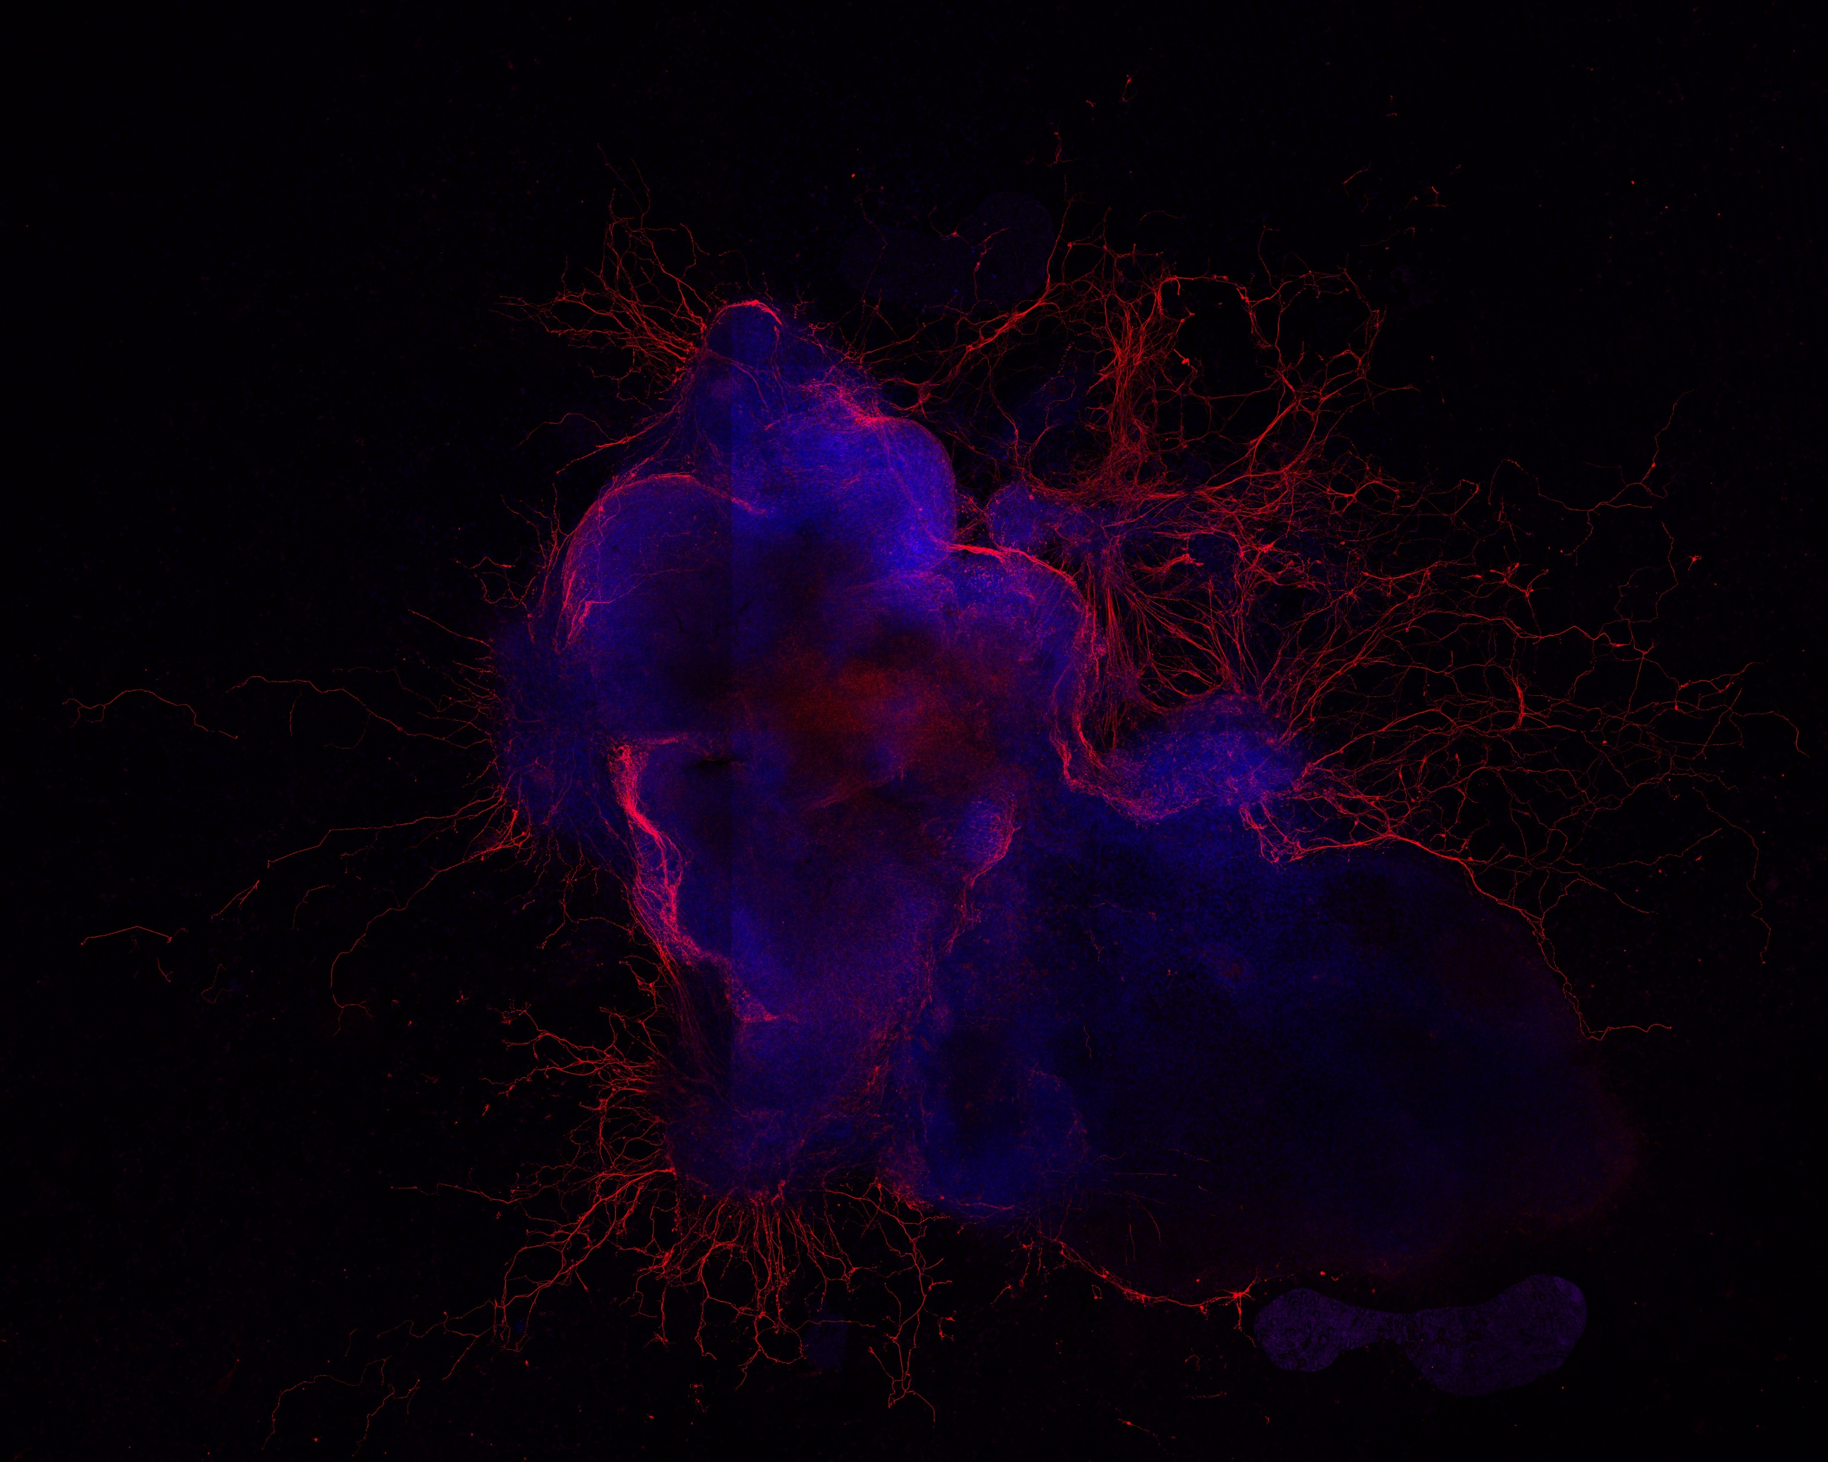
Additional figure 2 B. Whole embryoid body staining. The embryoid body was stained on day 20 with DAPI (blue) and βIIItubulin (red). The embryoid body of DUSP7 KOa cells is shown. Scale bar 200μm

Slide 7
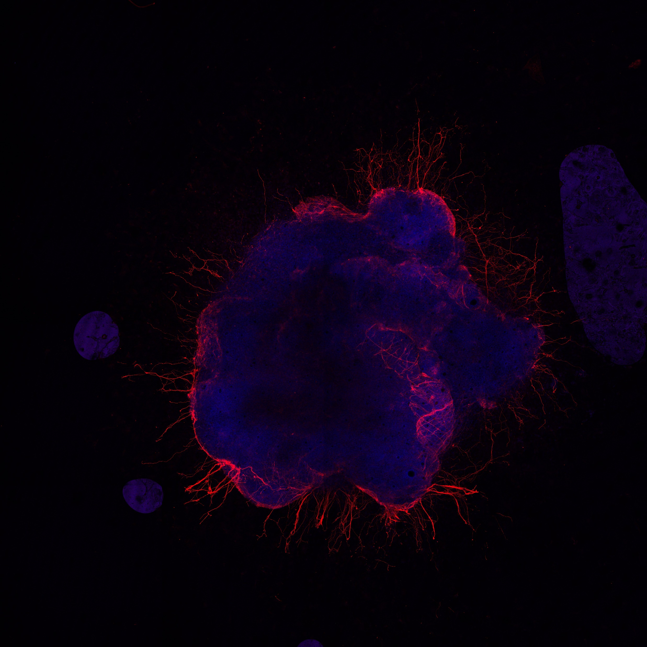
Additional figure 2 C. Whole embryoid body staining. The embryoid body was stained on day 20 with DAPI (blue) and βIIItubulin (red). The embryoid body of DUSP7 KOb cells is shown. Scale bar 200μm

Slide 8
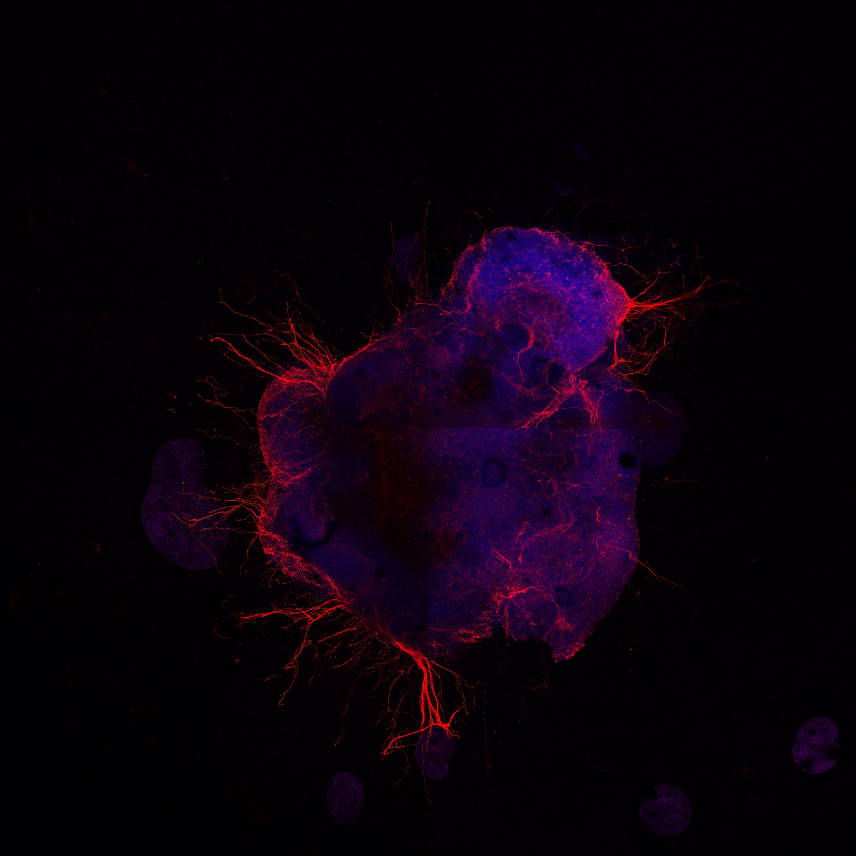
Additional figure 2 D. Whole embryoid body staining. The embryoid body was stained on day 20 with DAPI (blue) and βIIItubulin (red). The embryoid body of DUSP7 KOc cells is shown. Scale bar 200μm

Slide 9
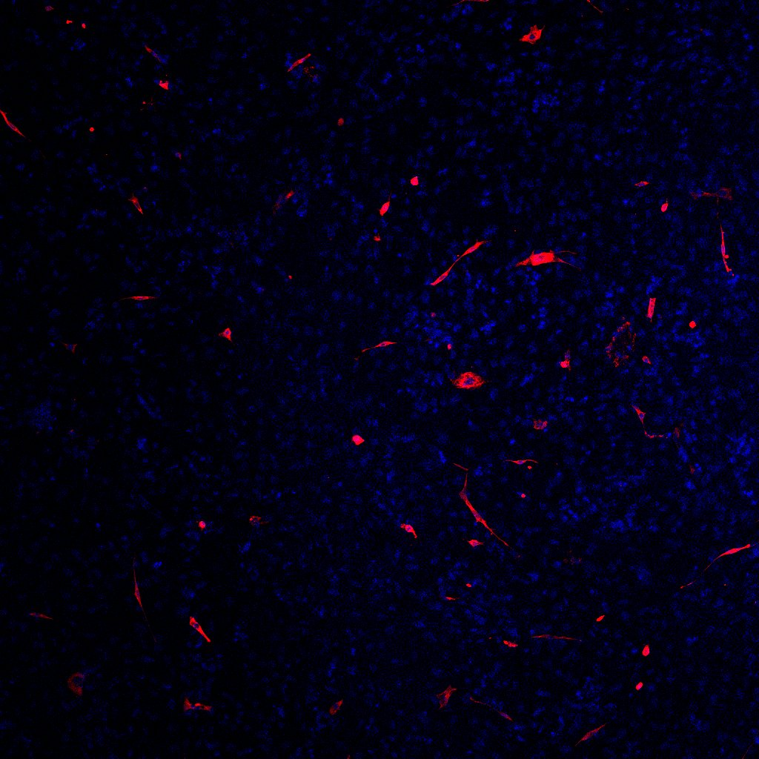
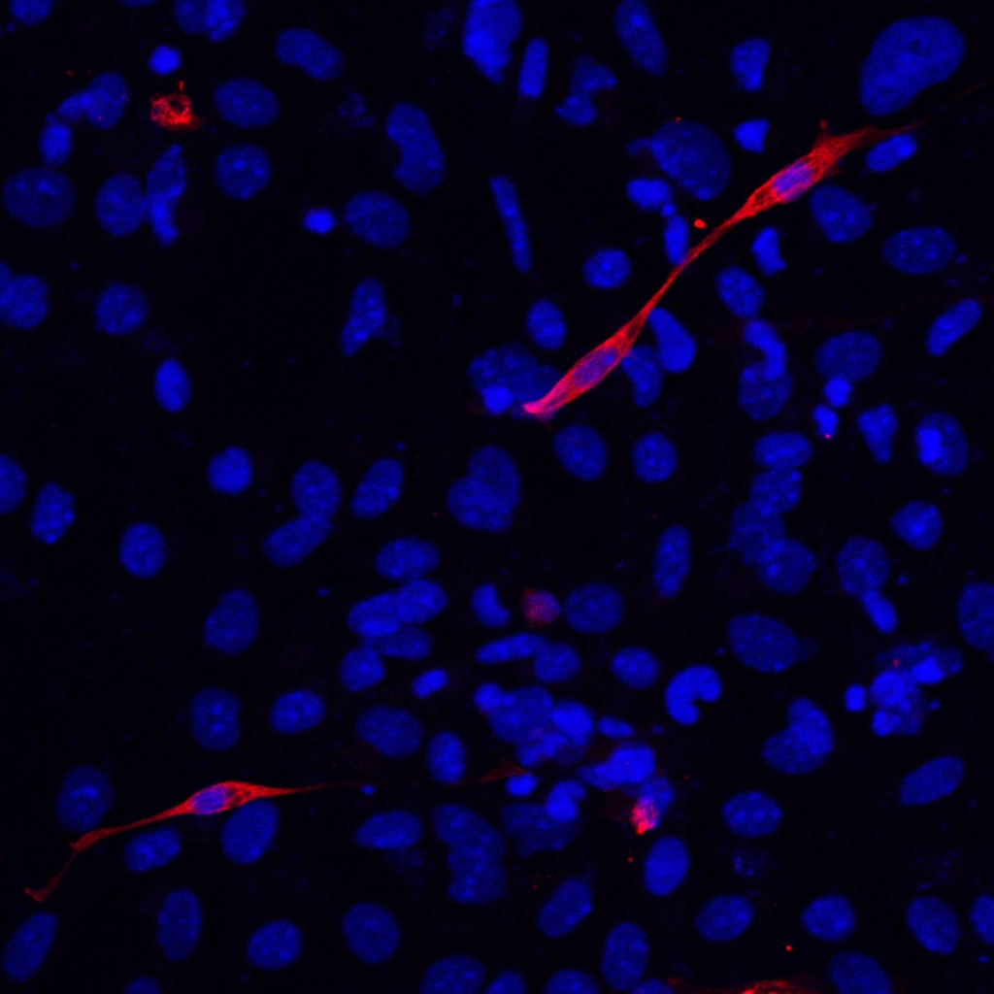
Additional figure 3 A. DUSP7 KO cells form fewer cardiomyocytes compared to wild type cells, as analyzed by immunocytochemistry. Cells were stained after a total of 21 days of differentiation. The nucleus is shown in blue (DAPI) and cardiomyocytes in red (MHC). WT cells are shown. Scale bar 100μm. The inset of magnified section is shown in yellow rectangle. Scale bar 50μm

Slide 10
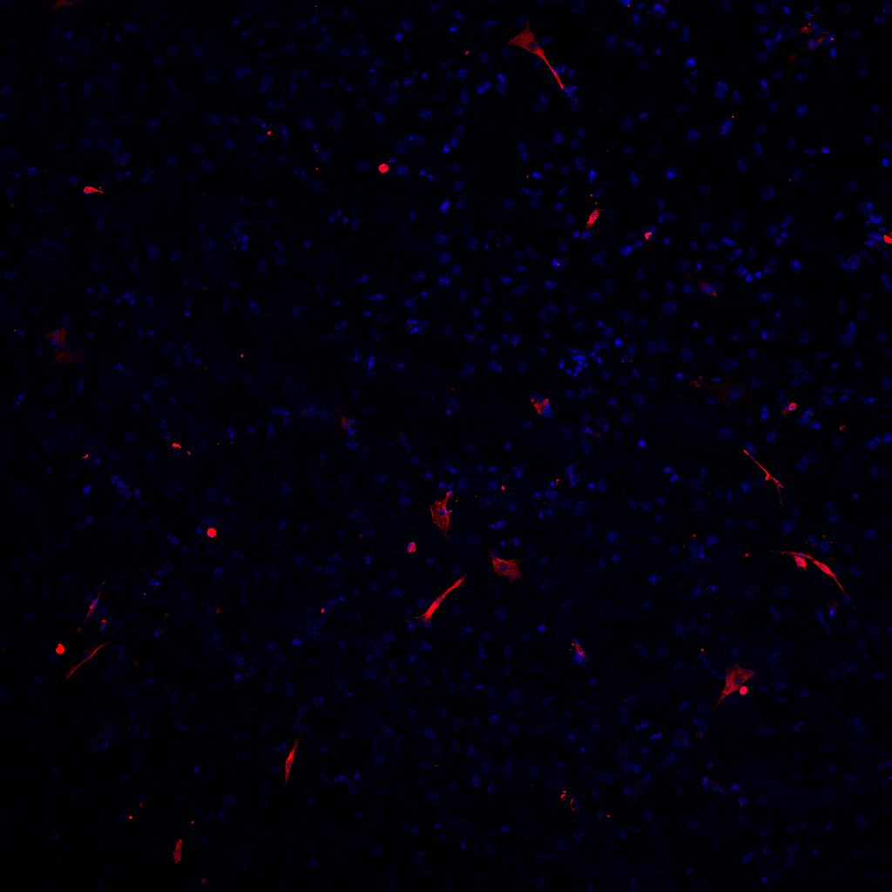
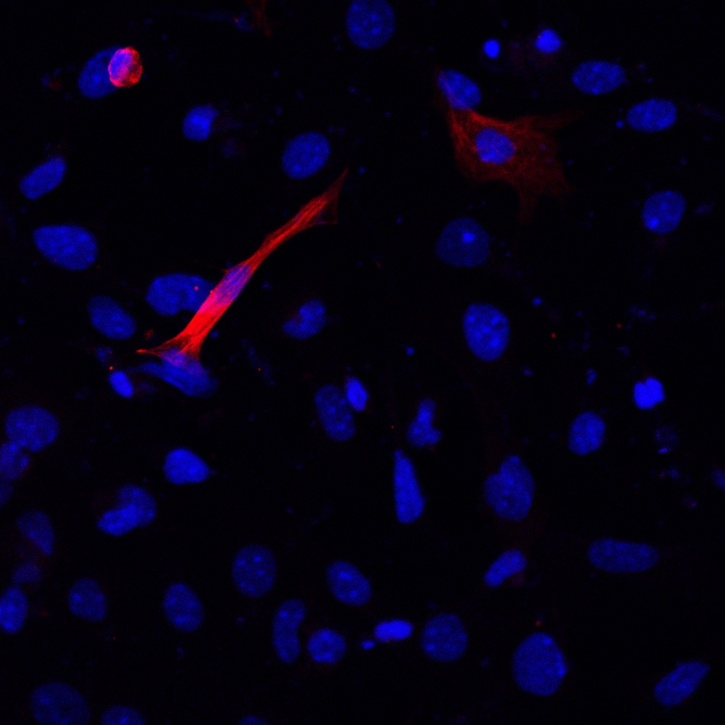
Additional figure 3 B. DUSP7 KO cells form fewer cardiomyocytes compared to wild type cells, as analyzed by immunocytochemistry. Cells were stained after a total of 21 days of differentiation. The nucleus is shown in blue (DAPI) and cardiomyocytes in red (MHC). DUSP7 KOa cells are shown. Scale bar 100μm. The inset of magnified section is shown in yellow rectangle. Scale bar 50μm

Slide 11
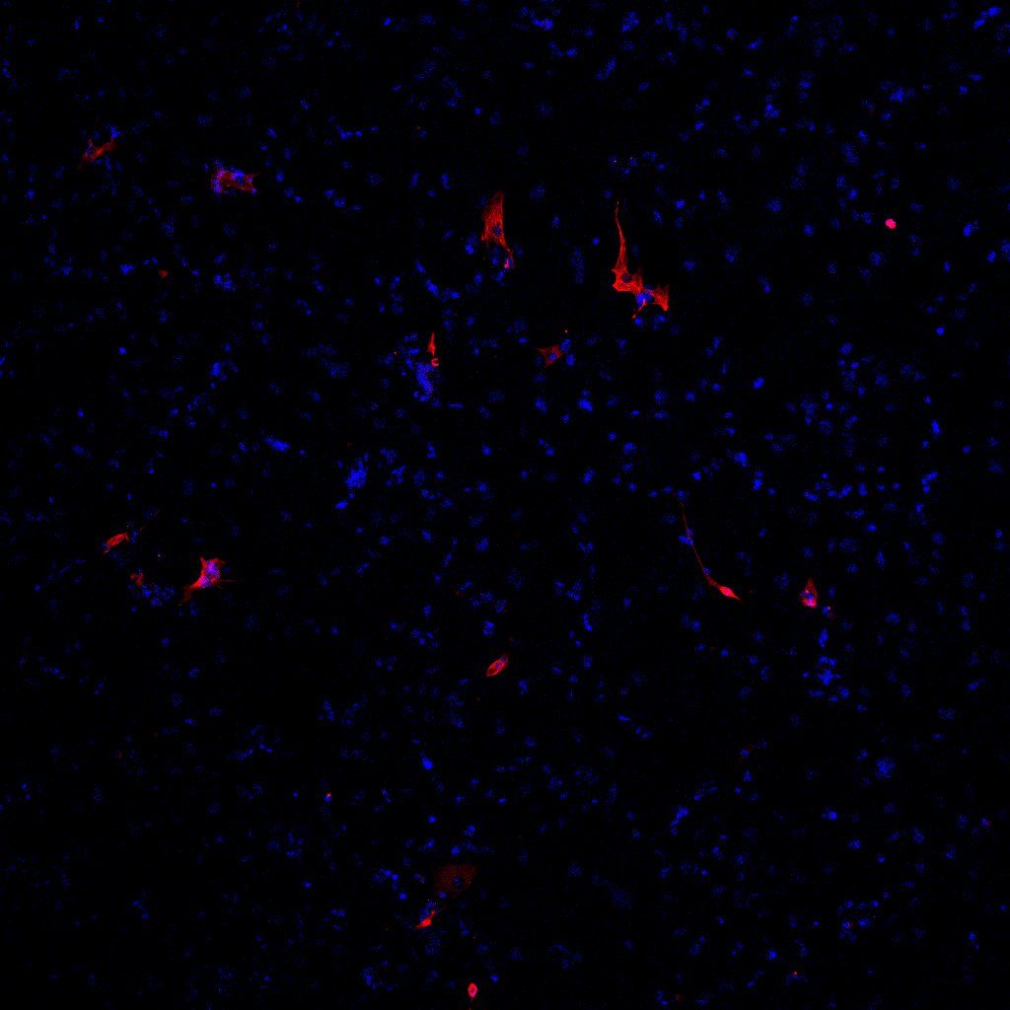
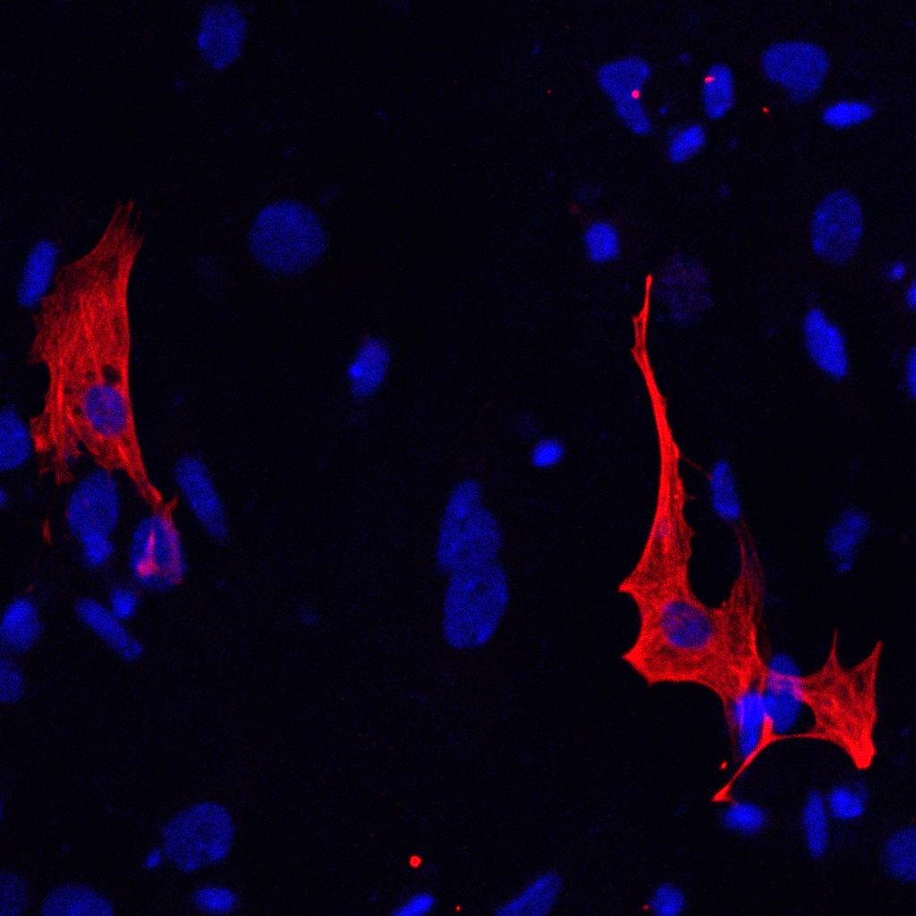
Additional figure 3 C. DUSP7 KO cells form fewer cardiomyocytes compared to wild type cells, as analyzed by immunocytochemistry. Cells were stained after a total of 21 days of differentiation. The nucleus is shown in blue (DAPI) and cardiomyocytes in red (MHC). DUSP7 KOb cells are shown. Scale bar 100μm. The inset of magnified section is shown in yellow rectangle. Scale bar 50μm

Slide 12
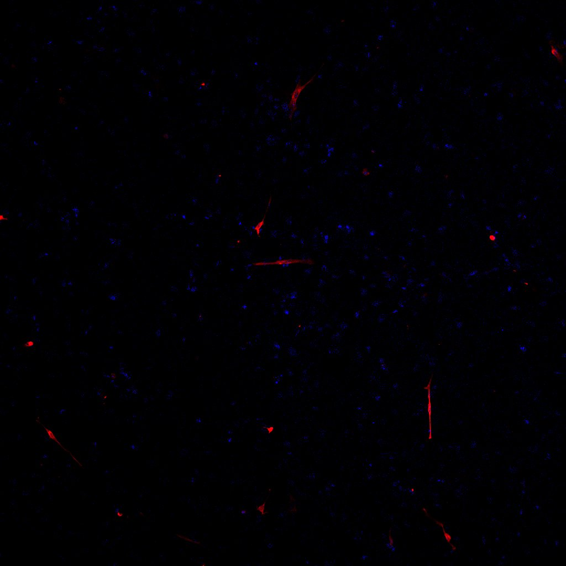
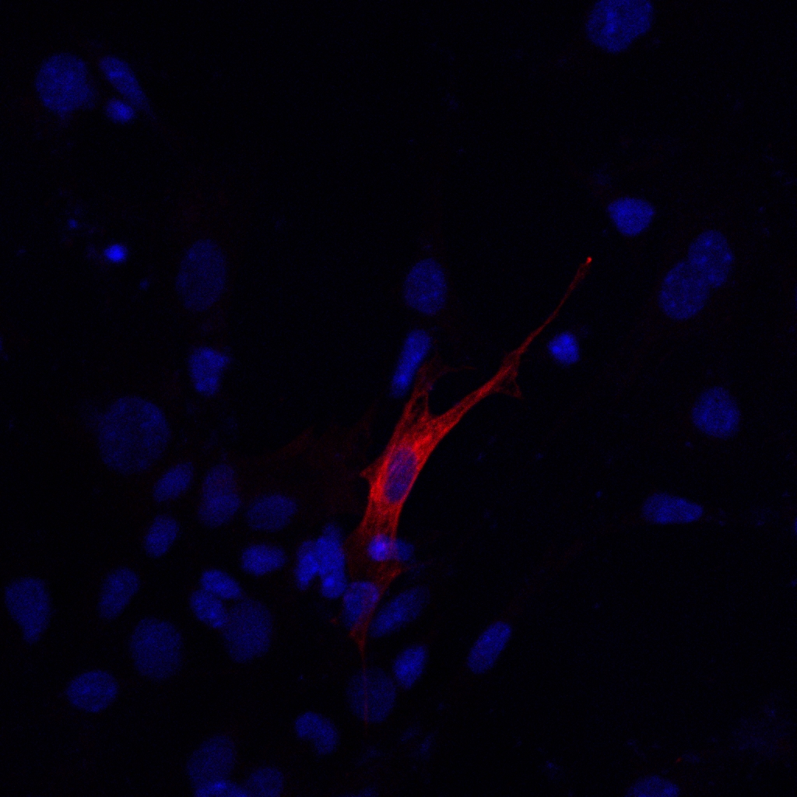
Additional figure 3 D. DUSP7 KO cells form fewer cardiomyocytes compared to wild type cells, as analyzed by immunocytochemistry. Cells were stained after a total of 21 days of differentiation. The nucleus is shown in blue (DAPI) and cardiomyocytes in red (MHC). DUSP7 KOc cells are shown. Scale bar 100μm. The inset of magnified section is shown in a yellow rectangle. Scale bar 50μm

Slide 13






DUSP7 KO
CTR
DUSP7 KO
CTR
DUSP7 KO
CTR
+
+
-
+
+
-
-
-
TPA
+
+
+
-
-
+
-
-
MHC
βIIItubulin
β-Actin
Additional figure 4. Addition of TPA increases the number of cardiomyocytes. Western blot analysis of cardiac (MHC) and neural (βIIItubulin) markers on cells that were treated with 12-O-Tetradecanoylphorbol-13-acetate (TPA, P1585, Sigma-Aldrich). TPA in a final concentration of 1μm was added on the 6th day of culture for 48h hours, after which cells were standardly cultivated. Cells were analyzed on day 20. Both WT and DUSP7 KO cells that were treated with TPA showed increased expression of cardiac marker MHC.

Slide 14
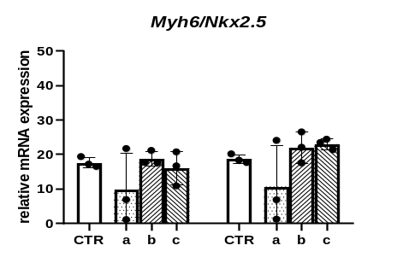
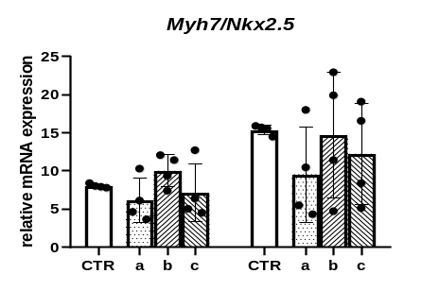
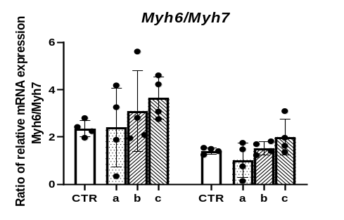
DUSP7 KO
DUSP7 KO
DUSP7 KO
DUSP7 KO
DUSP7 KO
DUSP7 KO
Day 14
Day 20
Day 14
Day 20
Day 14
Day 20
Additional figure 5. Cardiomyocytes derived from DUSP7 KO cells have the same maturity profile as cardiomyocytes from wt cells. A) Relative mRNA levels of Myh6 and Myh7 genes normalized to Nkx2.5. Cells were analyzed after 14 and 20 days of differentiation. Graphs represent mean ± SD, of three-four independent experiments. B) Ratio of relative mRNA expressions of Myh6 and Myh7 genes. Both genes were normalized to the average of Rpl and Hprt. Graphs represent mean ± SD, of four independent experiments.

Slide 15
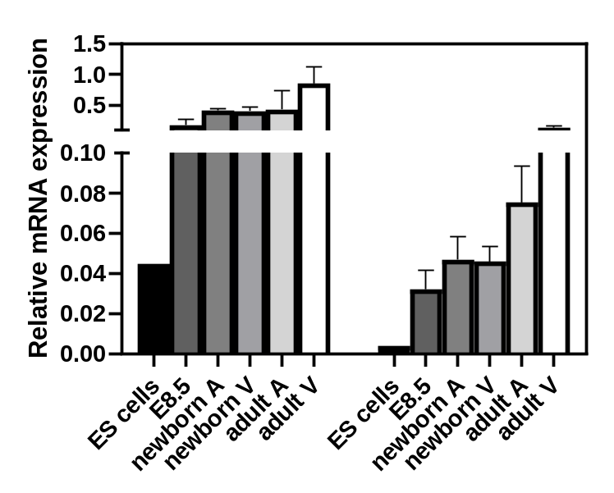
Dusp6
Dusp7
Additional figure 6. Expression of DUSP changes during development. Levels of Dusp6 and Dusp7 in ES cells and murine heart at different stages of its development analyzed by qPCR. Their levels have the same pattern in both atrium (A) and ventriculus (V) at each individual timepoint analyzed. The lowest expression is seen in ES cells and the highest in adult hearts for both analyzed DUSPs; however, the level of Dusp7 in ES cells and early stages of development is about 10x lower compared to Dusp6. Graph represents mean ± SD of three-four independent replicates for heart samples.

Slide 16

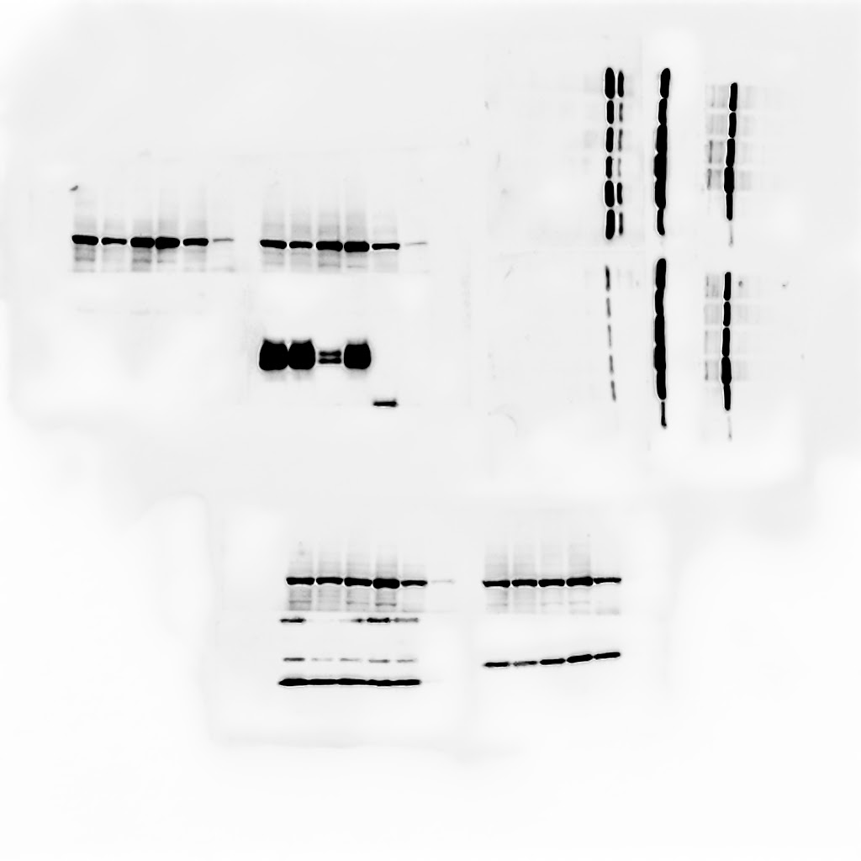


(A)
scr
siDUSP6
(B)
CTR
DUSP6 KO
(C)
DUSP6 KO
a
b
PARP
CTR
a
b
PARP
PARP
pERK1/2
DUSP6
pERK1/2
35kDa
DUSP6
ERK1/2
Additional figure 7. Difference in the phosphorylation of ERK1/2 by the downregulation of DUSP6. When siRNA for DUSP6 was used on mouse ES cells and phosphorylation was analyzed 24h after transfection, we observed a change in ERK1/2 phosphorylation. When we used ES KO cells for DUSP6, which were obtained using CRISPR/Cas9, we observed no change in the phosphorylation of ERK1/2. (A) Western blot analysis of phosphorylation status of ERK1/2 after DUSP6 was knocked-down using siRNA. (B) Western blot verification of DUSP6 KO mouse ES cell line. (C) Western blot analysis of phosphorylation status of ERK1/2 in DUSP6 KO mouse ES cell lines.

