Slide 1
1 2 3 4 13
5 6 7 8 14
Supplemental Fig. 2.

Slide 2
9 10 11 12 15
Supplemental Fig. 2.

Slide 3
17 18 20
Supplemental Fig. 2.

Slide 4
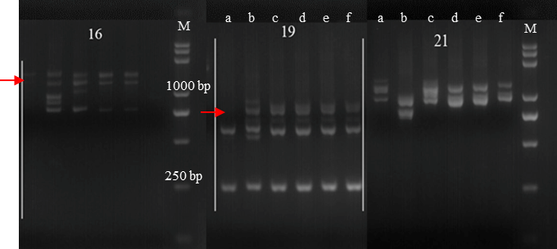
Supplemental Fig. 2.

Slide 5
1 2
Supplemental Fig. 3.

Slide 6
3 4 5 6 7
Supplemental Fig. 3.

Slide 7
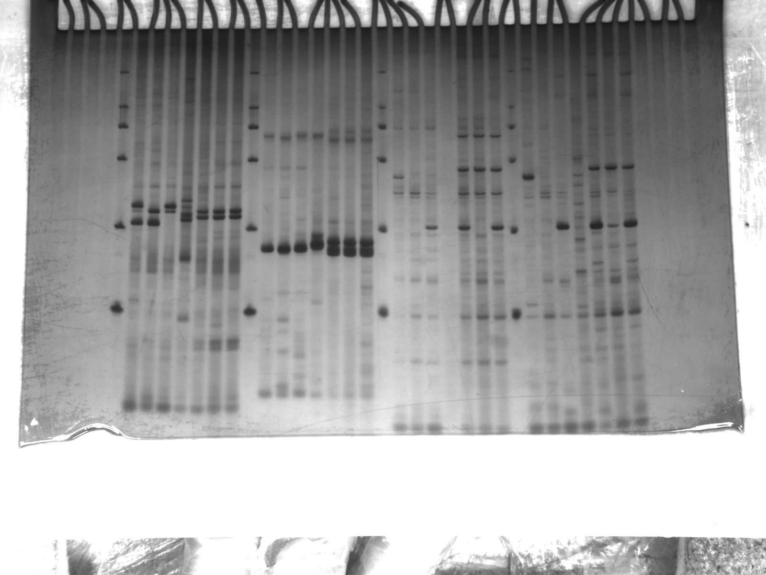
Xmag3124
Supplemental Fig. 4.

Slide 8
GPW7465
GPW4344
Supplemental Fig. 4.

Slide 9
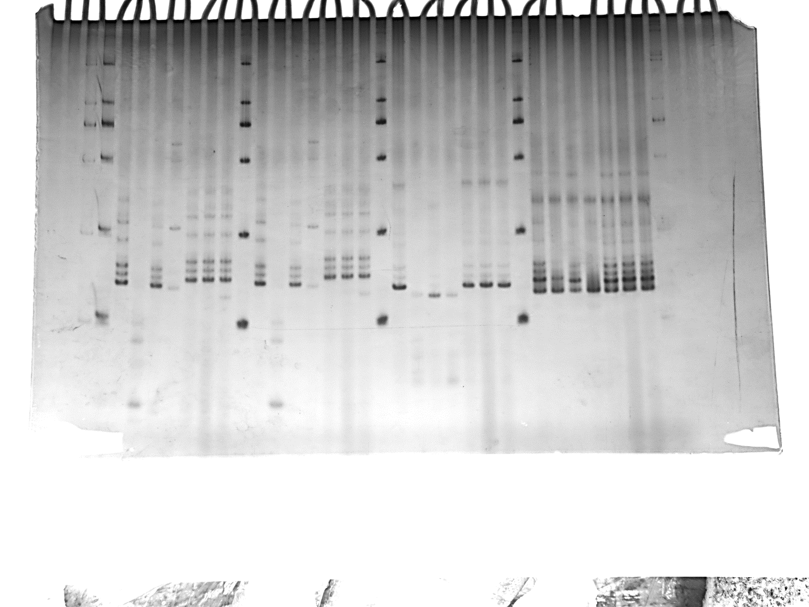
Xgwm219
Supplemental Fig. 4.

Slide 10
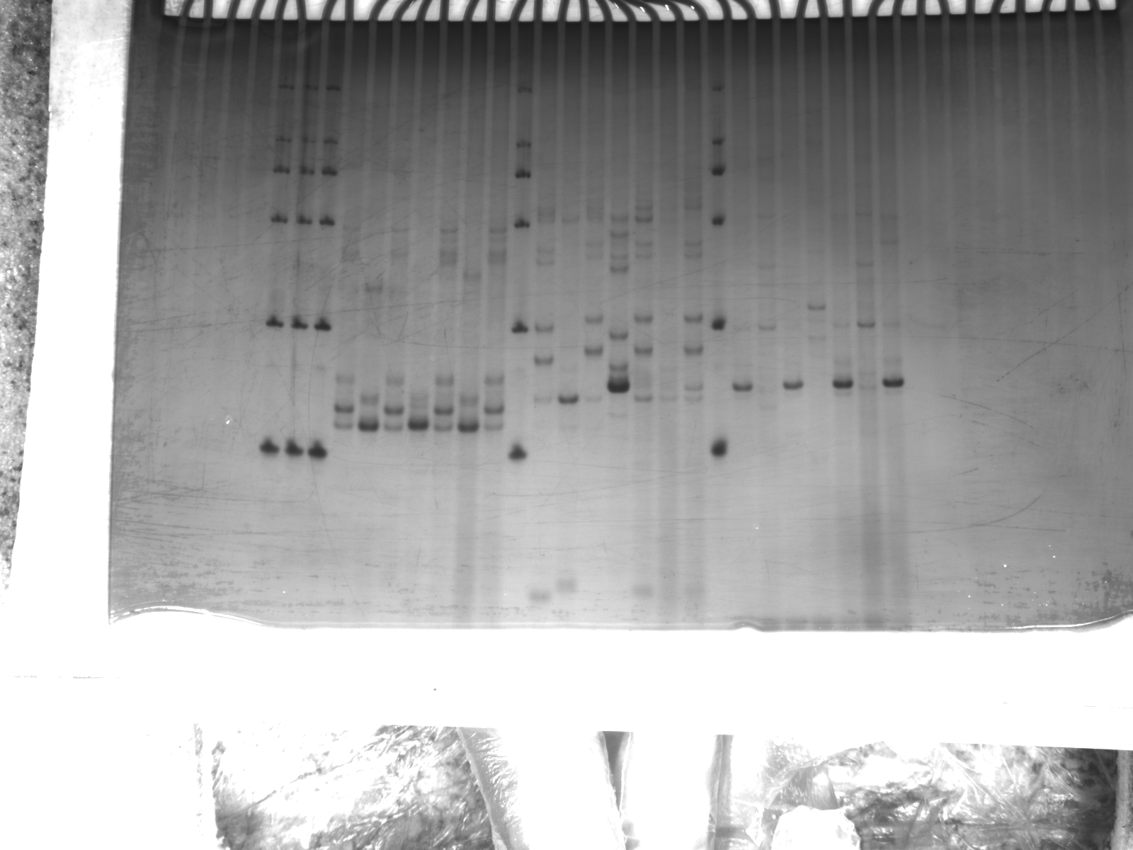
Wmc245
Xgdm35
Wmc245
Supplemental Fig. 4.

Slide 11
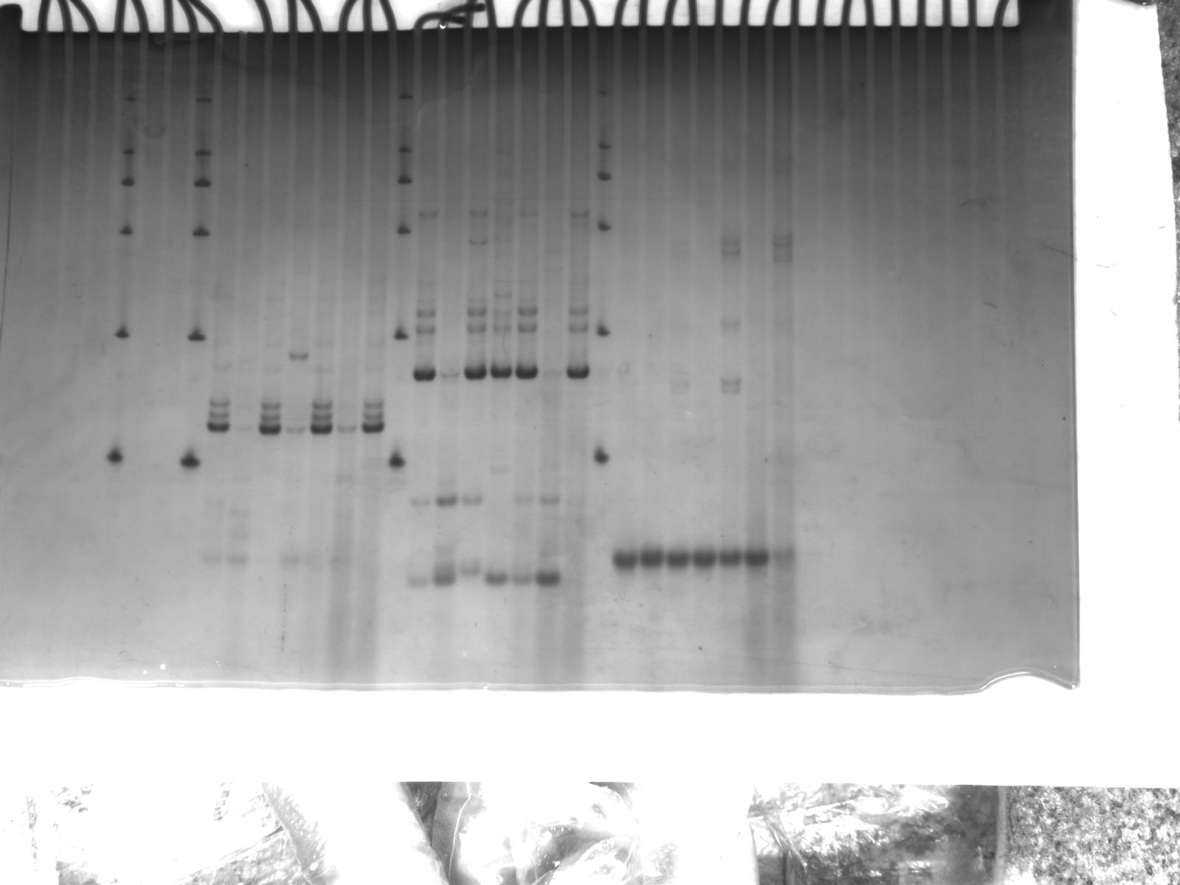
BARC095
Xgdm77
Supplemental Fig. 4.

Slide 12
Ppd-D1
Supplemental Fig. 4.

Slide 13
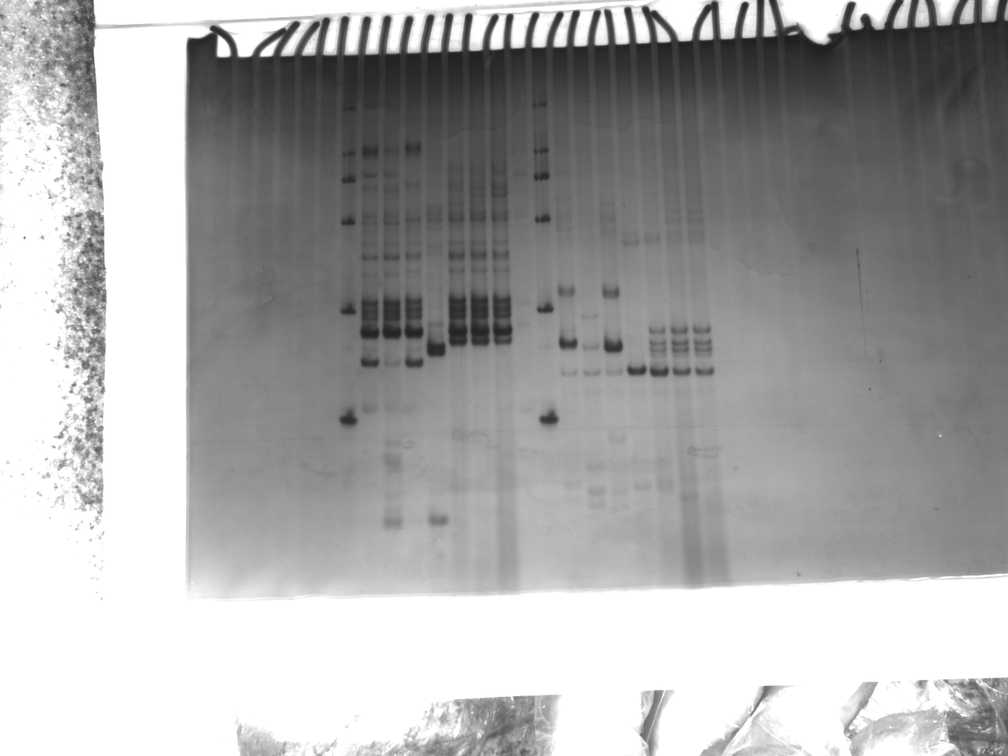
BARC053
BARC172
Supplemental Fig. 4.

