Slide 1
The Interplay Between Regular T Cells and Immunotherapy in Cervical Cancer
Fengying Xu^{1, †}, Fengying Zhang^{1, †}, Qian Wang², Ying Xu³, Shuifang Xu¹, Caihong Zhang¹, Lihua Wang^{4*}
Department of Gynaecology and Obstetrics, Jinshan District Tinglin Hospital, Shanghai, 100191, China.
Department of Pathology, Jinshan District Tinglin Hospital, Shanghai, 100191, China.
Department of Gastroenterology, Jinshan District Tinglin Hospital, Shanghai. Shanghai, 100191, China.
International Peace Maternity & Child Health Hospital, Shanghai JiaoTong University School of Medicine Department of Gynecologic Oncology, Shanghai, 200025, China.
*Correspondence author: Li-hua Wang, International Peace Maternity & Child Health Hospital, Shanghai JiaoTong University School of Medicine Department of Gynecologic Oncology. Address: 910 Hengshan Road, Xuhui District, Shanghai, 200030 China. Phone: 86-21-64070434; E-mail: drwanglh0420@163.com.
† These authors contributed equally to this work.

Slide 2
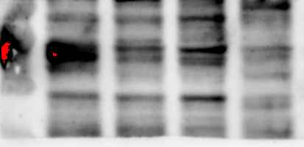
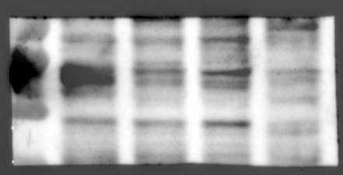

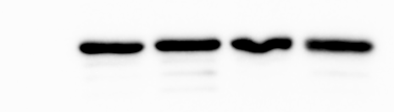
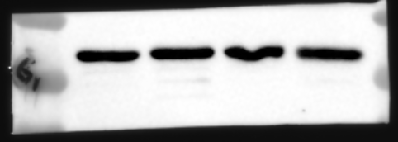
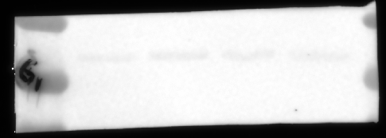
A
marker
A2058
Hela
MCF-7
THP1
marker
A2058
Hela
MCF-7
THP1
PD-L1≈ 40kd
blot
merge
55
PD-L1≈ 40kd
43
34
Color
marker
A2058
Hela
MCF-7
THP1
blot
marker
A2058
Hela
MCF-7
THP1
GAPDH≈ 36kd
merge
43
34
Color
26

Slide 3
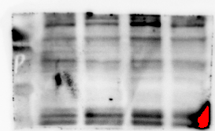
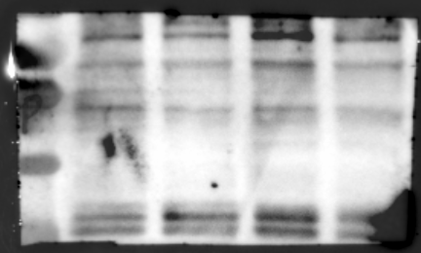

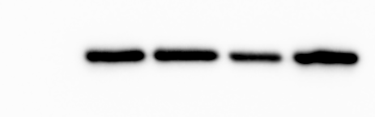
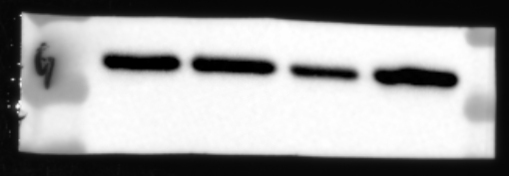
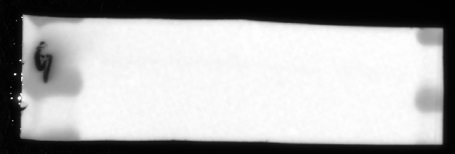
B
marker
B16F10
H22
Lewis
U14
marker
B16F10
H22
Lewis
U14
blot
PD-L1≈ 40kd
merge
55
PD-L1≈ 40kd
43
34
Color
marker
B16F10
H22
Lewis
U14
marker
B16F10
H22
Lewis
U14
GAPDH≈ 36kd
blot
merge
43
34
Color
26

Slide 4
Figure S1. The uncropped blot for the cropped band of western blot in figure 2.
The uncropped blot for figure 2B.
The uncropped blot for figure 2D.

Slide 5
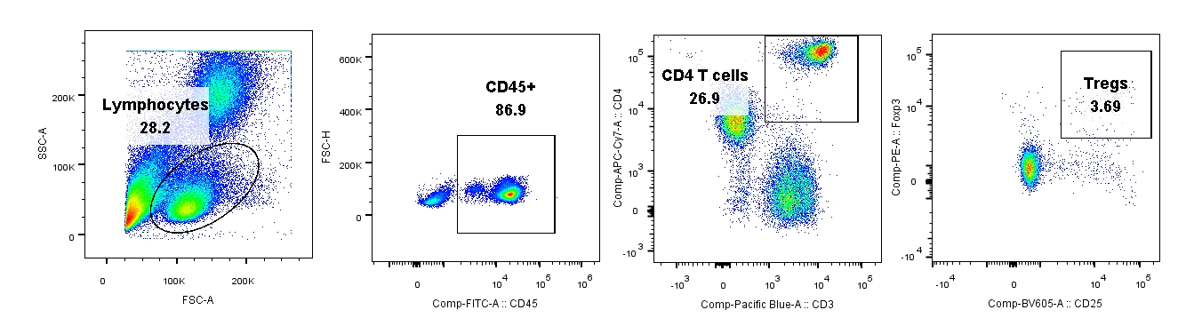
Supplementary data.
A
Tumor challenge (U14 cell 3 x 10⁶/mice)
0
5
12
14
16
18
20
B
PBS or Anti-PD-1 or Anti-CD25 or Combination
Figure S2. The treatment schedule and Tregs analyses and isolation.
The anti-PD-L1 treatment schedule in syngeneic tumor mouse model. 3x106 U14 cervical cells was
subcutaneously injected on the flank of 7-weeks C57BL/6 mouse. PBS or Anti-PD-L1 or CD25 or combination was intraperitoneally injected in mouse seven days post tumor challenge.
B. The schematic diagram of flow cytometry for Tregs analysis and sorting.
A

