Slide 1
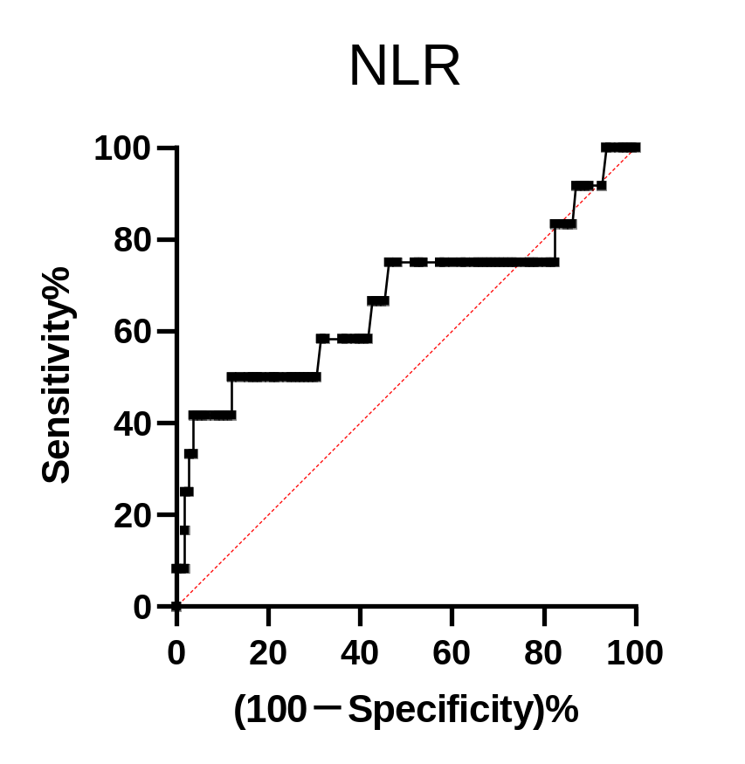
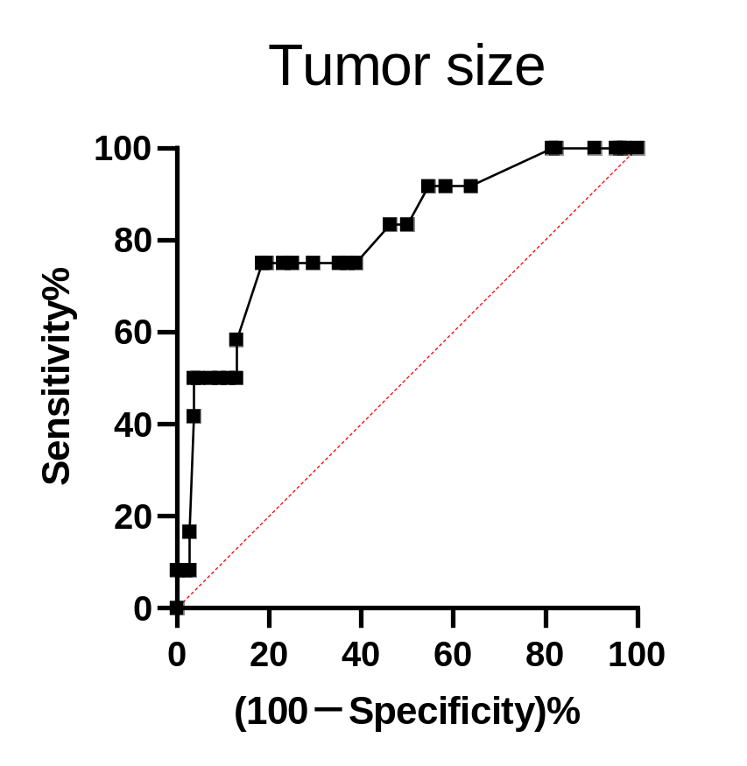
Additional file 1: Fig. S1.
(a)
(b)

Slide 2
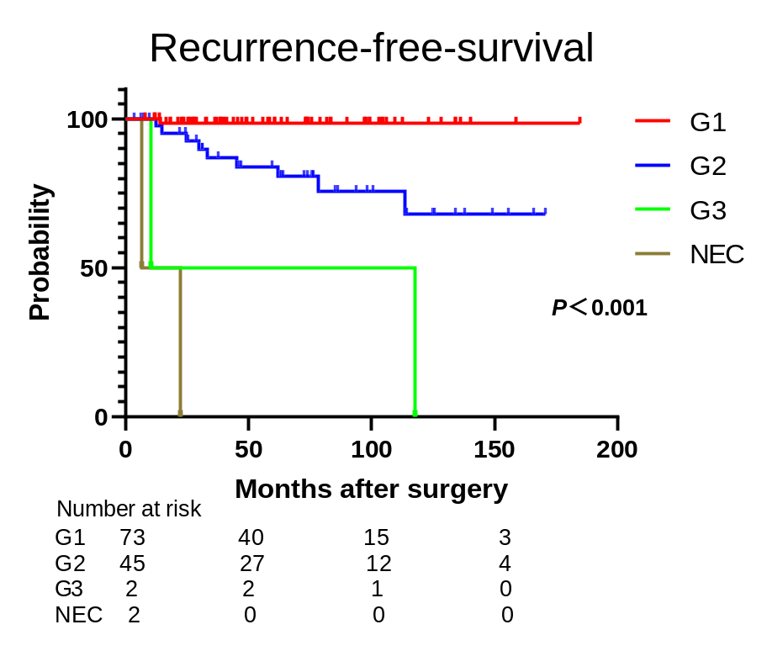
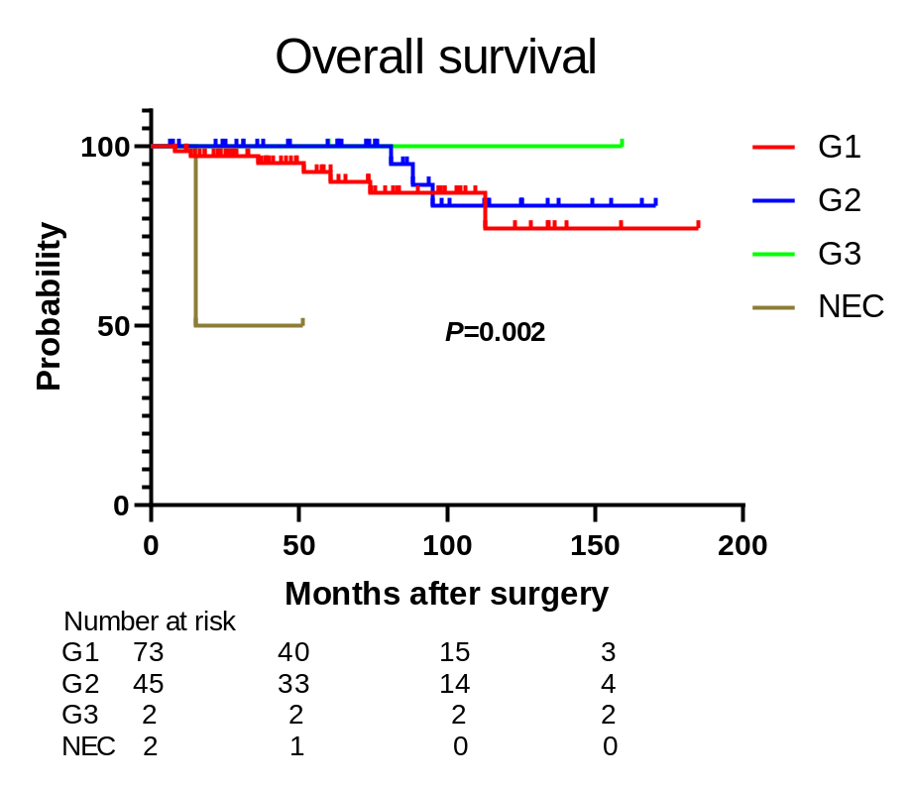
Additional file 2: Fig. S2.
(a)
(b)

Slide 3
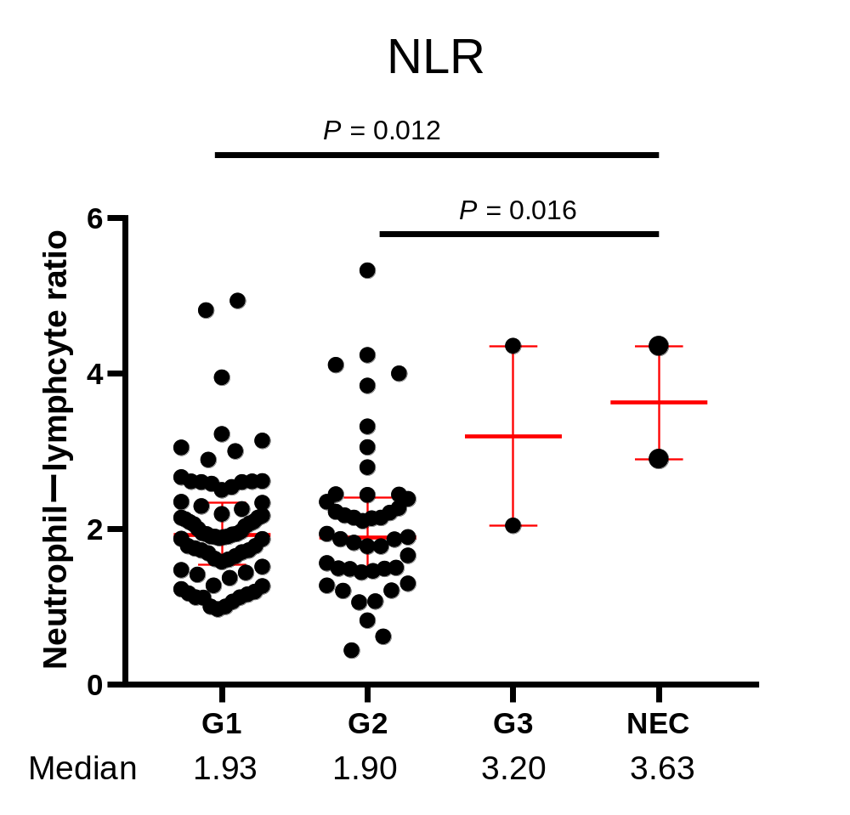
Additional file 3: Fig. S3

