Slide 1
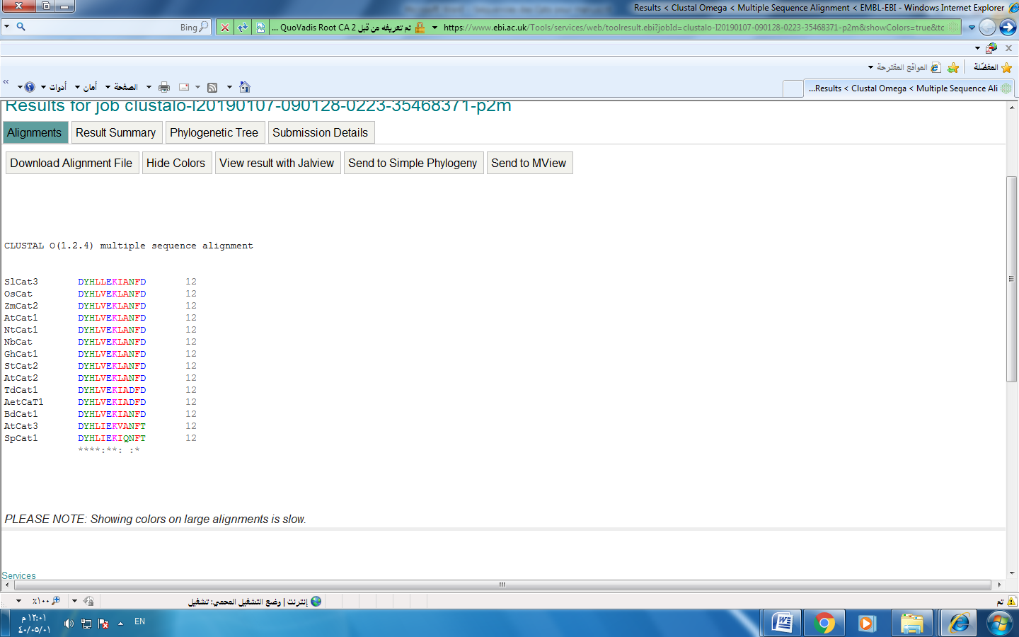
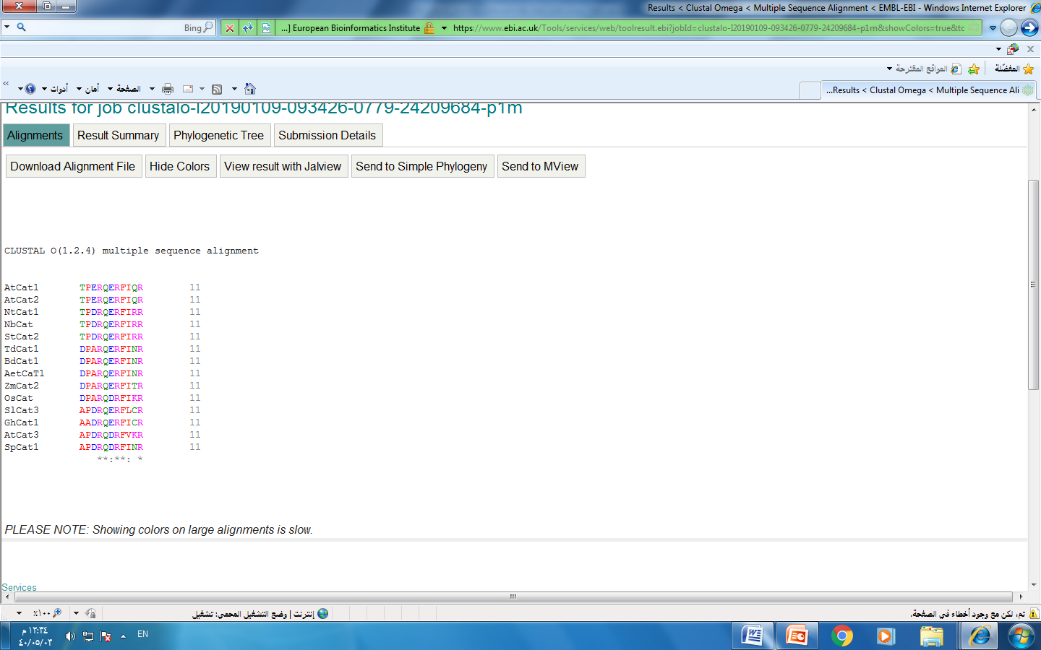
Supplemental Figure 2
a)
b)
Mn²⁺ binding Domain
Mg²⁺ binding Domain

