Slide 1
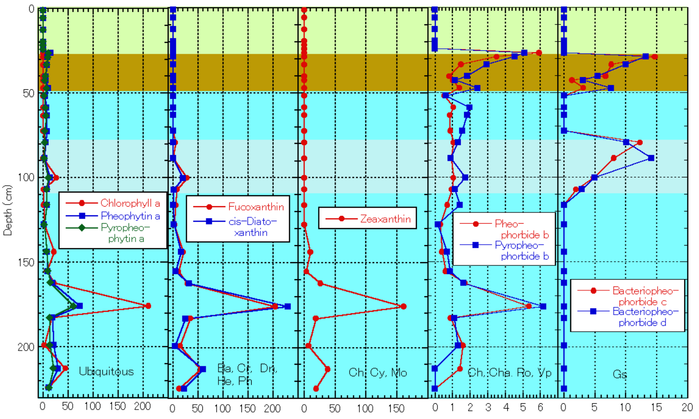
Concentration (μg/L)
Fig. 10 Chlorophyl compounds and carotenoids found in the Mw4C-01 sediment core from Lake Maruwan-oike. Ba, Bacillariophyceae; Dn, Dinopyceae; He, Heptophyceae; Ph, Phaeophyceae; Fucoxanthin and cis-diatoxanthin: Bacillariophyceae, Chrysophyceae, Dinophyceae, Heptophyceae and Phaeophyceae (Verleyen et al. 2004). Bacteriopheophorbide c and bacteriopheophorbide d: Green sulfur bacteria (Pfennig 1967; Borrego and Garcia-Gil. 1994; Squier et al. 2002). Other abbreviations and relationships of pigments and organisms are shown in explanations of Fig. 7. Light blue: Coastal marine environment (CME). Light gray: CME with anoxic photic zone. Light brown: Brackish lake environment. Light green: Lacustrine lake environment.

