Slide 1
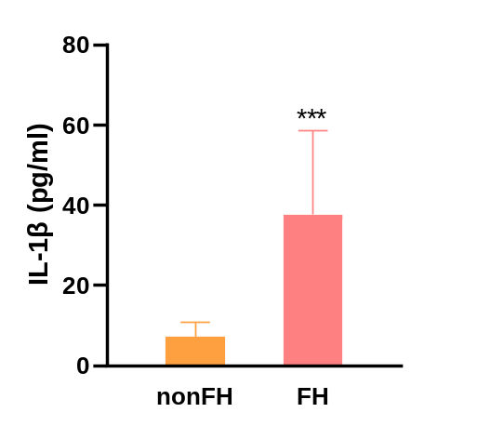
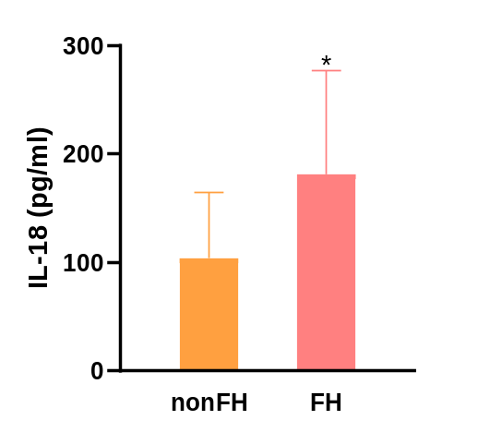
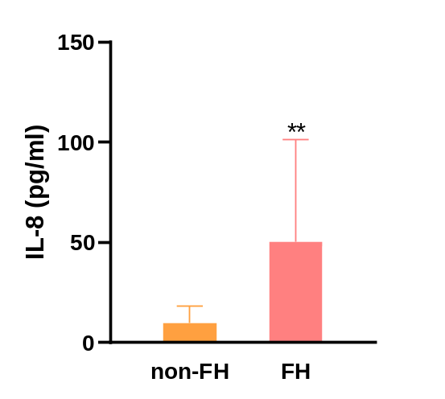
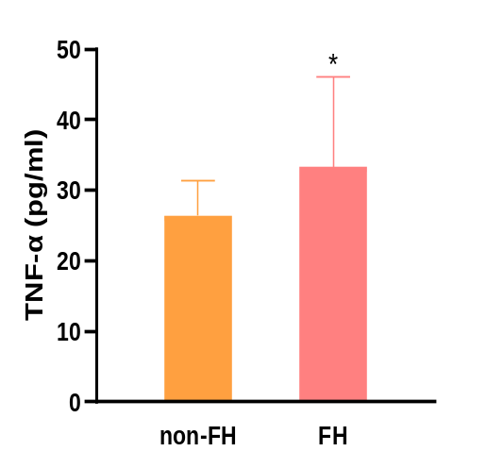
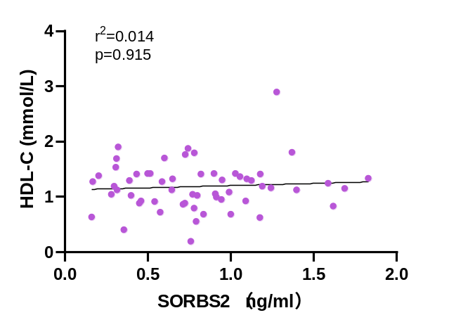
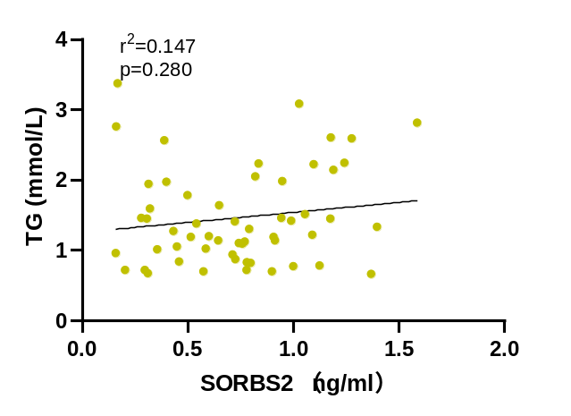
(A)
(B)
(C)
(D)
(E)
(F)
Notes:
Supplementary Fig.1 ELISA results showing concentrations of (A) IL-1β, (B) IL-18, (C) IL-8, and (D) TNF-α in serum from FH patients and normal control participants (n=30). Spearman correlation analyses demonstrated that SORBS2 levels were not significantly associated with (E) HDL-C; and (F) TG.

Slide 2
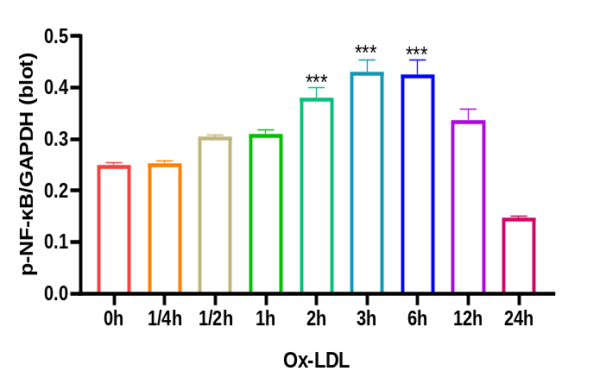
(A)
OxLDL 0h 1/4h 1/2h 1h 2h 3h 6h 12h 24h
P-NF-κB
65KD
GAPDH
37KD
(B)
Notes:
Supplementary Fig.2 The expression of NF-κB phosphorylation after stimulation upon ox-LDL at different time using western blotting analysis (n=3) (A-B) .

