Slide 1
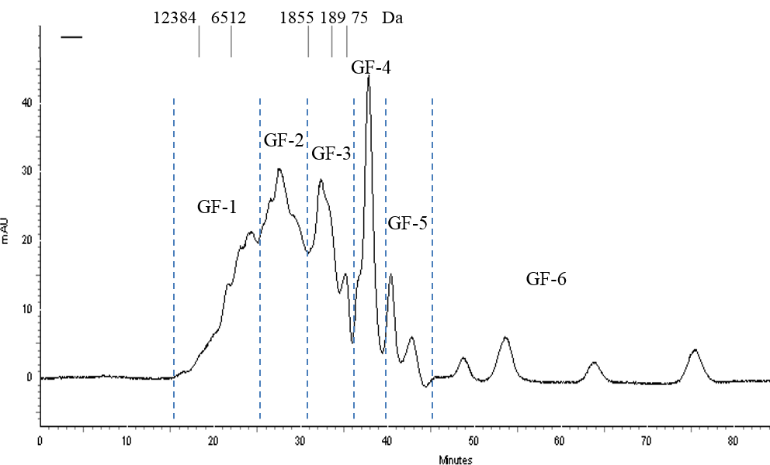
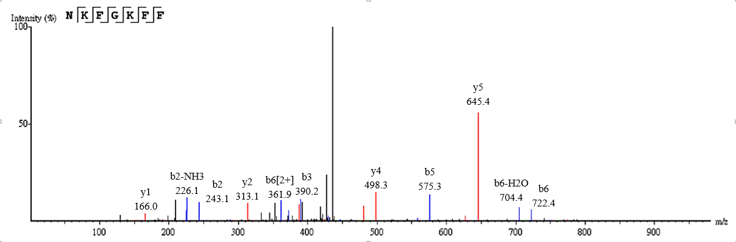
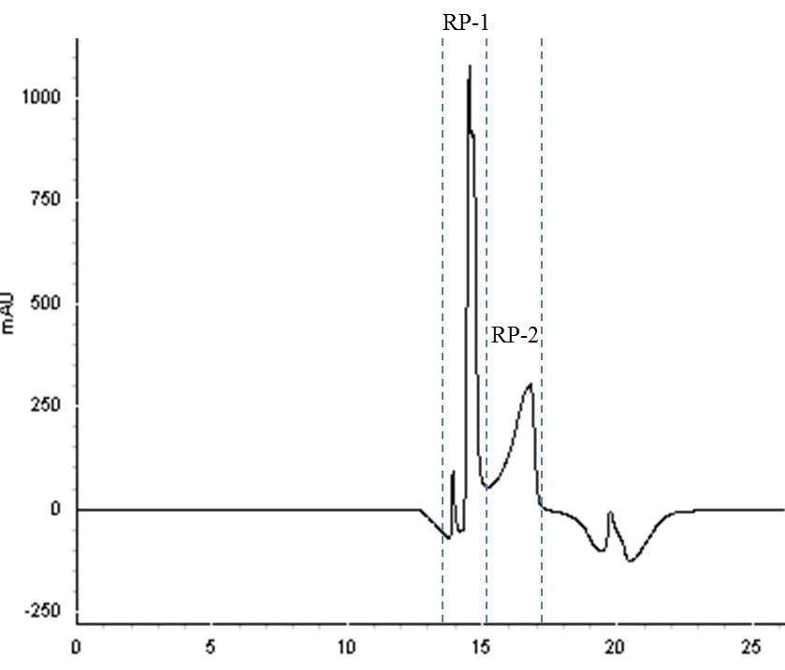
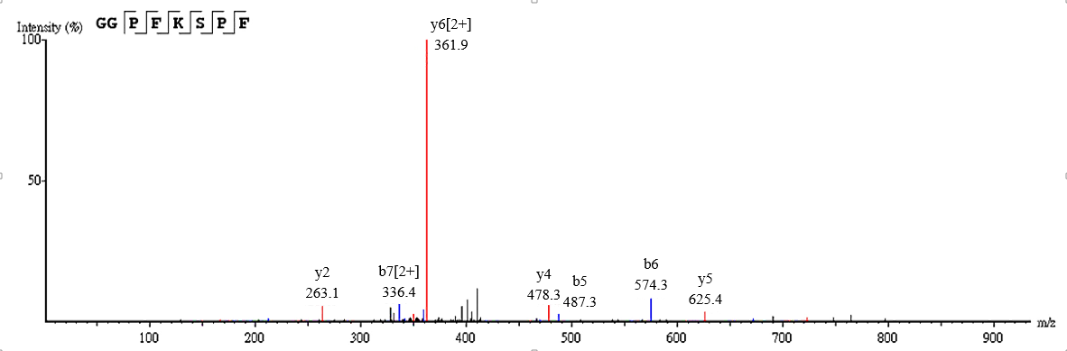
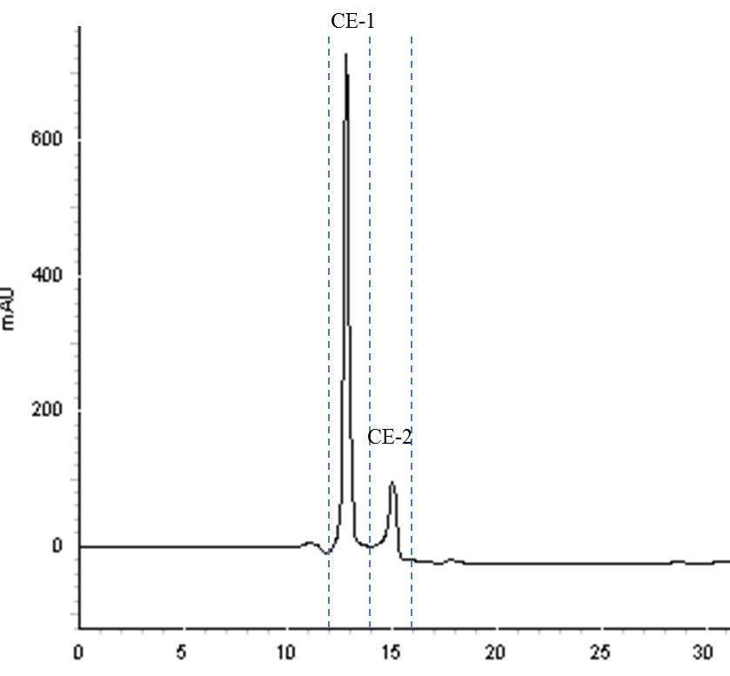
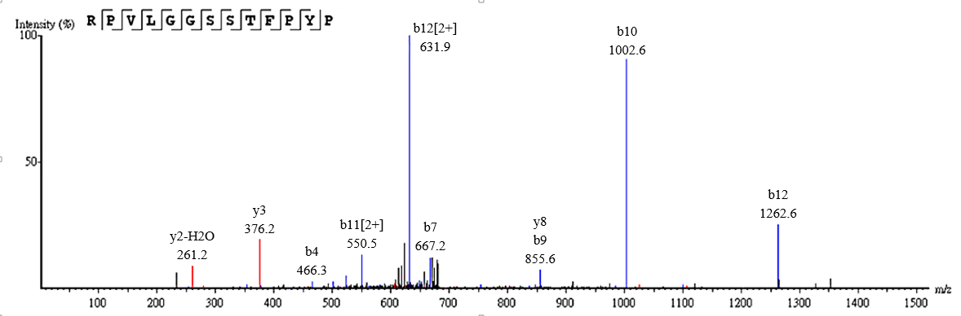
Graphic Abstract
Pea Protein
Pea Protein Hydrolysate
Purification Processes
Gel Filtration Chromatography
Reverse Phase Chromatography
Cation exchange Chromatography
GC/MS/MS Identification
Neuroprotective Peptides

