Slide 1
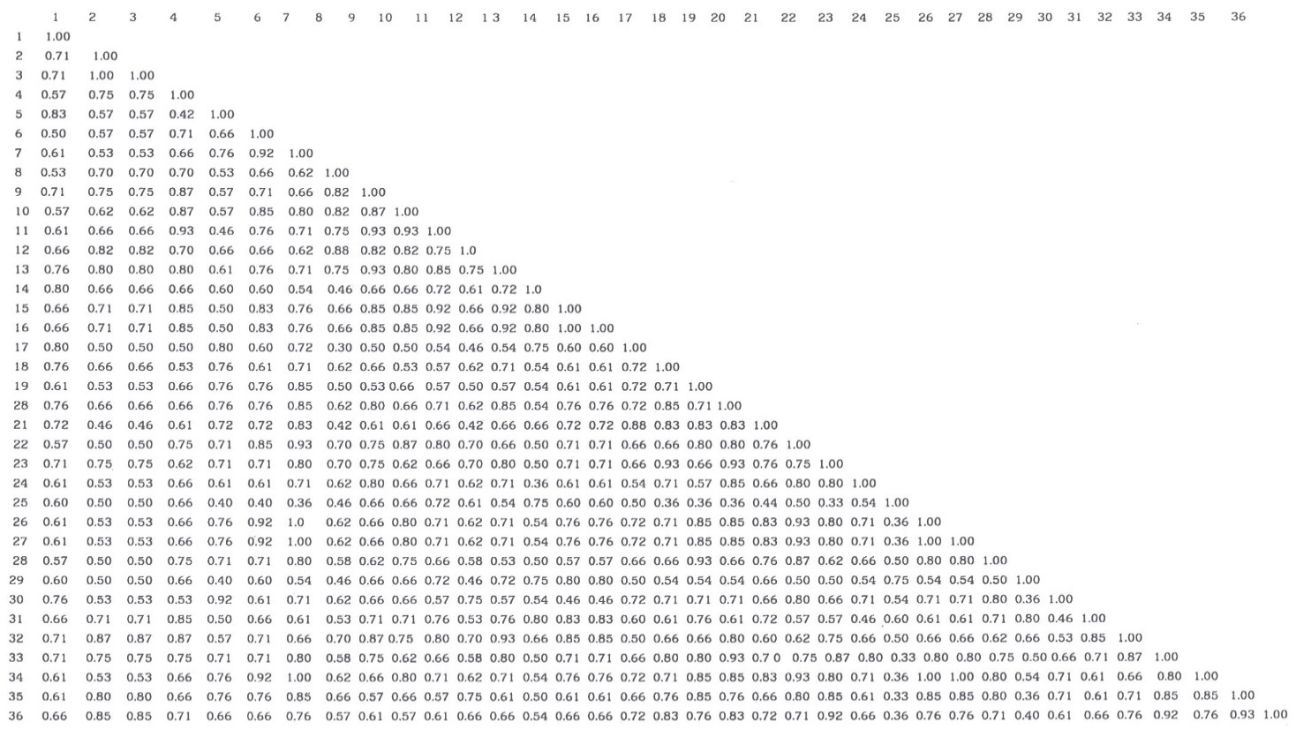
Figure S1 : Coefficients of genetic similarity (Nei, 1972) for 36 local tomato landraces by using SSRs markers.

Slide 2
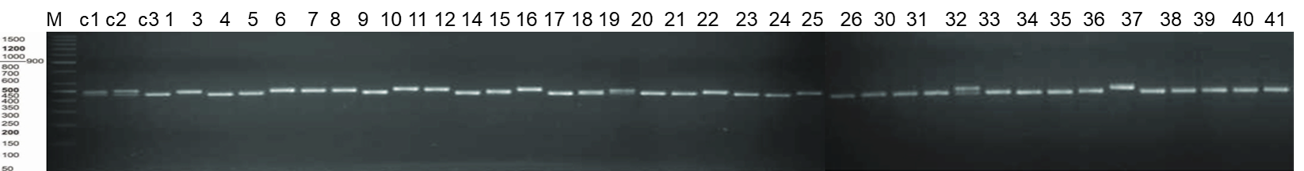
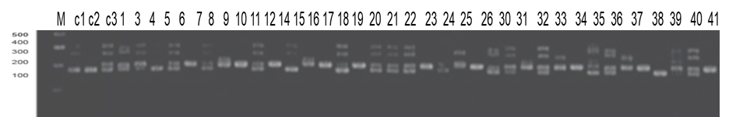
Asr2
Figure S2: SSRs patterns using primer Asr2 for 41 tomato landraces. M=molecular weight marker (1kp, 100bp).
LEat018
Figure S3: SSR pattern using primer LEat018 for 41 tomato landraces. M=molecular weight marker (100bp).

Slide 3
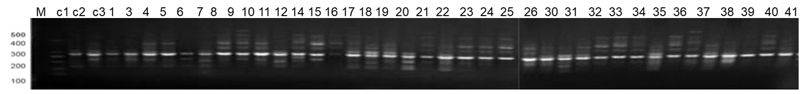
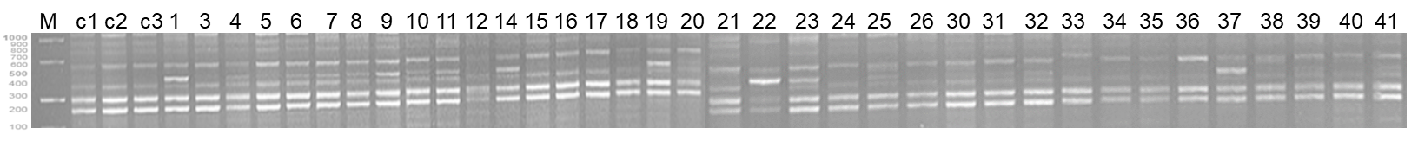
LEct004
Figure S4: SSRs patterns using primer LEct004 for 41 tomato landraces. M=molecular weight marker (100bp).
LEa014
Figure S5: SSRs patterns using primer LEa014 for 41 tomato landraces. M=molecular weight marker (100bp).
LEta020
Figure S6: SSRs patterns using primer LEta020 for 41 tomato landraces. M=molecular weight marker (100bp).

Slide 4
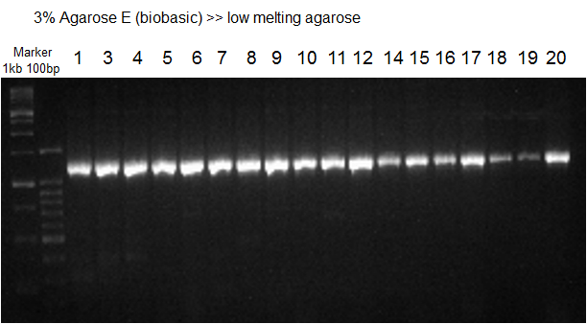
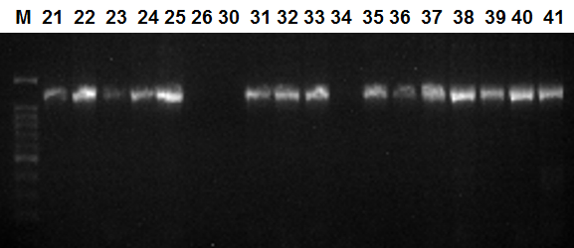
Figure S7: SSRs patterns using primer CT114 for 41 tomato landraces. M=molecular weight marker (1kp, 100bp) using 3% Agarose gel.

