Slide 1
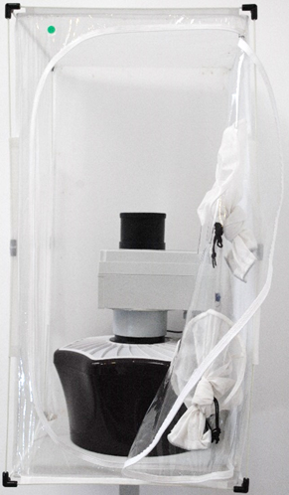
AUTOMATIC CLASSIFICATION OF MOSQUITOES
MACHINE LEARNING ACCURACY RESULTS
Genus
94.2%
Aedes
Culex
Sex
99.4%
Sex
100%
Female
Male
Female
Male

