Slide 1
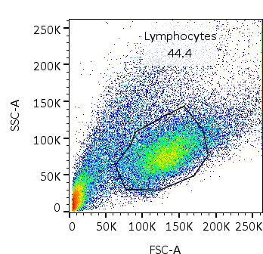
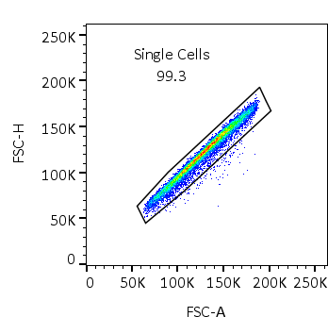
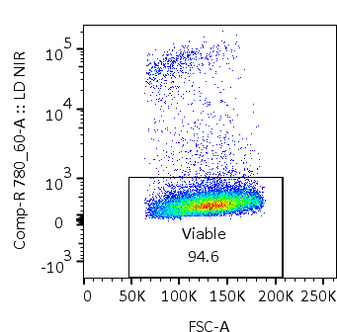
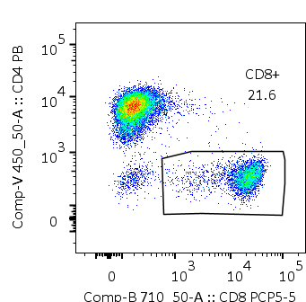
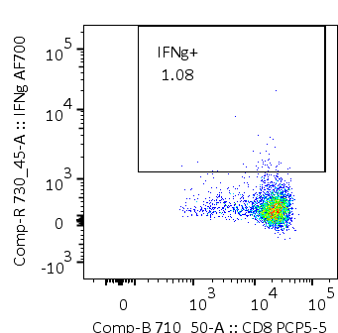
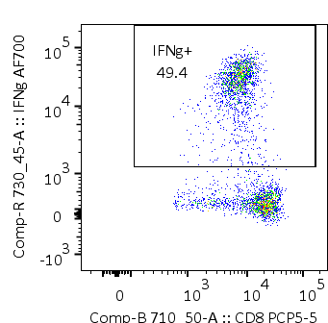

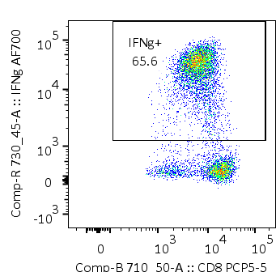
A
B
ORF3A
Spike
No Peptide
Peptide Pool
No Peptide
Peptide Pool
Q-014
Supplementary Figure 1: (A) Representative gating strategy used to identify CD8⁺ T cells (B) Representative IFN-γ production by ORF3A and spike-specific CD8⁺ T cells from a COVID-19-convalescent HLAA*29:02-positive participant.

Slide 2
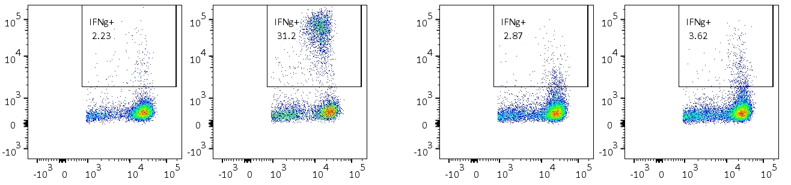
A
Pool (% IFN-γ⁺) | 1 (0.01) | 2 (0.00) | 3 (0.08) | 4 (0.00) | 5 (40.89) | 6 (48.79) | 7 (0.14) | 8 (0.00) | 9 (0.05) | 10 (0.00) | 11 (0.09) | 12 (1.55) | 13 (1.87)
14 (0.00) | 1 | 2 | 3 | 4 | 5 | 6 | 7 | 8 | 9 | 10 | 11 | 12 | 13
15 (0.00) | 14 | 15 | 16 | 17 | 18 | 19 | 20 | 21 | 22 | 23 | 24 | 25 | 26
16 (0.00) | 27 | 28 | 29 | 30 | 31 | 32 | 33 | 34 | 35 | 36 | 37 | 38 | 39
17 (0.00) | 40 | 41 | 42 | 43 | 44 | 45 | 46 | 47 | 48 | 49 | 50 | 51 | 52
18 (0.09) | 53 | 54 | 55 | 56 | 57 | 58 | 59 | 60 | 61 | 62 | 63 | 64 | 65
19 (0.00) | 66 | 67 | 68 | 69 | 70 | 71 | 72 | 73 | 74 | 75 | 76 | 77 | 78
20 (2.82) | 79 | 80 | 81 | 82 | 83 | 84 | 85 | 86 | 87 | 88 | 89 | 90 | 91
21 (0.01) | 92 | 93 | 94 | 95 | 96 | 97 | 98 | 99 | 100 | 101 | 102 | 103 | 104
22 (0.00) | 105 | 106 | 107 | 108 | 109 | 110 | 111 | 112 | 113 | 114 | 115 | 116 | 117
23 (48.99) | 118 | 119 | 120 | 121 | 122 | 123 | 124 | 125 | 126 | 127 | 128 | 129 | 130
24 (0.00) | 131 | 132 | 133 | 134 | 135 | 136 | 137 | 138 | 139 | 140 | 141 | 142 | 143
25 (0.00) | 144 | 145 | 146 | 147 | 148 | 149 | 150 | 151 | 152 | 153 | 154 | 155 | 156
26 (0.09) | 157 | 158
B
HLA-A*29:02⁺ target
HLA-A*29:02⁻ target
No peptide
YFPLQSYGF
No peptide
YFPLQSYGF
IFN-γ PE
C
CD8-PerCPCy5.5
Pool (% IFN-γ⁺) | 1 (0.11) | 2 (0.16) | 3 (0.27) | 4 (3.82) | 5 (2.57) | 6 (0.68) | 7 (15.38) | 8 (14.98)
9 (0.22) | 1 | 2 | 3 | 4 | 5 | 6 | 7 | 8
10 (0.08) | 9 | 10 | 11 | 12 | 13 | 14 | 15 | 16
11 (1.25) | 17 | 18 | 19 | 20 | 21 | 22 | 23 | 24
12 (0.44) | 25 | 26 | 27 | 28 | 29 | 30 | 31 | 32
13 (4.07) | 33 | 34 | 35 | 36 | 37 | 38 | 39 | 40
14 (0.23) | 41 | 42 | 43 | 44 | 45 | 46 | 47 | 48
15 (11.08) | 49 | 50 | 51 | 52 | 53 | 54 | 55 | 56
16 (1.28) | 57 | 58 | 59 | 60 | 61 | 62 | 63 | 64
17 (0.15) | 65 | 66 | 67 | 68 | 69 | 70 | 71
Supplementary Figure 2: (A) Spike (S-1) matrix peptide pool responses for Q-031 T cells. Matrix pool numbers are highlighted in bold. Values in parentheses represent the percentage of IFN-γ⁺ CD8⁺ T cells following subtraction of no peptide control. Numbers in red represent the dominant reactive peptides (122 - GFNCYFPLQSYGFQP; 123 - YFPLQSYGFQPTNGV). . (B) HLA restriction of YFPLQSYGF-specific T cells from Q-031. (C) ORF3A matrix peptide pool responses for Q-031 T cells. Matrix pool numbers are highlighted in bold. Values in parentheses represent the percentage of IFN-γ⁺ CD8⁺ T cells following subtraction of no peptide control. Numbers in red represent the dominant reactive peptides (55 - VVLHSYFTSDYYQLY; 56 -SYFTSDYYQLYSTQL).

Slide 3
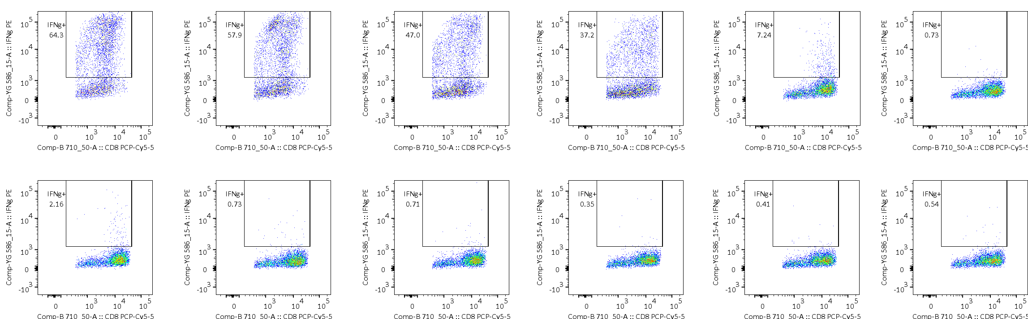
A
1µg/ml
0.1µg/ml
0.01µg/ml
0.001µg/ml
0.0001µg/ml
0µg/ml
B
Supplementary Figure 3: Representative intracellular cytokine analysis following stimulation of Q-031 T cells with serial dilutions of YFPLQSYGF (A) and YFPLRSYSF (B).

Slide 4
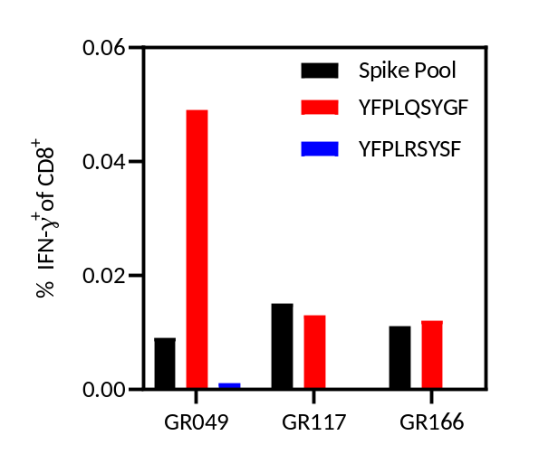
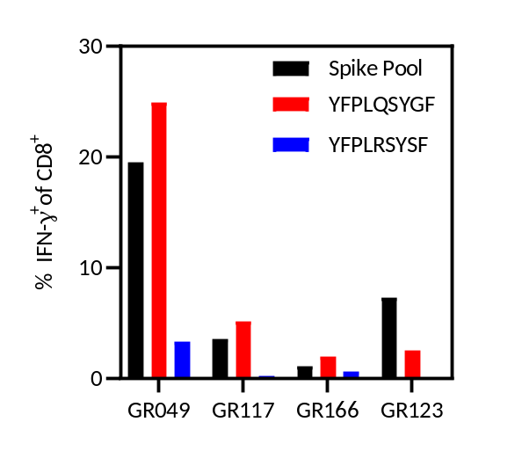
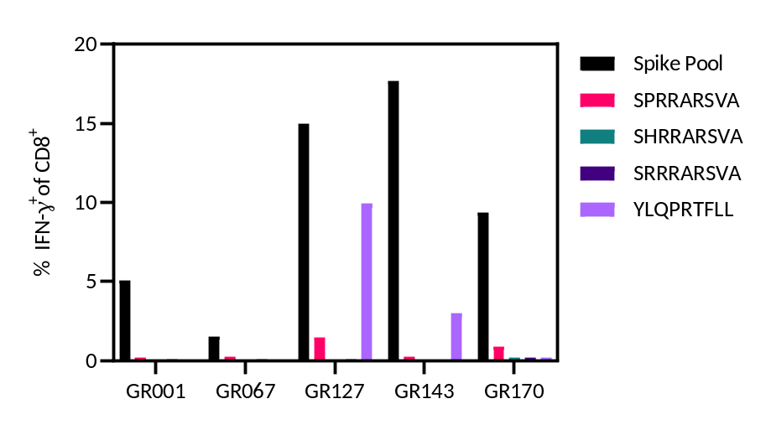
A
B
C
Supplementary Figure 4: IFN-γ response to spike peptide pool, YFPLQSYGF and YFPLRSYSF in PBMC (A) and following in vitro expansion (B). (C) IFN-γ response to spike peptide pool, SPRRARSVA, SHRRARSVA, SRRRARSVA and YLQPRTFLL following in vitro expansion

Slide 5
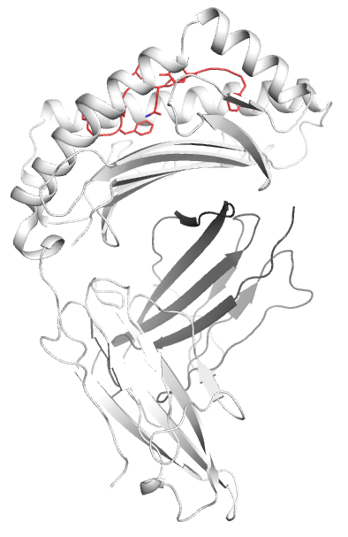
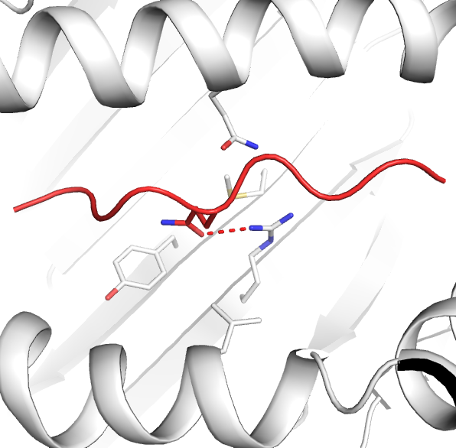
A
B
Gln70
P5-Gln
Met97
Tyr99
Arg114
Leu156
Supplementary Figure 5. Crystal structure of HLA-A*29:02-YFP complex. (A) Overall structure of the HLA-A*29:02, with the heavy chain as white cartoon and the β2m as grey cartoon, in complex with the YFP peptide in red cartoon and stick. (B) Interaction of the secondary anchor residue P5-Gln from the YFP peptide (red cartoon

Slide 6
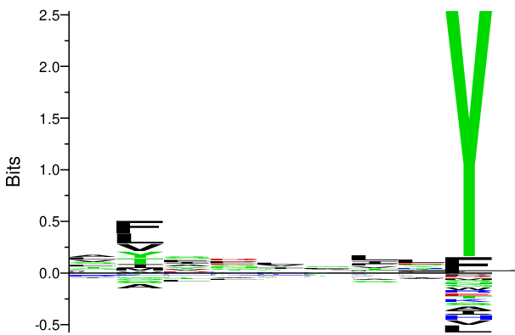
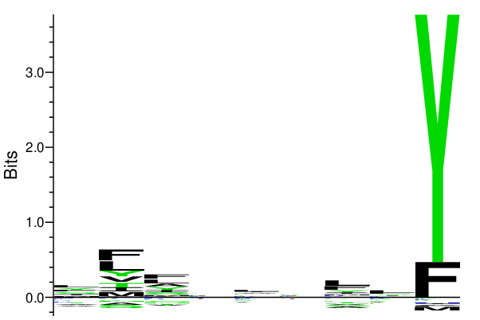
A
HLA-A*29:02 naturally presented peptides
B
HLA-A*29:02 MHC binder peptides
1
2
3
4
5
6
7
8
9
1
2
3
4
5
6
7
8
9
Peptide residue position
Peptide residue position
Supplementary Figure 6. HLA-A*29:02 peptide binding motif. The motif have been extracted from the netMHCpan4.1 web site reporting the (A) peptide binding motif from the naturally presented peptide and the (B) HLA-A*29:02 binder peptides (DOI: 10.1074/mcp.TIR119.001658).

