Slide 1

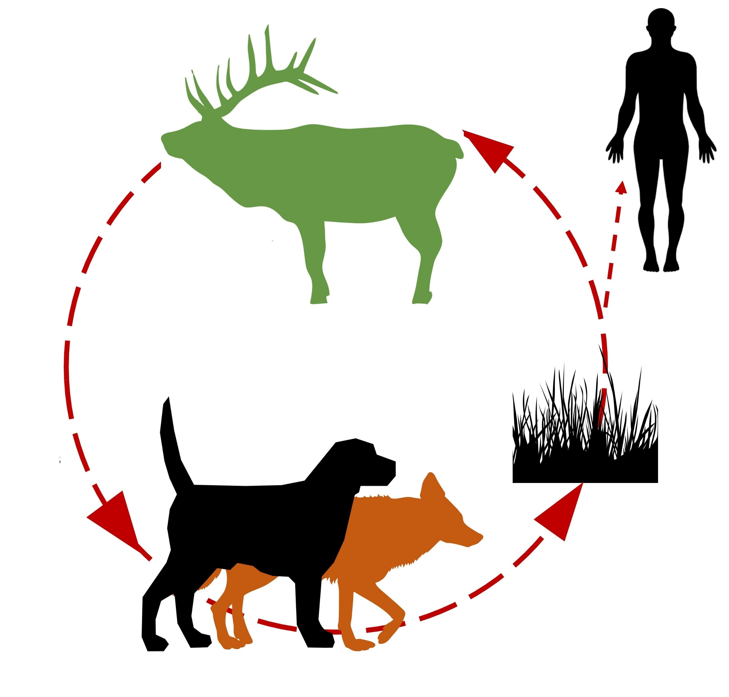


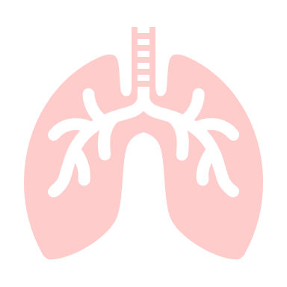
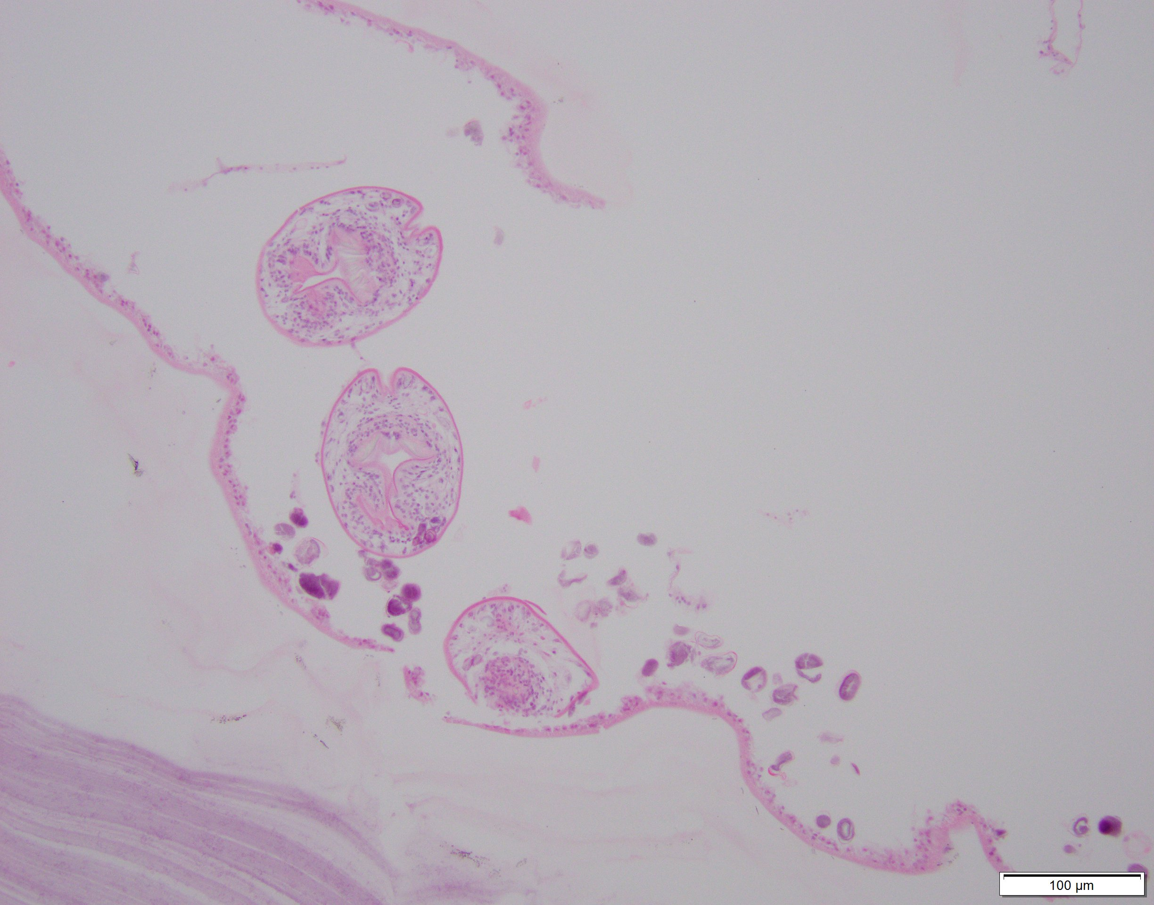
Echinococcus canadensis confirmed in 4 elk in Tennessee and likely establishment of a sustainable transmission cycle.

