Slide 1
Patients with suspected Omicron infection from 1-18 Dec 2021
(n=120)
Patients confirmed with Omicron infection on WGS
(n=102)
Patients confirmed with Delta infection from 27 Apr – 11 Aug 2021
(n=409)
Patient with partial vaccination excluded (n=1)
Patients with partial vaccination excluded (n=122)
Full vaccinated Omicron breakthrough infection
(n=101)
Fully vaccinated Delta breakthrough infection
(n=287)
Age-matched cohort
(n=87 from each group)
Supplemental Figure 1. Flowchart of eligibility, inclusion, exclusion and matching of patients. Fully vaccinated was defined as COVID-19 infection onset >=14 days after completion of the primary vaccine series.

Slide 2
x Negative viral culture (symptomatic)
Positive viral culture (symptomatic)
x Negative viral culture (asymptomatic)
Positive viral culture (asymptomatic)
Supplemental Figure 2. Viral cultures and PCR Ct values correlated with day of illness

Slide 3
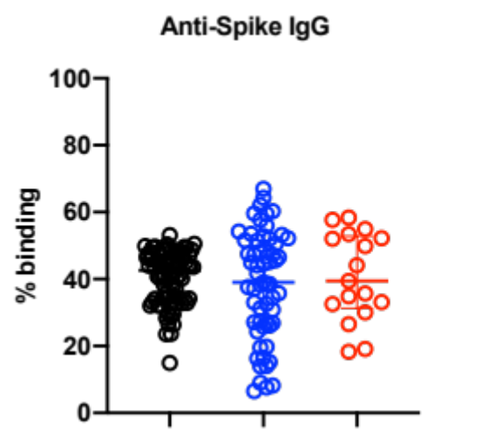
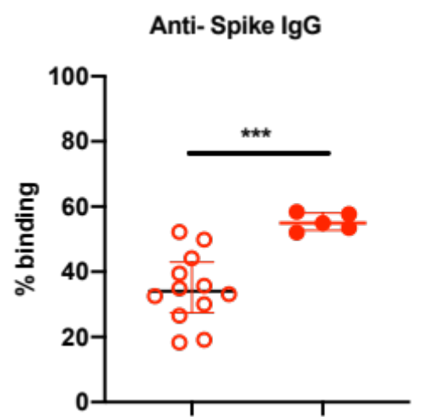
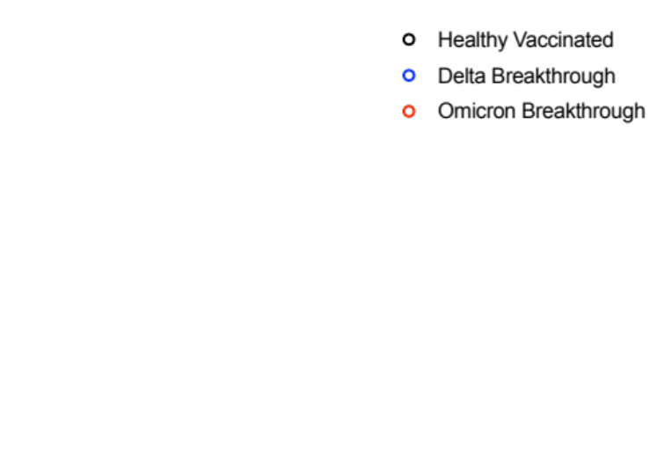
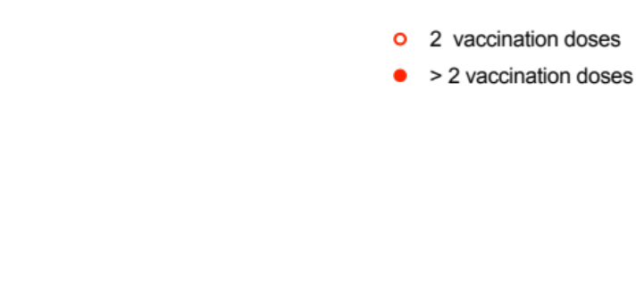
A
B
Supplemental Figure 3. Specific IgG antibodies against full length S protein. Plasma samples were collected from vaccinated healthy controls (n=85), Delta vaccine breakthrough acute infections (n=59) and Omicron vaccine breakthrough acute infection (n=17). (A) IgG against full length SARS-CoV2 S protein expressed on the surface of HEK293T cells, in vaccinated healthy controls, Delta vaccine breakthrough cases and Omicron vaccine breakthrough infections, were presented as scatter plots. Data are shown as mean ± SD. Statistical analysis was carried out using Kruskal-Wallis tests, followed by post hoc Dunn’s multiple comparison tests. (B) Specific IgG antibodies against full length S protein in plasma samples collected from Omicron breakthrough cases who received >2 vaccination doses, compared to those received only 2 doses of vaccines. Data are shown as mean ± SD. Statistical analysis was carried out using Mann-Whitney U test. (***p < 0.001).

Slide 4
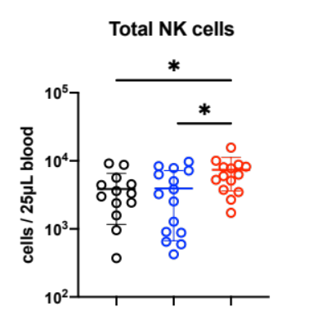
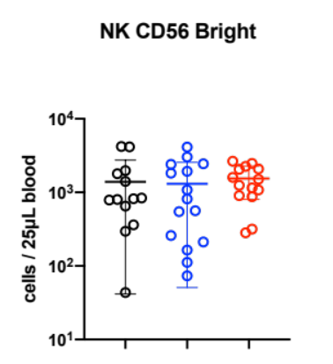
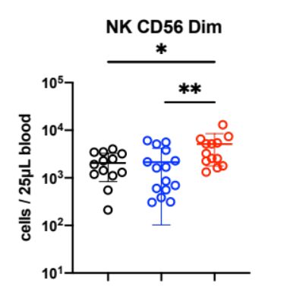
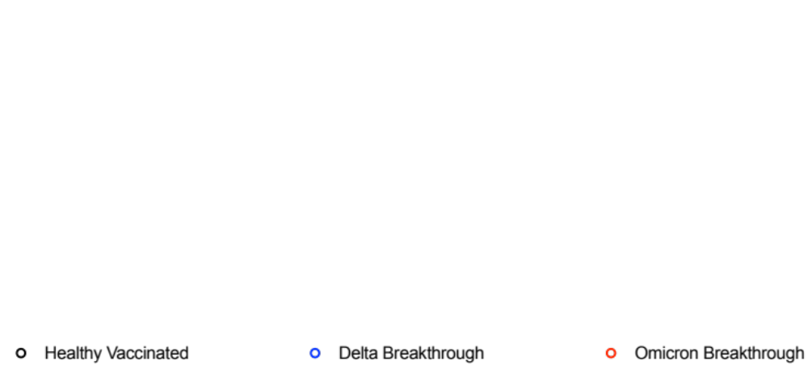
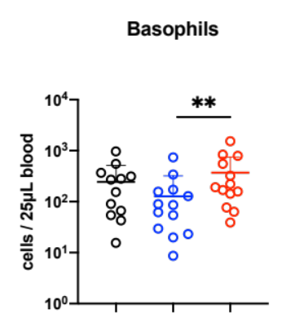
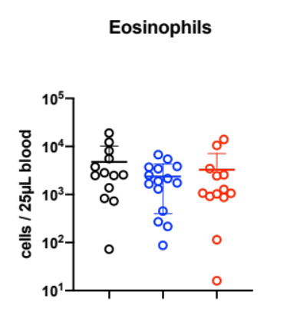
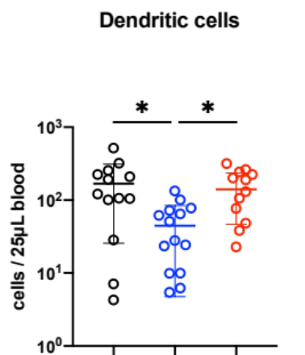
Total NK cells
NK CD56 Bright
NK CD56 Dim
Basophils
Eosinophils
Dendritic cells
Supplemental Figure 4. Whole blood immunophenotyping of Omicron breakthrough cases. Absolute counts of circulating natural killer cells, basophils, eosinophils and dendritic cells in vaccinated healthy controls (n=13), Delta vaccine breakthrough acute infections (n=15) and Omicron vaccine breakthrough acute infection (n=17). Data were presented as scatter plots. Kruskal-Wallis test with post-hoc Dunn's multiple comparisons test was performed to compare the cellular profiles among the three groups. (*p < 0.05; **p < 0.01).

