Slide 1
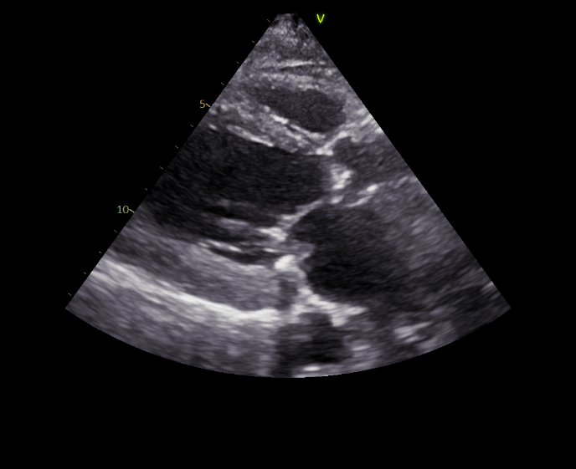
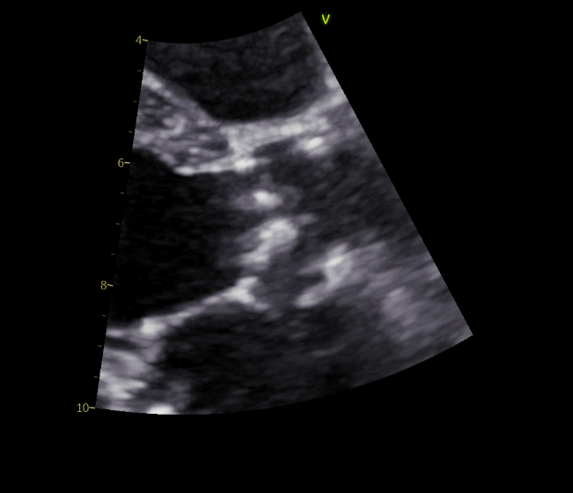
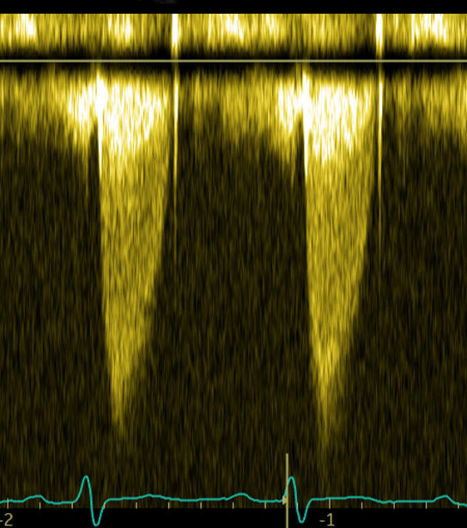


equal AS severity
Before TAVI
After TAVI
Left ventricular remodeling
Left ventricular reverse remodeling
LV volumes
LV mass
LV ejection fraction
Larger LV volumes in men
Larger LV mass in men
LV ejection fraction comparable
↓
=
↓
↑
<
Survival
The interaction between LV reverse remodeling and sex is not associated with survival

