Slide 1
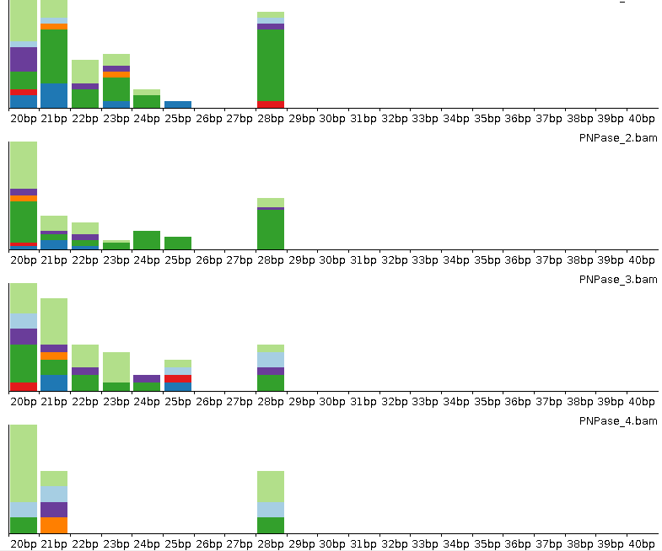
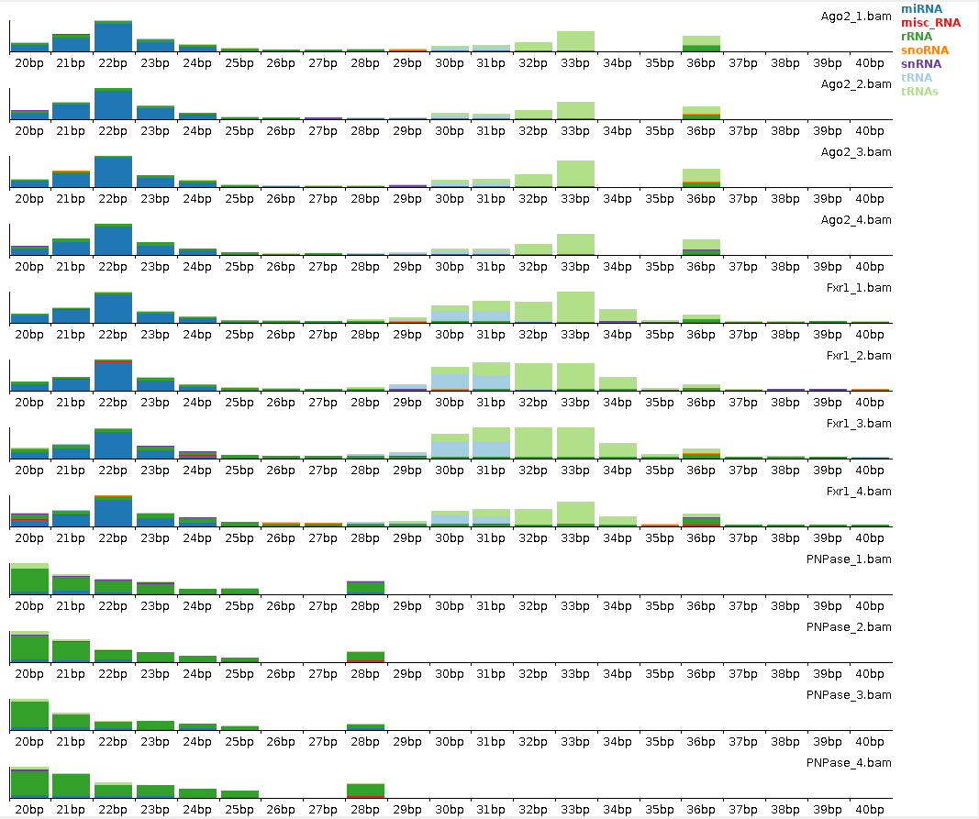
Hathaway_Figure S3
B
Human
A
Mouse
miRNA
misc_RNA
rRNA
snoRNA
snRNA
tRNA
tRNAs
C
Ago2
Fxr1
PNPase
Fold Change
Deviation
DbDb
WT
Notes:
Figure S3: Sample Characteristics CLIP

