Slide 1
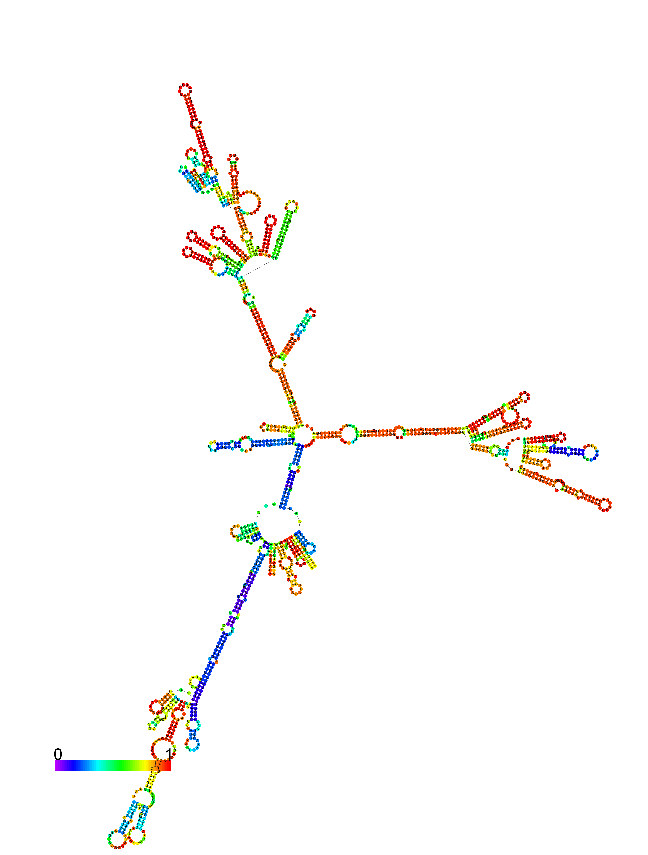
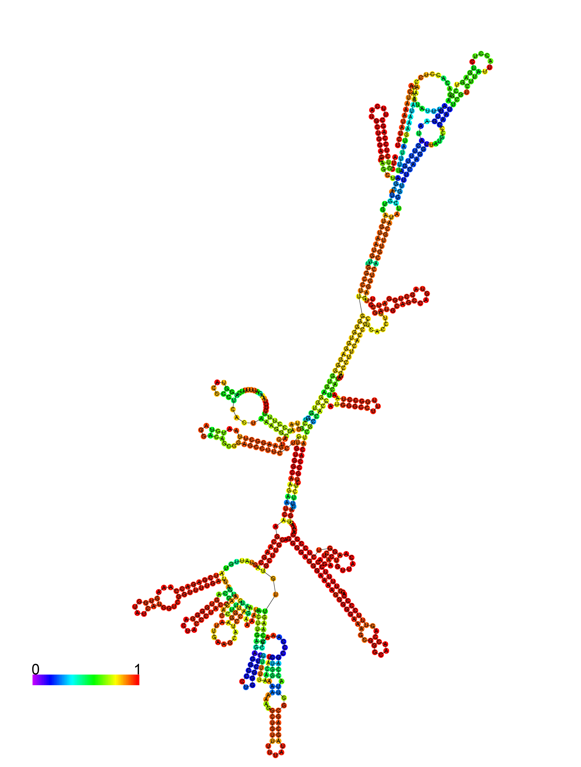
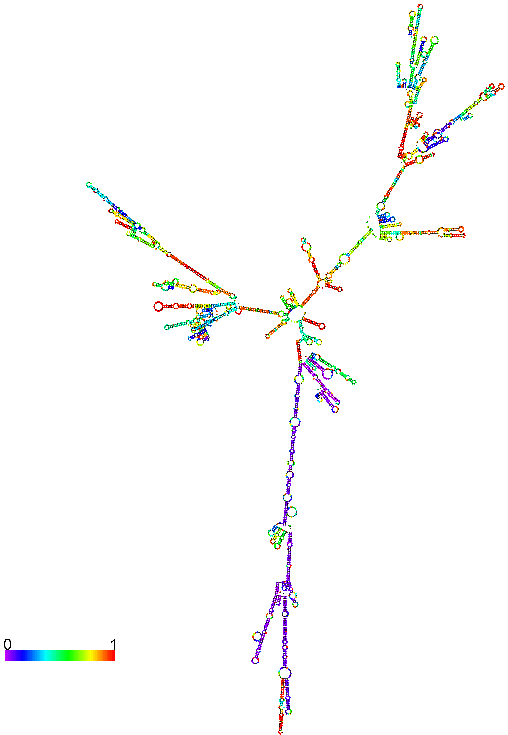

Hathaway_Figure S5
MALAT1-201
Malat1-204
NEAT1-201
Neat1-202 (partial)
Notes:
Figure S5: Target Sequence Folding Full

