Slide 1
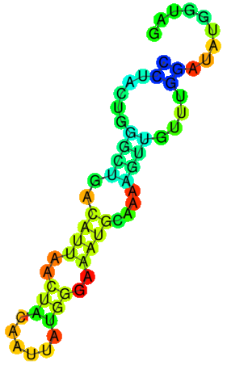
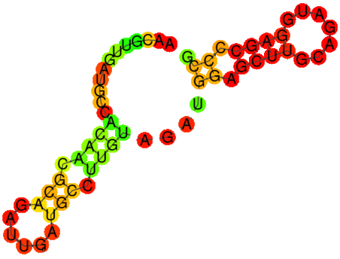
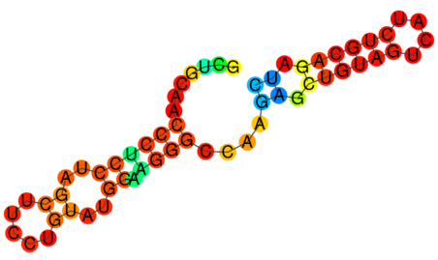
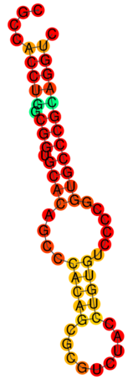
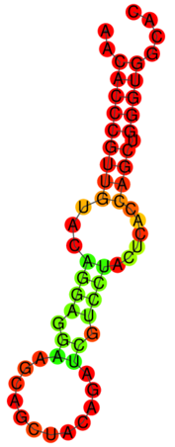
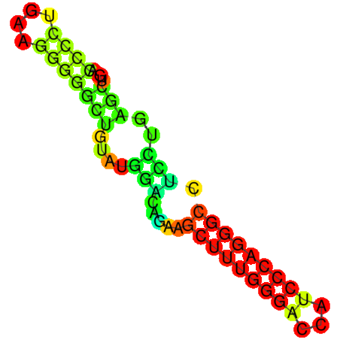
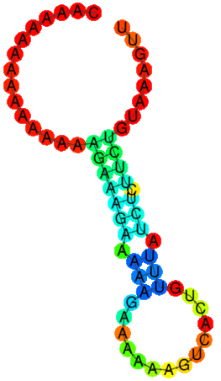
A
0 1
B
Producer’s Accuracy (CV)
Producer’s Accuracy (Model)
Hathaway_Figure S6
Base-Pair
Probability
100
90
80
70
60
50
76
75
74
73
72
71
MALAT1
Accuracy (%)
C
ROC
Positive
Negative
Positive
Negative
1.0
0.8
0.6
0.4
0.2
0.0
2 4 6 8 10
2 4 6 8 10
NEAT1
OoB Error (CV)
OoB Error (Model)
True Positive Rate
AUC = 0.7535
0.28
0.26
0.24
0.22
0.20
0.28
0.26
0.24
0.22
0.20
Error
0.0 0.2 0.4 0.6 0.8 1.0
Positive
Negative
OoB
Positive
Negative
OoB
False Positive Rate
KCNQ1OT1
2 4 6 8 10
2 4 6 8 10
Iteration
Iteration
D
E
Zfp469
AL450468.2
4933434M16Rik
HELLPAR
0.3
0.2
0.1
0.0
-0.1
-0.2
-0.3
1
2
0 1
Dimension 2
Base-Pair
Probability
4
3
High MFE
(-23.1 kcal/mol)
High GC
(0.73)
Medium MFE
(-16.6 kcal/mol)
Medium GC
(0.57)
High MFE
(-23.5 kcal/mol)
Medium GC
(0.60)
Low MFE
(-2.2 kcal/mol)
Low GC
(0.22)
-0.3 -0.2 -0.1 0.0 0.1 0.2 0.3
Dimension 1
Notes:
Figure S6: Target Sequence, Machine Learning, RNA Import

