Slide 1
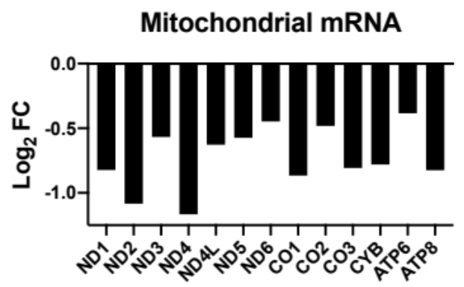
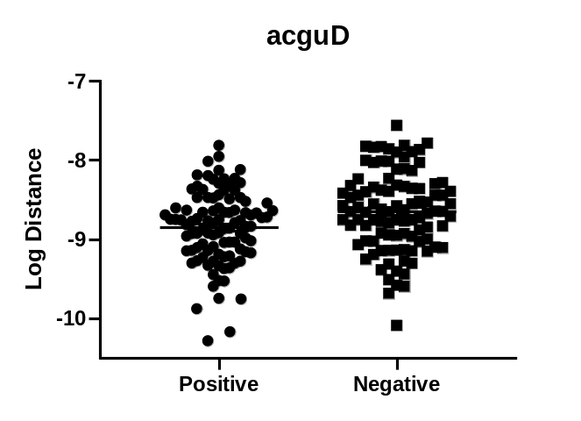
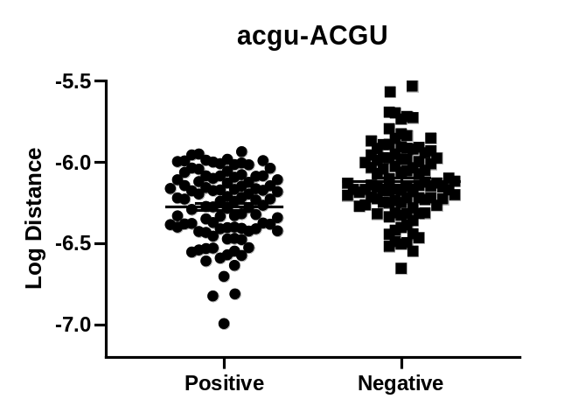
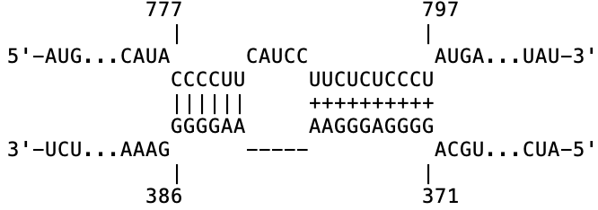
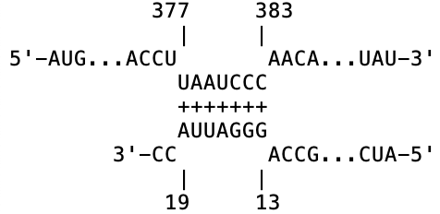
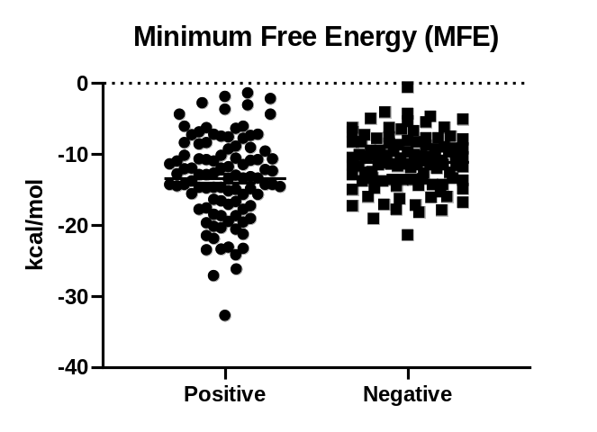
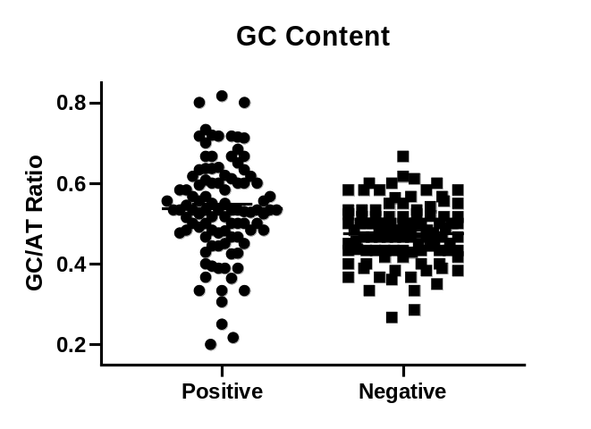
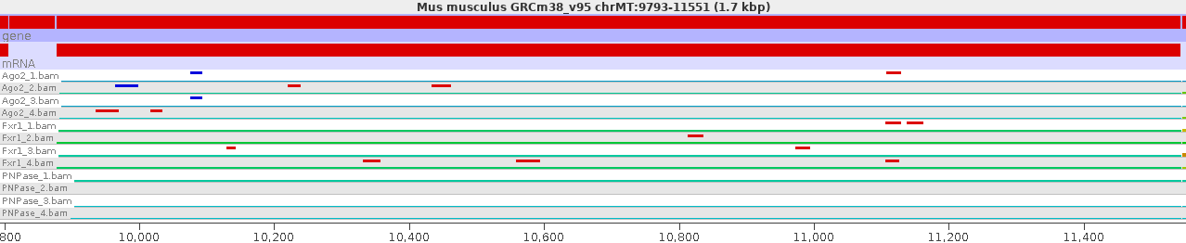
Hathaway_Figure S7
E
A
B
*
*
*
*
F
mt-Nd4-201
mt-Nd4-201
C
*
D
*
Malat1-204
miRNA-23b-3p
Nd4-201 (MT: 10,167-11,544)
Ago2_1
Ago2_2
Ago2_3
Ago2_4
Fxr1_1
Fxr1_2
Fxr1_3
Fxr1_4
10,000 10,400 10,800 11,200
Notes:
Figure S7: Machine Learning Parameters, IntaRNA 2.0 mt-Nd4

