Slide 1
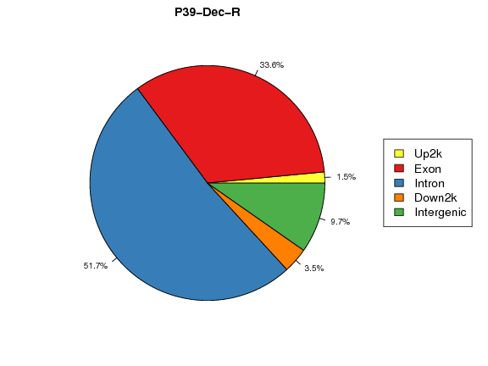
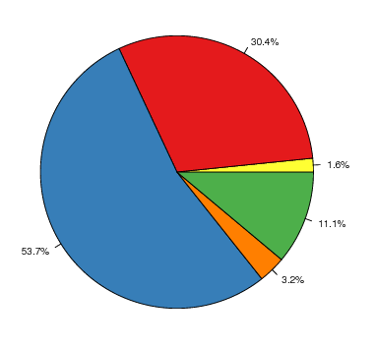

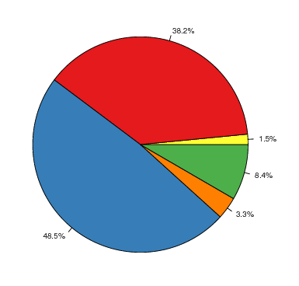

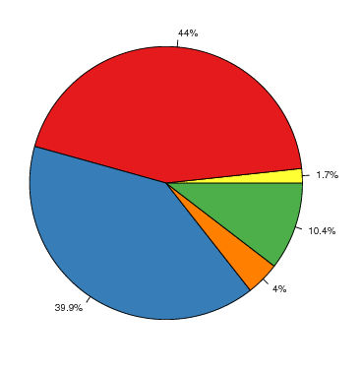
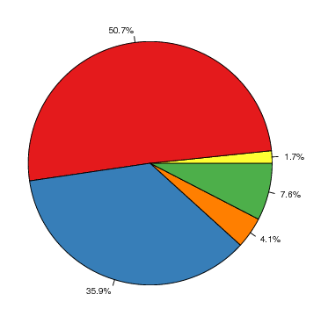
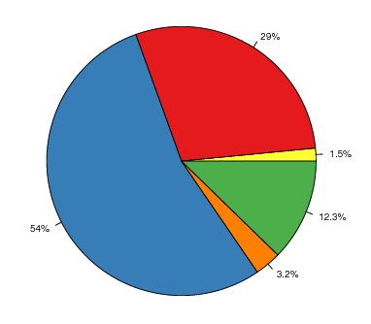
Supplemental file 14
SNP
INDEL
Parental P39 sensitive to AZA
P39-AZA-R
Parental P39 sensitive to AZA
P39-AZA-R
Parental P39 sensitive to DEC
P39-DEC-R
Parental P39 sensitive to DEC
P39-DEC-R

