Slide 1
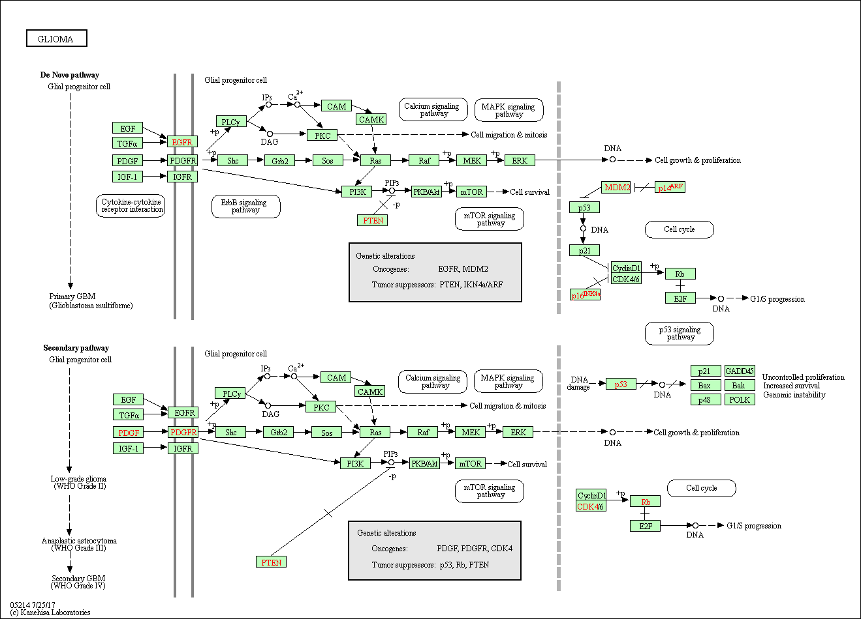
Supplemental file 7

