Slide 1
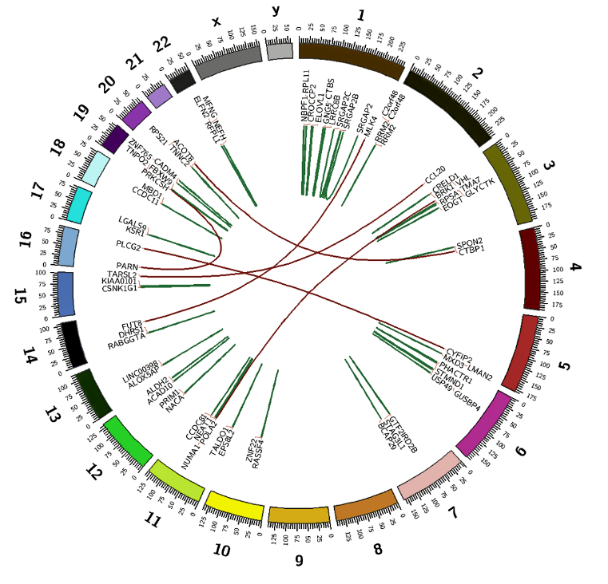
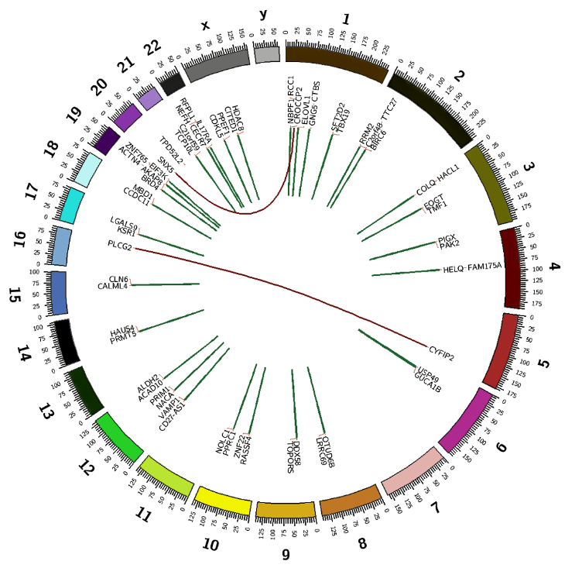
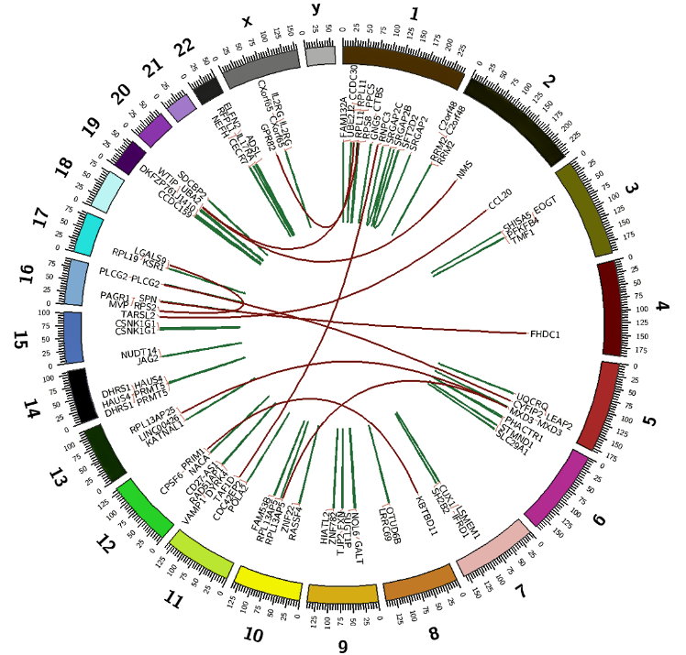
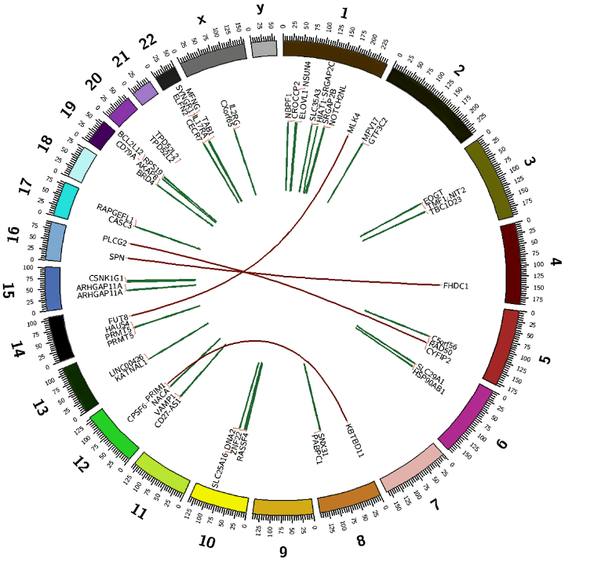
Supplemental file 15
Parental P39 sensitive to AZA
P39-AZA-R
Parental P39 sensitive to DEC
P39-DEC-R

