Slide 1
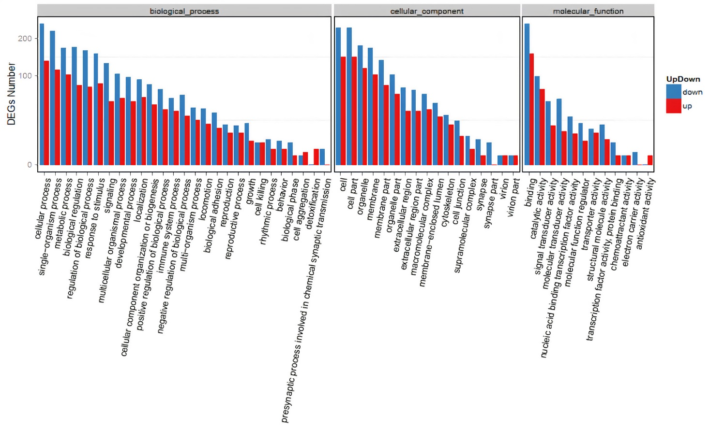
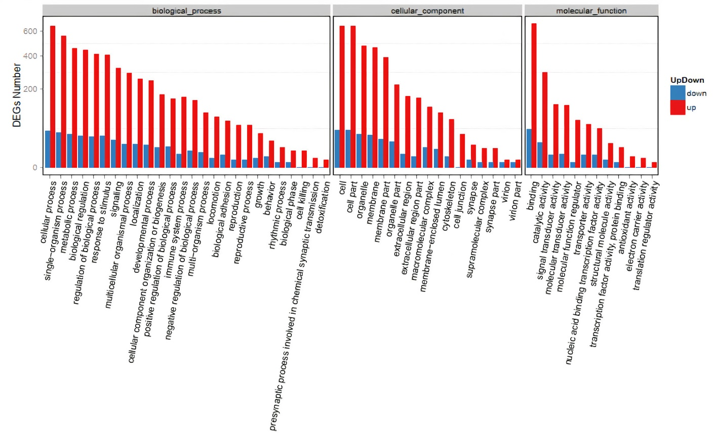
Supplemental file 10
P39-AZA-R
P39-DEC-R

