Slide 1
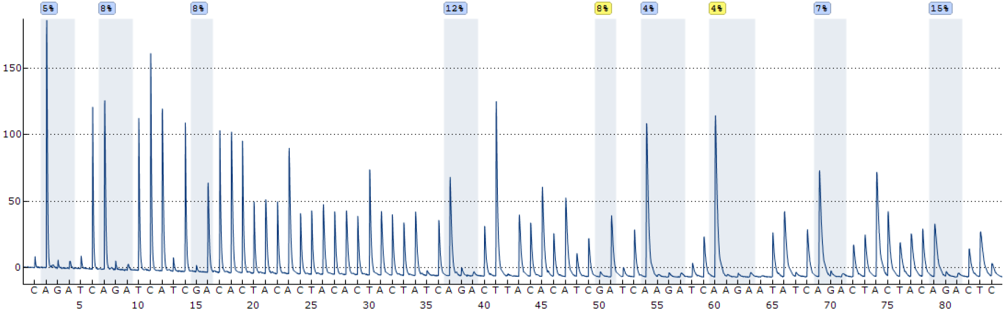
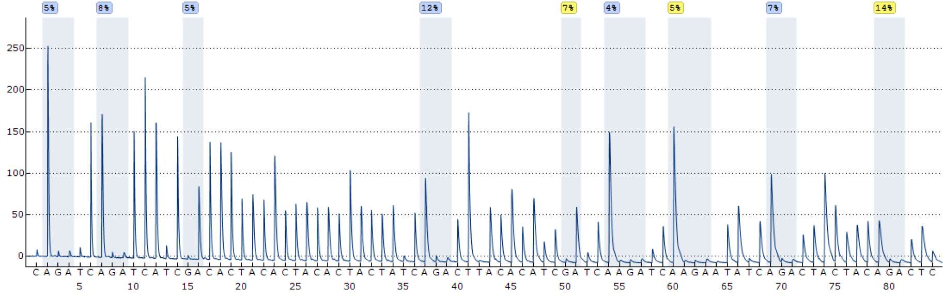
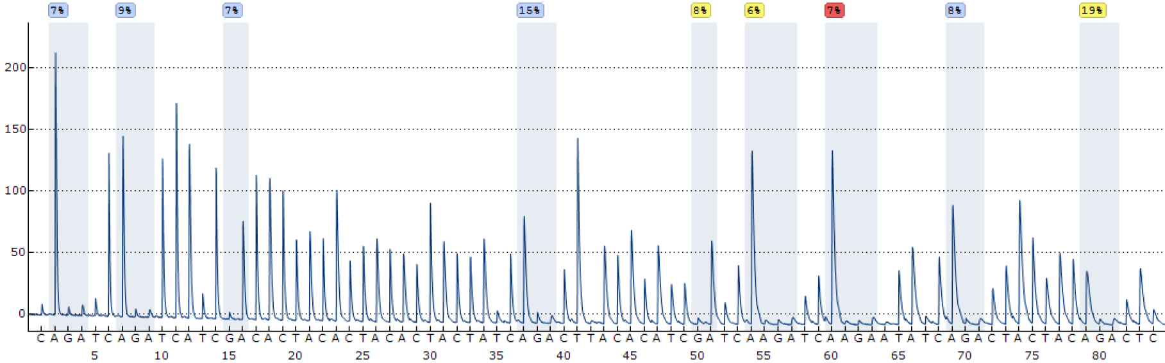
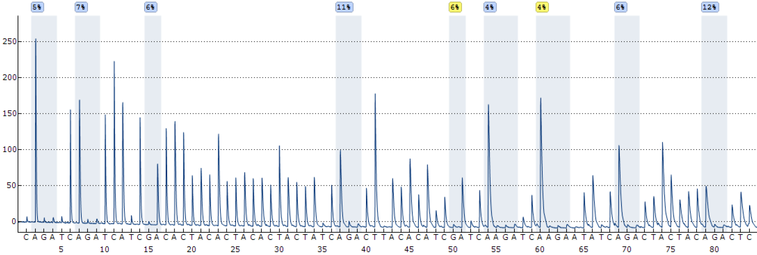
Supplemental file 12
Parental Kasumi-1 sensitive to AZA
Parental Kasumi-1 sensitive to DEC
Kasumi-1-AZA-R
Kasumi-1-DEC-R

