Slide 1
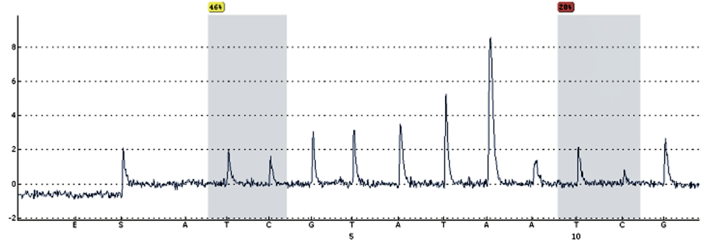
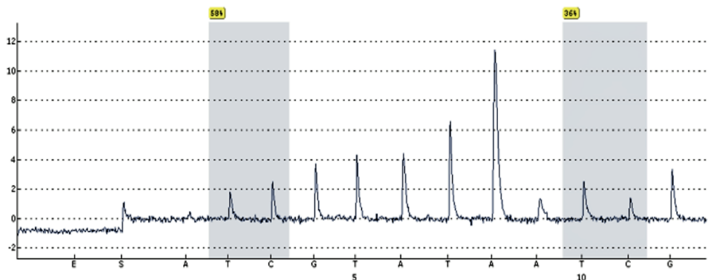
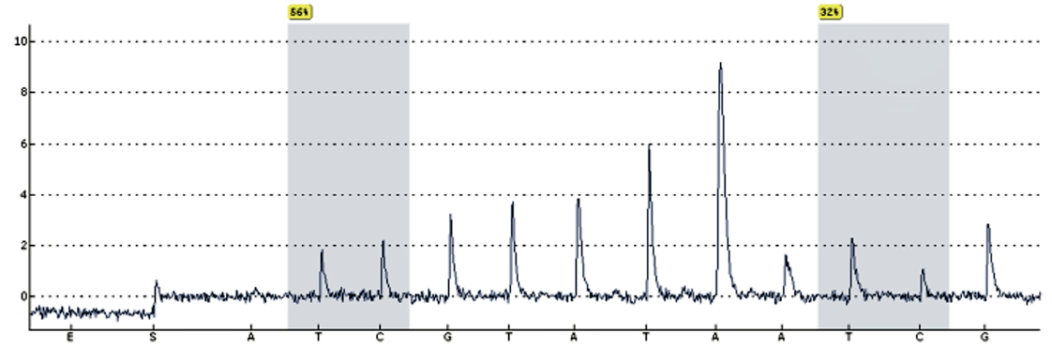
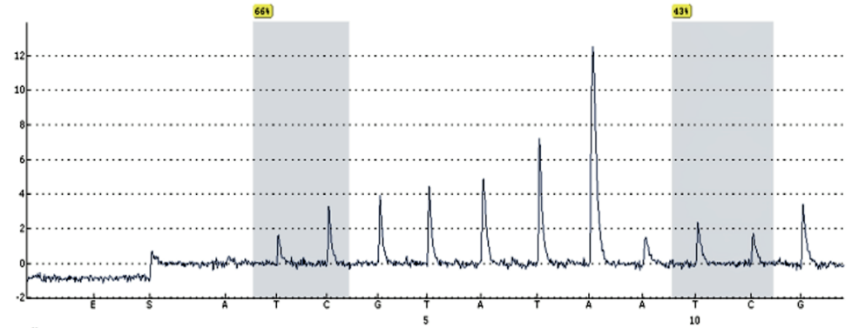
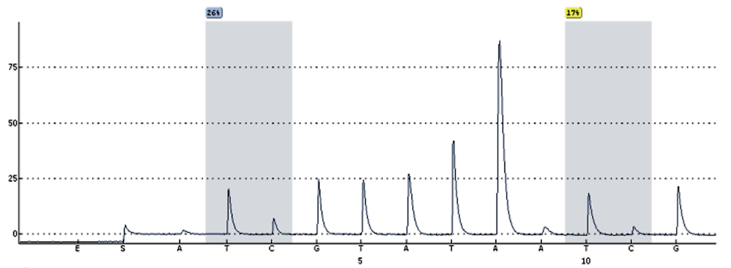
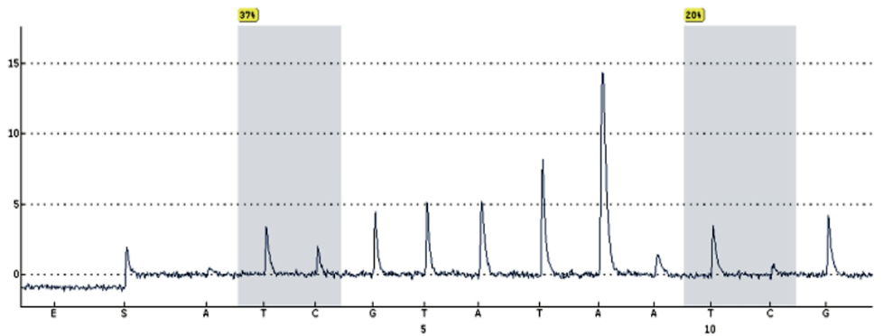
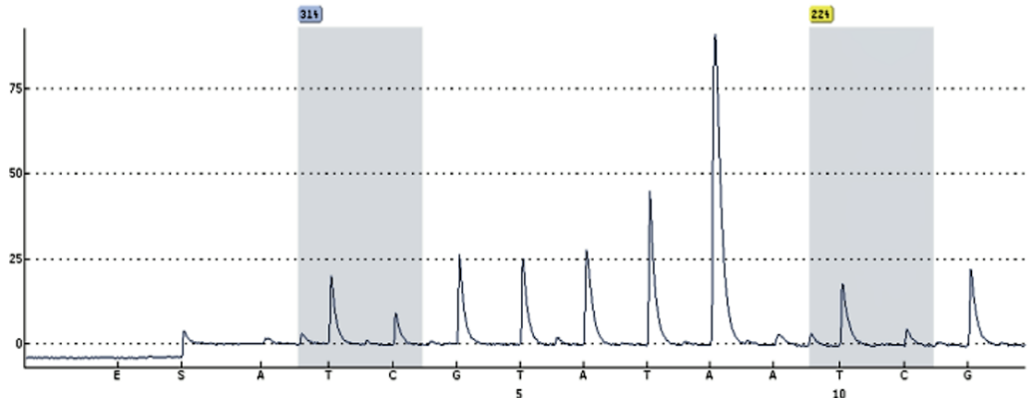
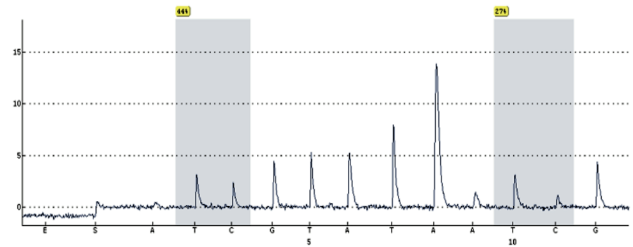
Supplemental file 13
A
B
Parental P39 sensitive to AZA
Parental Kasumi-1 sensitive to AZA
Parental P39 sensitive to DEC
Parental Kasumi-1 sensitive to DEC
P39-AZA-R
Kasumi-1-AZA-R
P39-DEC-R
Kasumi-1-DEC-R

