Slide 1
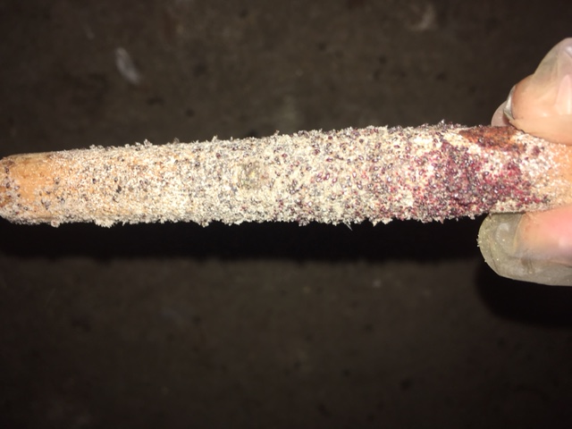
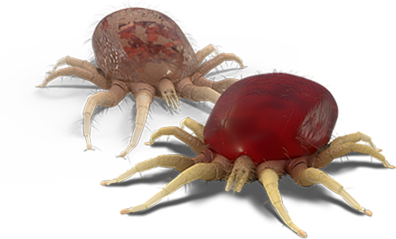
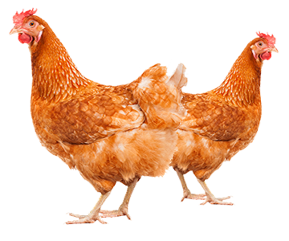
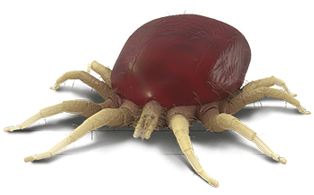
Red mite infestation
STRESS RESPONSE
WELFARE CONSIDERATIONS
Mites on trap
Mites on trap
PHYSIOLOGICAL IMPROVEMENT
BEHVIOURAL CHANGES
PRODUCTION IMPROVEMENT

