Slide 1
Lung CCR6-CXCR3- Th2 cells as an indicator of progressive fibrosing interstitial lung diseases: A prospective observational study
Tsukie Kin Tsukuda, Minoru Fujimoto, Hiroshi Ohnishi, Yu Nakantani, Kazufumi Takamatsu, Tetsuji Naka, and Akihito Yokoyama
Additional data
Supplemental Method：3 pages
Supplemental Figures: Fig.E1, Fig E2
Supplemental Figure legends: 2 pages

Slide 2
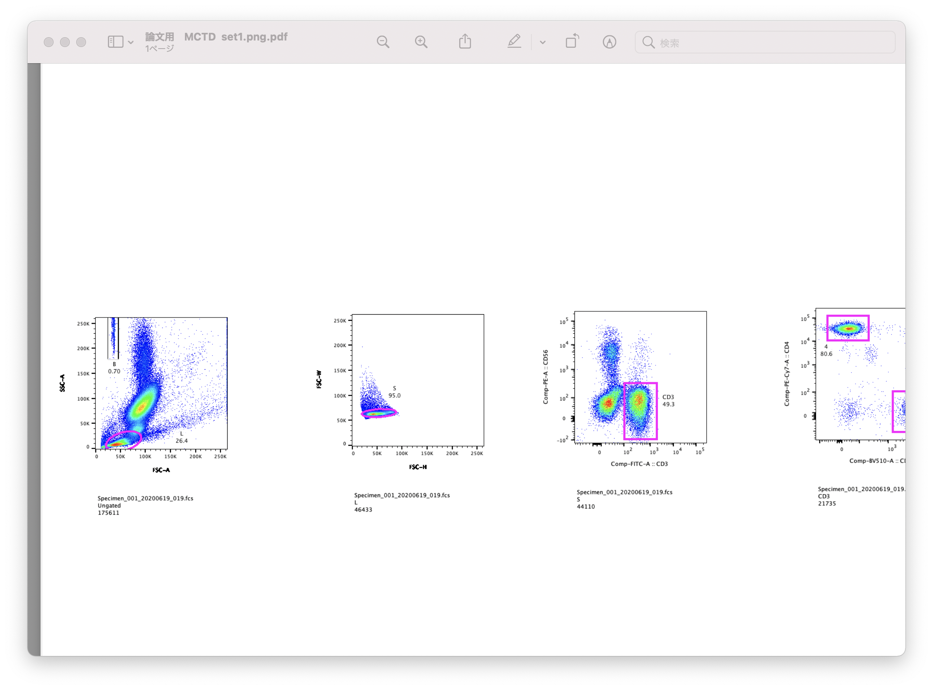
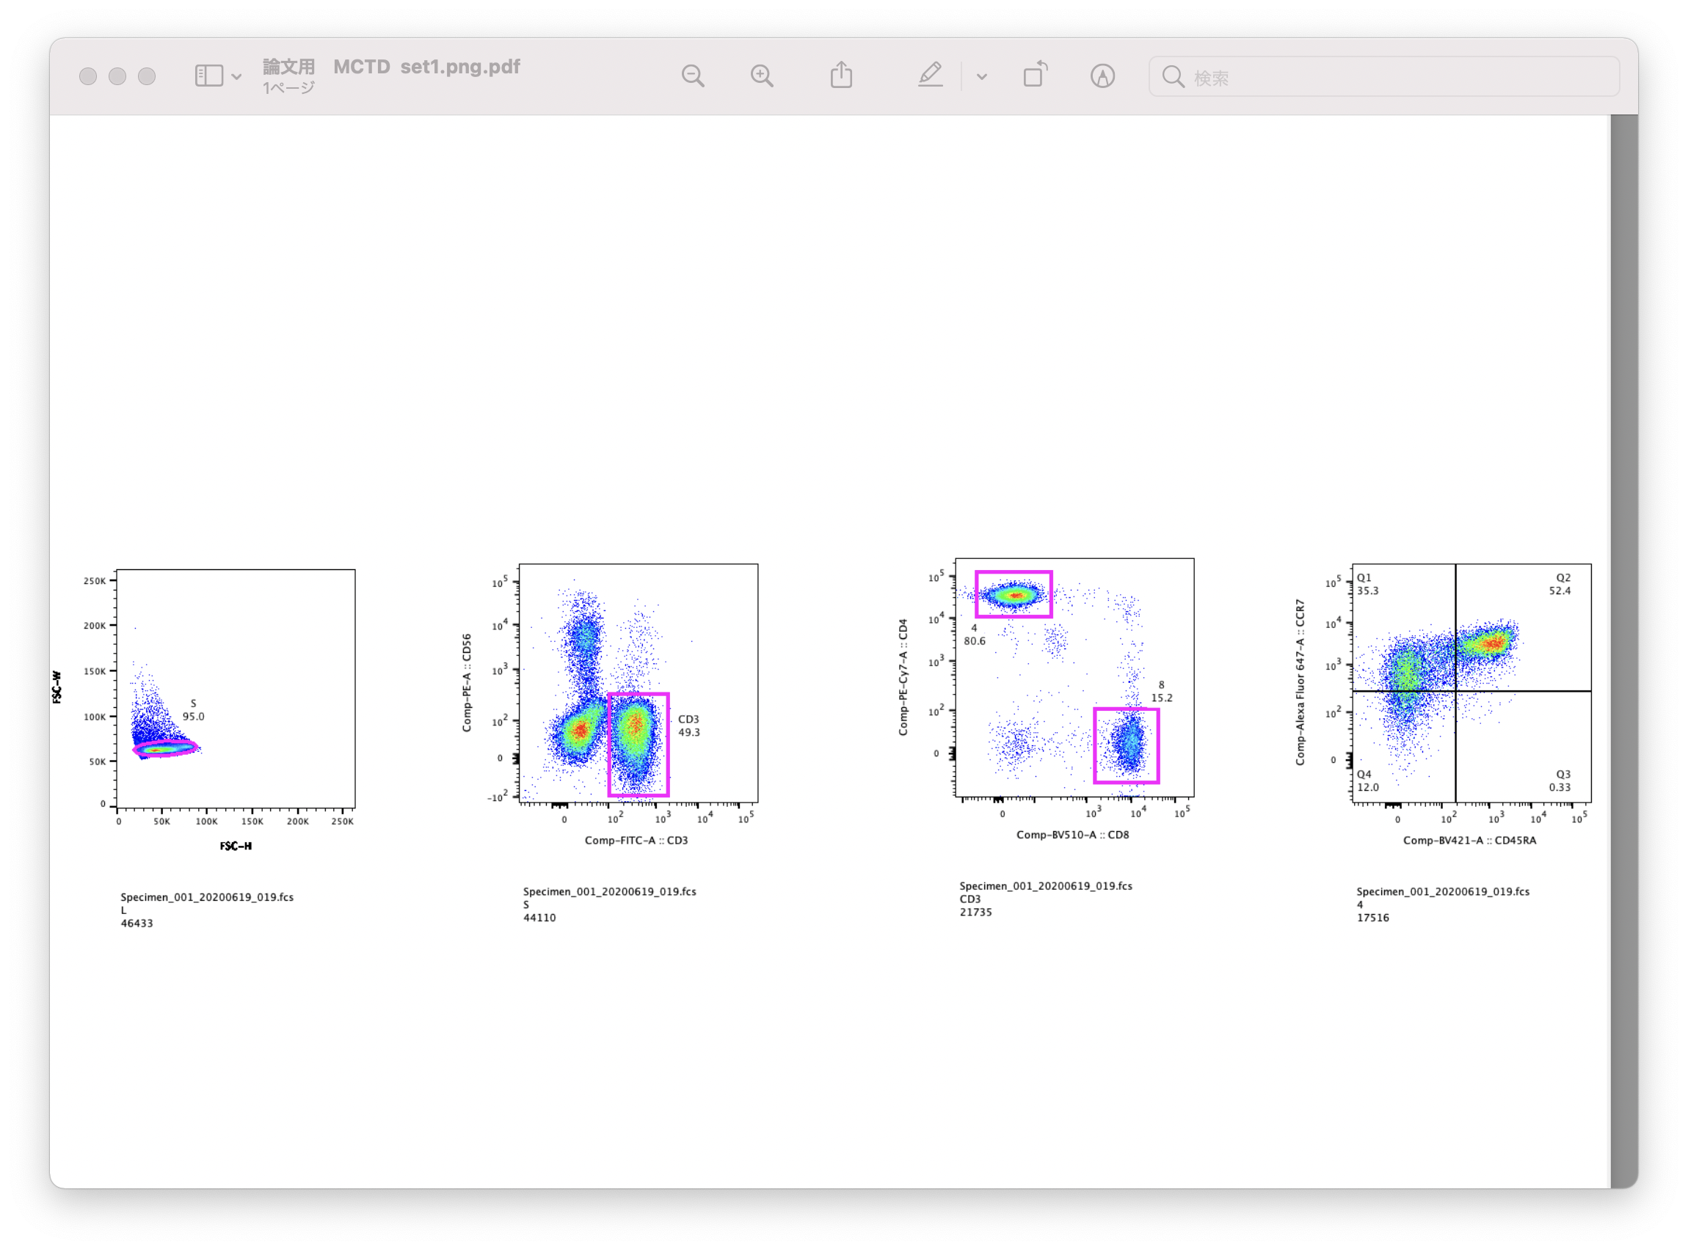
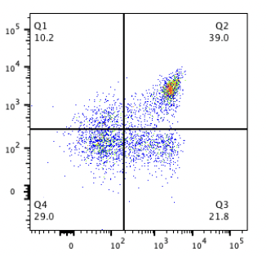
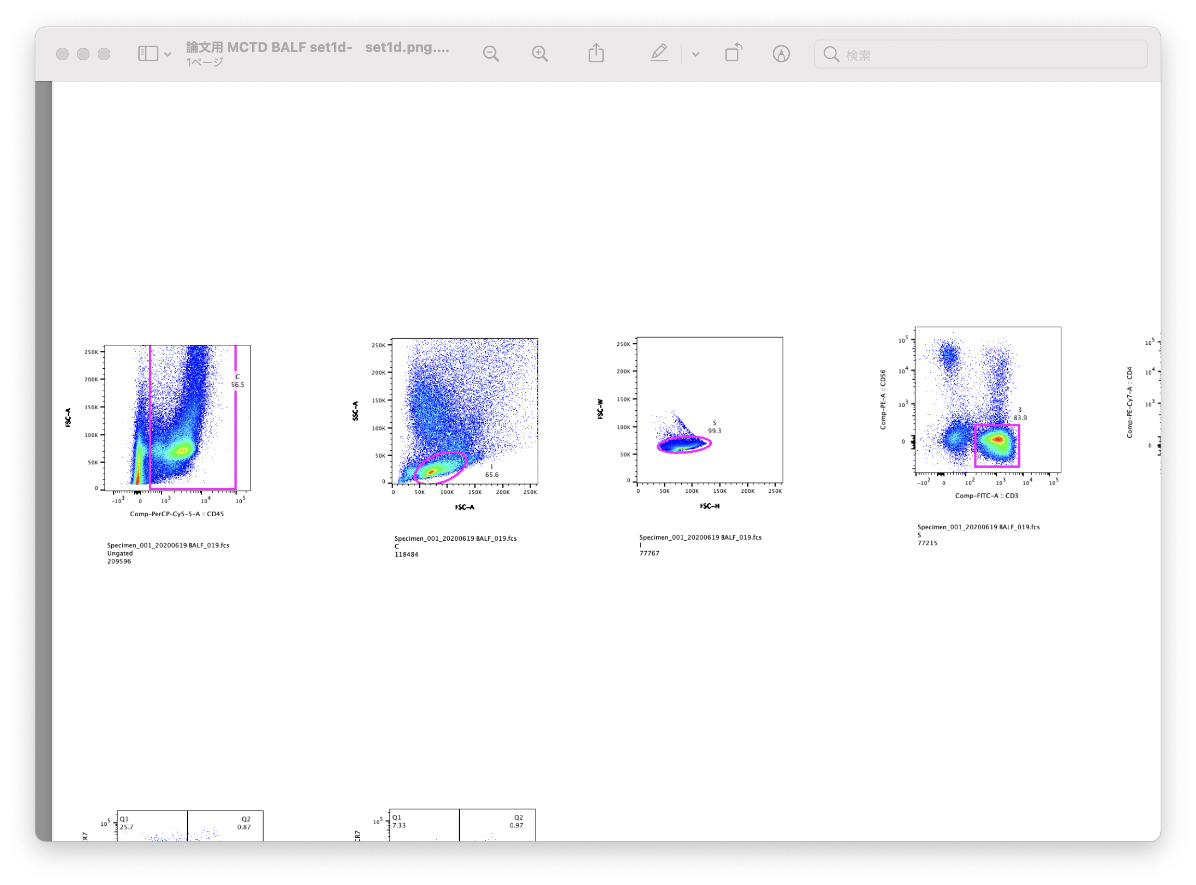
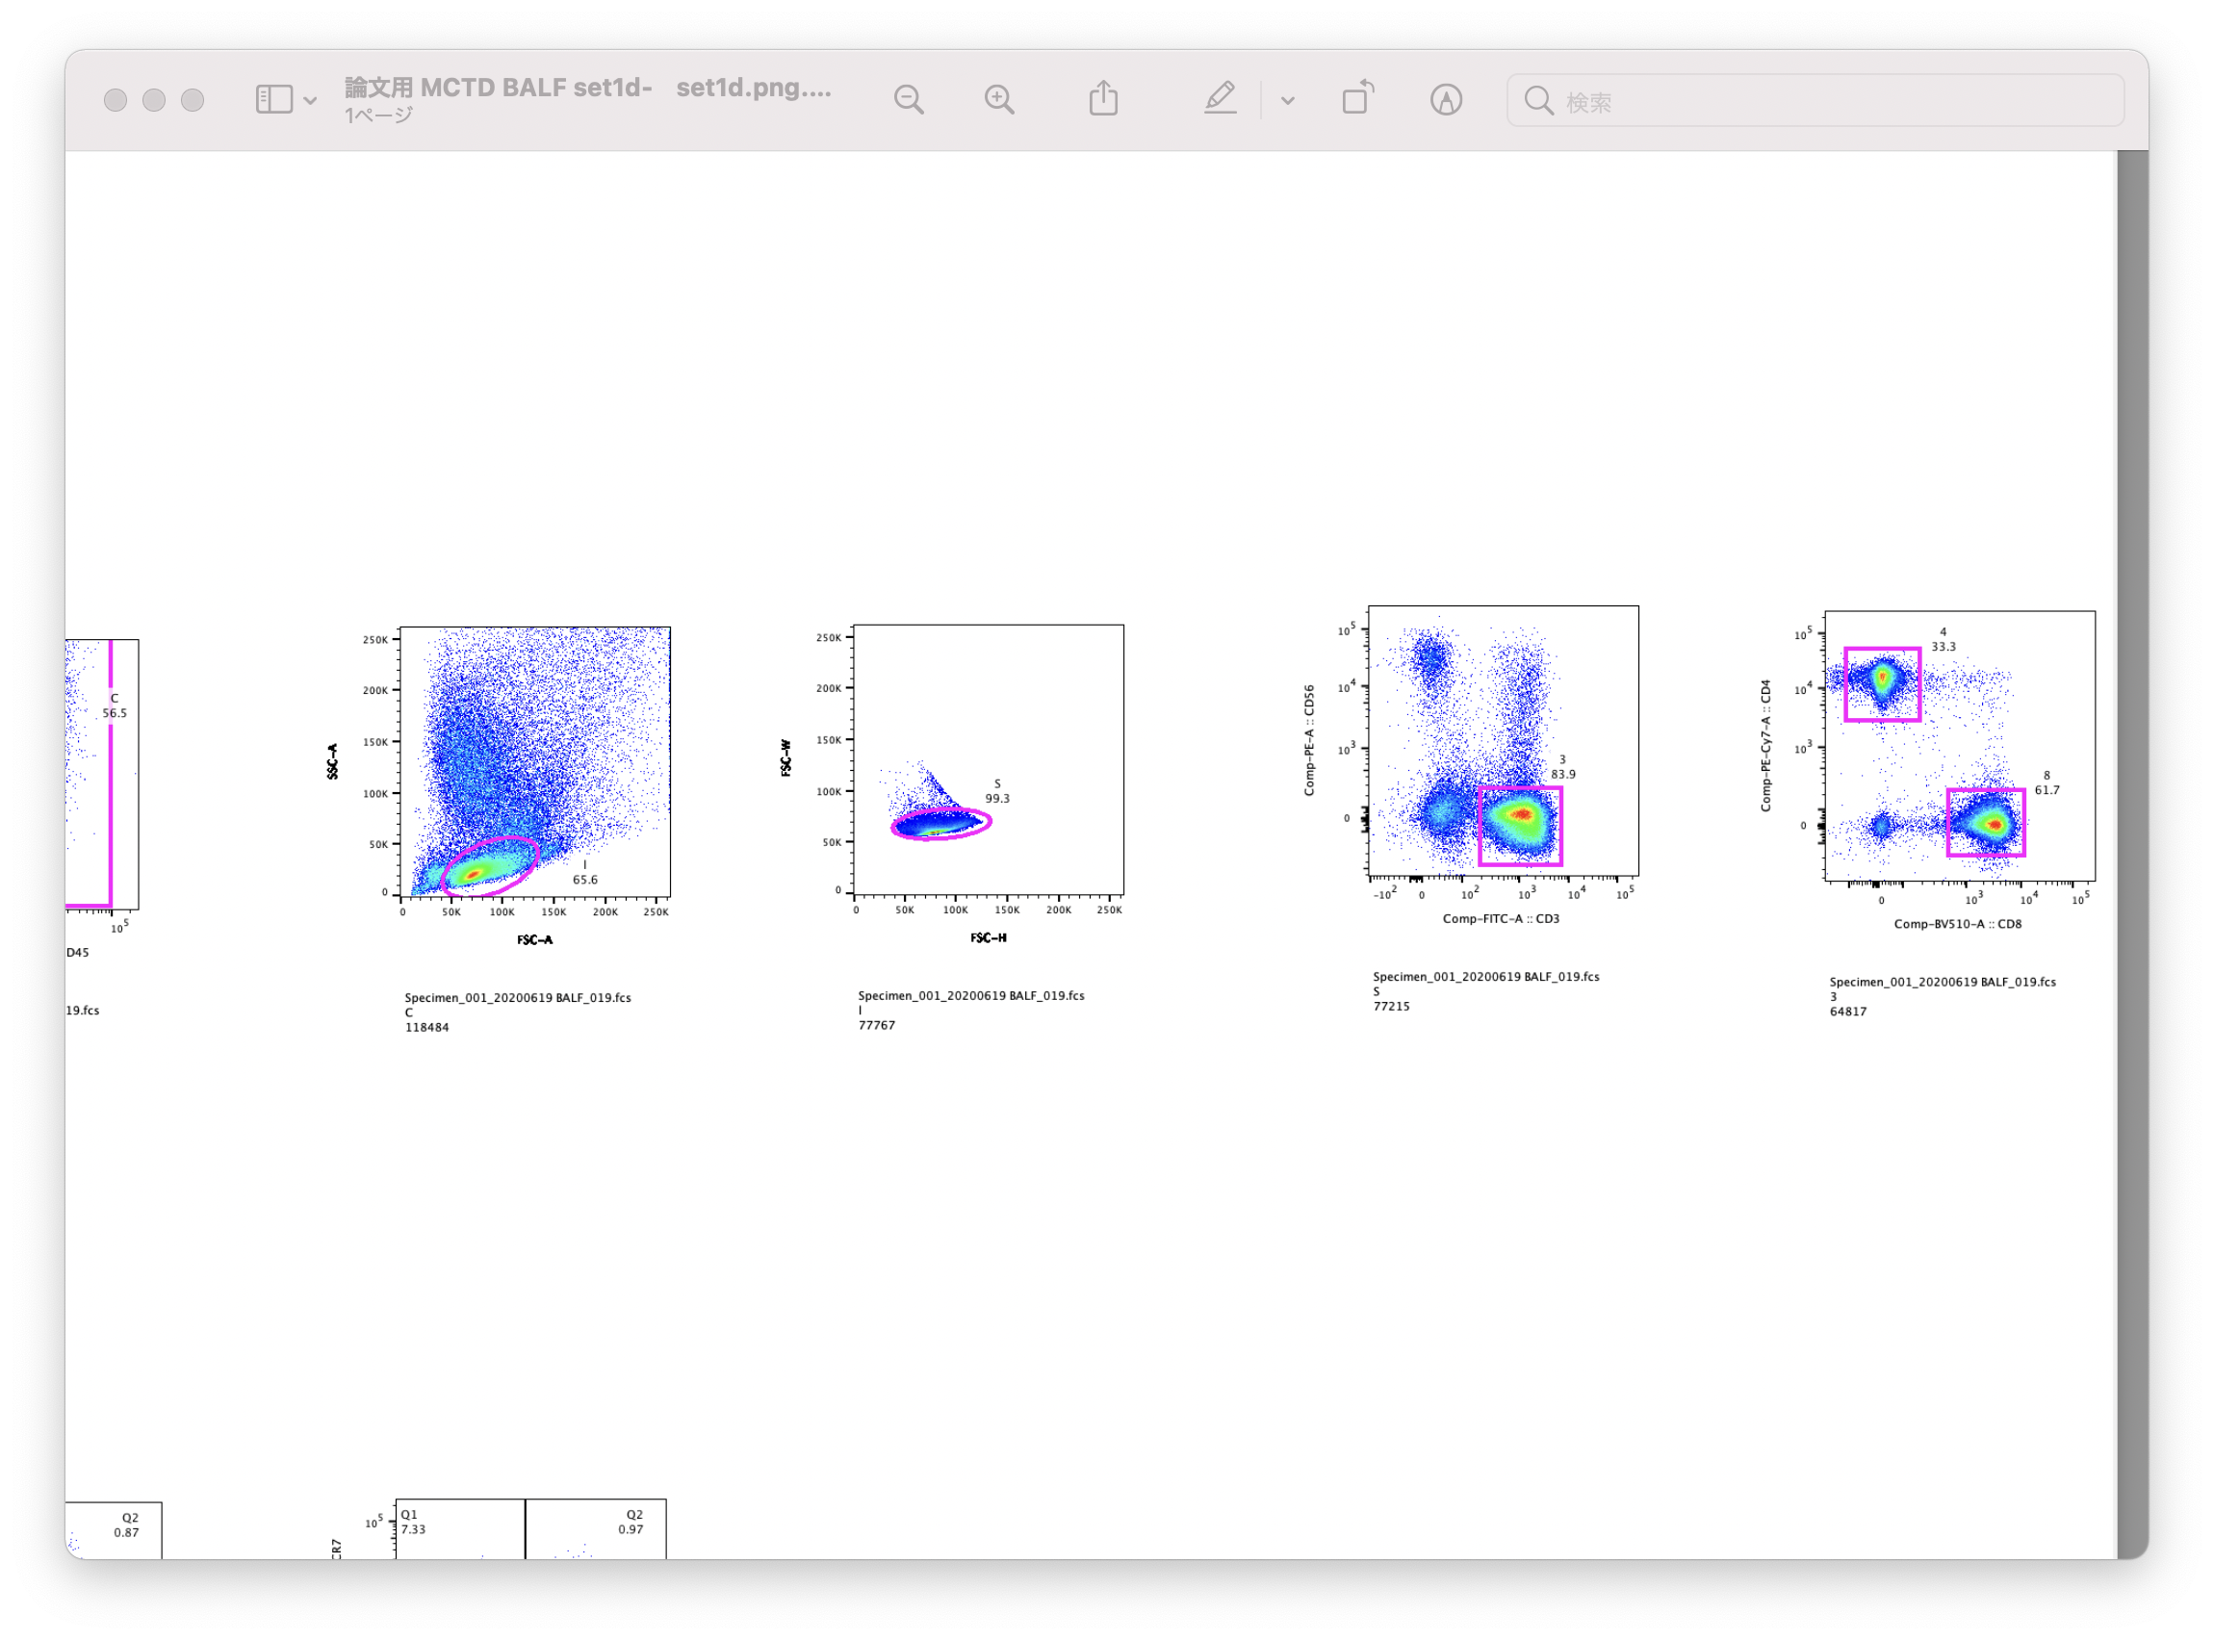
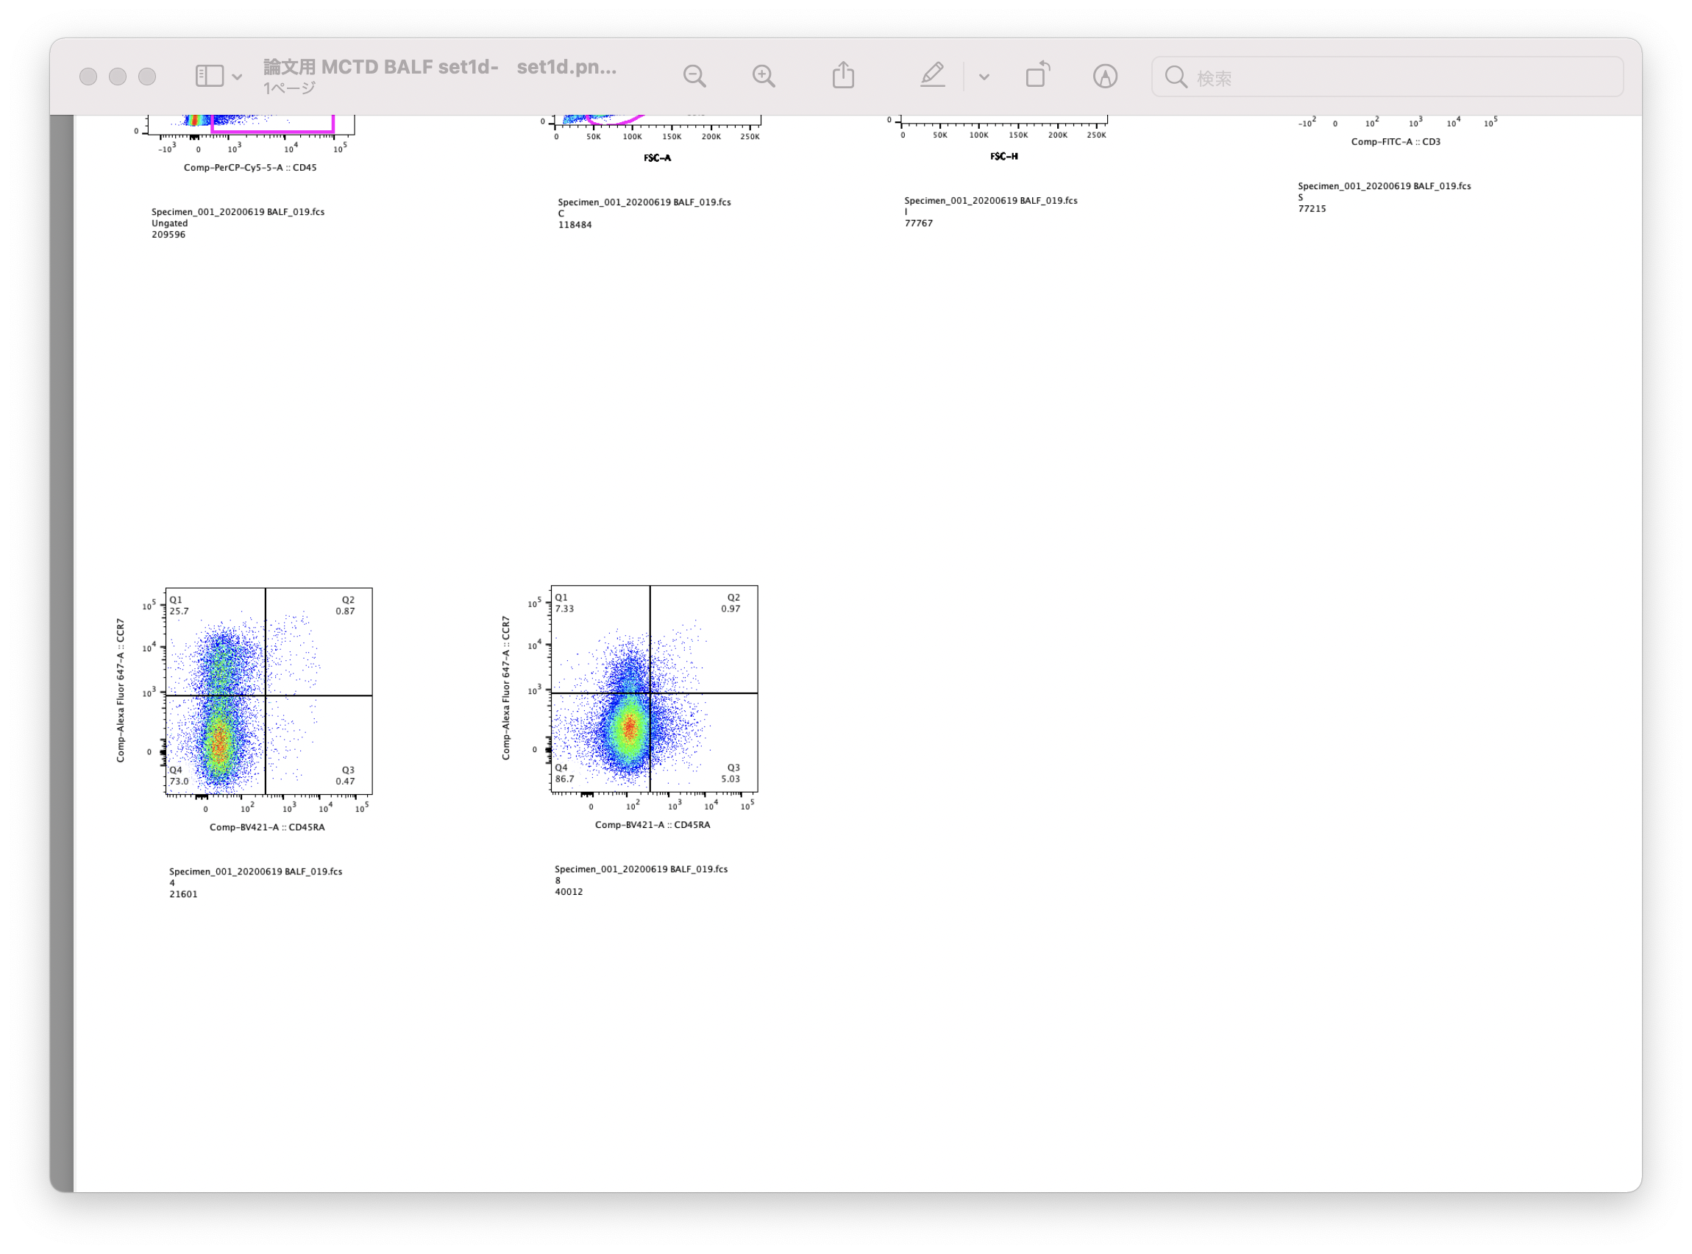
Figure E1.
A
Beads
CD4
Single cells
CD8
^{FSC-W}
^{CD56}
T cells
^{CD4}
^{SSC}
Lymphocytes
^{FSC}
^{FSC-H}
^{CD3}
CD8
^{CD8}
CD4
T_{CM}
T_{N}
T_{CM}
T_{N}
^{CCR7}
^{CCR7}
T_{EM}
TEMRA
T_{EM}
TEMRA
^{CD45RA}
^{CD45RA}
CD4
B
CD45⁺cells
Single cells
T cells
CD8
^{FSC-W}
^{CD56}
^{CD4}
^{FSC}
^{SSC}
Lymphocytes
^{CD45}
^{FSC}
^{FSC-H}
^{CD3}
^{CD8}
CD4
CD8
T_{CM}
T_{N}
T_{CM}
T_{N}
^{CCR7}
^{CCR7}
T_{EM}
TEMRA
T_{EM}
TEMRA
^{CD45RA}
^{CD45RA}

Slide 3
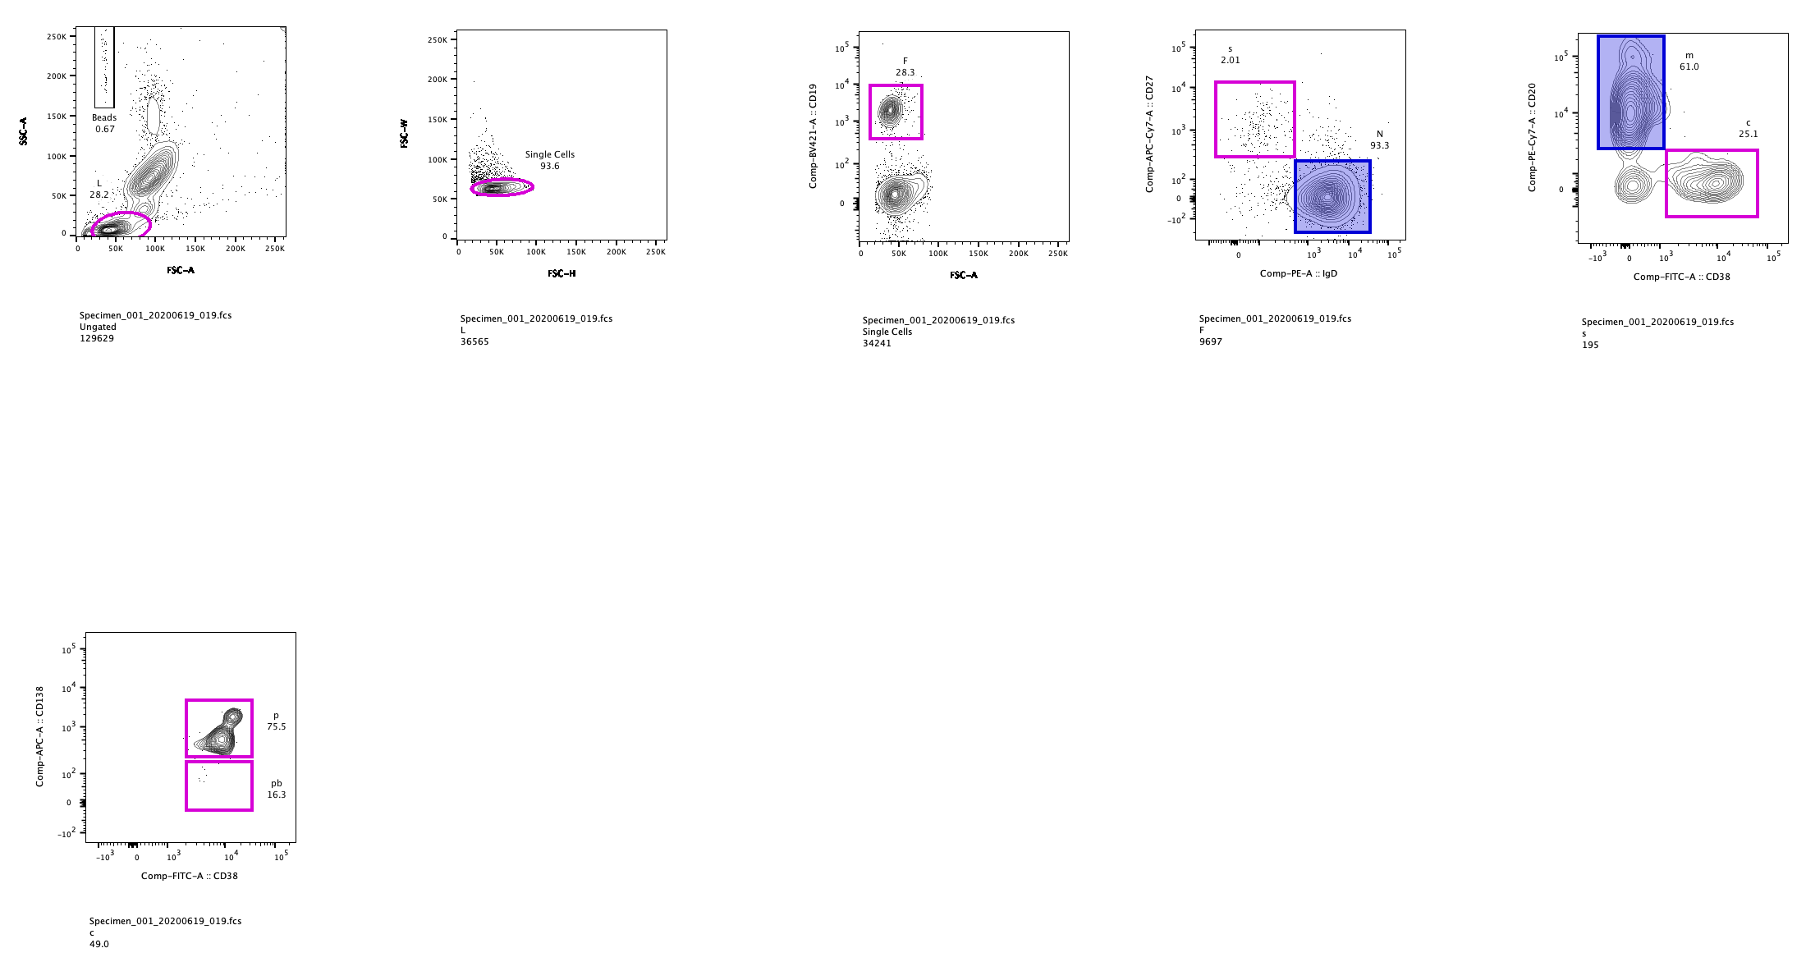
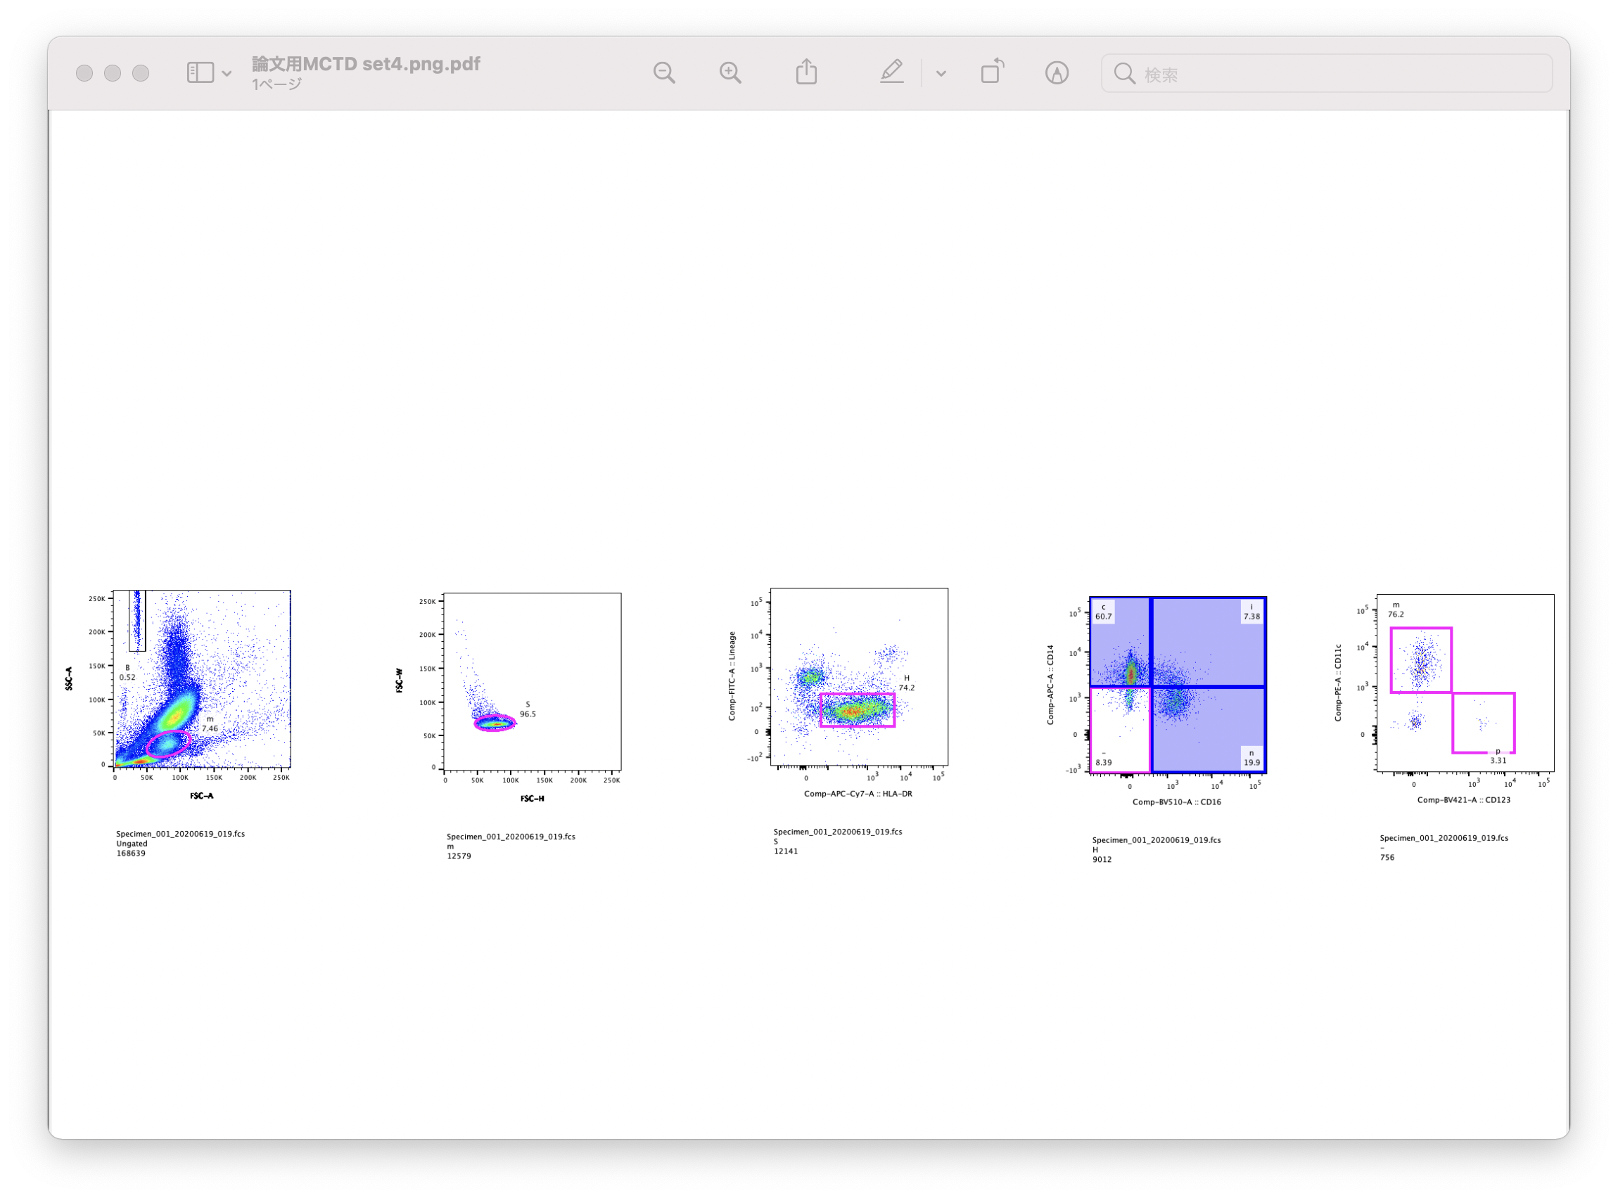
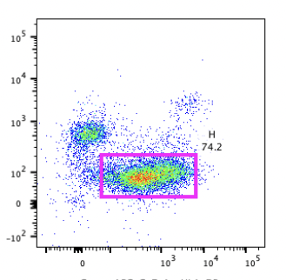
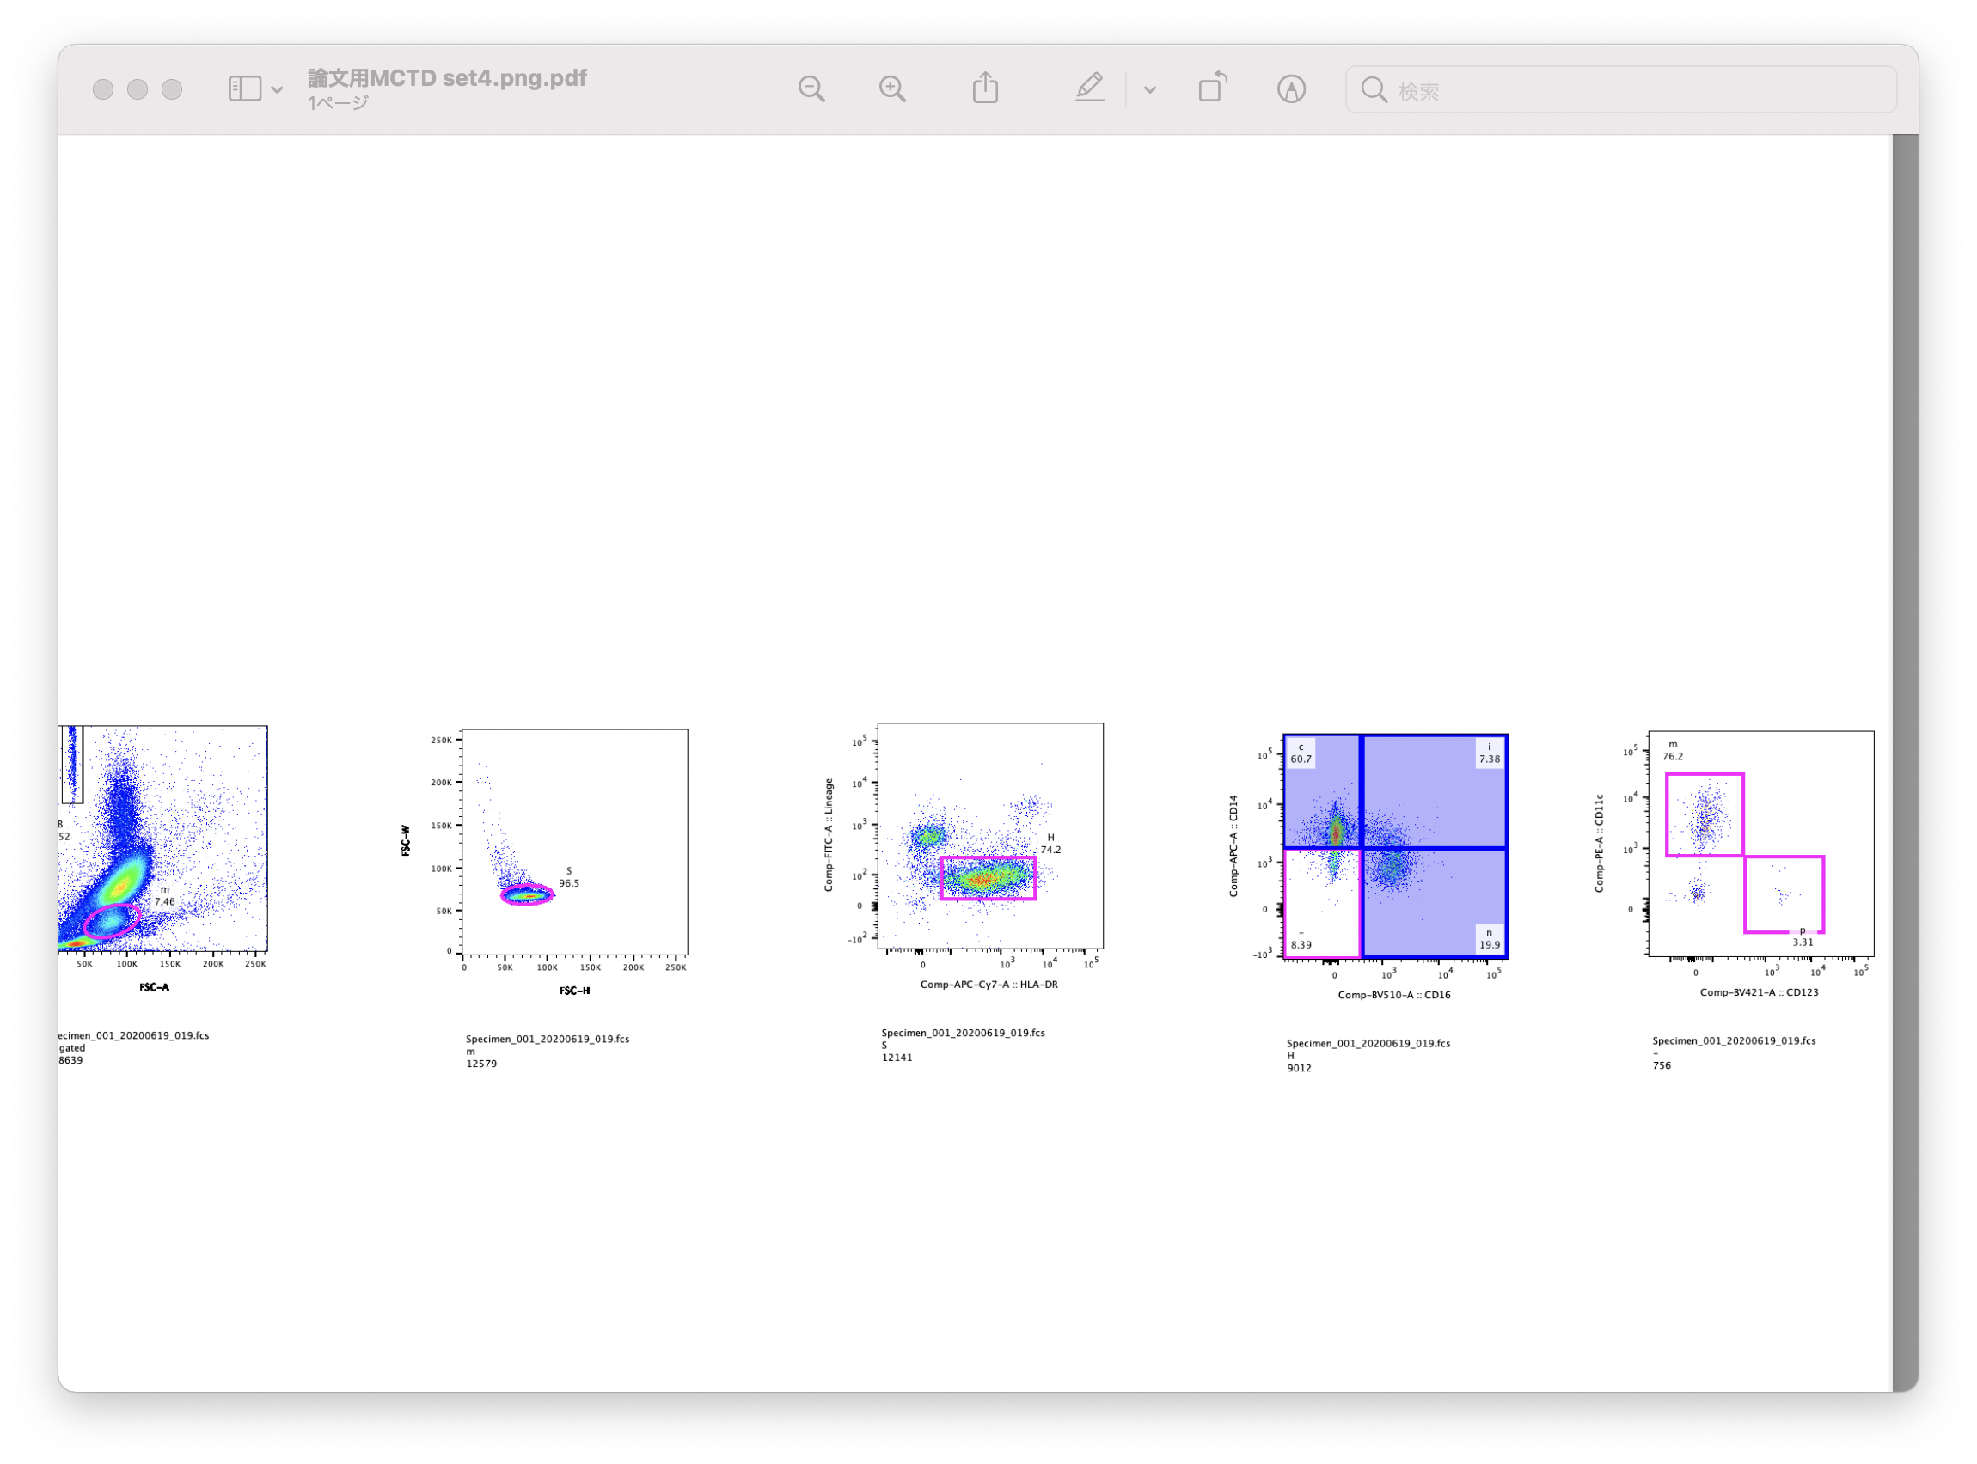
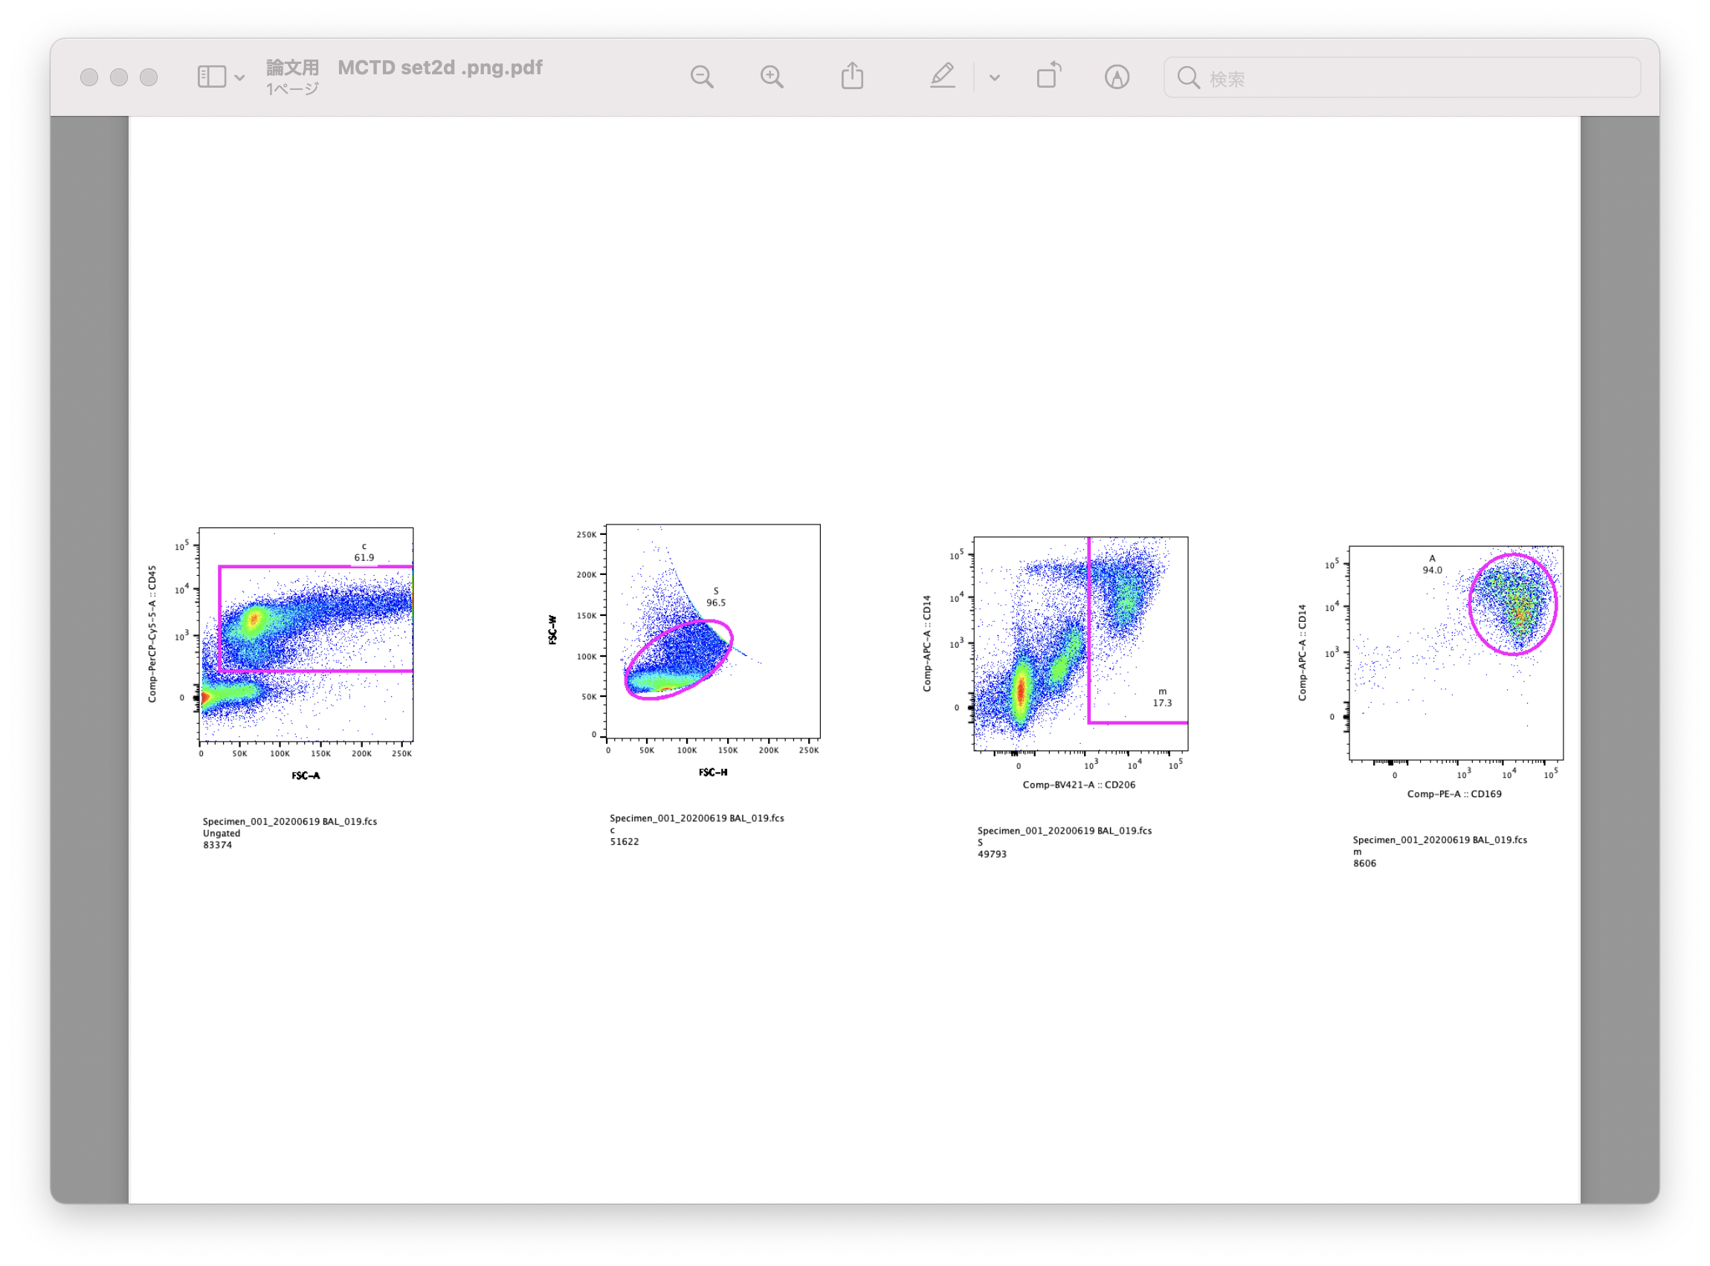
Figure E2.
Beads
B cell
Switched B cell
Memory B cell
A
Naïve B cell
CD38⁺CD20⁻
Plasma cell
^{FSC-W}
Single cells
^{CD19}
Plasma blast
^{SSC}
^{CD27}
^{CD20}
^{CD138}
Lymphocytes
^{FSC}
^{FSC-H}
^{FSC-A}
^{IgD}
^{CD38}
^{CD38}
Classical
Intermediate
Myeloid DC
B
Beads
HLA-DR⁺
Lineage⁻
Single cells
^{Lineage}
^{CD14}
^{CD11c}
^{SSC}
Monocytes
^{FSC-W}
CD16⁻CD14⁻
Non classical
Plasmacytoid DC
^{FSC}
^{FSC-H}
^{HLA-DR}
^{CD16}
^{CD123}
CD45⁺cells
Alveolar MΦ
C
Single cells
^{FSC}
^{FSC-W}
^{CD14}
Macrophage
^{CD14}
^{CD45}
^{FSC-H}
^{CD206}
^{CD169}

