Slide 1
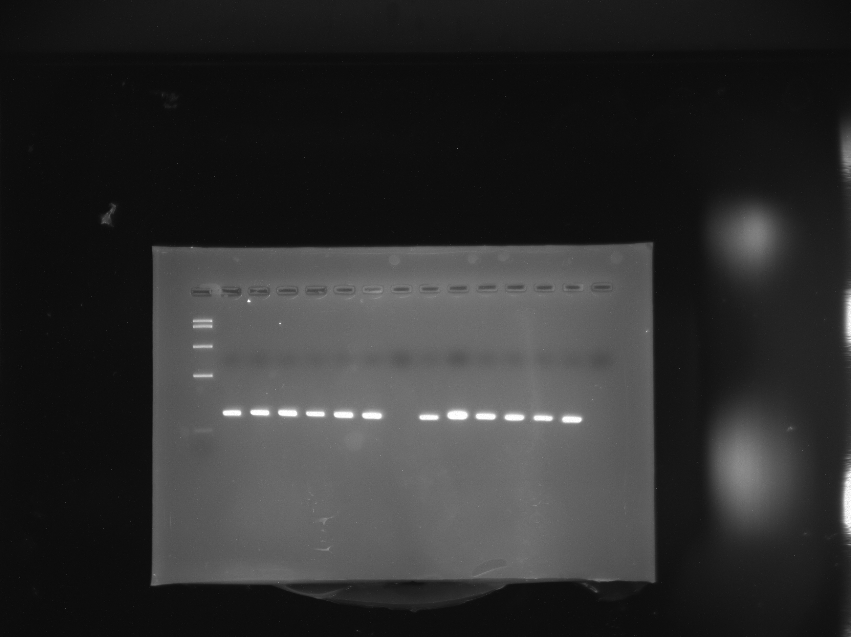
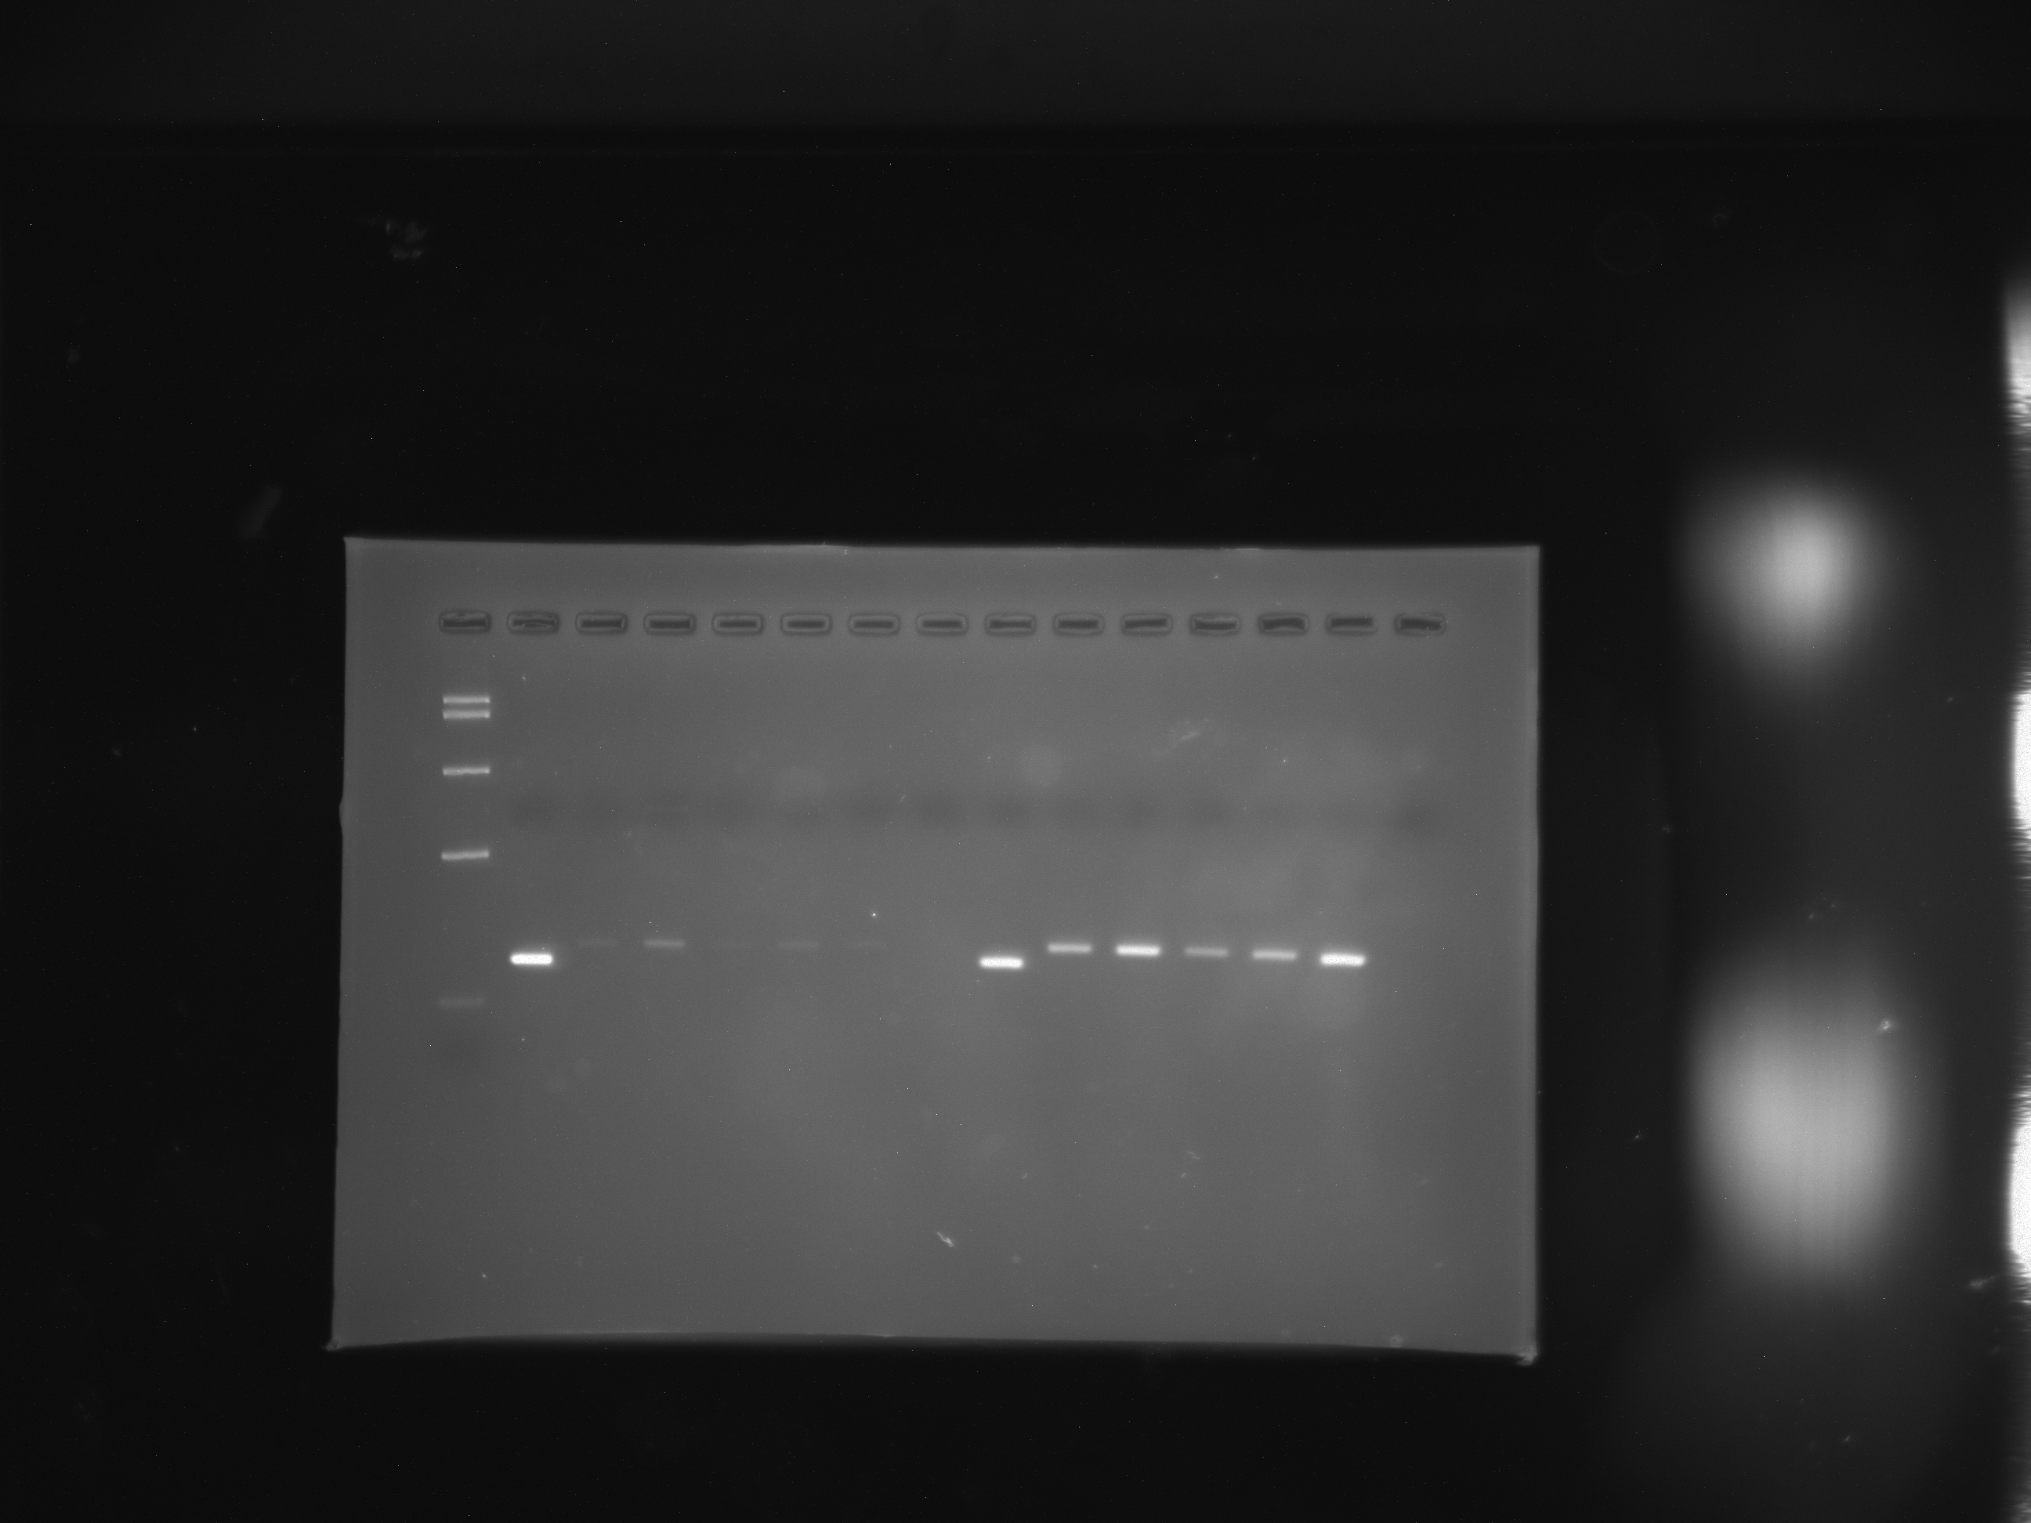
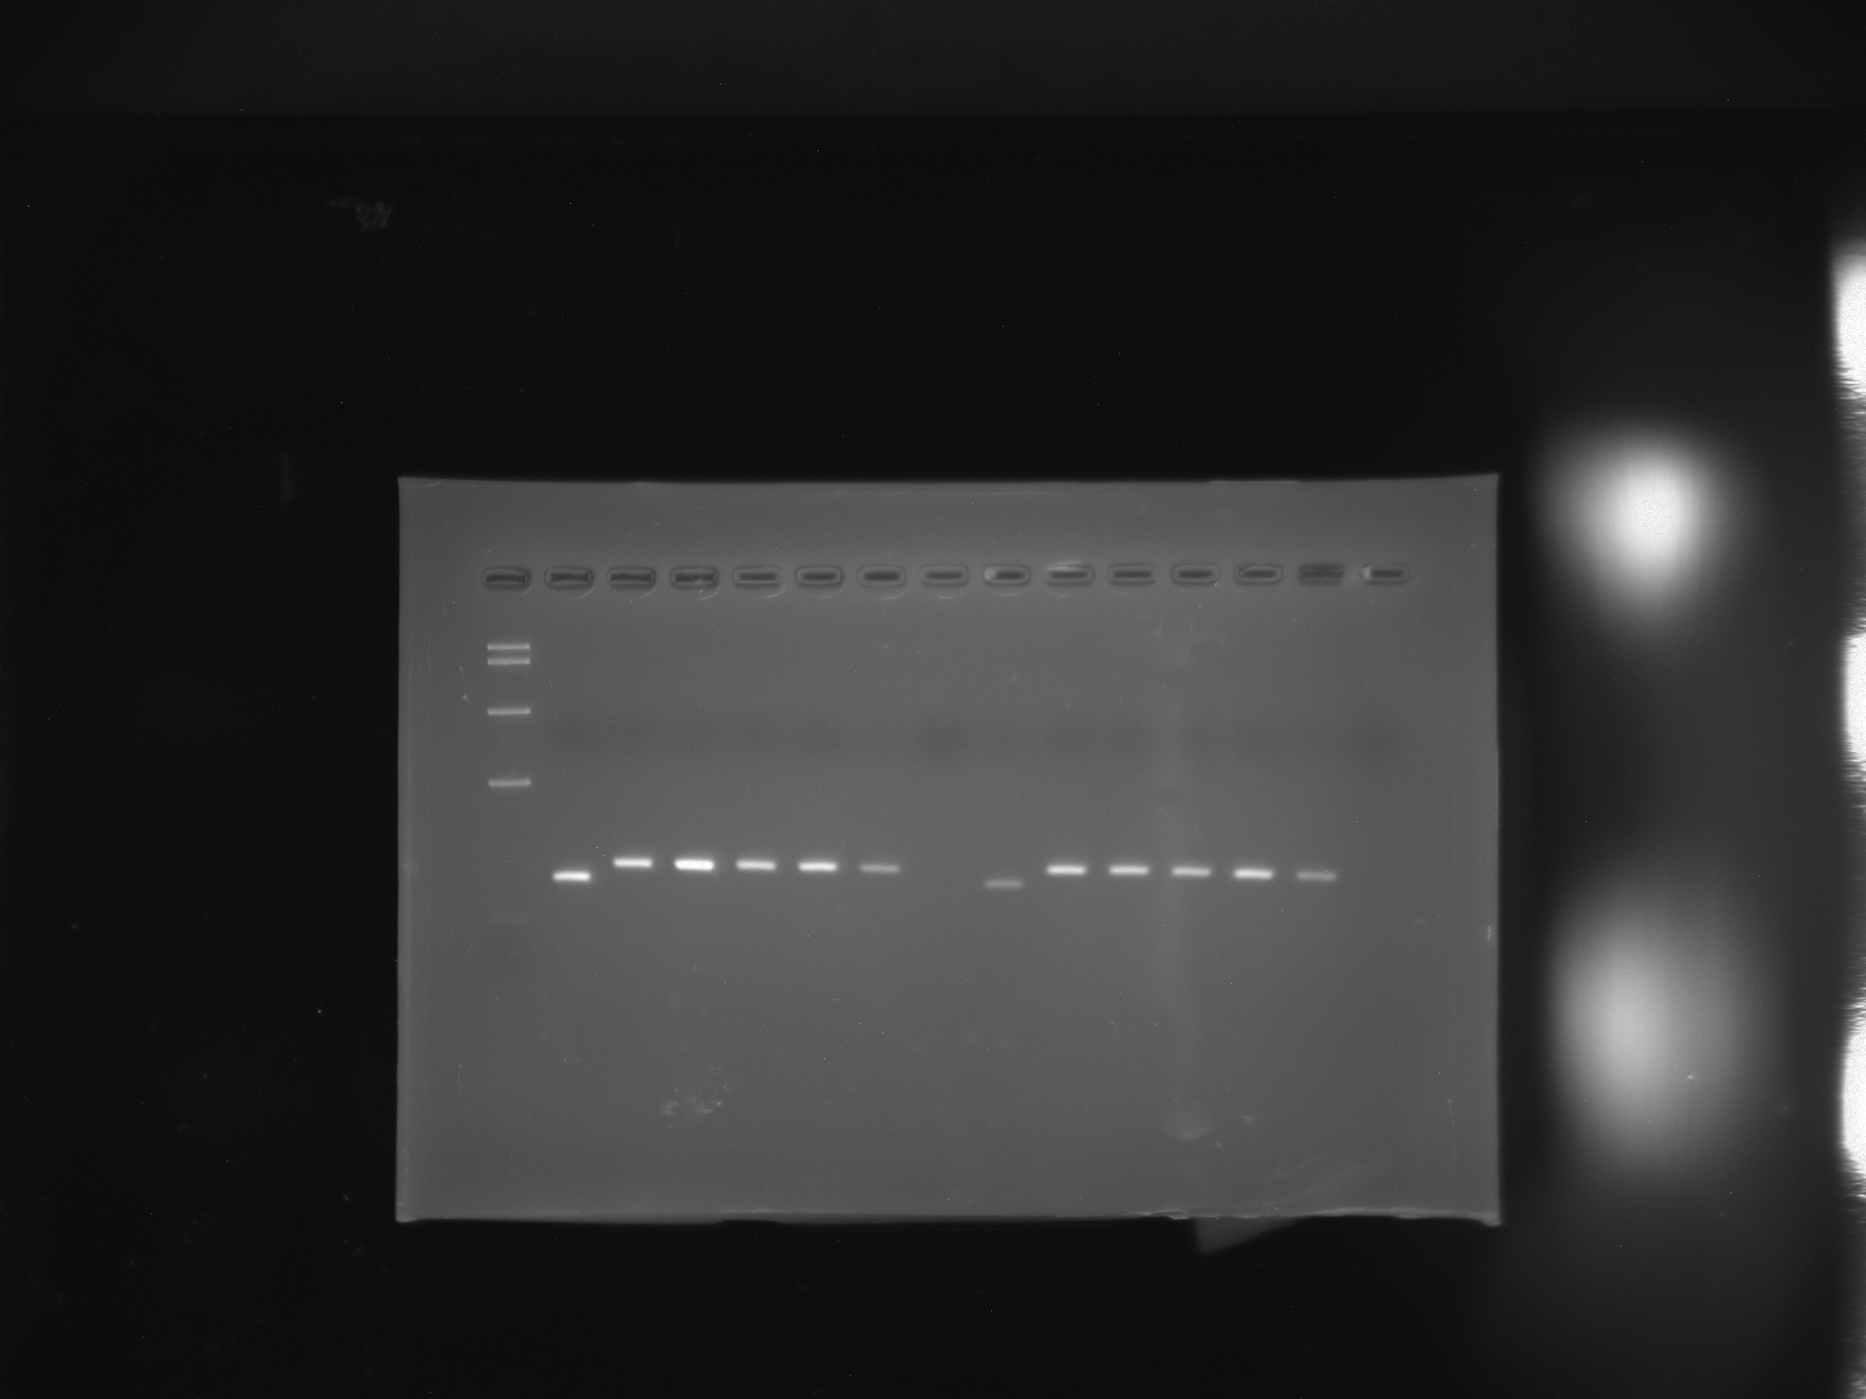
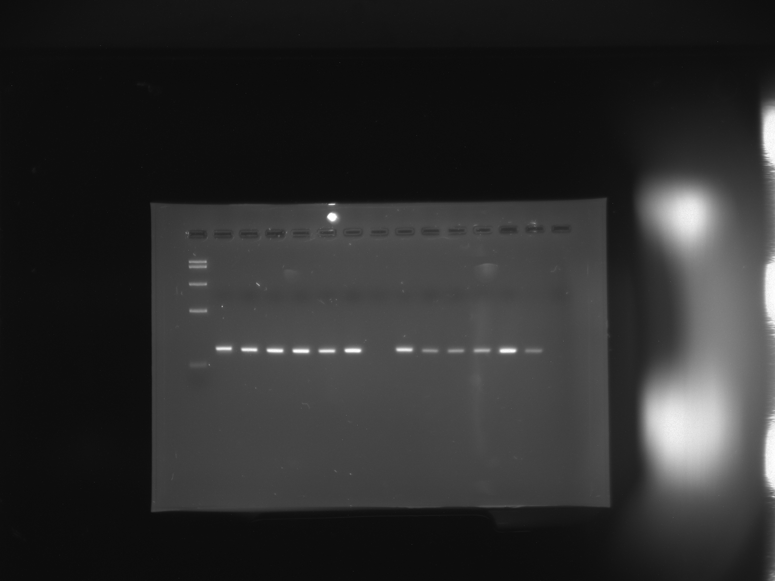
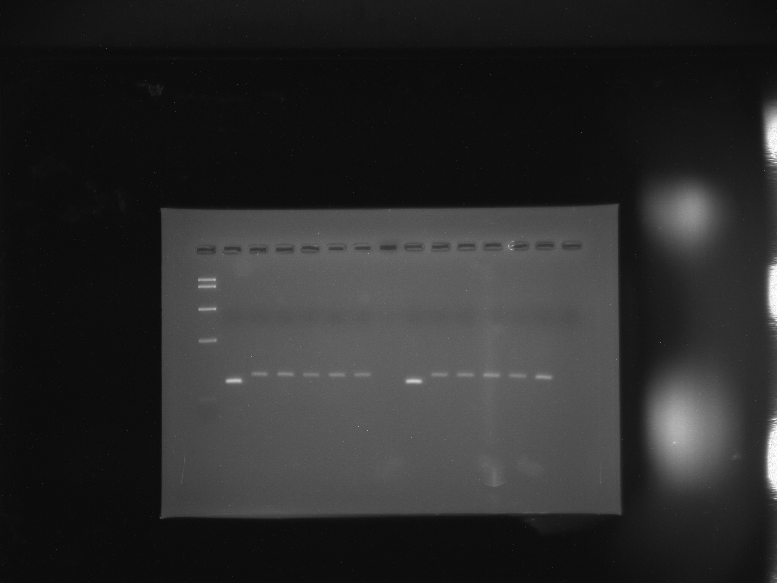
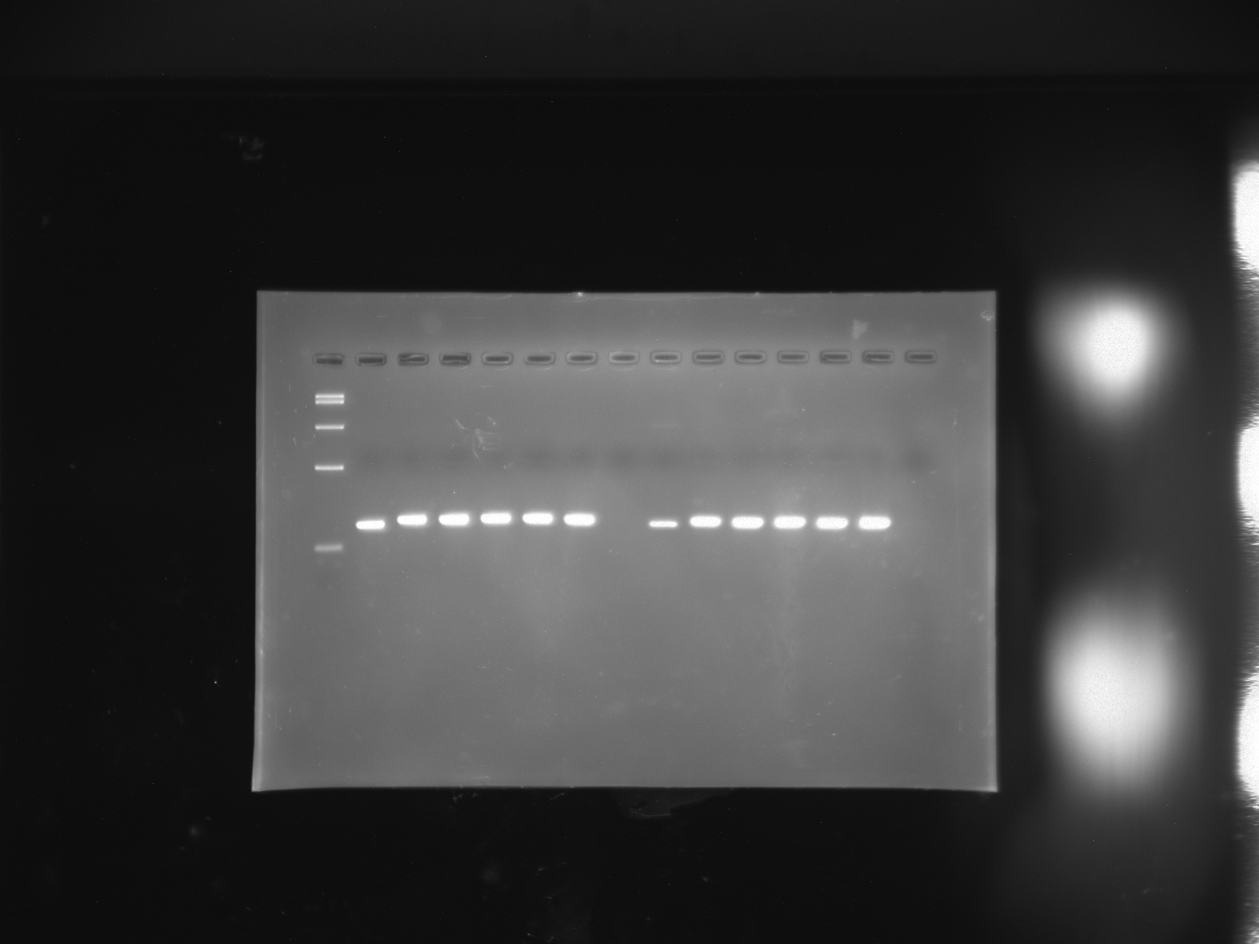
Supplementary Figure 1
A
B
Asu-gon-2
Asu-ced-11
_{Intestine}
_{Muscle bag region}
_{Intestine}
_{Muscle bag region}
_{Ci}
_{2b}
_{4b}
_{NC}
_{1i}
_{2i}
_{1b}
_{3b}
_{5b}
_{3i}
_{4i}
_{5i}
_{Cb}
_{Ci}
_{2b}
_{4b}
_{NC}
_{M}
_{NC}
_{1i}
_{2i}
_{1b}
_{3b}
_{5b}
_{3i}
_{4i}
_{5i}
_{Cb}
_{M}
_{NC}
5 Kb
5 Kb
2 Kb
2 Kb
850bp
850bp
400bp
400bp
100bp
100bp
C
D
Asu-trp-2
Asu-ocr-1
_{Intestine}
_{Muscle bag region}
_{Intestine}
_{Muscle bag region}
_{Ci}
_{2b}
_{4b}
_{NC}
_{1i}
_{2i}
_{1b}
_{3b}
_{5b}
_{3i}
_{4i}
_{5i}
_{Cb}
_{Ci}
_{2b}
_{4b}
_{NC}
_{M}
_{NC}
_{1i}
_{2i}
_{1b}
_{3b}
_{5b}
_{3i}
_{4i}
_{5i}
_{Cb}
_{M}
_{NC}
5 Kb
5 Kb
2 Kb
2 Kb
850bp
850bp
400bp
400bp
100bp
100bp
E
F
Asu-osm-9
Asu-trpa-1
_{Intestine}
_{Muscle bag region}
_{Intestine}
_{Muscle bag region}
_{Ci}
_{2b}
_{4b}
_{NC}
_{1i}
_{2i}
_{1b}
_{3b}
_{5b}
_{3i}
_{4i}
_{5i}
_{Cb}
_{Ci}
_{2b}
_{4b}
_{NC}
_{M}
_{NC}
_{1i}
_{2i}
_{1b}
_{3b}
_{5b}
_{3i}
_{4i}
_{5i}
_{Cb}
_{M}
_{NC}
5 Kb
2 Kb
5 Kb
850bp
2 Kb
400bp
850bp
100bp
400bp
100bp

