Slide 1
Supplementary data file 2
The effect of CPT-1A expression on overall survival in breast cancer and the relationship with the immune compartments.

Slide 2
Data obtained used the KM plotter. CPT-1A remains a poor prognostic marker at all stages at both low and high mutation burden. The immune compartments do not affect this. Expression of CPT-1A Poor prognostic marker at stage 2. Stage and mutational burden do not alter the effect of CPT-1A. All immune compartment data are from the RNA Seq dataset.

Slide 3
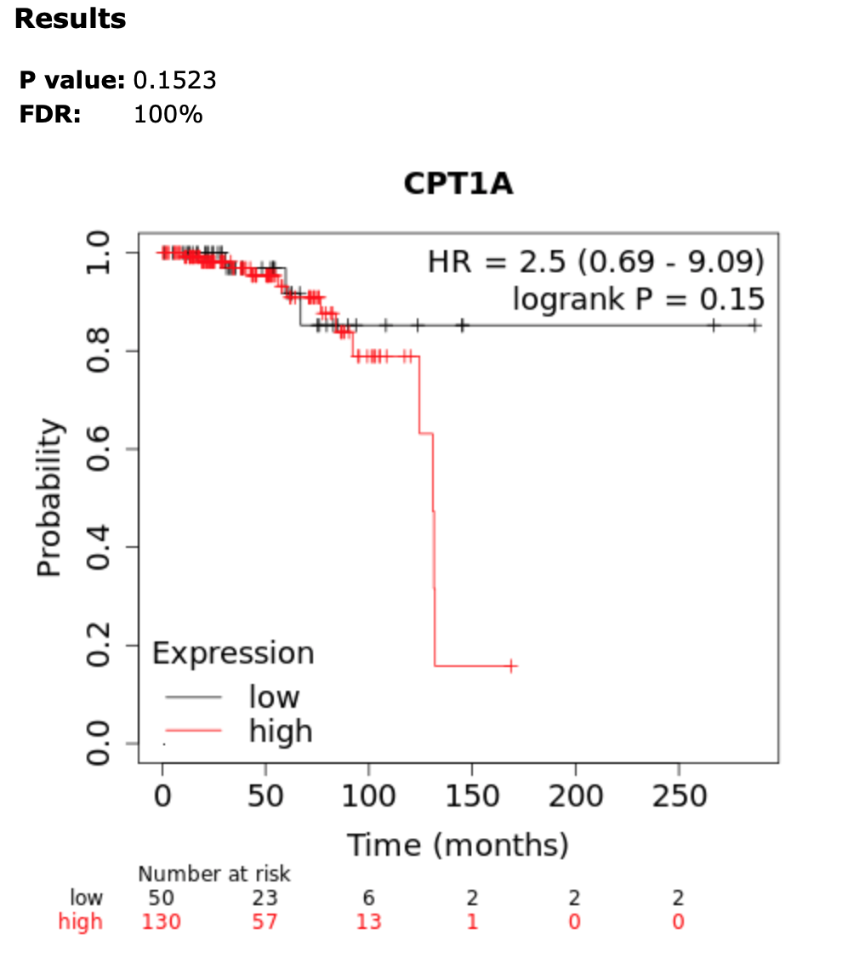
CPT-1A Overall Survival Stage 1
Notes:
No effect

Slide 4
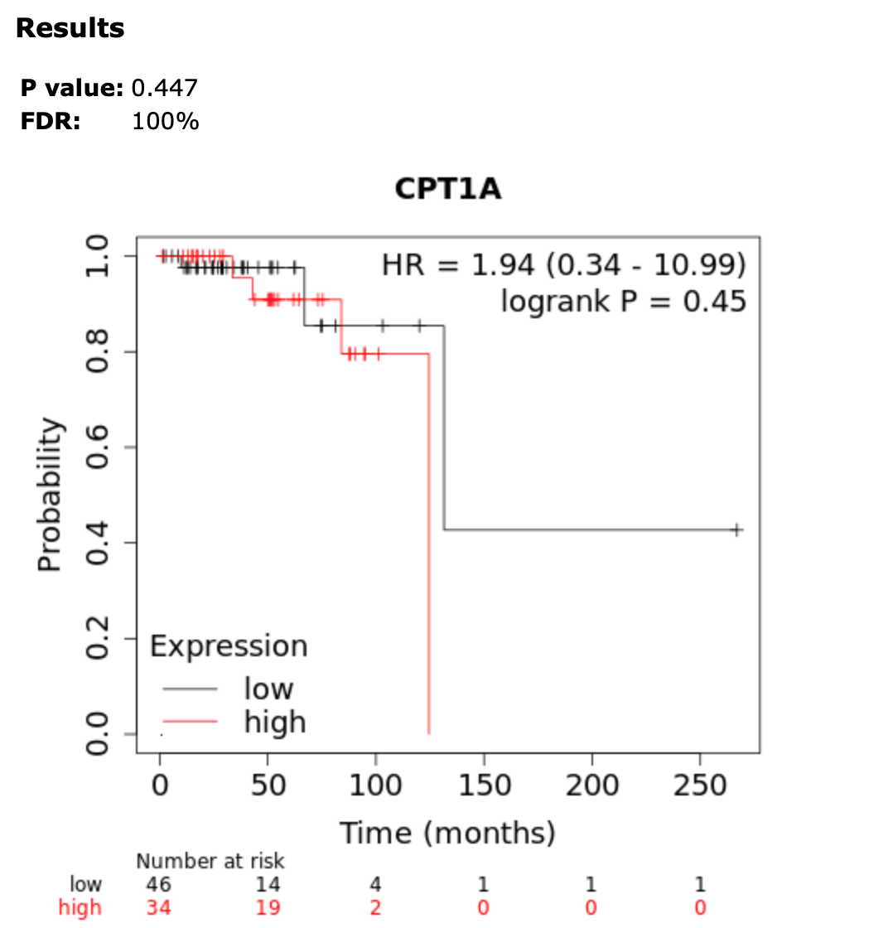
CPT-1A Overall Survival Stage 1 low mutation burden

Slide 5
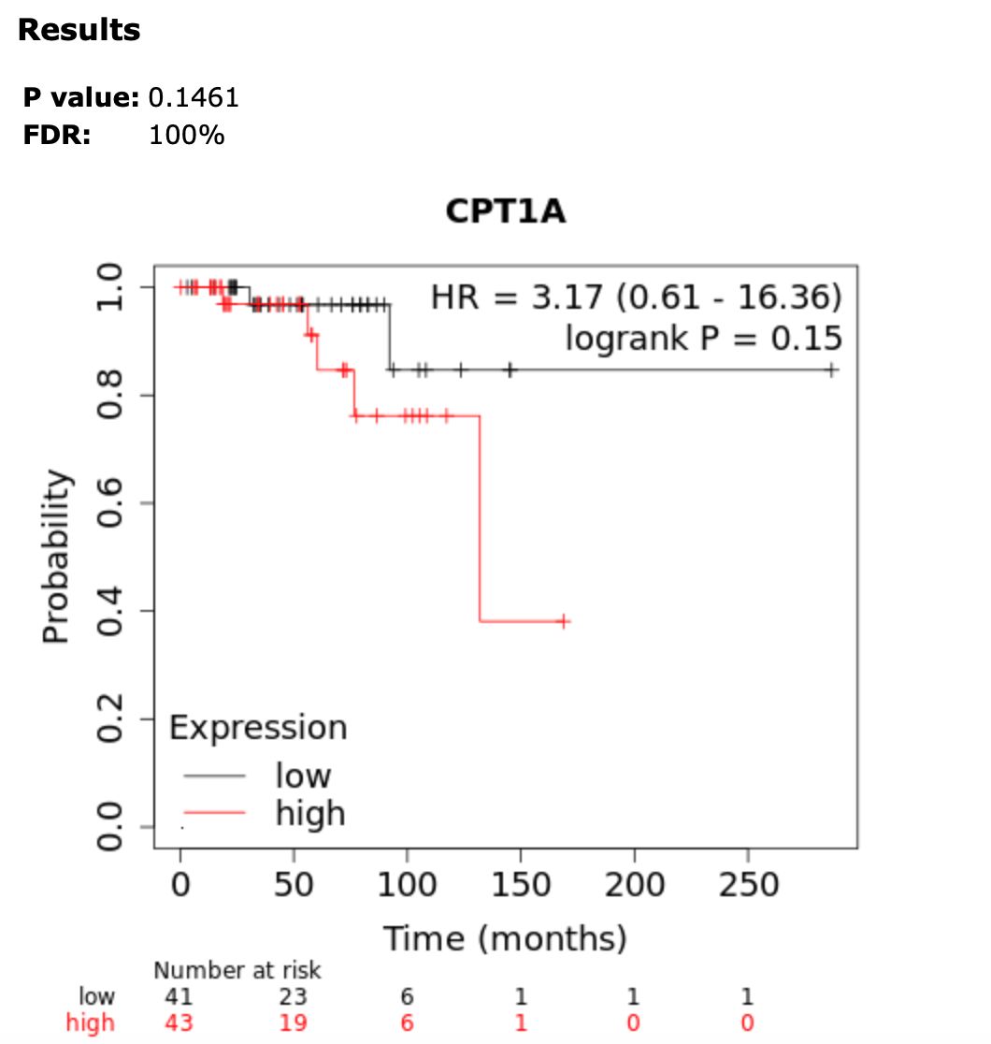
CPT-1A Overall Survival Stage 1 – high mutation burden

Slide 6
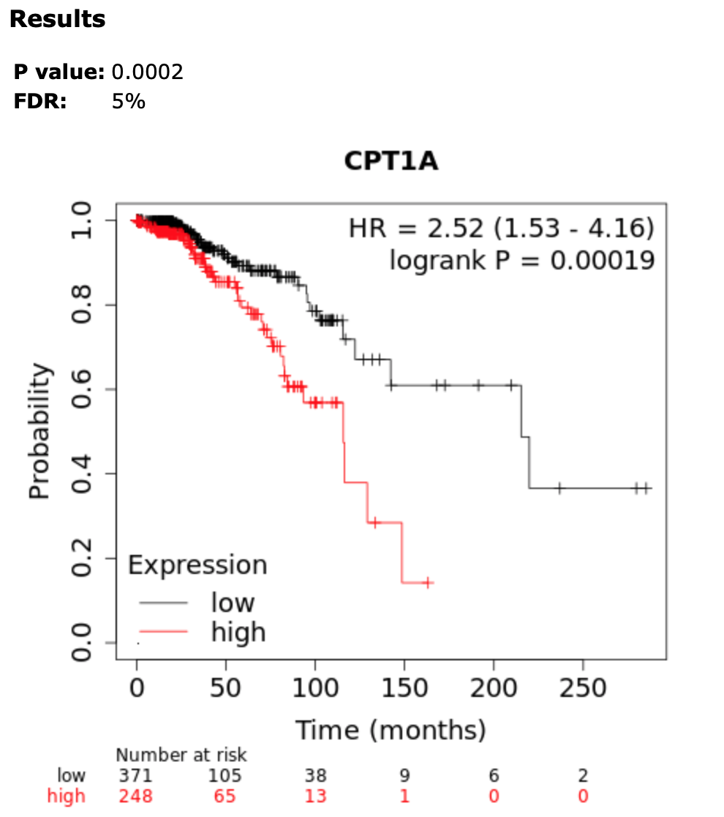
CPT-1A Overall Survival Stage 2
Notes:
Poor prognostic effect

Slide 7
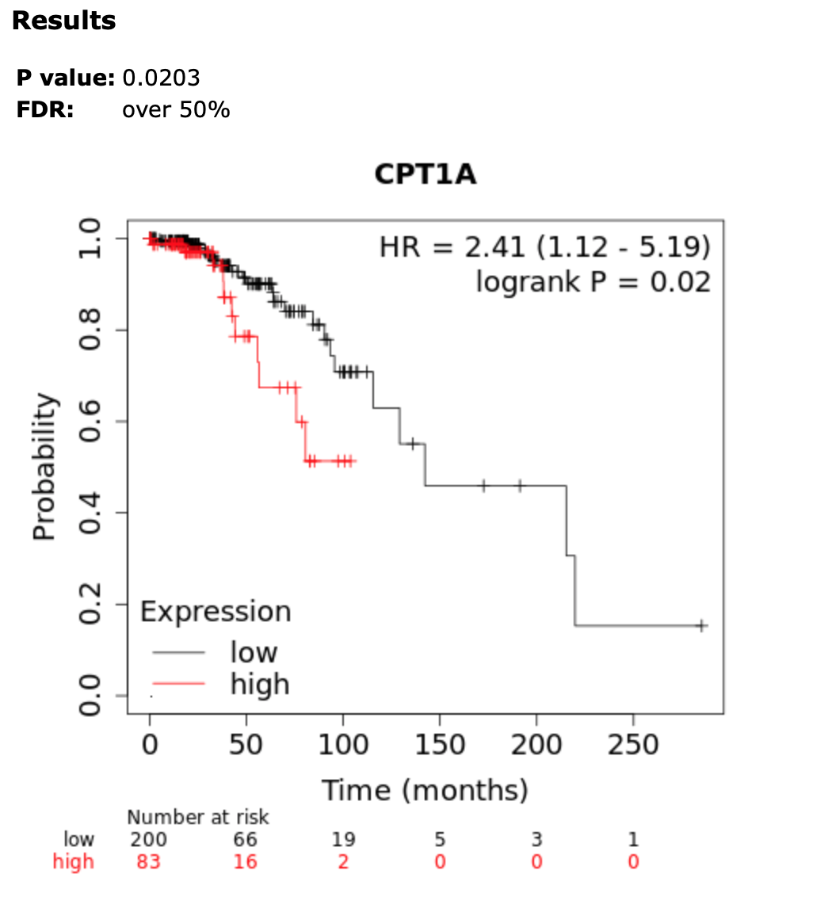
CPT-1A Overall Survival Stage 2 low mutation burden
Notes:
Overall regardless of high or low mutation burden overexpression of CPT1A confers a poor prognosis

Slide 8
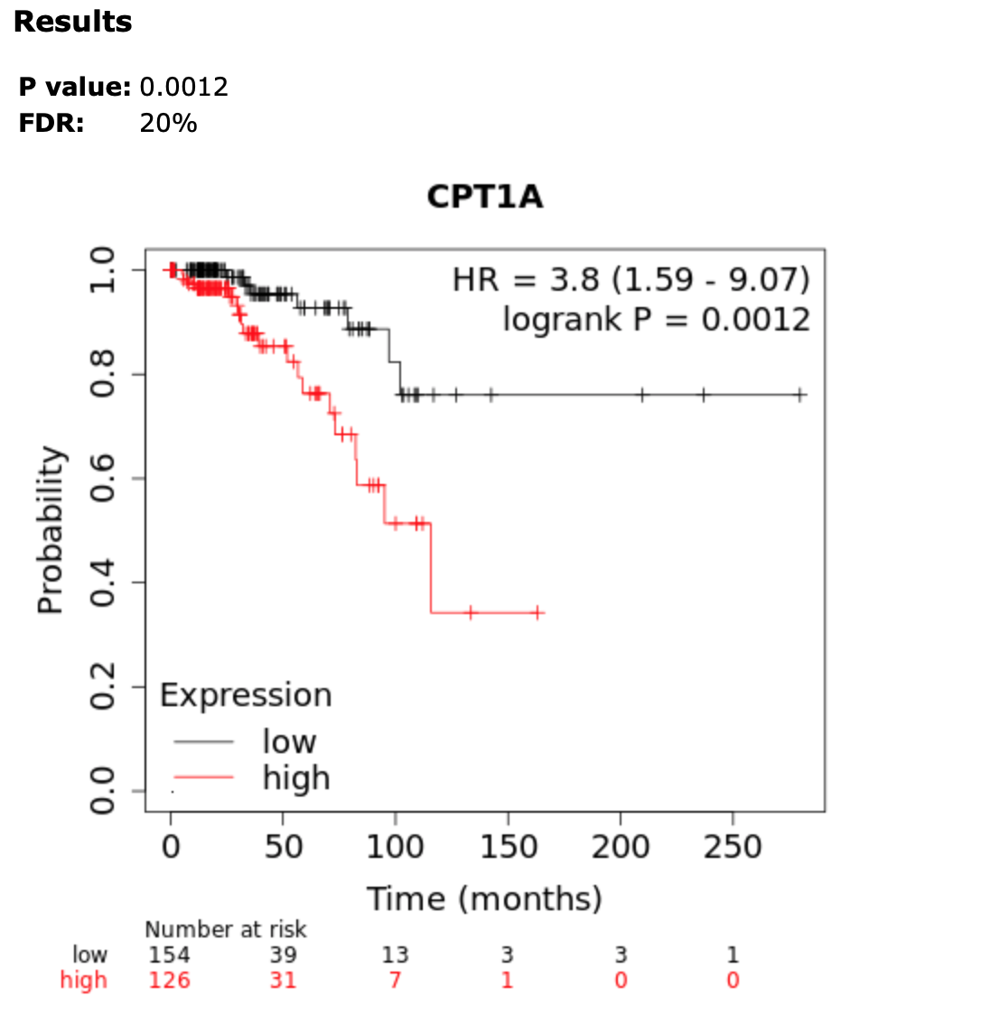
CPT-1A Overall Survival Stage 2 – high mutation burden
Notes:
Poor prognostic effect
This is when we start doing operating , stage 2 is where we can intervene stage 3 is where we start developing distant metastases

Slide 9
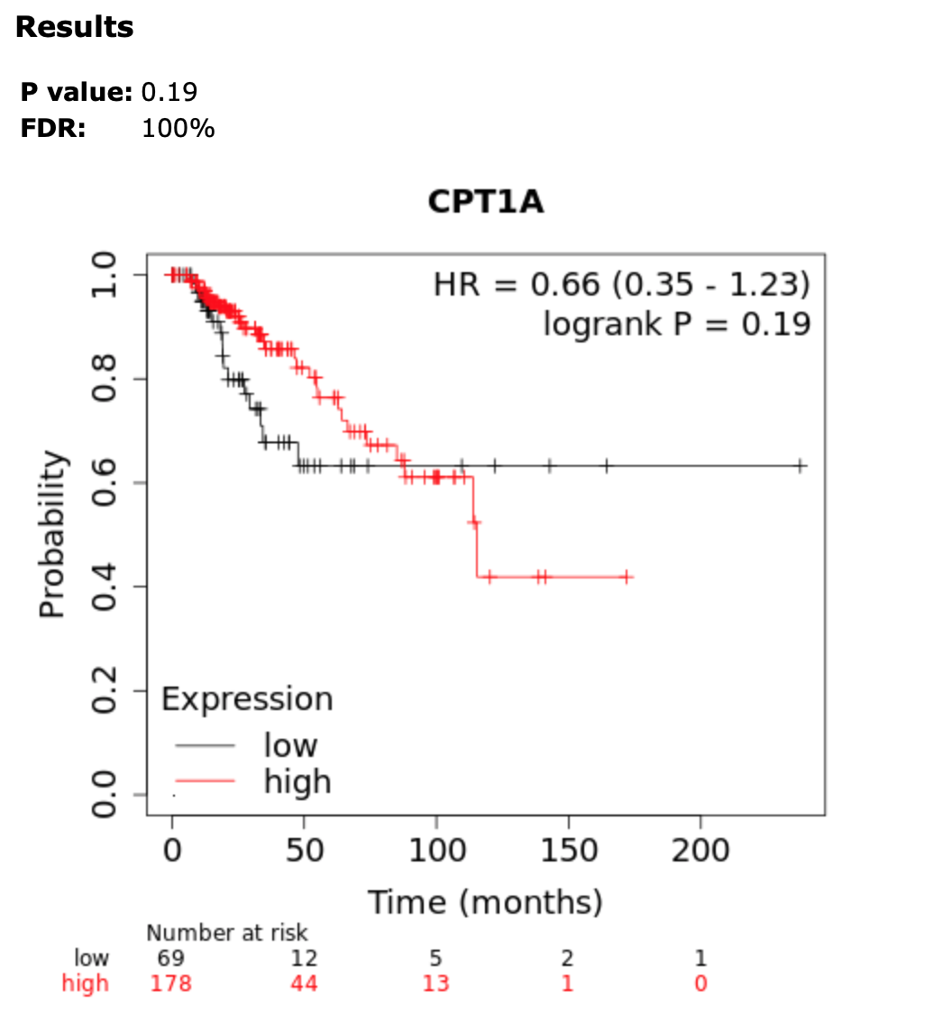
CPT-1A Overall Survival Stage 3
Notes:
No effect

Slide 10
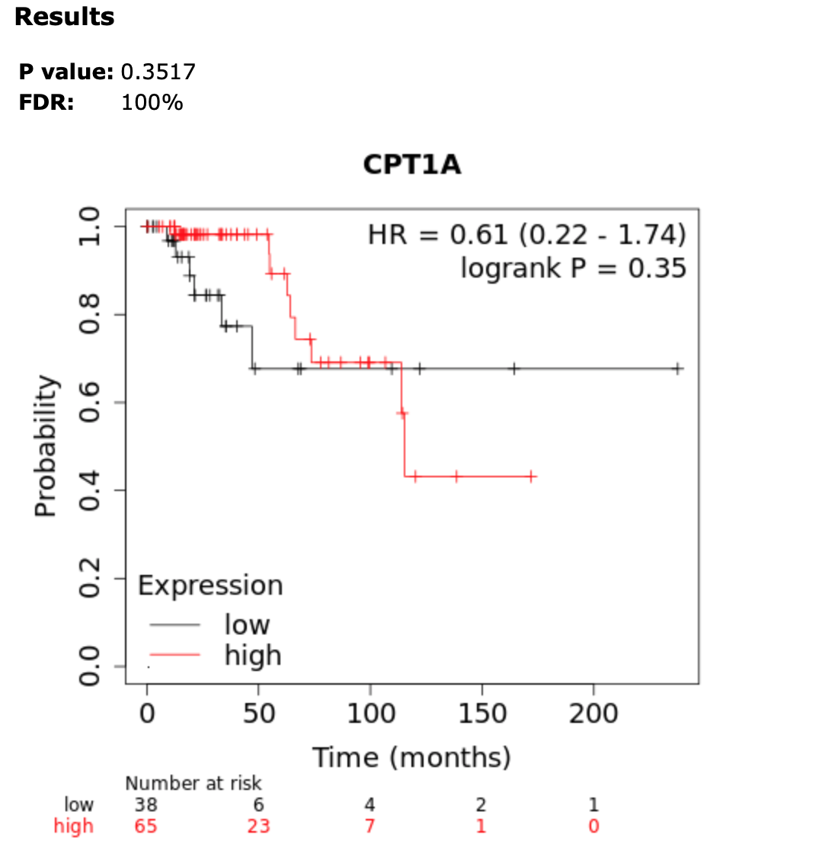
CPT-1A Overall Survival Stage 3 low mutation burden

Slide 11
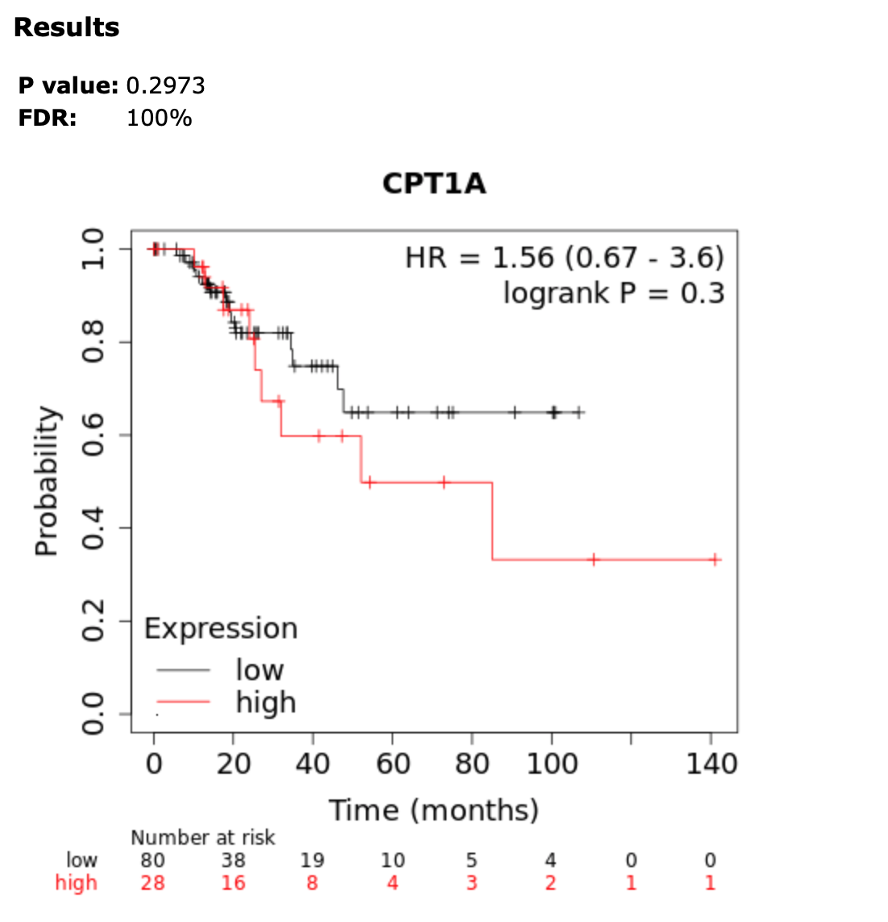
CPT-1A Overall Survival Stage 3 high mutation burden

Slide 12
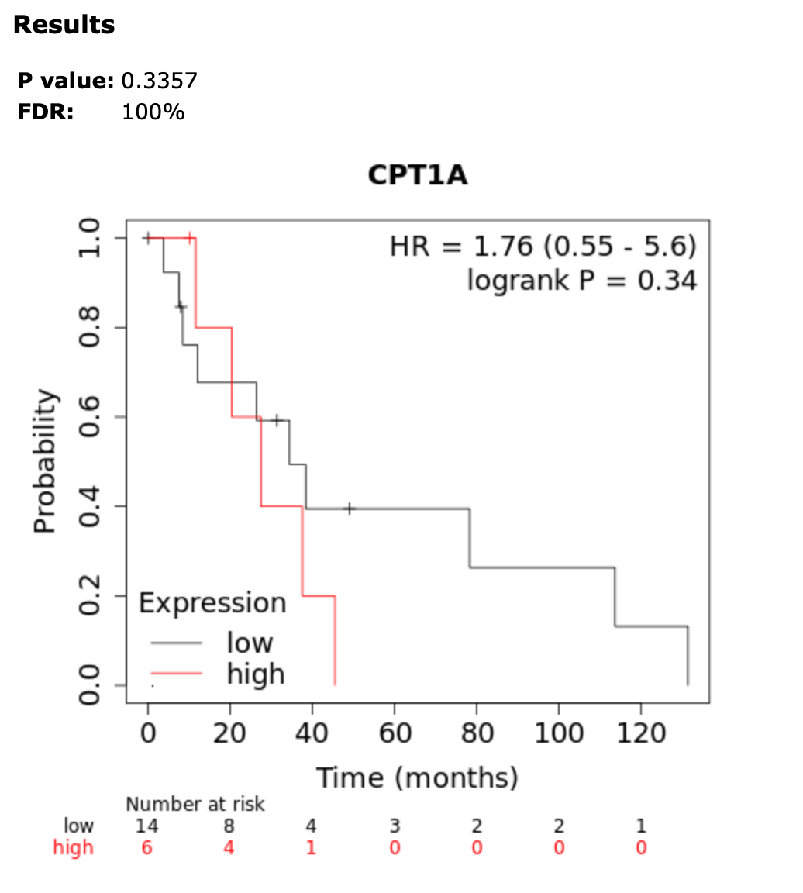
CPT-1A Overall Survival Stage 4

Slide 13
CPT-1A Overall Survival Stage 4 – low mutation burden
Sample too low for meaningful analysis

Slide 14
CPT-1A Overall Survival Stage 4 high mutation burden
Sample too low for meaningful analysis

Slide 15
CPT1A Overall Survival looking at grade
Grade 1 – 4 – sample too low

Slide 16
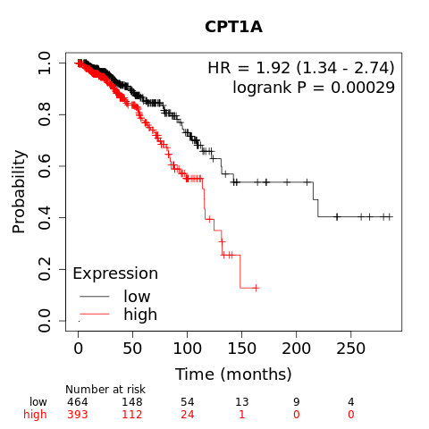
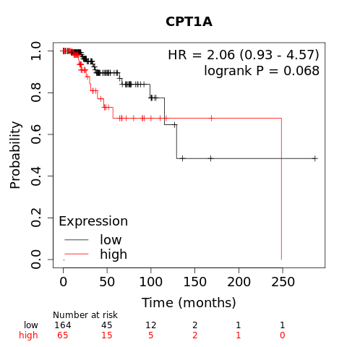
CPT-1A and Immune Compartments
Basophil Enriched
Basophil Reduced

Slide 17
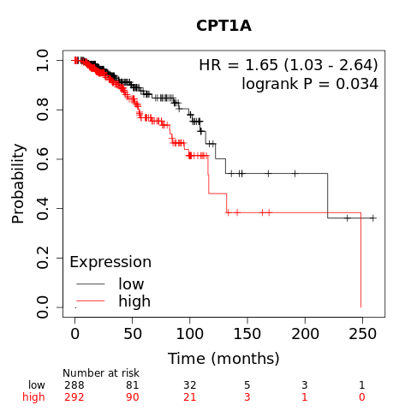
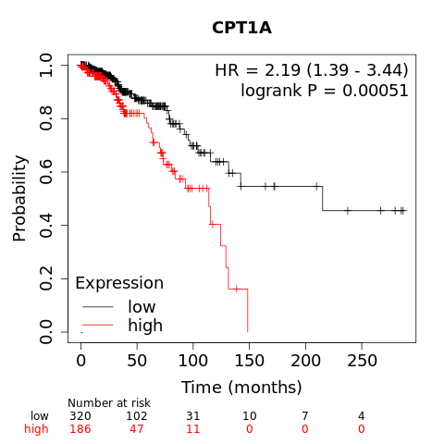
CPT-1A and Immune Compartments
B-cells enriched
B-cells decreased

Slide 18
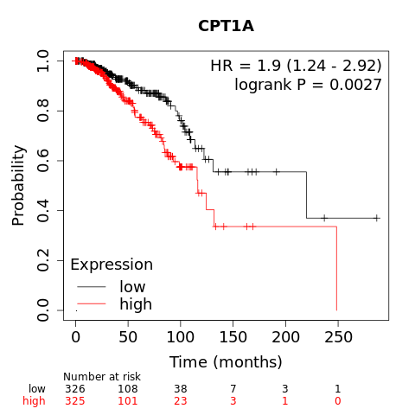
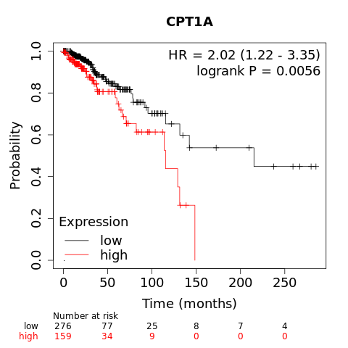
CPT-1A and Immune Compartments
CD4+ memory T-Cells enriched
CD4+ memory T-Cells reduced

Slide 19
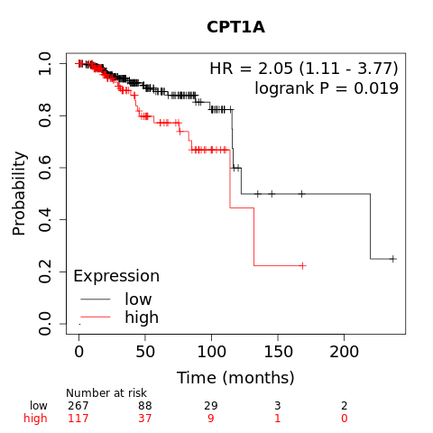
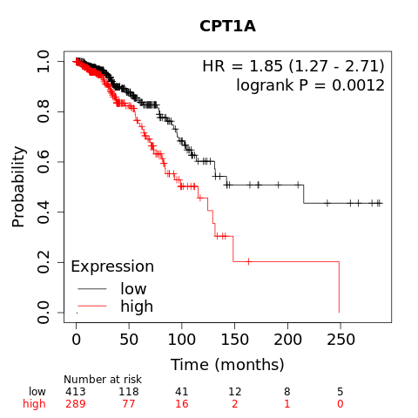
CPT-1A and Immune Compartments
CD8+ T-Cells enriched
CD8+ T-Cells reduced

Slide 20
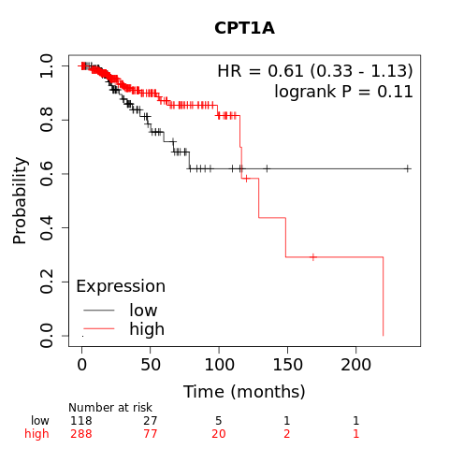
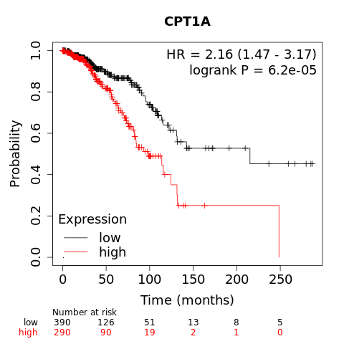
CPT-1A and Immune Compartments
Eosinophils enriched
Eosinophils decreased

Slide 21
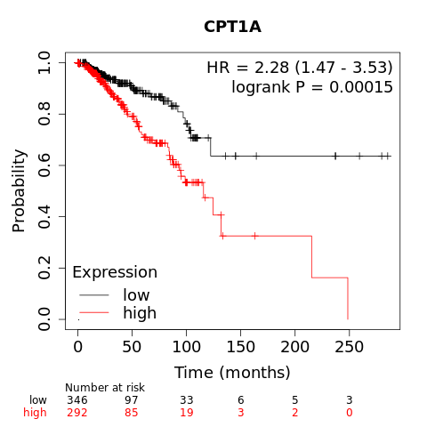
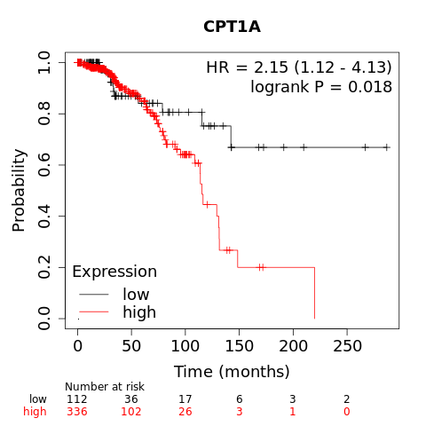
CPT-1A and Immune Compartments
Macrophages enriched
Macrophages decreased

Slide 22
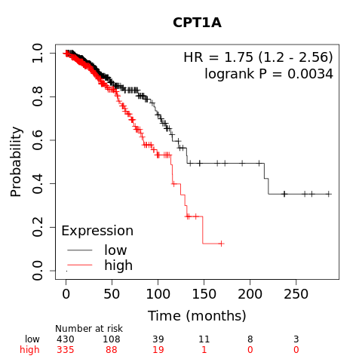
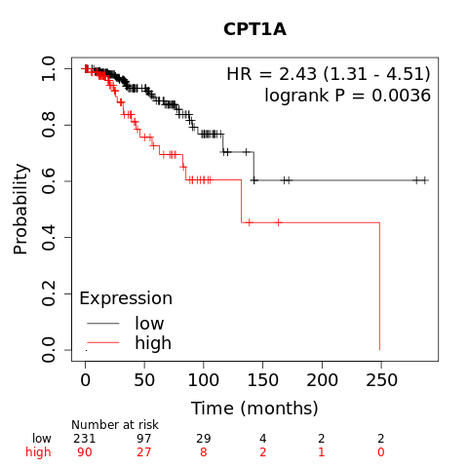
CPT-1A and Immune Compartments
Mesenchymal stem cells enriched
Mesenchymal stem cells reduced

Slide 23
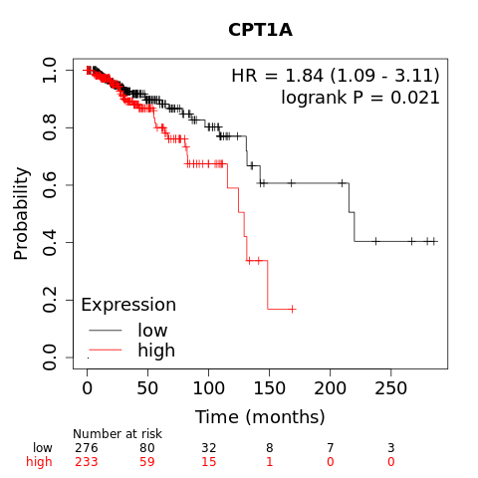
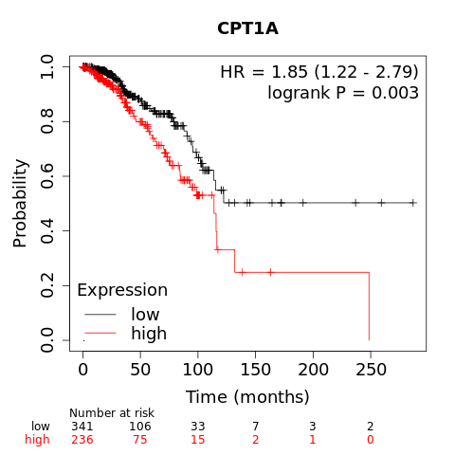
CPT-1A and Immune Compartments
Natural Killer T-cells enriched
Natural Killer T-cells decreased

Slide 24
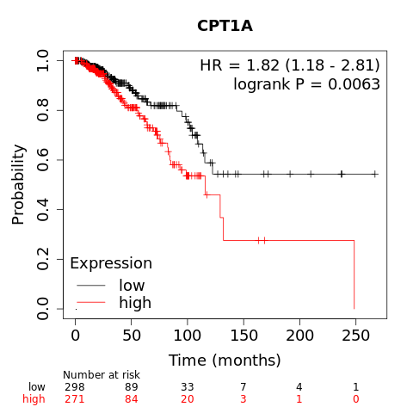
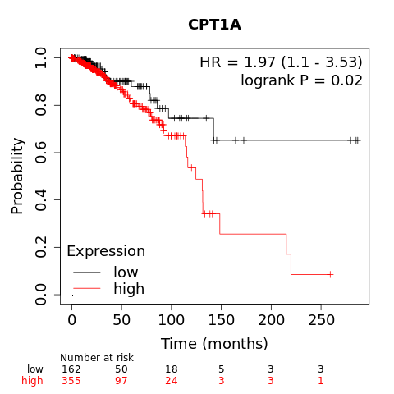
CPT-1A and Immune Compartments
Regulatory T-cells enriched
Regulatory T-cells reduced

Slide 25
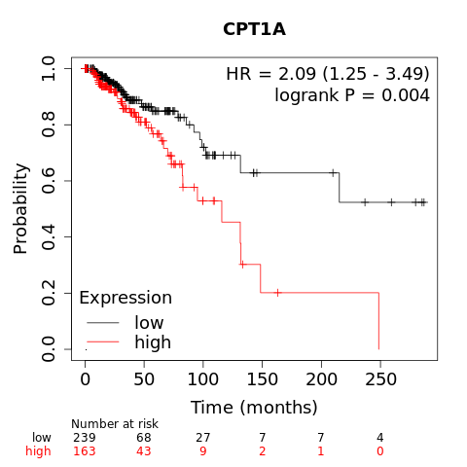

CPT-1A and Immune Compartments
Type 1 T-helper cells enriched
Type 1 T-helper cells decreased

Slide 26
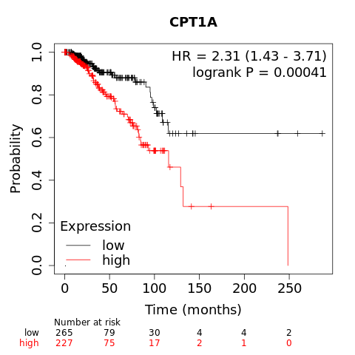
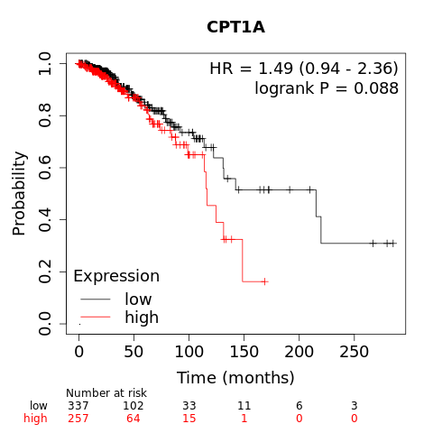
CPT-1A and Immune Compartments
Type 2 T-helper cells enriched
Type 2 T-helper cells decreased

