Slide 1
Supplementary Figures
Analysis using the ROC plotter tool to investigate CPT-1A as a biomarker of sensitivity or resistance to endocrine therapy, HER2-directed therapy or chemotherapy in breast cancers. Molecular subgroups were assessed both in terms of complete pathological response and relapse-free survival.

Slide 2
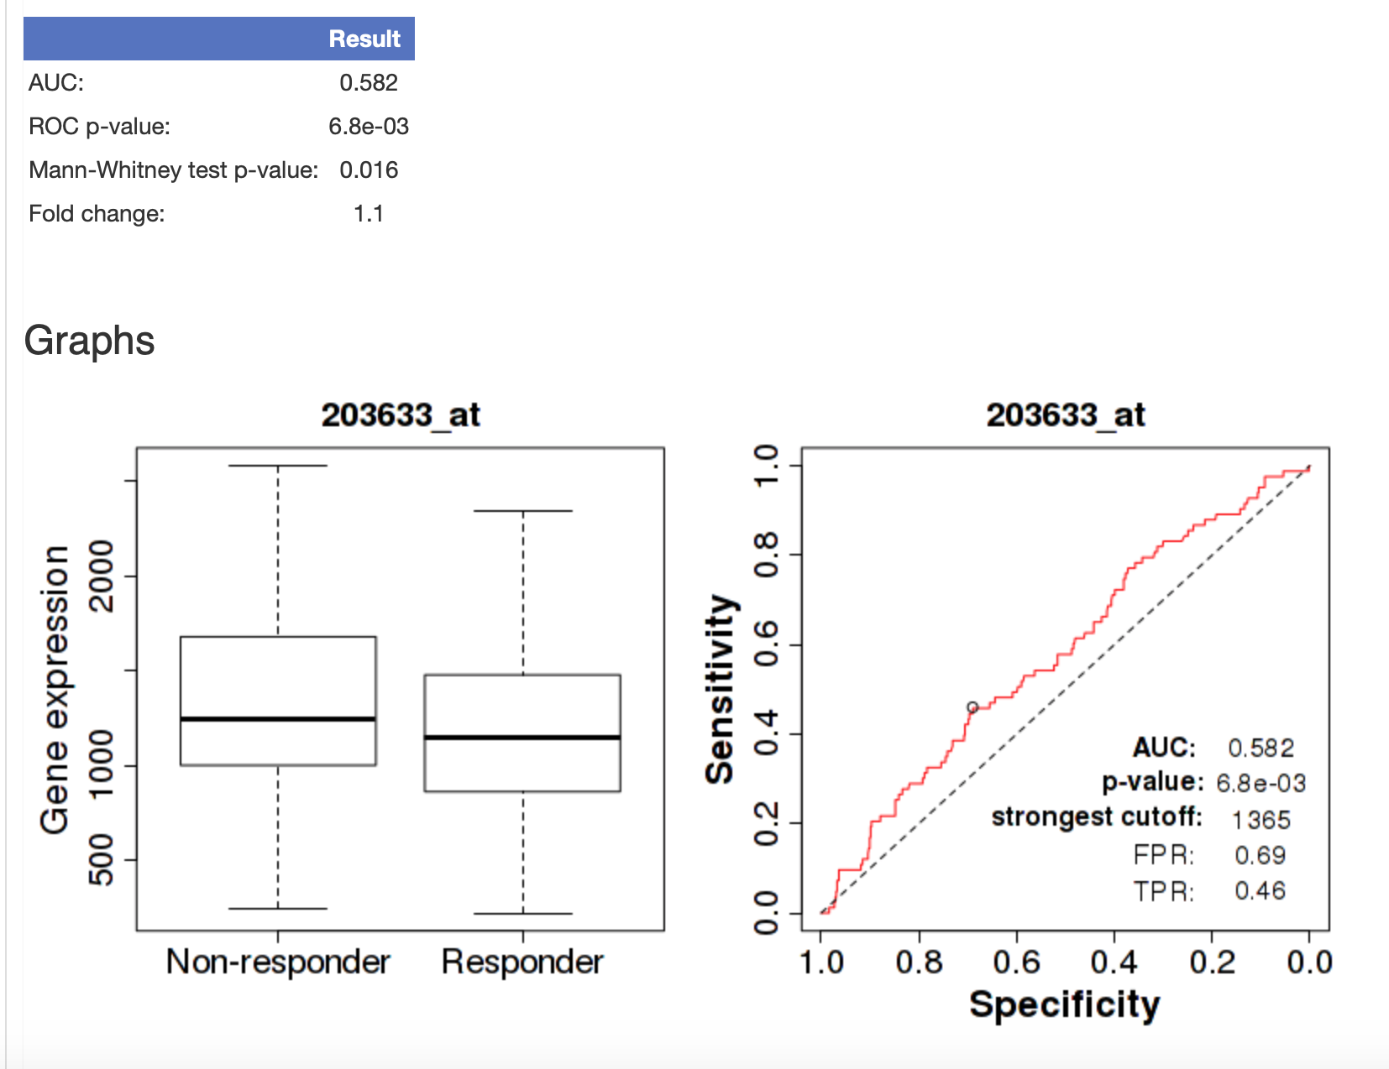
Supplementary Figure 1: Luminal A 5yr Relapse Free Survival (RFS) - Endocrine treatment (ET)

Slide 3
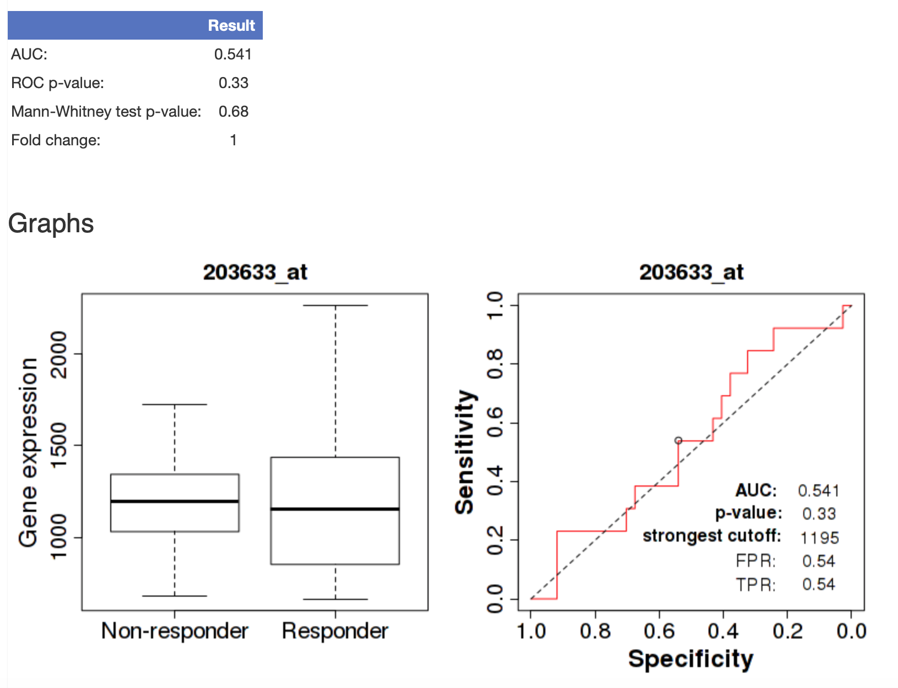
Supplementary Figure 2: Luminal A Complete Pathological Response (CPR) ET

Slide 4

Supplementary Figure 3: Luminal B CPR Chemotherapy

Slide 5
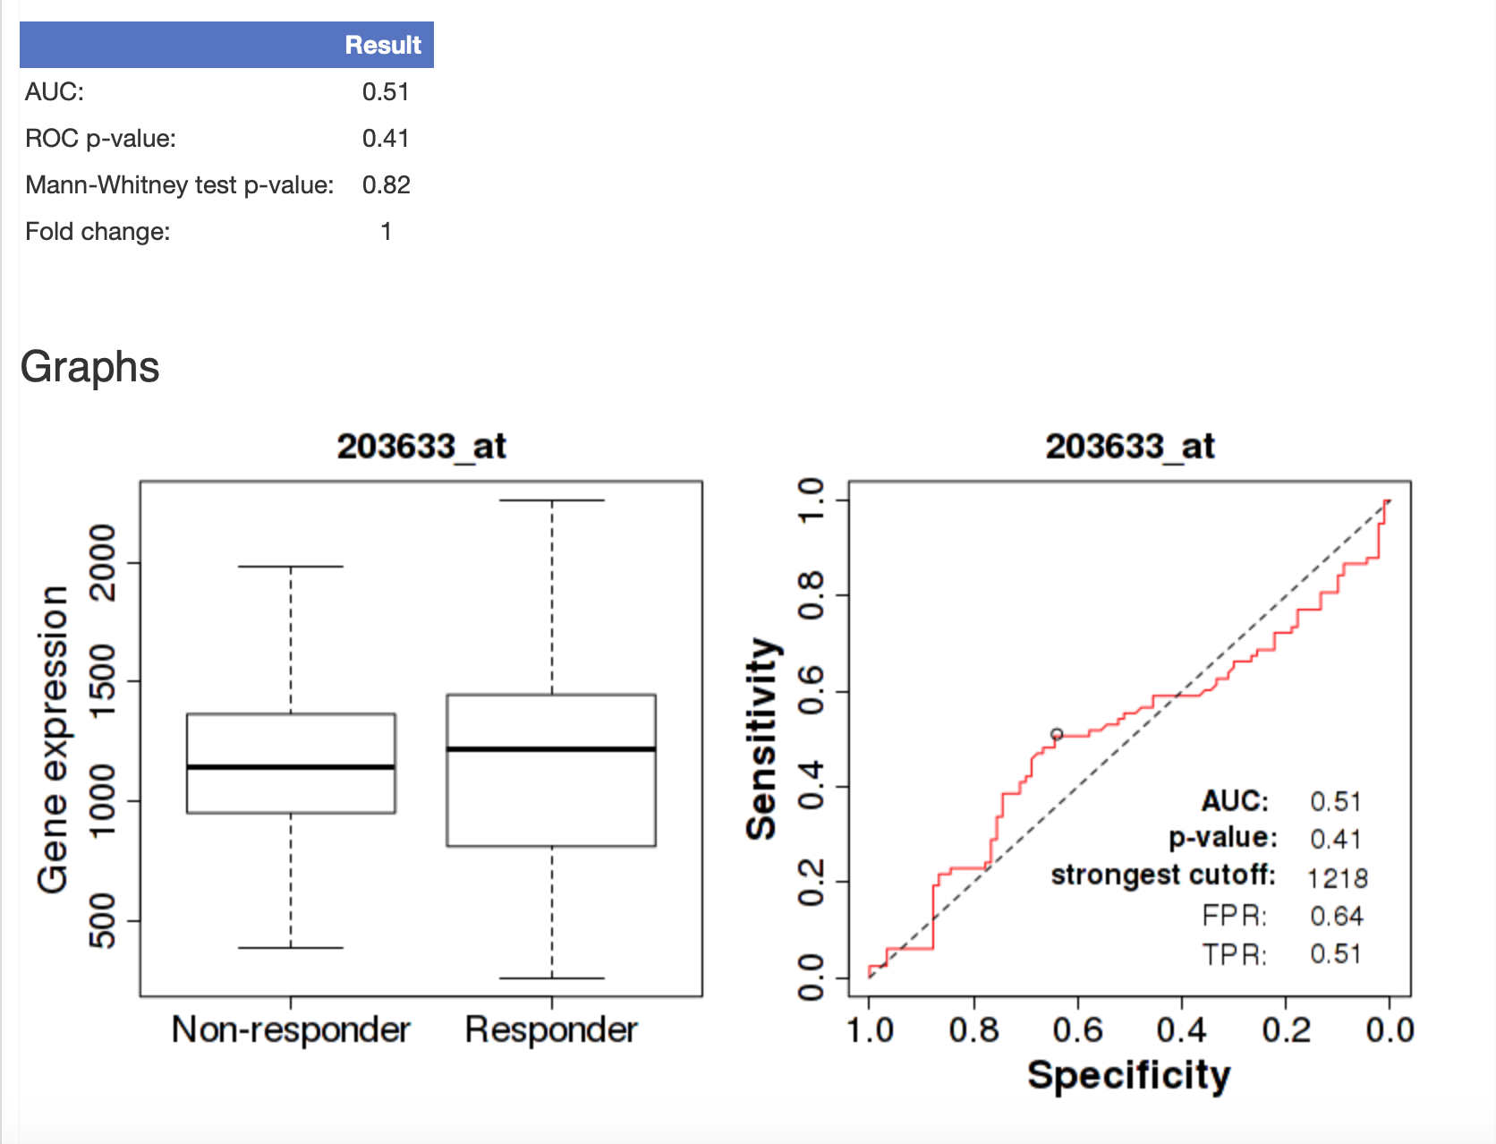
Supplementary Figure 4: Luminal B 5yr RFS - Chemotherapy

Slide 6
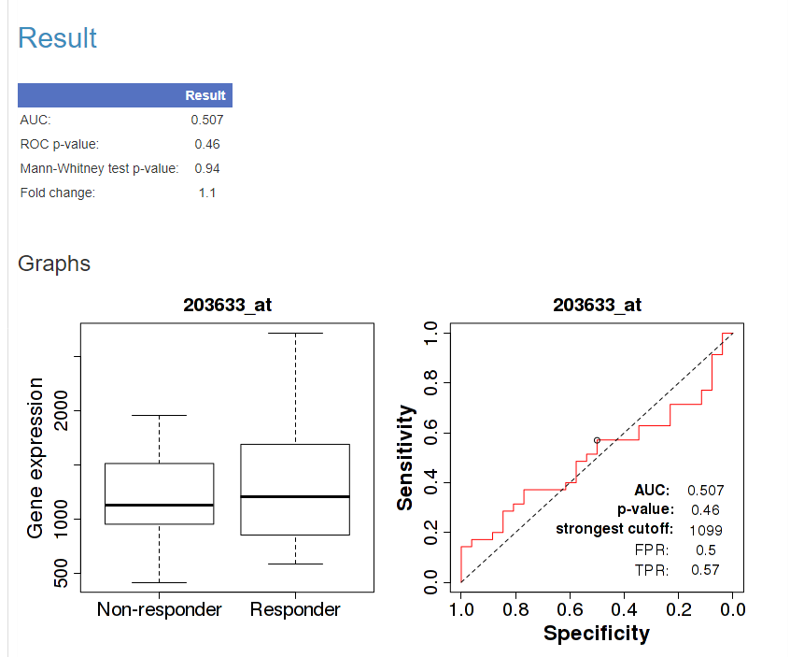
Supplementary Figure 5: Her2+ve only 5year RFS - Chemotherapy

Slide 7
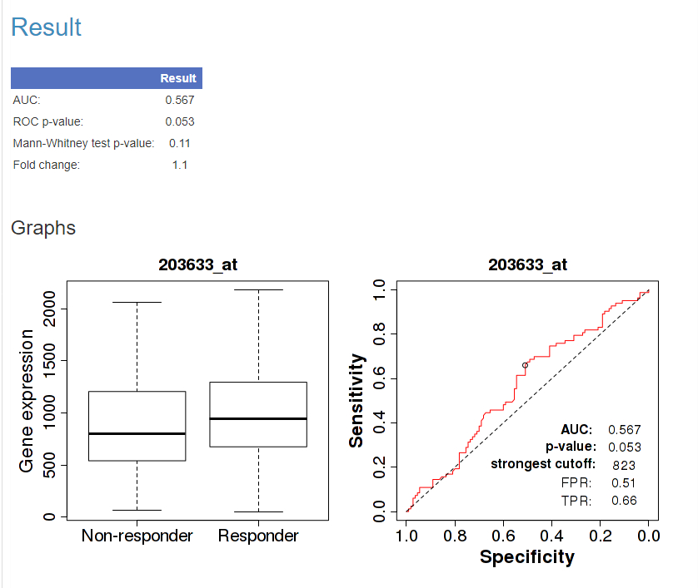
Supplementary Figure 6: Her2+ve only CPR Chemotherapy

Slide 8
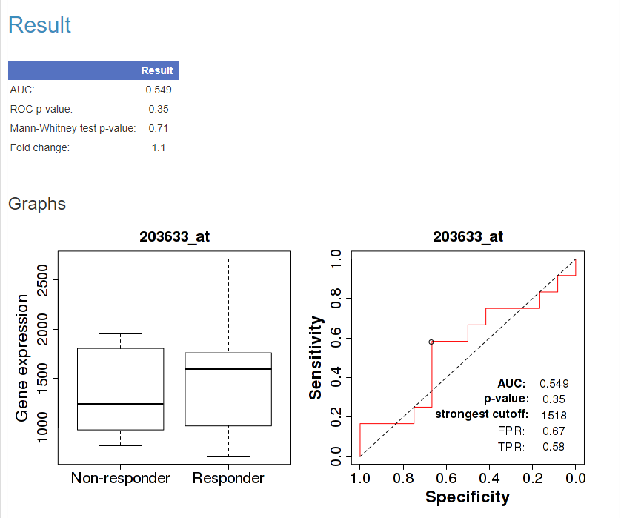
Supplementary Figure 7: Her2+ve only 5yr- RFS anti her2 only

Slide 9
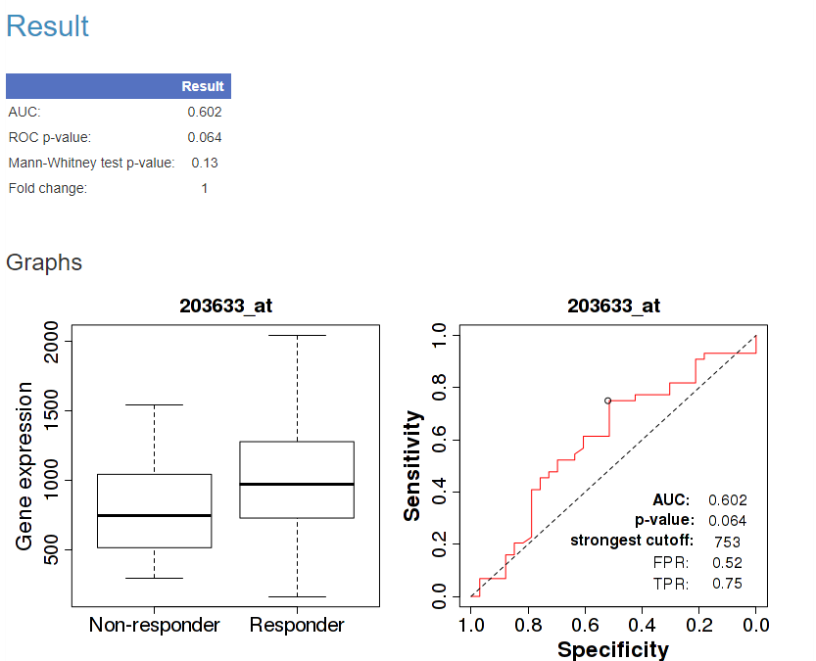
Supplementary Figure 8: Her2+ve only CPR- anti her 2 only

Slide 10

Supplementary Figure 9: TNBC - CPR Chemotherapy

Slide 11
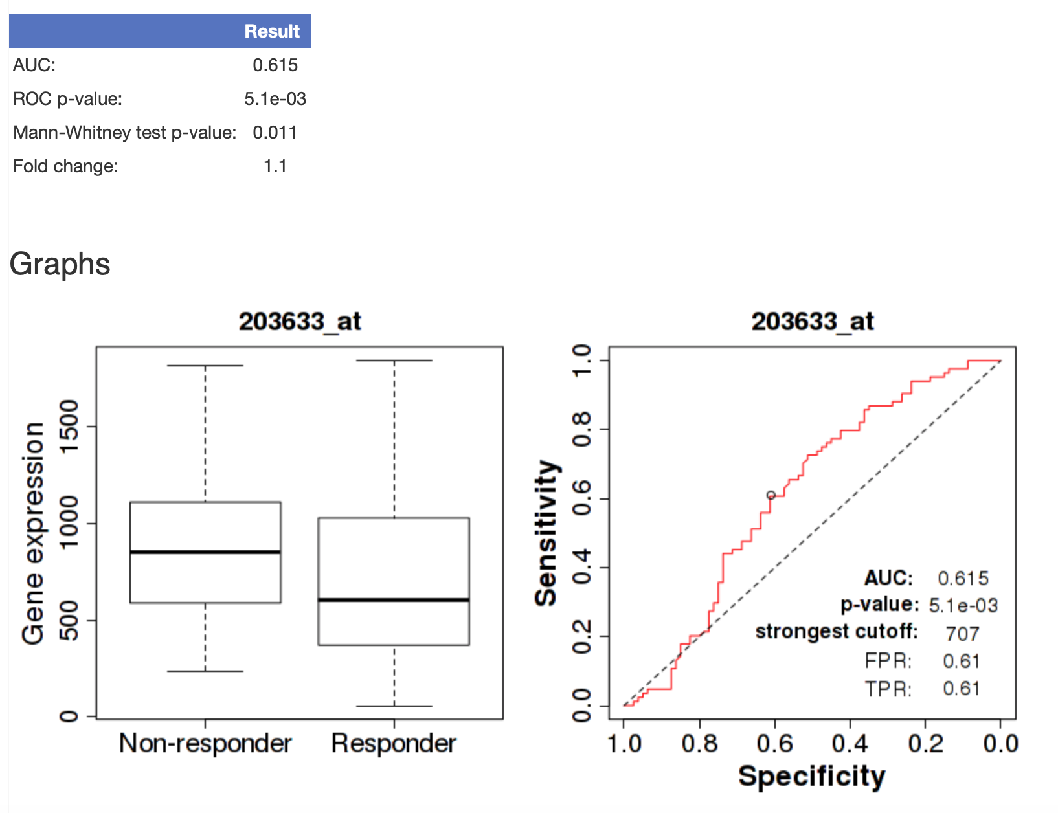
Supplementary Figure 10: TNBC 5yr RFS- Chemotherapy

