Slide 1
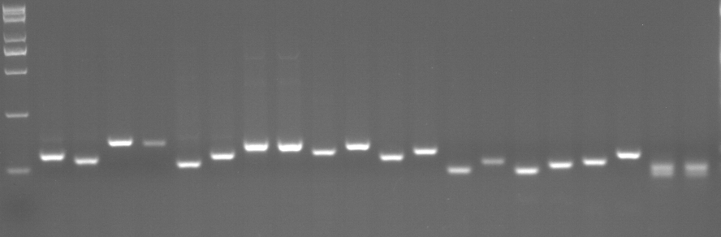
tin5
G3146
M
Tu-50
Tu-51
Tu-52
Tu-53
Tu-54
Tu-55
Tu-56
Tu-57
Tu-58
Tu-59
Fig. S1 Agarose-resolvable InDel markers between parents through with agarose gels.
M, DNA marker; parents pair (the tin5 mutant and G3146) is listed in the figure. Polymorphic markers are indicated in red front.

Slide 2
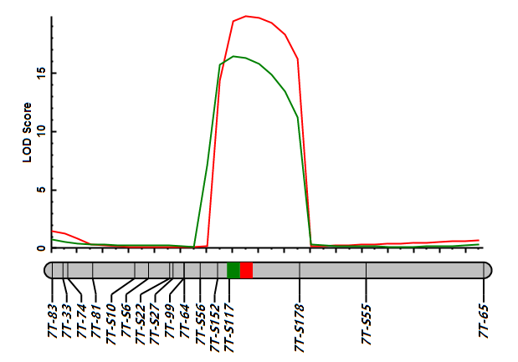
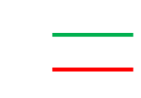
TNP
AGB
2.5 cM
Fig. S2 QTL mapping for TNP and AGB using the genetic map.
The interval of genetic map highlighted in green and red colored represents the interval of QTNP.ucas-7A and QAGB.ucas-7A, respectively. TNP, tiller number per plant; AGB, aboveground biomass.

Slide 3
Fig. S3 Homology analysis of TuG1812G0700004540.
Protein sequence alignment of gene TuG1812G0700004540 (TuD27) in T. urartu among rice (D27, Os11g0587000) and common wheat (TaD27-A, TraesCS7A01G418900; TaD27-B, TraesCS7B01G319100; TaD27-D, TraesCS7D01G411500). Highlight homology level: blue, ≧50%; pink, ≧75%; black, 100%.

Slide 4
a
TuG1812G0700004540
(TuD27)
b
TaD10
c
TaD17
G1812
tin5
G1812
tin5
G1812
tin5
Fig. S4 Transcript levels of TuD27 were similar between G1812 and the tin5 mutant at three-leaf stage.
Expression of TuD27 (a), TuD10 (b) and TuD17 (c) in tiller nodes of G1812 and the tin5 mutant. Values are means ± SD of three biological repeats. Student’s t-test (*P < 0.05) was used for statistical analysis.

