Slide 1
Supplemental figure 1
p < 0.001
p < 0.001
p < 0.001
p < 0.001
CD8 (fpkm)
Iba1 (fpkm)
PD-L1 (fpkm)
PD-L2 (fpkm)
GM-CSF
GM-CSF
GM-CSF
GM-CSF
Supplemental Figure 1. Gene expression analysis in breast cancer cases from TCGA database. Gene expression levels of CD8, Iba1, PD-L1, and PD-L2 in breast cancer were compared between the cases with and without GM-CSF expression. The Mann-Whitney U-test was performed.

Slide 2
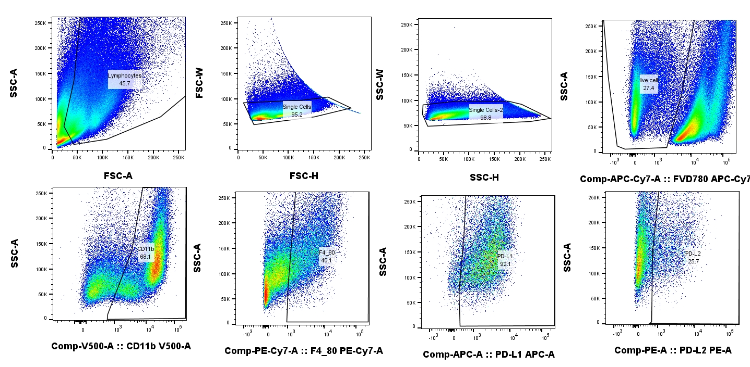
Supplemental figure 2
Supplemental Figure 2. Flow cytometry of an E0771 tumor sample. Cell suspensions were stained with APC anti-mouse PD-L1 antibody, PE anti-mouse PD-L2 antibody, PE/Cyanine7 anti-mouse F4/80 antibody, Violet 510 anti-mouse/human CD11b antibody, or isotype-matched control IgGs. Dead cells were excluded by staining with Fixable Viability Dye eFluor™ 780.

Slide 3

Supplemental figure 3
Lymphocytes
Immune-suppression
Cytotoxic signals
IFNs
GM-CSF
OPN, IL6, HB-EGF
PD-L1/2
Protumor signals
Macrophages
Stat1/3 etc
Chemotaxis
and differentiation into protumor phenotype
Breast
cancer cells
CCL5
CCL2
Supplemental Figure 3. Hypothetical functions of TAMs in the breast cancer TIME. Activated TILs stimulate the secretion of chemokines, such as CCL2 and CCL5, from breast cancer cells. CCL2 and CCL5 induce the chemotaxis of TAMs in the TIME, and cancer-derived factors enhance TAM activation into a protumor phenotype. TAMs secret protumor factors, including osteopontin (OPN), heparin-binding epidermal growth factor-like growth factor (HB-EGF), and IL-6. Activated TILs induced PD-L1 and PD-L2 overexpression on TAMs, which suppresses TIL activation. Thus, TAMs are involved in cancer progression via protumor and immunosuppressive functions.

Slide 4
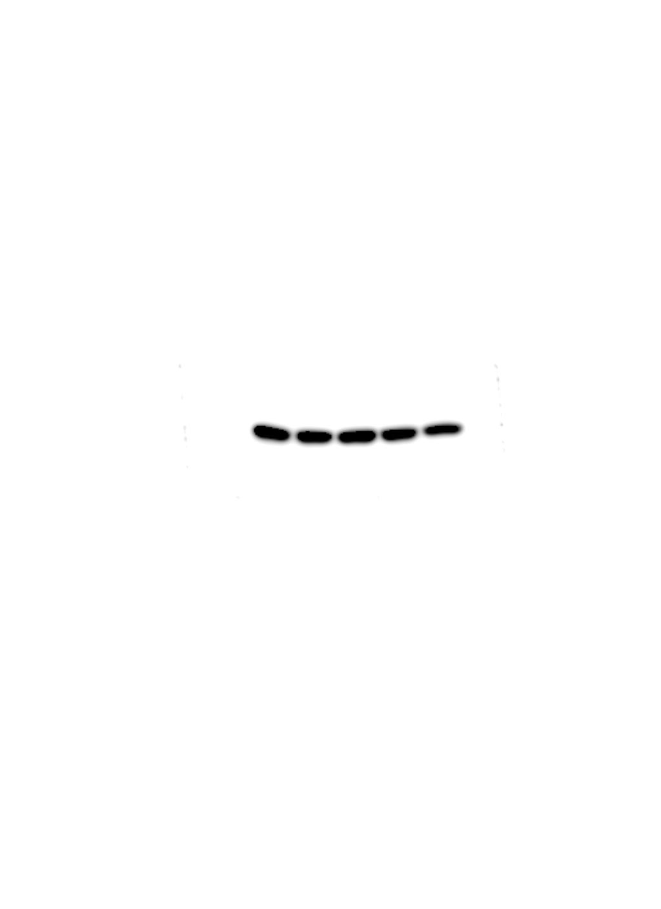
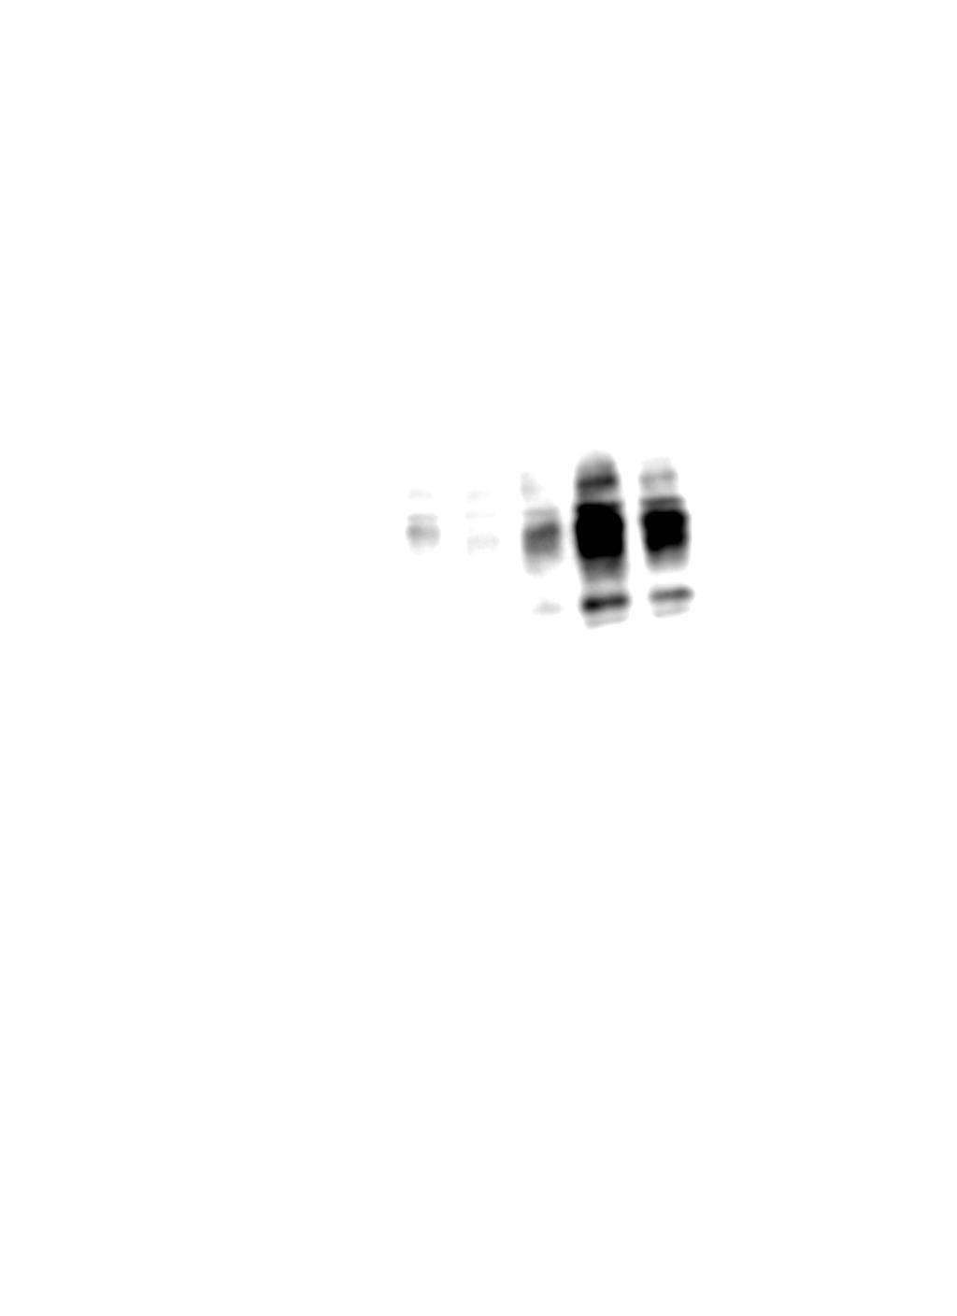
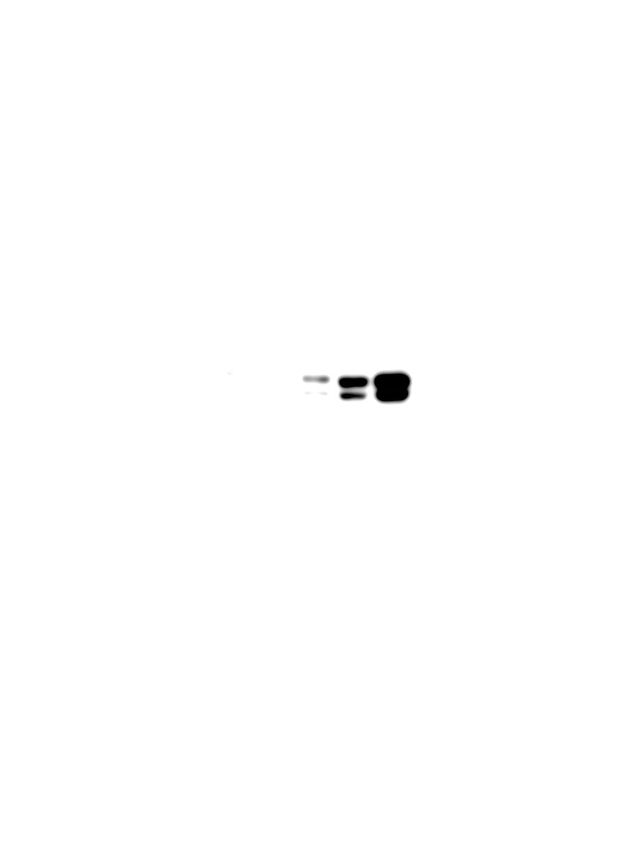
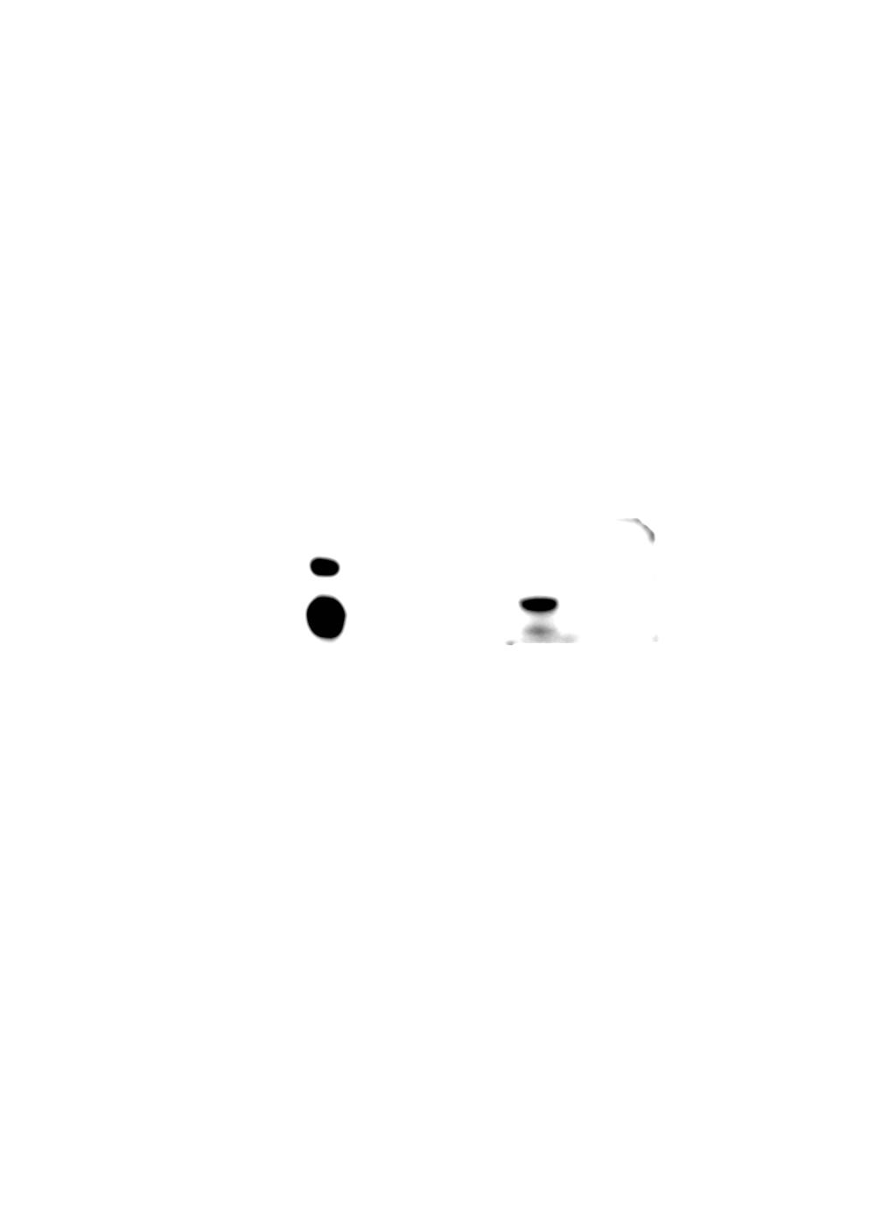
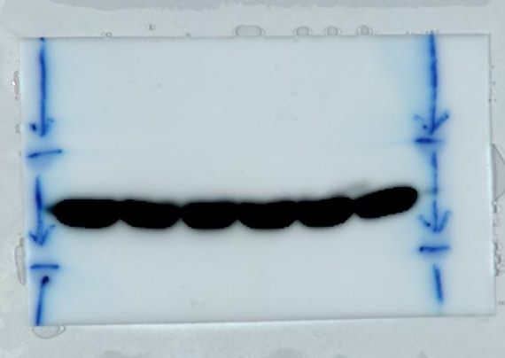
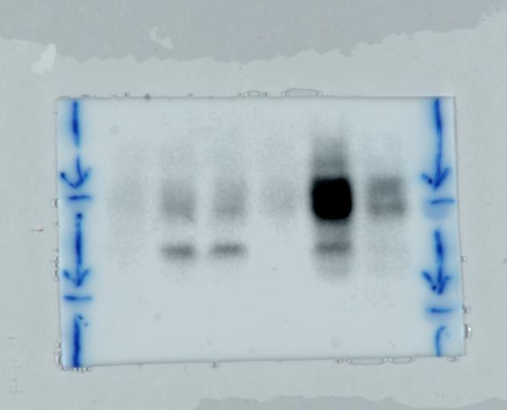
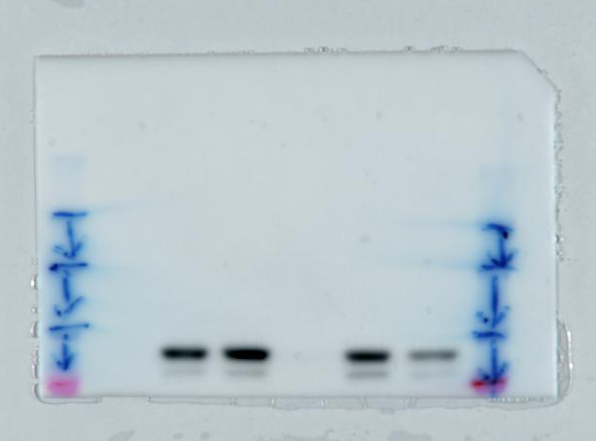
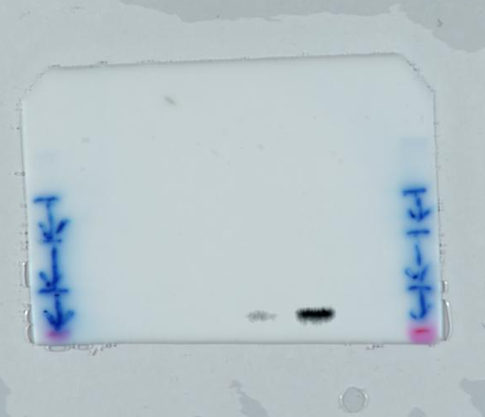
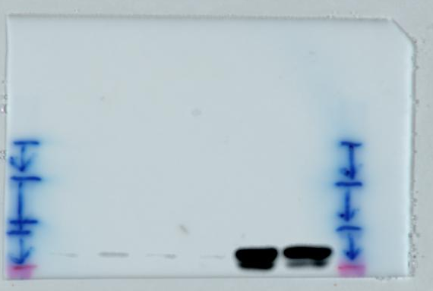
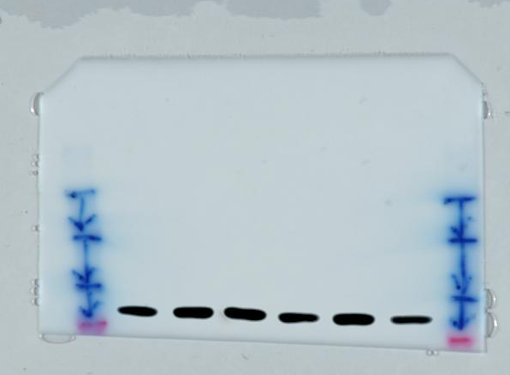
Supplemental figure 4
A
PD-L1
p-STAT3
β-actin
p-STAT1
Western blot data
B
β-actin
PD-L1
p-STAT1
p-STAT3
3h 24h
3h 24h
3h 24h
3h 24h
STAT1
STAT3
3h 24h
3h 24h
Supplemental Figure 4. Full-length gels or blots of figure 2C (A) and figure 3C (B) were presented.

