Slide 1
Supplementary figures
Research article:
Assessing dynamic changes in flavor-related compounds during durian fruit ripening using metabolome and transcriptome analyses

Slide 2
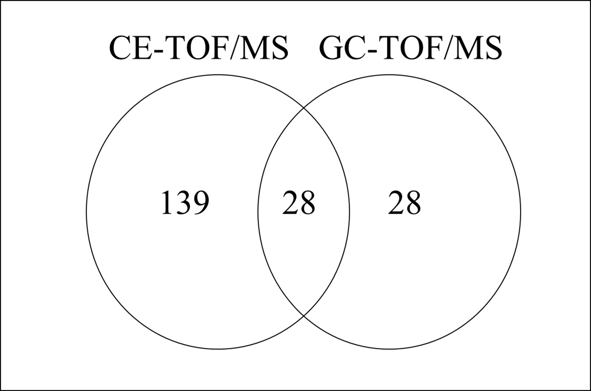
Supplementary Fig. S1. Venn diagram showing number of metabolites detected by CE-TOF/MS and GC-TOF/MS.

Slide 3
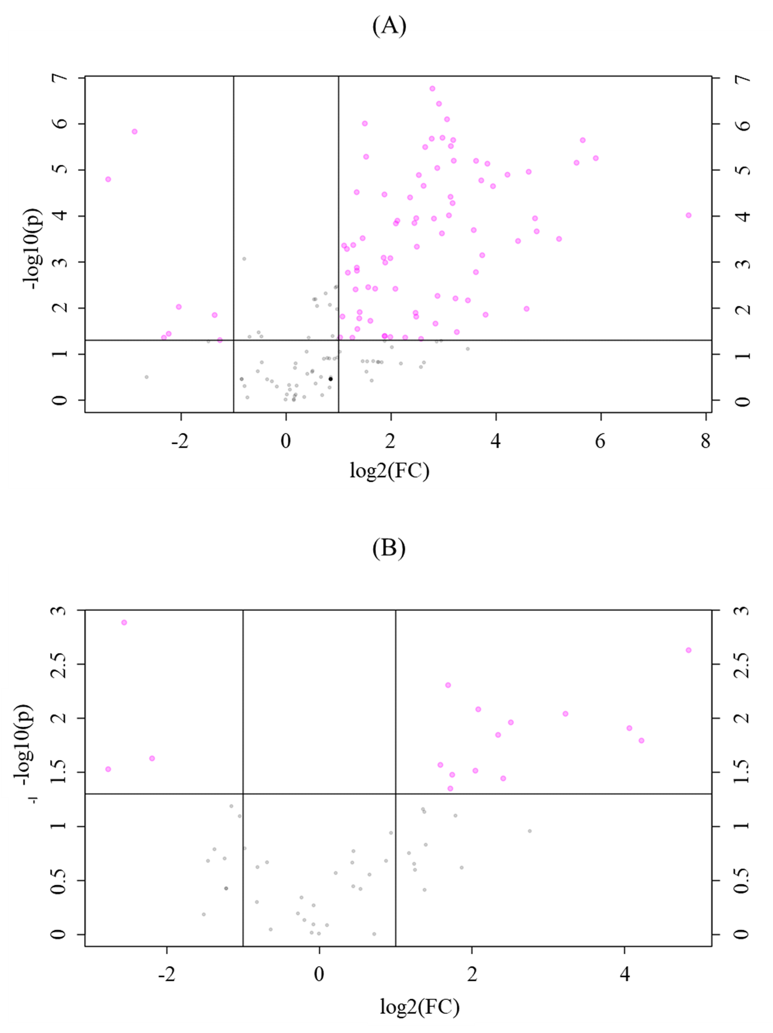
Supplementary Fig. S2. Volcano plot presenting the significant metabolites in (A) CE-TOF/MS metabolome data and (B) GC-TOF/MS metabolome data.

Slide 4
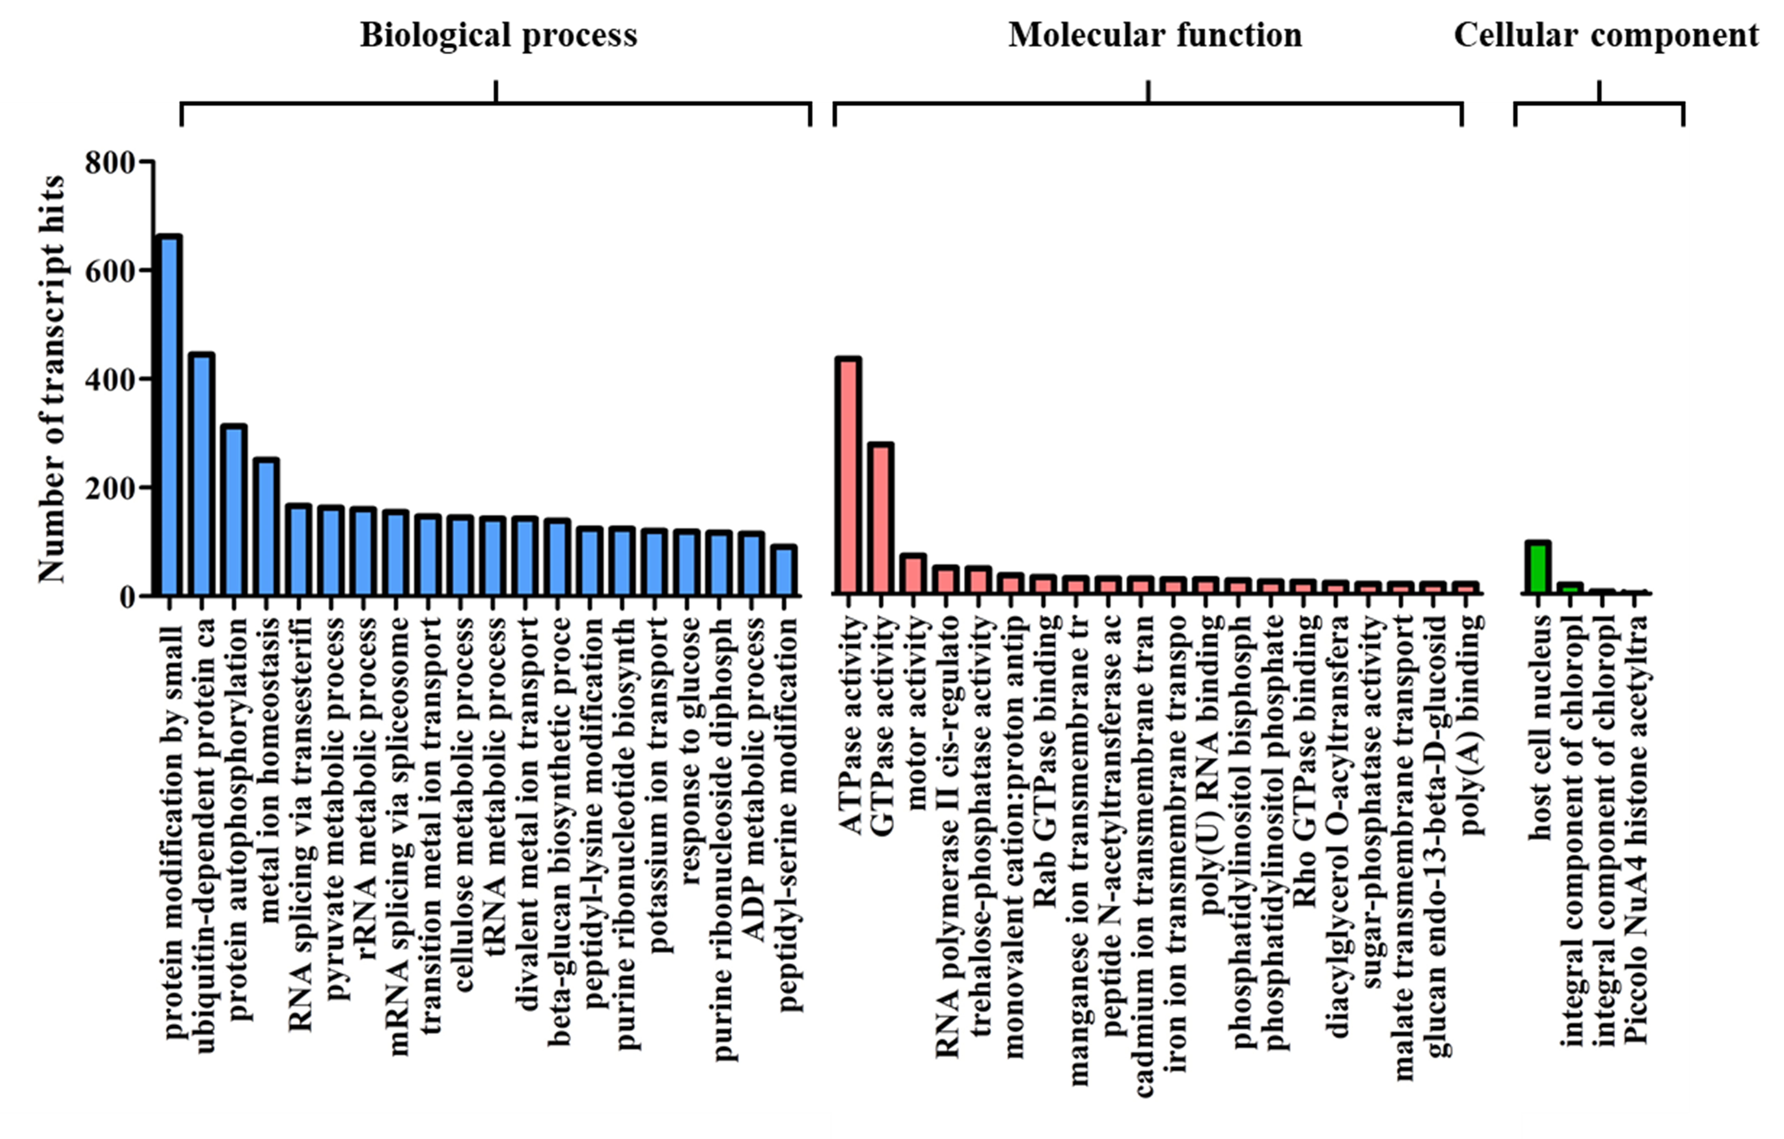
Supplementary Fig. S3. Gene ontology classification of DEGs.

Slide 5
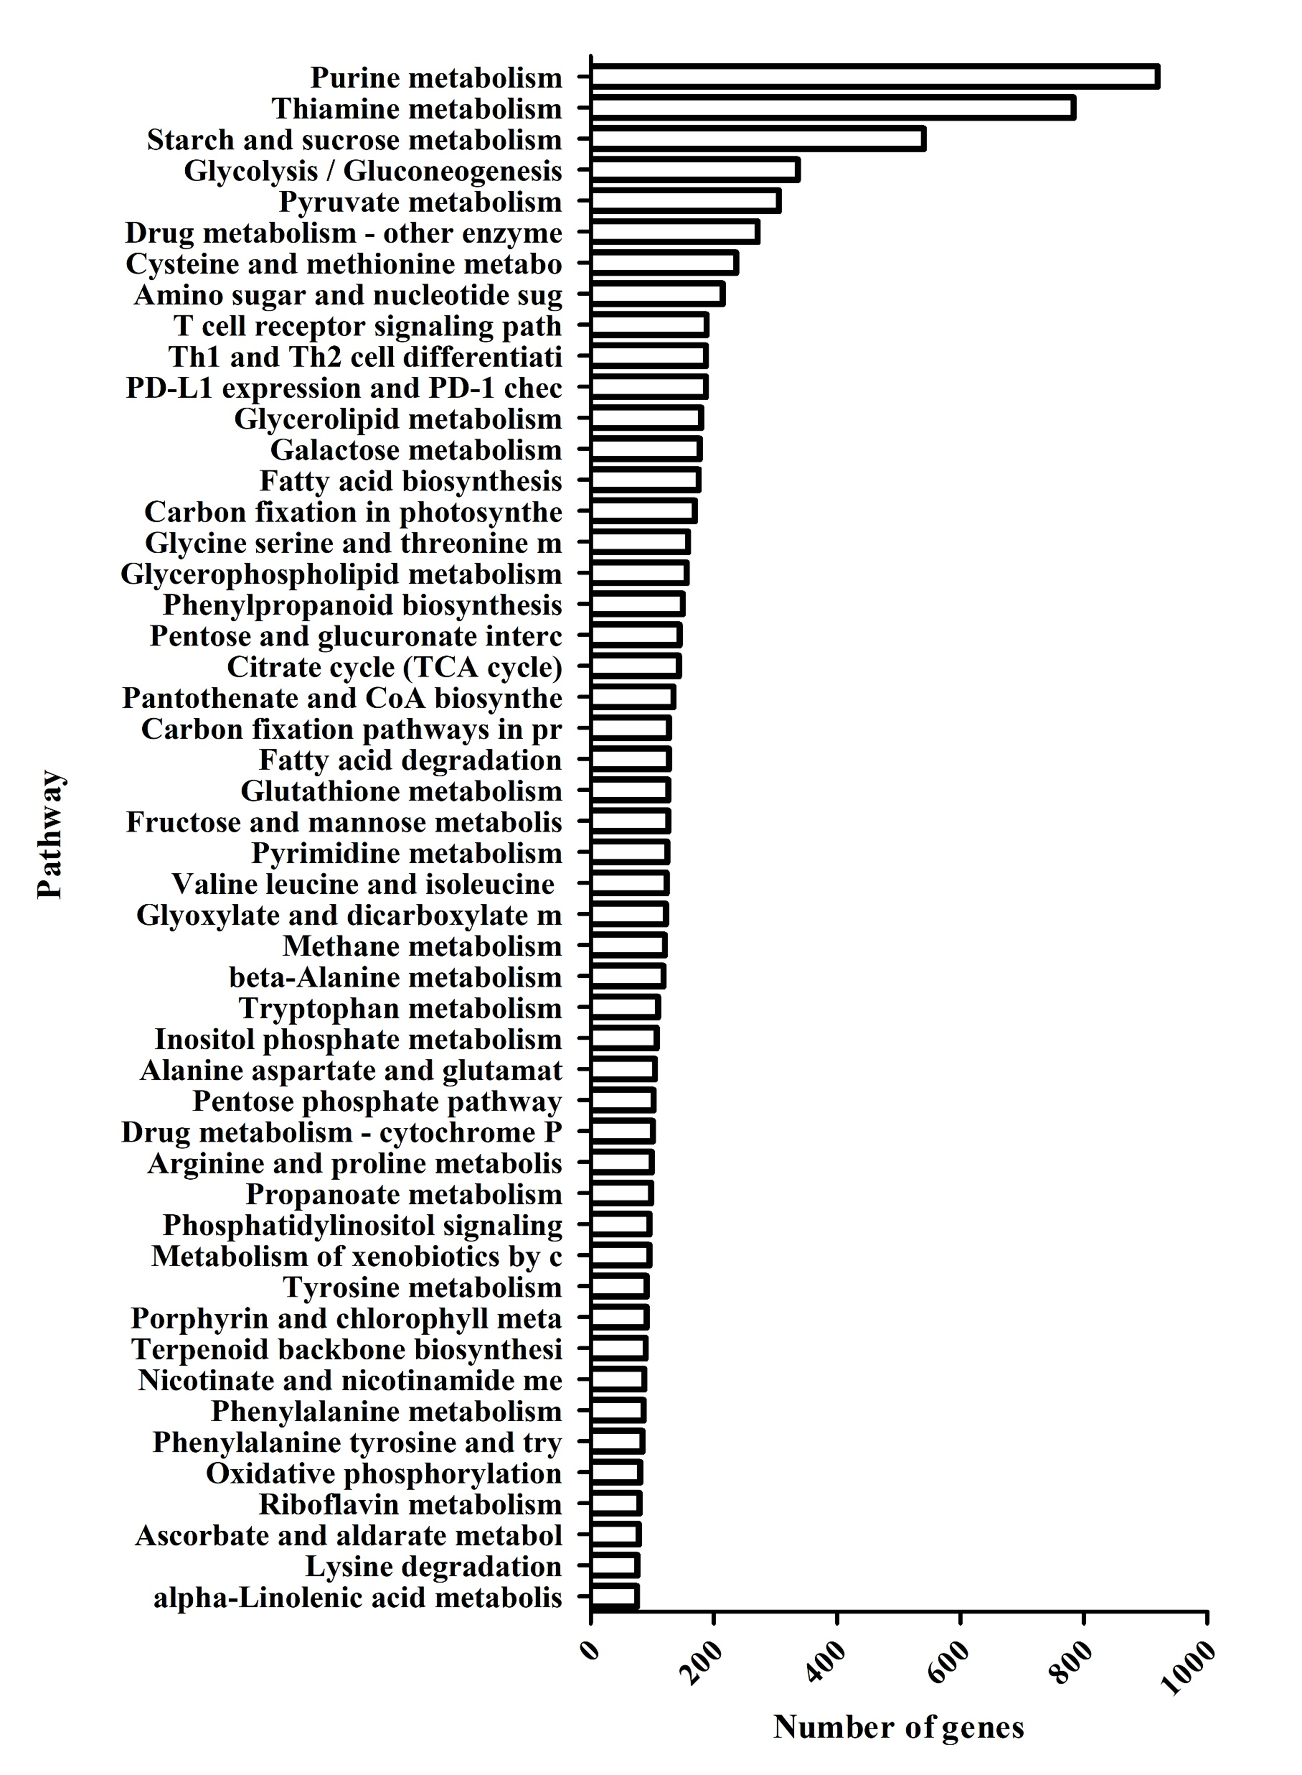
Supplementary Fig. S4. The top 50 KEGG pathway of DEGs.

