Slide 1
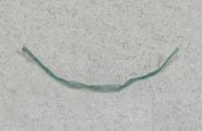
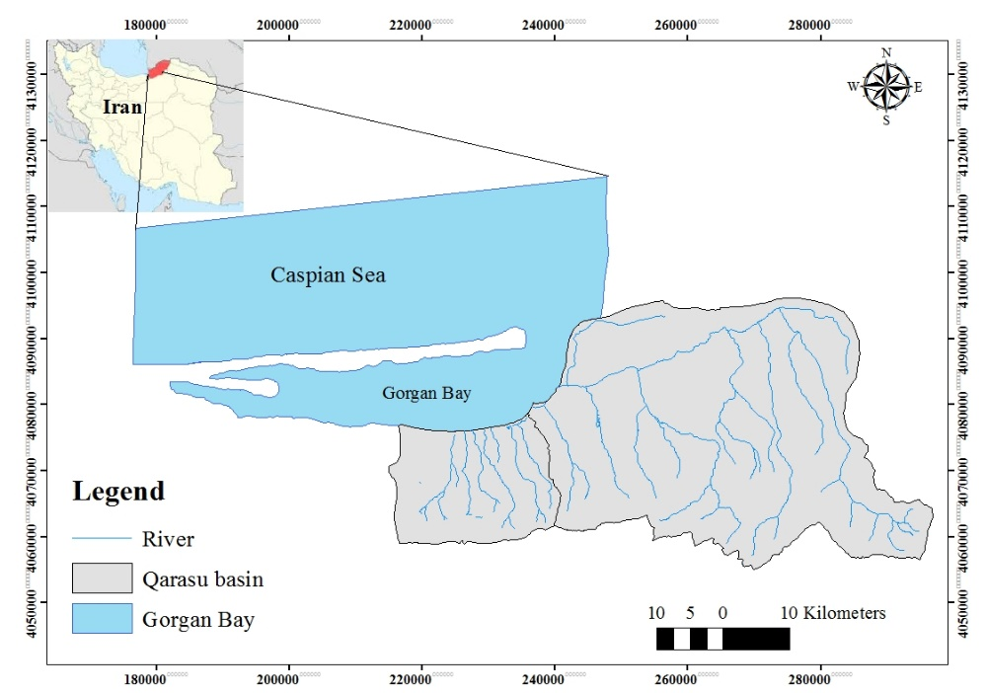
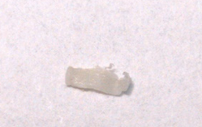
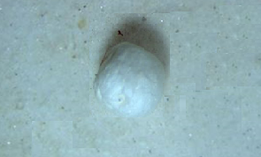

The highest was observed in in agricultural use, lowest was related to forest use.
Qarasu river basin considered as the source of Gorgan Bay pollution.
8 different rivers
3 usage type forest, residential and agricultural
9 different fish species
Microplastic

