Slide 1
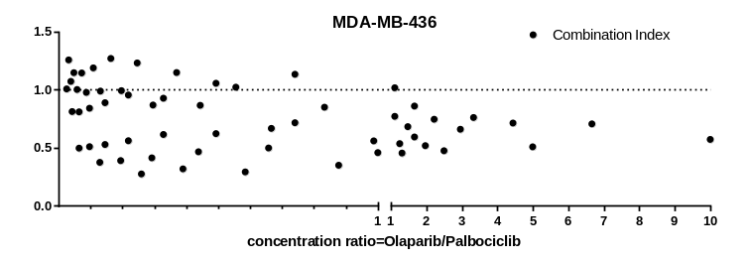
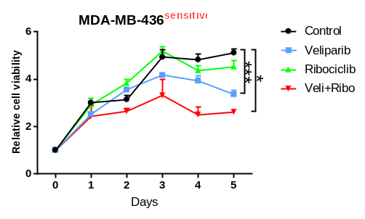
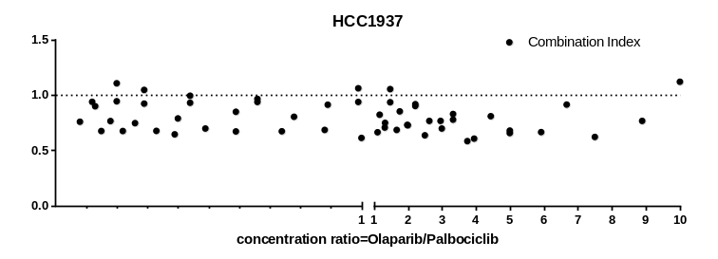
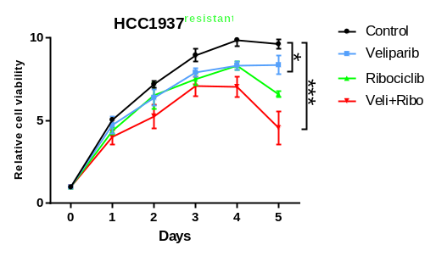
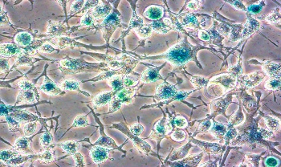
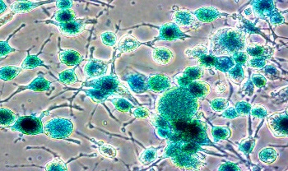
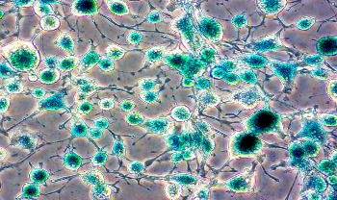
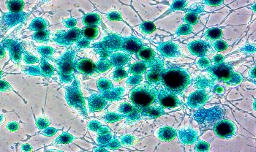
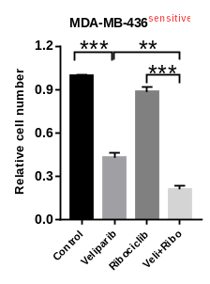
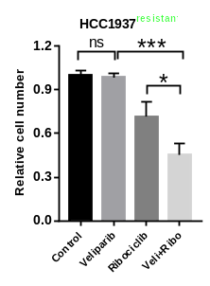
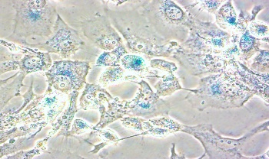
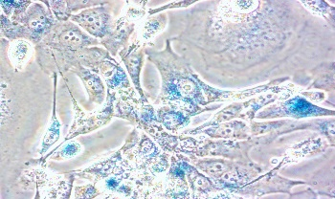
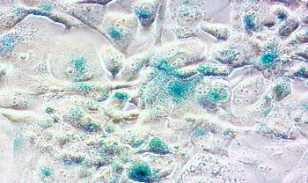
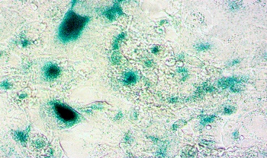
a
c
b
Control
Olaparib
Palbociclib
Ola+Palb
d
MDA-MB-436
HCC1937
Fig. S1 Synergistic response to combined PARPi and CDK4/6i treatment in BRCA^{mut}/TNBCs.
a The combination index (CI) of (Up) MDA-MB-436 and (Down) HCC1937 cells treated with varying concentrations of olaparib and palbociclib for 5 days. The CI was calculated by the Chou-Talalay method with CompuSyn software.
b Cell senescence of (Up) MDA-MB-436 and (Down) HCC1937 cells was determined by the β-Galactosidase Staining Kit after treatment with 5 µM olaparib or 5 µM palbociclib alone or in combination.
c Cell proliferation curve of 5 µM veliparib or 5 µM ribociclib alone or combined in (Up) PARPi-sensitive MDA-MB-436 and (Down) PARPi-resistant HCC1937 cells.
d Changes in the relative cell numbers after three days of single-agent or combined treatment.
Student’s t-test; ***p < 0.001, **p < 0.01, *p < 0.05; ns, not significant. The data are presented as the means ± SEMs. Con: Control; Ola: olaparib; Palb: palbociclib; Veli: Veliparib; Ribo: Ribociclib.

Slide 2
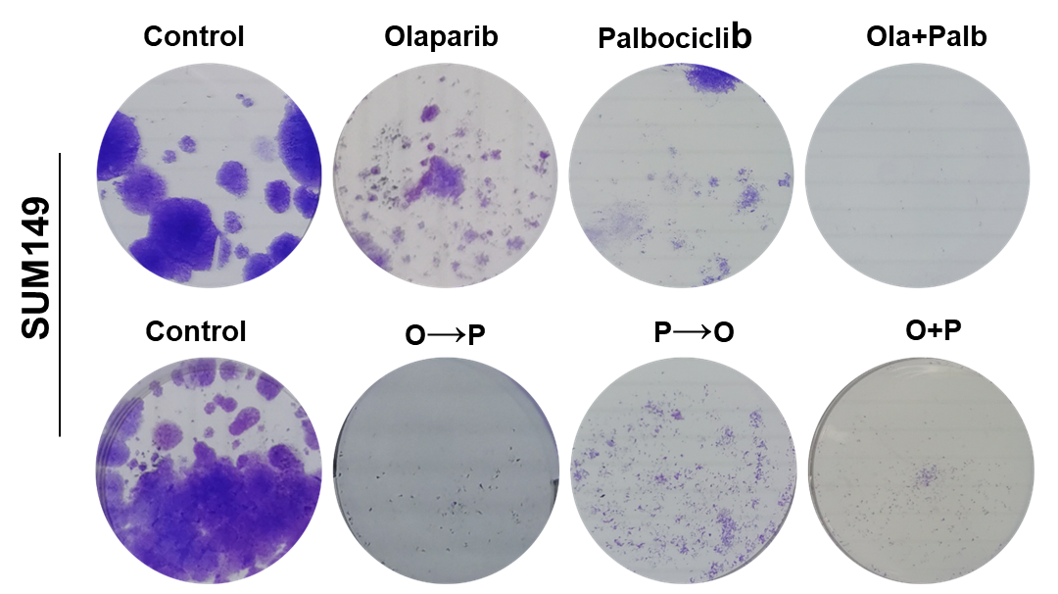
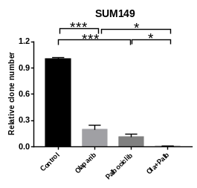
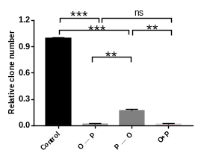
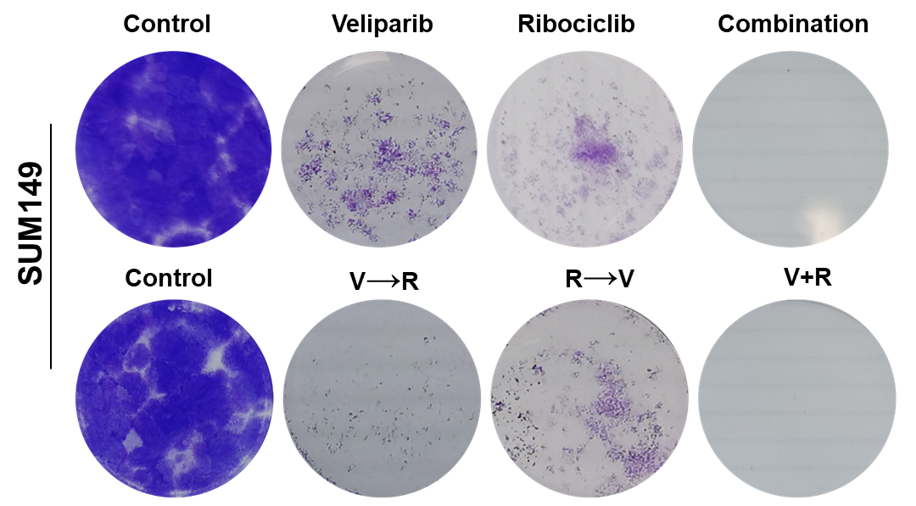
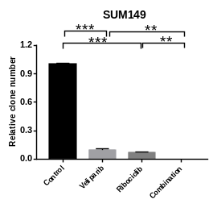
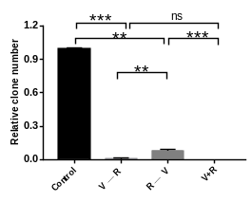
a
Time (Days)
Time (Days)
b
Time (Days)
Time (Days)
Fig. S2. Colony formation assays of SUM149 cells treated with PARPi and/or CDK4/6i.
a Colony formation assays of SUM149 cell lines treated with vehicle, 0.5 µM olaparib, 0.5 µM palbociclib or the combination for 12 days. The effect of the 6-day olaparib→6-day palbociclib sequential application (O→P) and its reverse (P→O) effect were also tested.
b Colony formation assays of SUM149 cell lines treated with vehicle, 0.5 µM veliparib, 0.5 µM ribociclib or the combination for 12 days. The effect of the 6-day veliparib →6-day ribociclib sequential application (V→R) and its reverse (R→V) effect were also tested. (Left) Pattern diagram of the sequential administration. (Middle) Representative images of colony formation assays. (Right) Quantification of colony formation.
Student’s t-test; ***p < 0.001, **p < 0.01, *p < 0.05; ns, not significant. The data are presented as the means ± SEMs. Con: Control; Ola/O: Olaparib; Palb/P: Palbociclib; Veli/V: Veliparib; Ribo/R: Ribociclib.

Slide 3
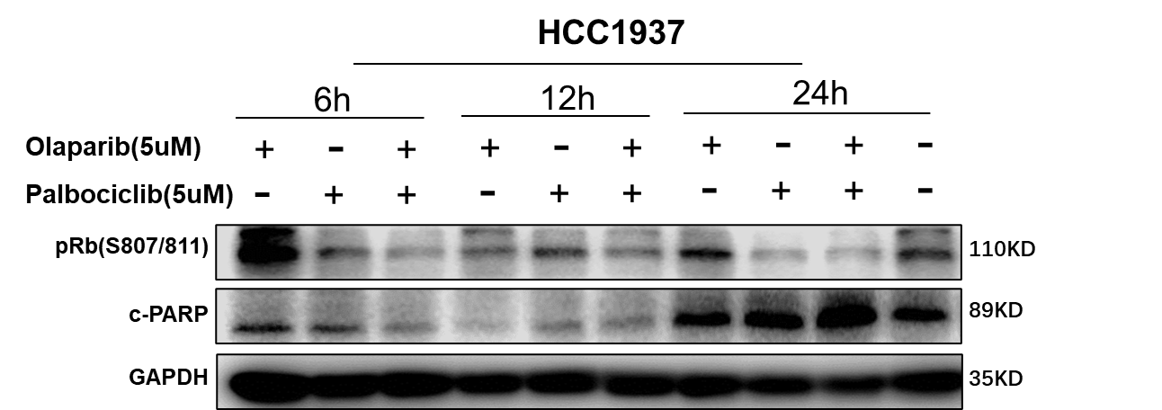
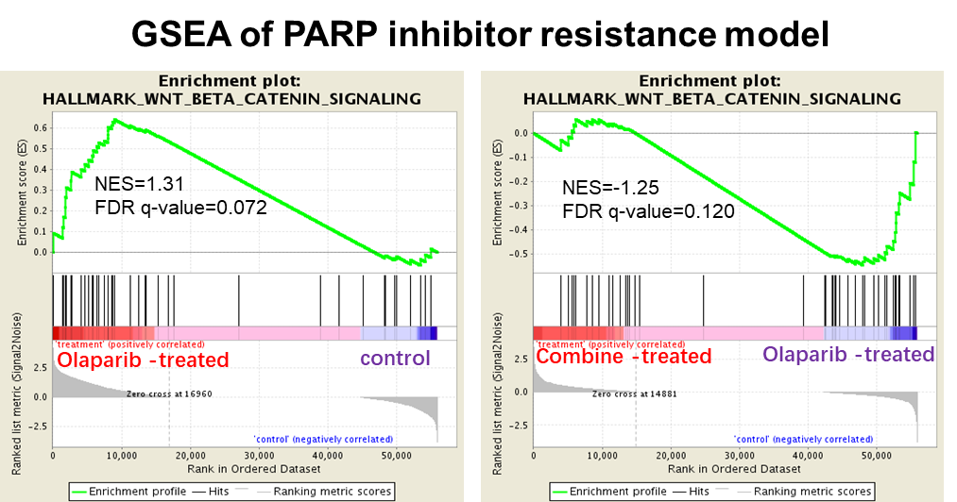
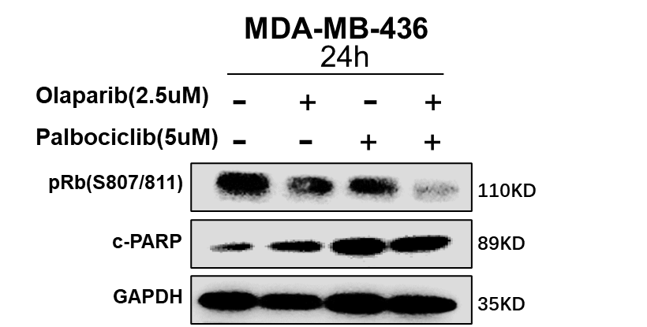
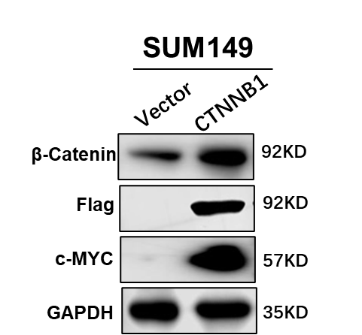
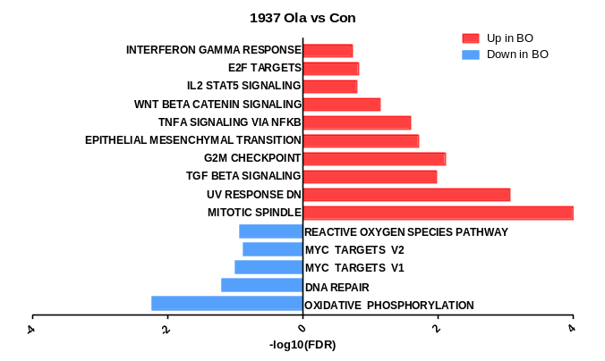
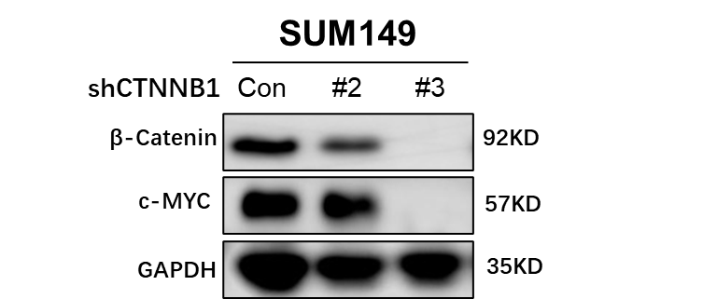
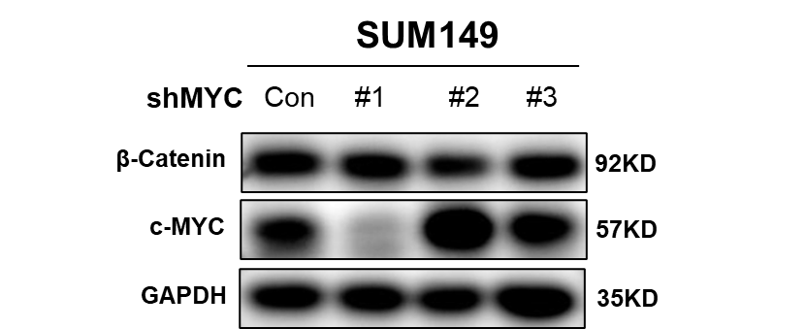
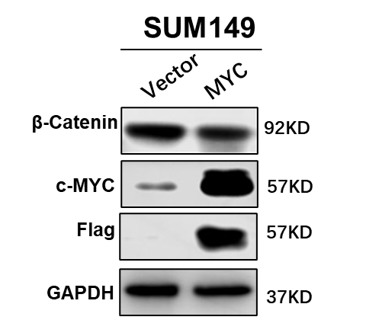
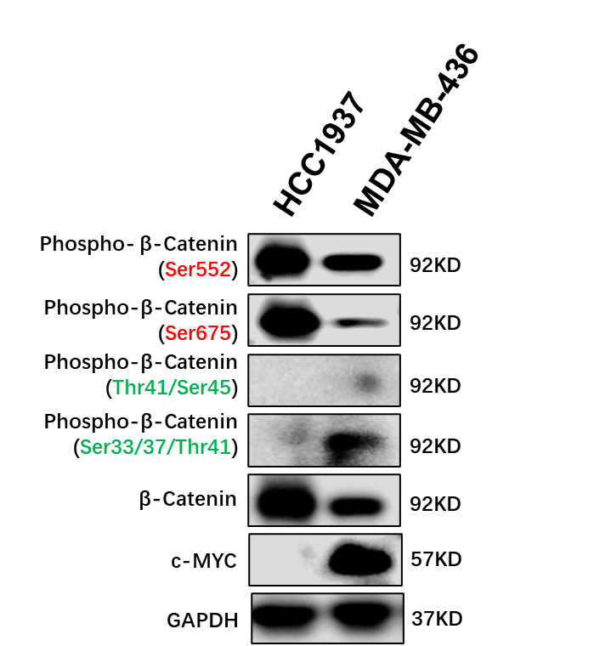
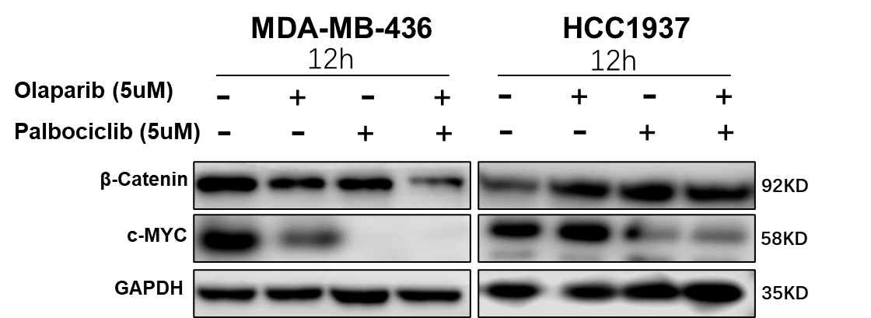
a
c
d
b
e
f
g
Fig. S3 The combined use of PARPi and CDK4/6i can inhibit the WNT pathway, which is not downregulated by single-agent PARPi treatment.
a Western blot (WB) analysis showing the level of phospho-Rb (Ser807/811) and cleaved PARP (Asp214) over time with drugs as indicated.
b GSEA results in olaparib-treated PARPi-resistant HCC1937 cells (BO) compared to vehicle-treated cells (BC).
c The Hallmark WNT_beta_catenin_signaling gene sets analyzed by GSEA which were upregulated in olaparib-treated HCC1937 cells (Left) but downregulated in combined-treated HCC1937 cells (Right).
d WB analysis showing the levels of c-myc in CTNNB1-knockdown (CTNNB1 KD) or overexpression (CTNNB1 OE) SUM149 cells.
e WB analysis showing levels of β-catenin in MYC-knockout (MYC KO) or overexpression (MYC OE) SUM149 cells.
f WB analysis showing total levels of β-catenin and c-myc in MDA-MB-436 and HCC1937 cells treated with drugs as indicated for 12 h.
g WB analysis showing the levels of β-catenin, phosphorylated β-catenin (pβ-cateninSer552, pβ-cateninSer675, pβ-cateninThr41/Ser45 and pβ-cateninSer33/37/Thr41) and c-myc in the primary PARPi-sensitive MDA-MB-436 cells and PARPi-resistant HCC1937 cells. The phosphorylation of the sites marked in green negatively regulates the Wnt signaling pathway, while the sites marked in red promote its nuclear translocation, thereby positively regulating the Wnt signaling pathway.

Slide 4
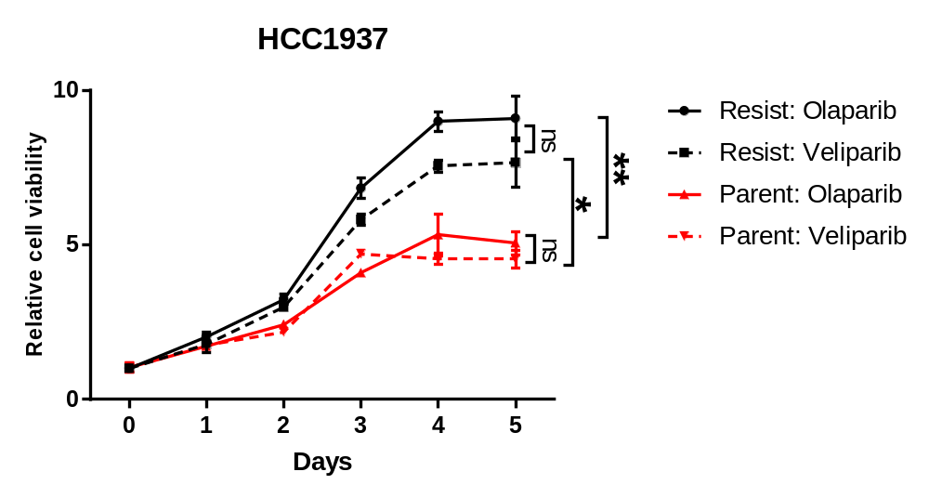
Fig. S4 Cross-resistance of the sensitivity of cells with acquired olaparib resistance (HCC1937) to other PARP inhibitors. Cell proliferation curve of parental HCC1937 and acquired Olaparib-resistant cells with 20 µM olaparib or 20 µM veliparib.
Student’s t-test; ***p < 0.001, **p < 0.01, *p < 0.05; ns, not significant. The data are presented as the means ± SEMs.

