Slide 1
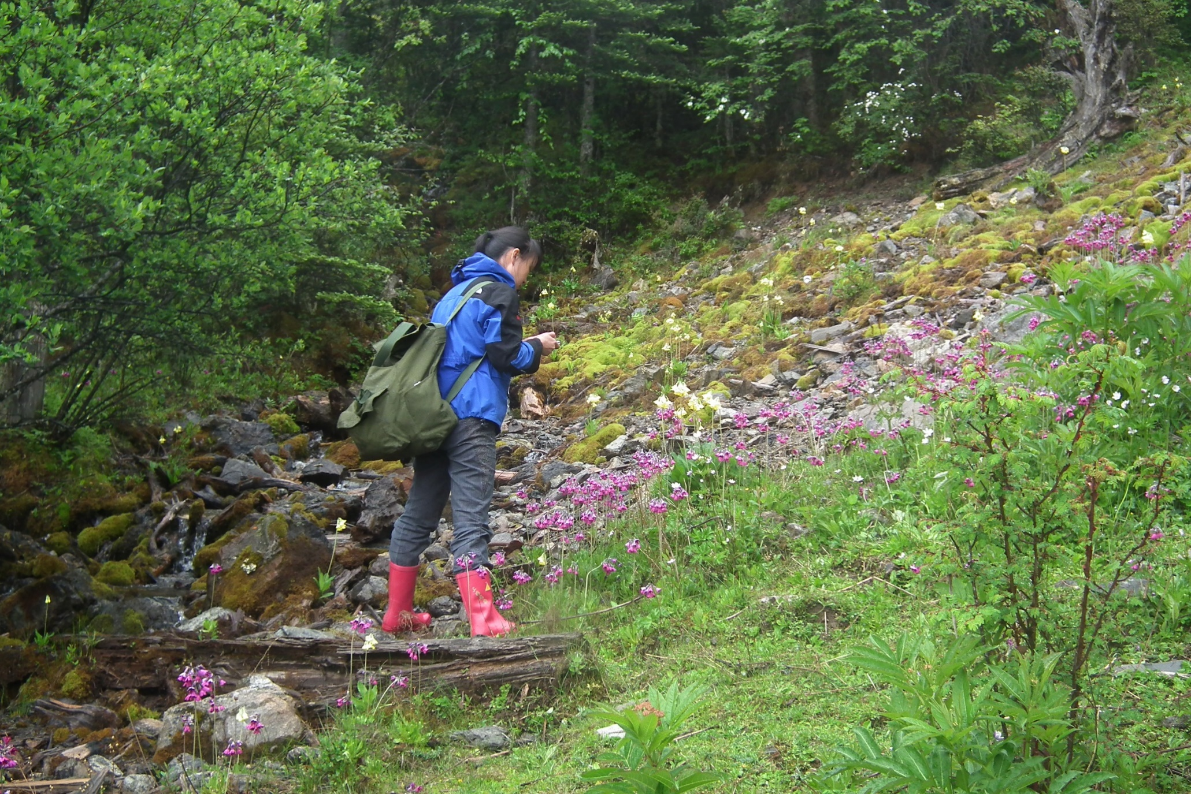
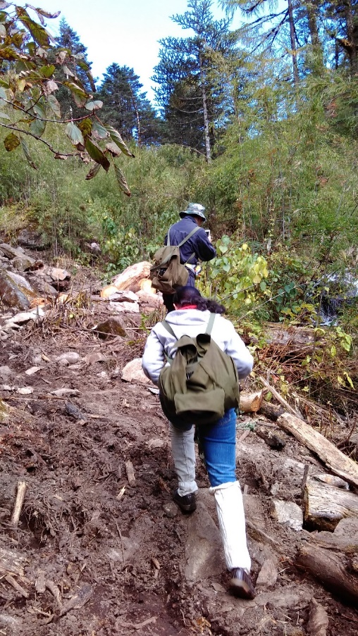
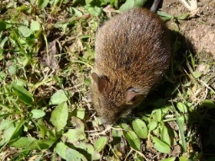
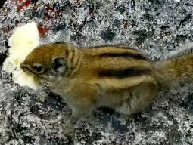
Sino-Burmese border, Yunnan Province, area of southern China near southeast Asia.
From 2011 to 2016, totally 3659 small mammals, categorized to 57species were detected for Borrelia burgdorferi sensu lato infection. Five genospecies including B. afzelii, B. burgdorferi sensu stricto, B. garinii, B. valaisiana and B. japonica were found in 30 species, including 20 species not been previously documented.

