Slide 1
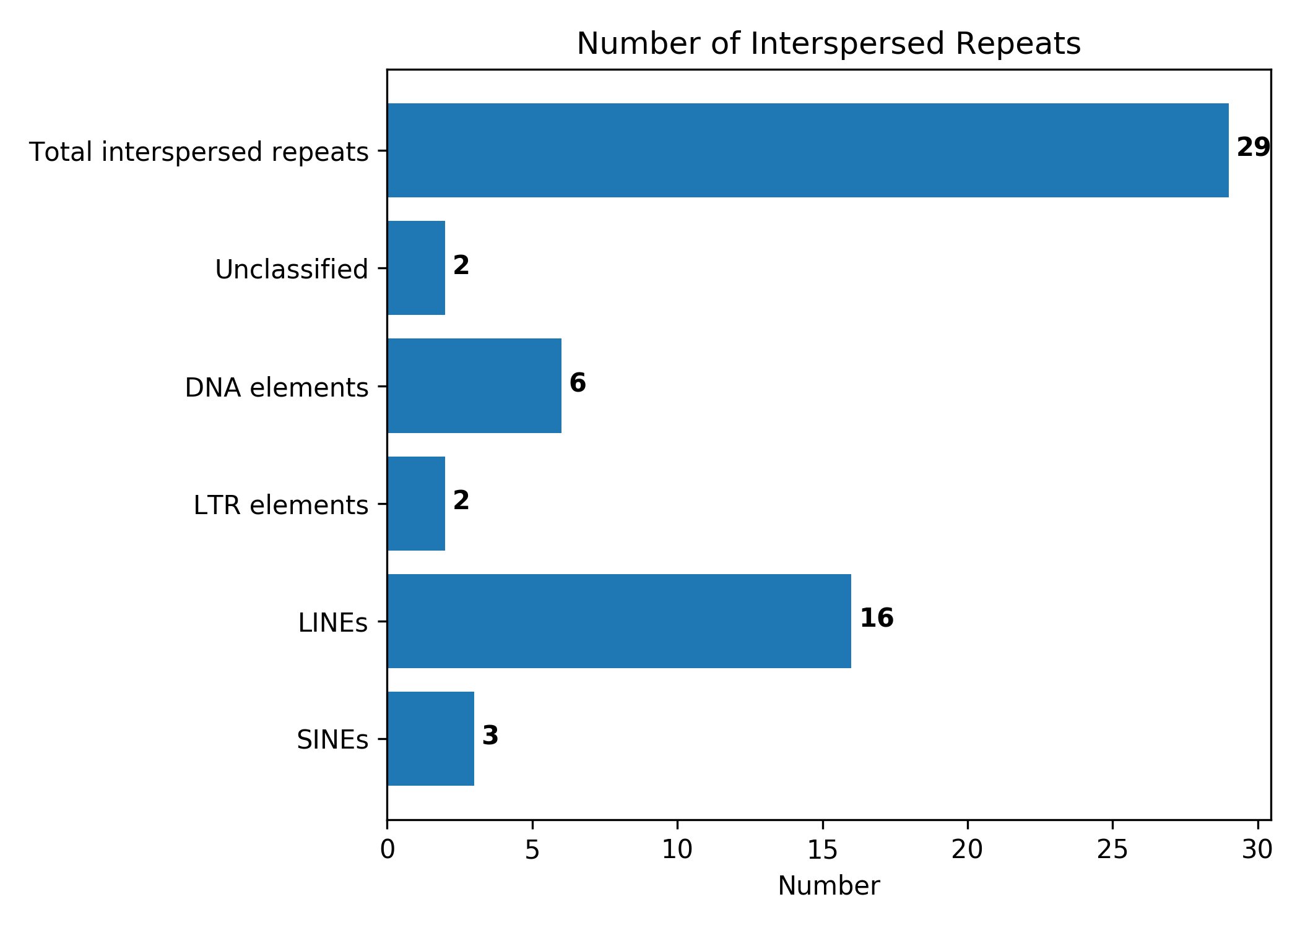
Fig. S1 Interspersed repetitive sequence histogramof the B. altitudinis D30202, The horizontal axis represents the number of interspersed repeats, and the vertical axis represents the type of interspersed repeats.The number on the bar graph represents the number of interspersed repeats.

Slide 2
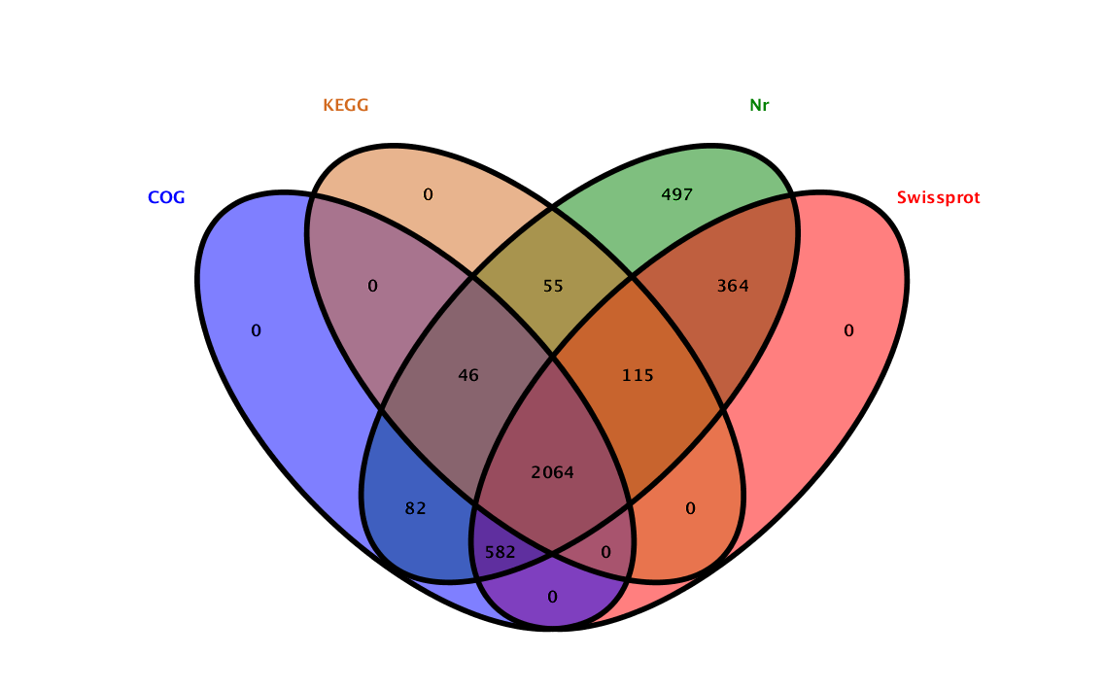
Fig. S2 Annotated venn map of four major databases. Each ellipse represents a database, the number above each region represents the number of gene annotated.

Slide 3
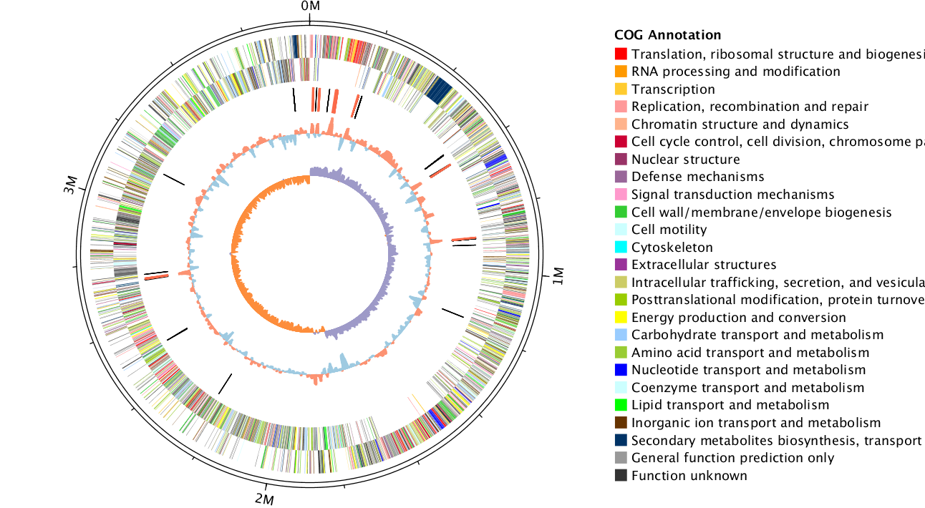

Fig. S3 Circular map of the B. altitudinis D30202 genome.The outermost circle is the position coordinates of the genome sequence. From the outer circle to the inner circle are: positive strand gene, negative strand gene, ncRNA (black means tRNA, red means rRNA), GC content (red means greater than the mean, blue means less than the mean) , GC skew (GC skew, used to measure the relative content of G and C, used to mark the start and end points in the circular chromosome; GC skew=(GC)/(G+C); purple means greater than 0, orange means less than 0)

Slide 4
Tryptophan
Tryptophan
[EC:1.4.3.2]
[EC:2.6.1.27]
[EC:4.1.1.28]
[EC:4.1.1.105]
[EC:2.6.1.99]
CO₂
[EC:2.6.1.99]
[EC:2.6.1.99]
3-(2-Aminoethyl)indole
3-(2-Aminoethyl)indole
Indolepyruvate
NADPH+O₂
NADPH+O₂
[EC:1.14.13.168]
[EC:1.14.13.168]
[EC:1.14.13.-]
[EC:1.14.13.168]
[EC:1.14.13.-]
[EC:1.14.13.-]
2NADPH+2 O₂
NADP⁺ +H₂O
NADP⁺ +H₂O
NADPH + H⁺ + O₂
NADPH + H⁺ + O₂
N-Hydroxyl-tryptamine
NADPH + H⁺ + O₂
[EC:1.14.14.156]
[EC:2.5.1.-]
[EC:1.14.14.156]
[EC:2.5.1.-]
2NADP⁺+CO₂ + 3 H₂O
Indole-3-acetaldoxime
2NADP⁺+CO₂ + 3 H₂O
NADP⁺ + H₂O + CO₂
NADP⁺ + H₂O + CO₂
[EC:1.7.3.-]
NADP⁺ + H₂O + CO₂
[EC:1.7.3.-]
Indoleacetic acid
Indoleacetaldehyde
Indoleacetic acid
H₂O₂
H₂O₂
H₂O+O₂
H₂O₂
H₂O + O₂
Fig. S4 Prediction of the metabolic pathway of indole acetic acid

Slide 5
Phenylalanine
[EC:1.4.1.20]
[EC:2.6.1.1]
[EC:1.4.1.20]
[EC:2.6.1.5]
[EC:2.6.1.5]
[EC:2.6.1.9]
[EC:2.6.1.57]
[EC:2.6.1.58]
[EC:2.6.1.57]
[EC:2.6.1.58]
Phenylpyruvate
O₂
O₂
[EC:1.13.11.27]
[EC:1.13.11.27]
CO₂
CO₂
2-Hydroxyphenylacetic acid
Fig. S5 Prediction of the metabolic pathway of 2-hydroxyphenylacetic acid

Slide 6
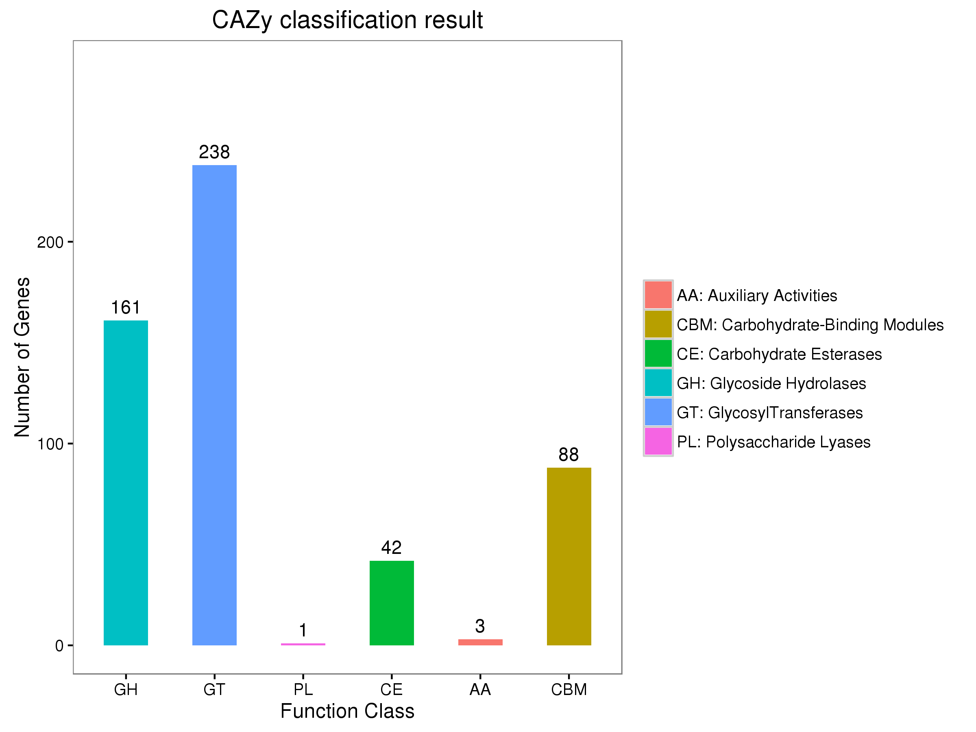
Fig. S6 CAZy classification map of the B. altitudinis D30202. The horizontal axis represents the classification of enzymes, and the vertical axis represents the number of genes included in the classification.

Slide 7
Table S1 B.altitudinis D30202 CAZy enzyme system family and quantity annotation results
family | count | family | count | family | count | family | count | family | count | family | count
AA1 | 1 | GH105 | 2 | GH5_7 | 1 | CBM6 | 1 | GH28 | 5 | GT30 | 1
AA3_2 | 1 | GH109 | 2 | GH6 | 2 | CBM63 | 1 | GH3 | 8 | GT32 | 1
AA4 | 1 | GH11 | 1 | GH65 | 1 | CBM66 | 3 | GH30_8 | 1 | GT35 | 1
AA6 | 1 | GH126 | 1 | GH72 | 1 | CBM9 | 1 | GH32 | 12 | GT4 | 65
CBM12 | 1 | GH13 |  | GH73 | 6 | CE0 | 1 | GH33 | 3 | GT47 | 1
CBM13 | 4 | GH133 | 2 | GH76 | 1 | CE1 | 6 | GH36 | 1 | GT5 | 2
CBM2 | 2 | GH135 | 2 | GH87 | 1 | CE11 | 2 | GH37 | 4 | GT51 | 13
CBM22 | 2 | GH13_11 | 6 | GH9 | 1 | CE12 | 2 | GH38 | 1 | GT57 | 1
CBM23 | 2 | GH13_29 | 5 | GH93 | 1 | CE14 | 6 | GH39 | 3 | GT61 | 1
CBM3 | 1 | GH13_3 | 8 | GH95 | 1 | CE4 | 15 | GH4 | 7 | GT66 | 1
CBM32 | 3 | GH13_30 | 1 | GH99 | 1 | CE6 | 1 | GH42 | 2 | GT68 | 7
CBM42 | 1 | GH13_32 | 1 | GT0 | 13 | CE7 | 1 | GH43_11 | 5 | GT7 | 1
CBM48 | 6 | GH16 | 5 | GT1 | 12 | CE8 | 3 | GH43_16 | 1 | GT8 | 3
CBM5 | 8 | GH17 | 2 | GT13 | 2 | CE9 | 5 | GH43_24 | 2 | GT9 | 2
CBM50 | 47 | GH18 | 3 | GT2 | 99 | GH0 | 10 | GH48 | 1 | GT96 | 1
CBM51 | 1 | GH19 | 4 | GT26 | 1 | GH1 | 22 | GH51 | 2 | PL0 | 1
CBM54 | 3 | GH2 | 7 | GT27 | 1 | GH10 | 3 | GH53 | 3 | PL1_5 | 1
CBM57 | 1 | GH23 | 20 | GT28 | 9 | GH101 | 2 | GH55 | 1 | PL9_2 | 1

Slide 8
Table S2 Functional classification of virulence factor genes
gene number | Functional-Categories
7 | Signal transduction mechanisms
39 | Cell motility
60 | Posttranslational modification, protein turnover, chaperones
52 | Translation, ribosomal structure and biogenesis
9 | Amino acid transport and metabolism
6 | Coenzyme transport and metabolism
8 | Inorganic ion transport and metabolism
3 | Energy production and conversion
3 | Transcription
35 | Intracellular trafficking, secretion, and vesicular transport
28 | Cell wall/membrane/envelope biogenesis
53 | Carbohydrate transport and metabolism
7 | Cell cycle control, cell division, chromosome partitioning
1 | Lipid transport and metabolism
18 | Function unknown

Slide 9
Table S3 B.altitudinis D30202 CARD special gene and drug resistance type annotation results
Resistance specific genes | Types of antibiotic resistance
gyrA、gyrB、parE | fluoroquinolone resistant
pncA、rpsA | pyrazinamide resistant
EF-Tu | elfamycin resistant
fusA、kasA、fabI、fabG、ndh、gidB | antibiotic resistant
pgsA、cls、liaS、mprF、liaR、gshF | daptomycin resistant
katG | isoniazid resistant
murA | transferase

Slide 10
Fig. S7 Display graph of secondary metabolite gene cluster of the B. altitudinis D30202. Each column represents a different gene cluster type, and different colors represent genes with different functions.

Slide 11
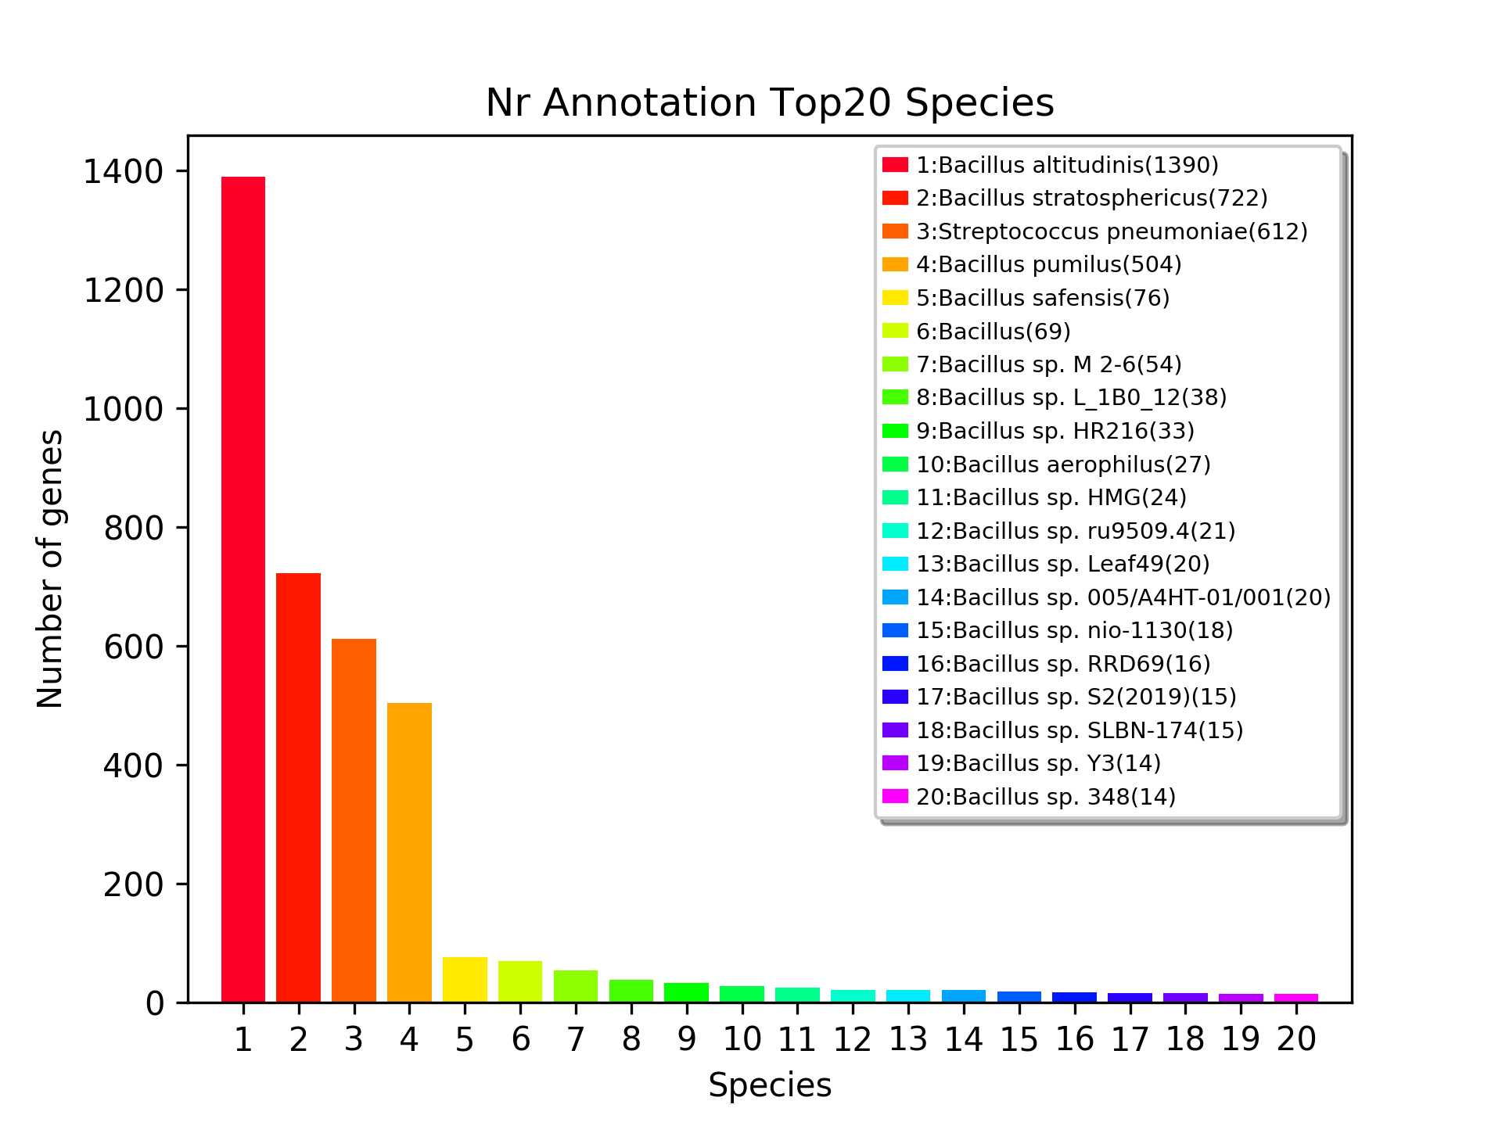
Fig. S8 Nr database annotated species statistics (top 20 species).The horizontal axis representsdifferent species, and the vertical axis represents the number of genes included in the classification.

