Slide 1

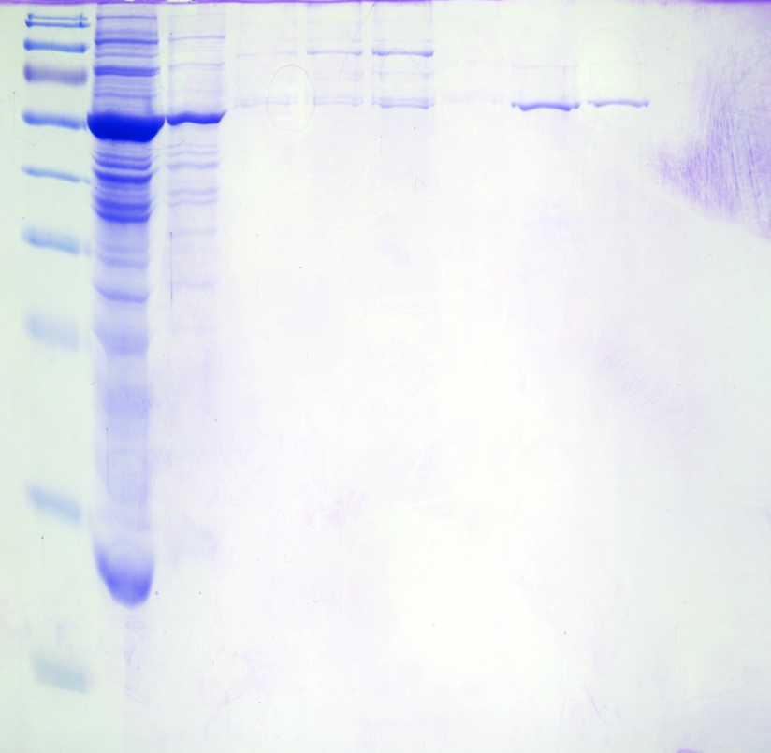


Figure S2
A
B
kDa
Washout
20-22
Crude
1-3
4-6
7-9
10-12
13-15
16-19
23-25
130
20
[Imidazole], mM
72
55
150
43
Twi1-His₆
15
34
26
A₂₈₀ (AU)
10
100
17
5
Control
Twi1-His₆
50
10
0
0
5
10
15
20
25
Imidazole gradient
Fraction number
Fig. S2. Purification of the Twi1 recombinant protein. (A) Elution profiles of nickel affinity chromathography with imidazole gradient from the crude extract of the control plants agroinoculated with the pGWB8 empty vector (Control) and the plants agroinoculated with pGWB8_Twi1 construction (Twi1-His₆). (B) The SDS/PAGE analysis of the protein content in the purified fractions. The protein band present in the fractions from 13 to 15 and from 16 to 19 corresponds to the His-tagged Twi1 recombinant protein.

