Slide 1
(A) BIP binds to a product of forward primer extension:
F1c
SNV
5’-GTAGAAGGTGGACCTGttttt
F2
F1
B2
CAGGCTTTGTGGATTTGACCCTCCATGATCAGGTCCACCTTCTACAATGTGCCTGGCTAGAGATCCTGATGATTGGTCTCGTC-3’
3’- USS BB0 21 – 5’
5’ - USS FB0 21 – 3’
GACTACTAACCAGAGCAG
B1c
83 bp
tttttGAGATCGGTCCGTGTAAC-5’
F1
B1
F2
G
B2
*3’ F1c
B1c
Variant base encoded extension from the 3’ open end of loop (green dot) of a FIP initiated reaction
(B) FIP binds to a product of reverse primer extension:
F1c
SNV (reverse strand)
5’-GTAGAAGGTGGACCTGttttt
F2
F1
B2
CAGGCTTTGTGGATTTGAC-3’
GTCCGAAACACCTAAACTGGGAGGTACTAGTCCAGGTGGAAGATGTTACACGGACCGATCTCTAGGACTACTAACCAGAGCAG
3’
USS BB0 21
3’
B1c
USS FB0 21
tttttGAGATCGGTCCGTGTAAC-5’
83 bp
B1
F1
F2
C
B2
F1c
3’ B1c
Variant base encoded extension from the 3’ open end of loop (green dot) of a BIP initiated reaction
Supplementary Figure 1. Compact design of ESR1 E380Q AS-Mini-LAMP+USS: The single nucleotide variant (SNV - indicated by an arrow) responsible for the E380Q missense mutation is encoded at the 5’-position of both FIP and BIP primers permitting mutant selective self-hybrisdising loop formation ahead of exponential amplification from the 3’open end of both FIP and BIP initiated reactions (A and B respectively). Poly-T linker incorporation between the F1-F1c and B1-B1c of FIP and BIP aid loop formation and enhance reaction velocity in lieu of the loop primers. Addition of USS_{WT} primers aim to further enhance amplification of the desired mutant allele by competitively binding to any WT sequences.

Slide 2
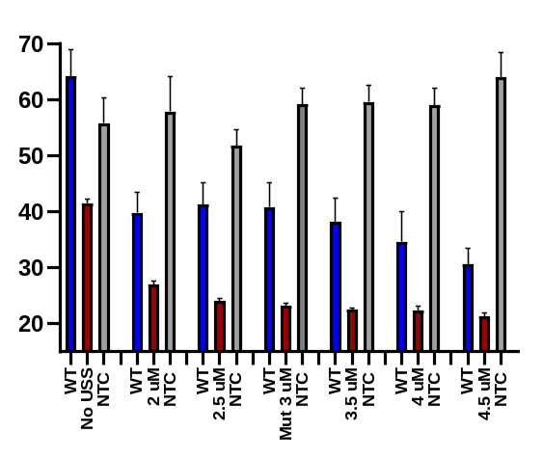
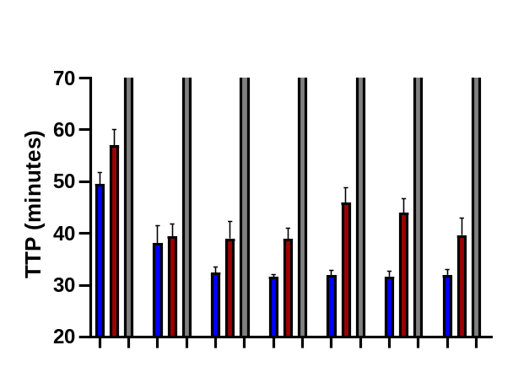
(A) AS-Mini-LAMP_{Mut} reaction
70
WT Mutant NTC
60
*
50
TTP (min)
40
30
20
0.0
2.0
2.5
3.0
3.5
4.0
4.5
WT USS (FB0 BB0 21) µM
(B) AS-Mini-LAMP_{WT} reaction
70
*
60
50
TTP (min)
40
30
20
0.0
2.0
2.5
3.0
3.5
4.0
4.5
Mutant USS (FB1 BB1 23) µM
Supplementary Figure 2. USS concentration optimisation. (A) USS_{WT} FB0/BB0 21 competitive inhibition of non-selective WT amplification in the AS-Mini-LAMP_{Mut} reaction. (B) USS_{Mut} FB1/BB1 23 competitive inhibition of non-selective mutant amplification in the AS-Mini-LAMP_{WT} reaction. Reactions are shown in the absence and presence of USS primers. The optimal concentration maintains the greatest delay (TTP in minutes) between reaction encoded selective template amplification and opposing allele non-selective template amplification (denoted by asterisk’s) . All reaction were performed at 65°C using synthetic 1x10⁴ copies of synthetic template DNA. WT template (blue), mutant template (red) and NTC (grey). Data represents the average of two experiments each performed in quadruplicate.
Notes:
Swap for more representative fig C – 40 mins

Slide 3
(A)
1.0
0.8
100
0.6
80
R square
0.7078
Normalized fluorescence
60
TTP (min)
0.4
40
0.2
20
0
10²
10³
10⁴
10⁵
10⁶
0.0
Copies WT template
20
30
40
50
60
70
80
TTP (min)
(B)
1.0
0.8
100
0.6
80
R square
0.7043
Normalized fluorescence
60
TTP (min)
0.4
40
0.2
20
0
10²
10³
10⁴
10⁴
10⁵
0.0
Copies mutant template
20
30
40
50
60
70
80
Supplementary Figure 3. AS-Mini-E380Q_{WT} + USS_{Mut} LAMP WT template selectivity and limit of detection. (A) Reaction selective WT template DNA and (B) non-selective mutant template DNA were serially diluted from 1x10⁶ (), 1x10⁵ (), 1x10⁴ (), 1x10³ (), and 5x10² () plus NTC shown in grey (). Time to positive (TTP) is the time (minutes) at which amplification exceeds the manually set, reaction consistent threshold (red dotted line) and enters the rapid linear, exponential phase. Linear regression analysis demonstrates the reaction efficiency against both mutant and WT templates. Data represents the average of two experiments each performed in quadruplicate. All reactions were performed at 65°C.

Slide 4
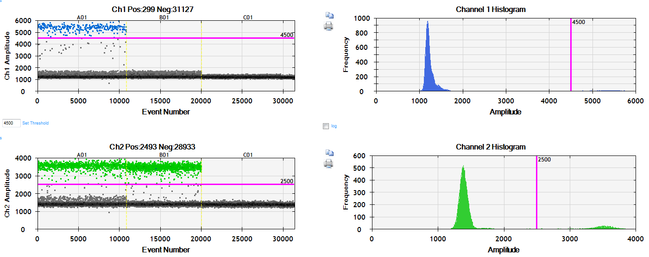
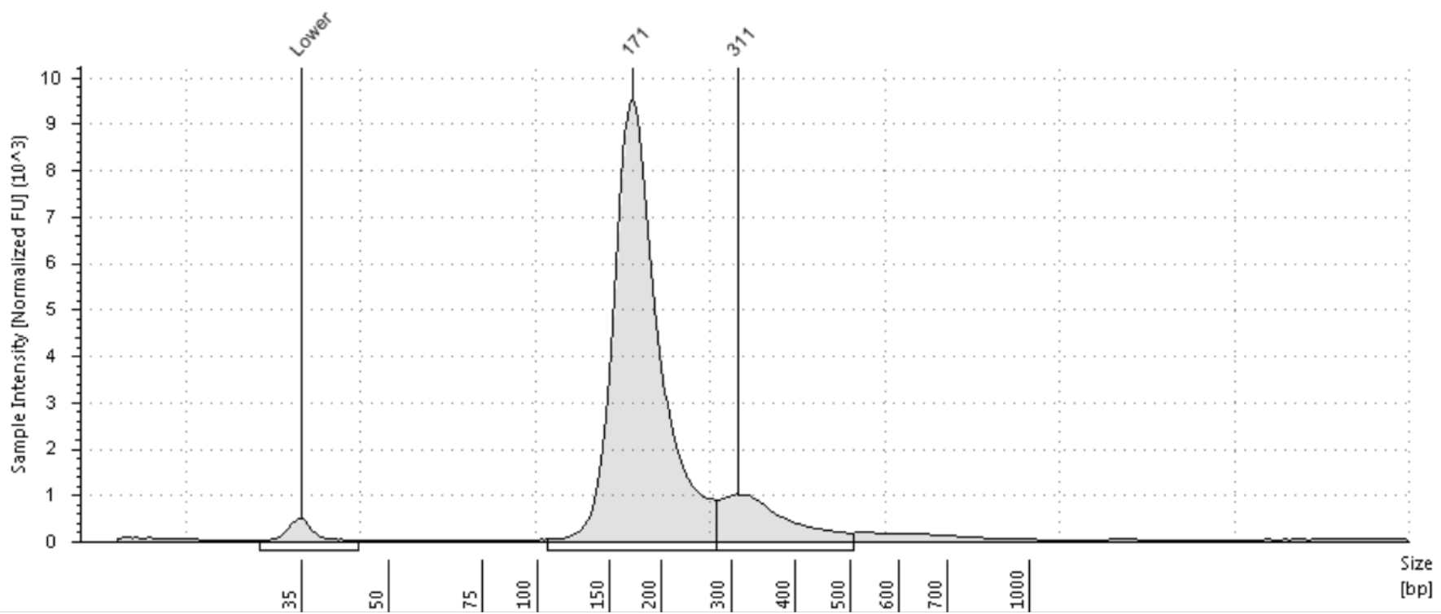
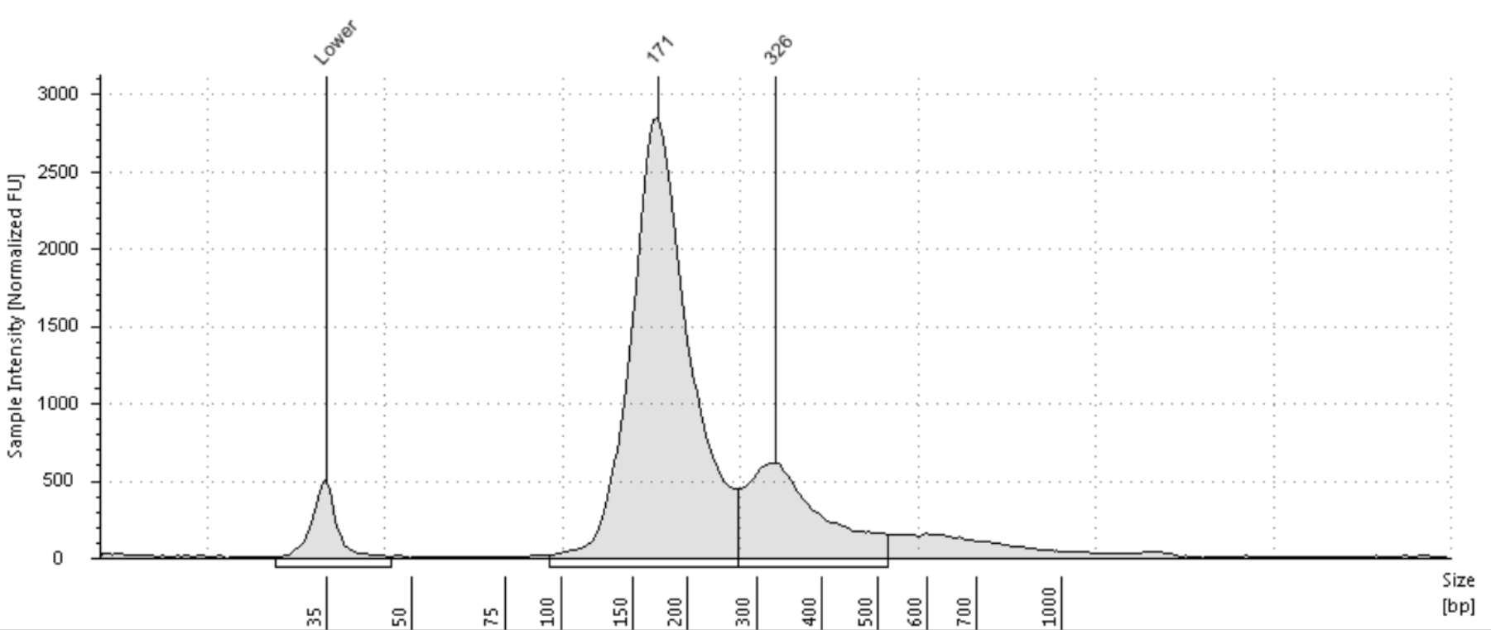
(A)
E380Q
positive
E380Q
negative
NTC
Mutant channel
amplitude
WT channel
amplitude
(B)
Sample intensity
[Normalized FU] 10^3
(C)
Sample intensity
[Normalized FU]
Size (bp)
Supplementary Figure 4. Plasma derived cfDNA sample preparation. (A+B) cfDNA ScreenTape profiles demonstrating the size profiles of the patient derived cfDNA. (C) ESR1 E380Q negative and positive plasma extracted cfDNA samples (A) ddPCR confirmed ESR1 E380Q positive and negative patient plasma extracted cfDNA samples (10 ng). Representative one-dimensional (1D) amplitude plots show the associated manual threshold gating (pink line) for FAM (mutant, blue) amplitudes in upper panel and VIC (wild type, green) amplitudes in lower panel. Black dots correspond to droplets without any dye fluorescence.

