Slide 1
Table 1 Patients characteristics
Table 2. Best Response
All patients |  |  |  | 53
Age, median (range) |  |  |  | 70 (29-89)
Sex (%) |  | Male |  | 36 ( 67.9)
 |  | Female |  | 17 ( 32.1)
PS (%) |  | 0 |  | 3 ( 5.7)
 |  | 1 |  | 44 ( 83.0)
 |  | 2 |  | 6 ( 11.3)
Smoking (%) |  | No |  | 13 ( 24.5)
 |  | Yes |  | 40 ( 75.5)
Pathology (%) |  | AD |  | 47 ( 88.7)
 |  | SQ |  | 0 (0)
 |  | Others |  | 6 ( 11.3)
Staging (%) |  | III |  | 10 ( 18.9)
 |  | IV or relapse |  | 43 ( 81.1)
EGFR mutaiton (%) |  | No or unknown |  | 46 ( 86.8)
 |  | Yes |  | 7 ( 13.2)
Treatment schedule of S-1 (%) |  | 4W2R |  | 31 ( 58.5)
 |  | 2W1R |  | 18 ( 34.0)
 |  | Others |  | 4 ( 7.5)
Prior treatments before S-1 (%) |  | 1 |  | 11 ( 20.8)
 |  | 2 or 3 |  | 42 ( 79.2)
Number of cycles of PEM (%) |  | 1〜4 |  | 29 ( 54.7)
 |  | 5≦ |  | 24 ( 45.3)
Median period between last PEM administration and first S-1 administration (range) |  |  |  | 118 days (11-625)
ICI between S-1 and PEM |  |  |  | none
Best respons (%) |  | PR |  | 1 (1.9)
 |  | SD |  | 21 (39.6)
 |  | PD |  | 31 (58.5)
ORR |  |  |  | 1.9% (95% CI:0.0-10.1%)
DCR |  |  |  | 41.5% (95% CI:28.1-55.9%)

Slide 2
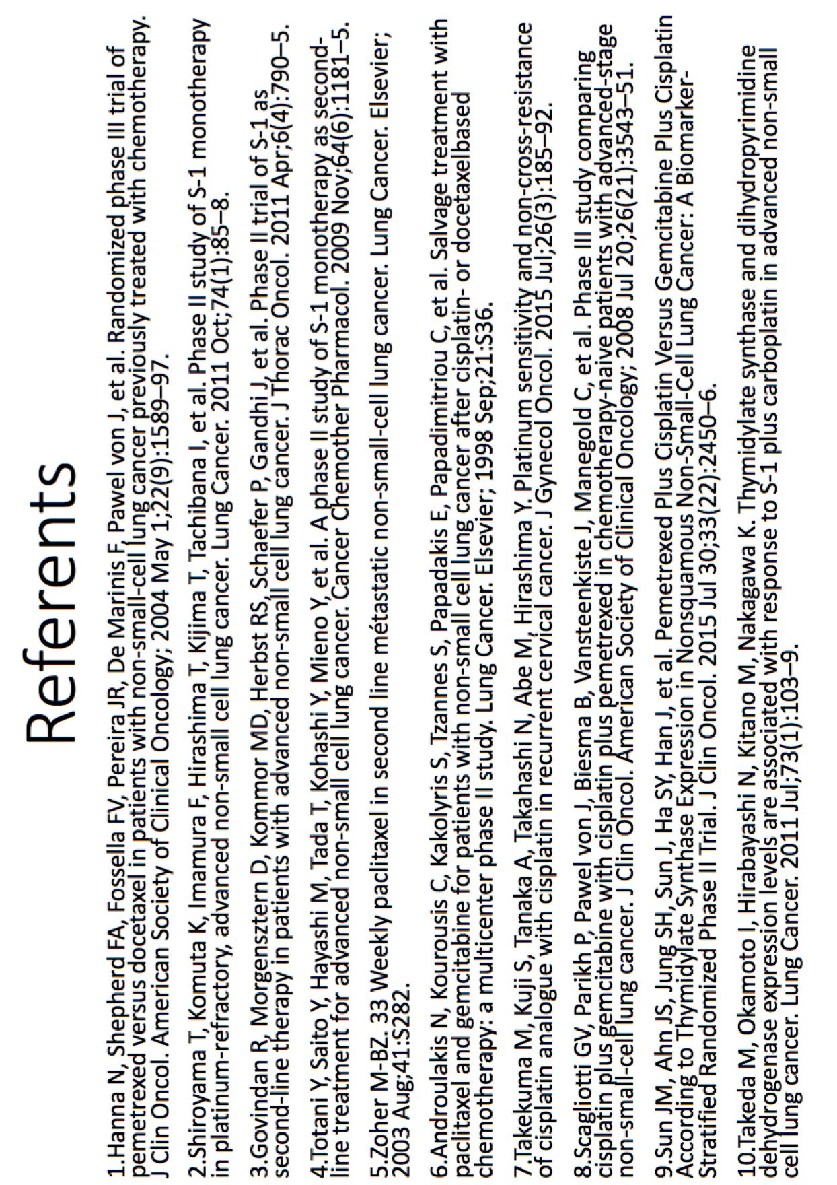
Table 3 Previous reports about S-1 monotherapy
Author | Year | Study design | Schedule^{*1} | Prior treatment number | Resistration period | Number of patients | Median age (y.o) | PS (0-1/2-4) | Pathology (AD/SQ/Others) | ORR(%) | DCR(%) | PFS (months) | OS (months)
Kawahara | 2001 | Phase II | 4W/2W | 0 | Unknown | 59 | 64 | 55/4 | 38/20/1 | Total:22.0 AD:26.3 SQ:10.0 | unknown | - | 10.2
Totani | 2009 | Phase II | 4W/2W | 1 | Aug. 2005- July 2007 | 48 | 66.5 | 36/12 | 36/5/7 | 12.5 | 52 | 2.5 | 8.2
Govindan | 2011 | Phase II | 2W/1W | 1 | Unknown | 57 | 62 | 57/0 | 26/18/13 | Total:7.1 Non-SQ:10.5 SQ:0 | Total:31 Non-SQ:60.5 SQ:44.4 | 2.9 | 7.3
Shiroyama | 2011 | Phase II | 4W/2W | 1≦ | June 2005- May 2007 | 44 | 64 | 44/0 | 30/11/3 | 13.6 | 77.3 | 4.2 | 16.4
Kasai | 2016 | Phase II | 4W/2W | 0 | June 2007- June 2010 | 32 | 80 | 32/0 | 24/6/2 | 22.6 | 65.6 | 5.5 | 12.4
Nokihara | 2017 | Phase III | 4W/2W | 1,2 | July 2010- June 2014 | 577 | 62 | 565/12 | 430/105/41 | 8.3 | 45.4 | 2.8 | 12.7
Tomita^{*2} | 2011 | Retrospective | Physician’s choisce | 1-3 | Mar. 2004- Oct. 2010 | 19 | Unknown | Unknown | 19/0/0 | 15.8 | 57.9 | unknown | unknown
 | present | Retrospective | Physician’s choisce | 1-3 | Apr. 2012- Mar. 2017 | 53 | 70 | 47/6 | 47/0/6 | 1.9 | 41.5 | 2.8 | 12.8
*1 4W2W: administration for 4 weeks and rest for 2 week.
*2 Adenocarcinoma subset analysis.
year | phase | cycle | prior treatment | number of patients | median age (y.o) | PS (0-1/2-4) | patho (AD/ SQ/Others) | RR(%) | PFS (month) | OS (month)
2009 | 2 | 4W/2W | 1 course | 48 | 66.5 | 36/12 | 36/5/7 | 12.5 | 2.5 | 8.2
2011 | 2 | 2W/1W | 1 course | 57 | 62 | 56/0 | 26/18/13 | 7.1 | 2.9 | 7.3
2011 | 2 | 4W/2W | 1 course≦ | 44 | 64 | 44/0 | 30/11/3 | 13.6 | 4.2 | 16.4
2016 | 2 | 4W/2W | 0 course | 32 | 80 | 32/0 | 24/6/2 | 22.6 | 5.5 | 12.4
present |  | - | - | 12 | 72 | 9/3 | Adeno only | 0 | 2.7 | -
year | phase | cycle | prior treatment | number of patients | median age (y.o) | PS (0-1/2-4) | patho (AD/ SQ/Others) | RR(%) | PFS (month) | OS (month)
2009 | 2 | 4W/2W | 1 course | 48 | 66.5 | 36/12 | 36/5/7 | 12.5 | 2.5 | 8.2
2011 | 2 | 2W/1W | 1 course | 57 | 62 | 56/0 | 26/18/13 | 7.1 | 2.9 | 7.3
2011 | 2 | 4W/2W | 1 course≦ | 44 | 64 | 44/0 | 30/11/3 | 13.6 | 4.2 | 16.4
2016 | 2 | 4W/2W | 0 course | 32 | 80 | 32/0 | 24/6/2 | 22.6 | 5.5 | 12.4
present |  | - | - | 12 | 72 | 9/3 | Adeno only | 0 | 2.7 | -
year | phase | cycle | prior treatment | number of patients | median age (y.o) | PS (0-1/2-4) | patho (AD/ SQ/Others) | RR(%) | PFS (month) | OS (month)
2009 | 2 | 4W/2W | 1 course | 48 | 66.5 | 36/12 | 36/5/7 | 12.5 | 2.5 | 8.2
2011 | 2 | 2W/1W | 1 course | 57 | 62 | 56/0 | 26/18/13 | 7.1 | 2.9 | 7.3
2011 | 2 | 4W/2W | 1 course≦ | 44 | 64 | 44/0 | 30/11/3 | 13.6 | 4.2 | 16.4
2016 | 2 | 4W/2W | 0 course | 32 | 80 | 32/0 | 24/6/2 | 22.6 | 5.5 | 12.4
present |  | - | - | 12 | 72 | 9/3 | Adeno only | 0 | 2.7 | -
year | phase | cycle | prior treatment | number of patients | median age (y.o) | PS (0-1/2-4) | patho (AD/ SQ/Others) | RR(%) | PFS (month) | OS (month)
2009 | 2 | 4W/2W | 1 course | 48 | 66.5 | 36/12 | 36/5/7 | 12.5 | 2.5 | 8.2
2011 | 2 | 2W/1W | 1 course | 57 | 62 | 56/0 | 26/18/13 | 7.1 | 2.9 | 7.3
2011 | 2 | 4W/2W | 1 course≦ | 44 | 64 | 44/0 | 30/11/3 | 13.6 | 4.2 | 16.4
2016 | 2 | 4W/2W | 0 course | 32 | 80 | 32/0 | 24/6/2 | 22.6 | 5.5 | 12.4
present |  | - | - | 12 | 72 | 9/3 | Adeno only | 0 | 2.7 | -
year | phase | cycle | prior treatment | number of patients | median age (y.o) | PS (0-1/2-4) | patho (AD/ SQ/Others) | RR(%) | PFS (month) | OS (month)
2009 | 2 | 4W/2W | 1 course | 48 | 66.5 | 36/12 | 36/5/7 | 12.5 | 2.5 | 8.2
2011 | 2 | 2W/1W | 1 course | 57 | 62 | 56/0 | 26/18/13 | 7.1 | 2.9 | 7.3
2011 | 2 | 4W/2W | 1 course≦ | 44 | 64 | 44/0 | 30/11/3 | 13.6 | 4.2 | 16.4
2016 | 2 | 4W/2W | 0 course | 32 | 80 | 32/0 | 24/6/2 | 22.6 | 5.5 | 12.4
present |  | - | - | 12 | 72 | 9/3 | Adeno only | 0 | 2.7 | -
year | phase | cycle | prior treatment | number of patients | median age (y.o) | PS (0-1/2-4) | patho (AD/ SQ/Others) | RR(%) | PFS (month) | OS (month)
2009 | 2 | 4W/2W | 1 course | 48 | 66.5 | 36/12 | 36/5/7 | 12.5 | 2.5 | 8.2
2011 | 2 | 2W/1W | 1 course | 57 | 62 | 56/0 | 26/18/13 | 7.1 | 2.9 | 7.3
2011 | 2 | 4W/2W | 1 course≦ | 44 | 64 | 44/0 | 30/11/3 | 13.6 | 4.2 | 16.4
2016 | 2 | 4W/2W | 0 course | 32 | 80 | 32/0 | 24/6/2 | 22.6 | 5.5 | 12.4
present |  | - | - | 12 | 72 | 9/3 | Adeno only | 0 | 2.7 | -
year | phase | cycle | prior treatment | number of patients | median age (y.o) | PS (0-1/2-4) | patho (AD/ SQ/Others) | RR(%) | PFS (month) | OS (month)
2009 | 2 | 4W/2W | 1 course | 48 | 66.5 | 36/12 | 36/5/7 | 12.5 | 2.5 | 8.2
2011 | 2 | 2W/1W | 1 course | 57 | 62 | 56/0 | 26/18/13 | 7.1 | 2.9 | 7.3
2011 | 2 | 4W/2W | 1 course≦ | 44 | 64 | 44/0 | 30/11/3 | 13.6 | 4.2 | 16.4
2016 | 2 | 4W/2W | 0 course | 32 | 80 | 32/0 | 24/6/2 | 22.6 | 5.5 | 12.4
present |  | - | - | 12 | 72 | 9/3 | Adeno only | 0 | 2.7 | -
year | phase | cycle | prior treatment | number of patients | median age (y.o) | PS (0-1/2-4) | patho (AD/ SQ/Others) | RR(%) | PFS (month) | OS (month)
2009 | 2 | 4W/2W | 1 course | 48 | 66.5 | 36/12 | 36/5/7 | 12.5 | 2.5 | 8.2
2011 | 2 | 2W/1W | 1 course | 57 | 62 | 56/0 | 26/18/13 | 7.1 | 2.9 | 7.3
2011 | 2 | 4W/2W | 1 course≦ | 44 | 64 | 44/0 | 30/11/3 | 13.6 | 4.2 | 16.4
2016 | 2 | 4W/2W | 0 course | 32 | 80 | 32/0 | 24/6/2 | 22.6 | 5.5 | 12.4
present |  | - | - | 12 | 72 | 9/3 | Adeno only | 0 | 2.7 | -
year | phase | cycle | prior treatment | number of patients | median age (y.o) | PS (0-1/2-4) | patho (AD/ SQ/Others) | RR(%) | PFS (month) | OS (month)
2009 | 2 | 4W/2W | 1 course | 48 | 66.5 | 36/12 | 36/5/7 | 12.5 | 2.5 | 8.2
2011 | 2 | 2W/1W | 1 course | 57 | 62 | 56/0 | 26/18/13 | 7.1 | 2.9 | 7.3
2011 | 2 | 4W/2W | 1 course≦ | 44 | 64 | 44/0 | 30/11/3 | 13.6 | 4.2 | 16.4
2016 | 2 | 4W/2W | 0 course | 32 | 80 | 32/0 | 24/6/2 | 22.6 | 5.5 | 12.4
present |  | - | - | 12 | 72 | 9/3 | Adeno only | 0 | 2.7 | -
year | phase | cycle | prior treatment | number of patients | median age (y.o) | PS (0-1/2-4) | patho (AD/ SQ/Others) | RR(%) | PFS (month) | OS (month)
2009 | 2 | 4W/2W | 1 course | 48 | 66.5 | 36/12 | 36/5/7 | 12.5 | 2.5 | 8.2
2011 | 2 | 2W/1W | 1 course | 57 | 62 | 56/0 | 26/18/13 | 7.1 | 2.9 | 7.3
2011 | 2 | 4W/2W | 1 course≦ | 44 | 64 | 44/0 | 30/11/3 | 13.6 | 4.2 | 16.4
2016 | 2 | 4W/2W | 0 course | 32 | 80 | 32/0 | 24/6/2 | 22.6 | 5.5 | 12.4
present |  | - | - | 12 | 72 | 9/3 | Adeno only | 0 | 2.7 | -

